Slide 1
Applied Machine Learning
Assignment 2
Lie Hong, Amnon Bleich, Ben Wulf

Slide 2
quick look on the dataset
Proteome I
Proteome II
Proteome III
UniParc UniProt Proteomes UPI00000BE434 Q9F867 UPI00000BA353 A0A0F6CD01 UP000002870: Plasmid pO157 UPI00000BA353 A0A0T7C0W2 UP000000558: Plasmid pO157 UPI00000BA353 O82885 UPI00000B722F A0A0H3JC22 UP000000558: Plasmid pO157 UPI00000AEE5C A0A0H3P156 UP000008084: Plasmid pYV03 UPI00000AEE5C O52162 UPI00000BE4A0 O87495 UPI00000B95E0 A0A0H3NX29 UP000008084: Plasmid pYV03 UPI00000B95E0 Q56844 UPI000000024B A0A0H3NX24 UP000008084: Plasmid pYV03 UPI000000024B Q01244 UPI000000024B Q7BRZ9 UPI0000000254 Q01253 UPI0000000254 Q7BRZ0
UniParc I
UniParc II
UniParc III
UniParc I
UniProt I
UniProt II
UniProt III
UniProt IV
UniProt V

Slide 3
Preprocessing
Create UniParc_dict (UniParc as key & set of UniProt as value)
Create Proteom_dict (Proteoms as key & set of UniParc as value)
Step remove duplicates

Slide 4
Huristics for minimum set cover
Iterate over the proteomes from the largest to the smallest
For each protein (UniParc ID) check if appears in another (bigger) proteome
all protein covered by bigger one→ just remove it
otherwise add proteom to list of required proteomes and delete it from the intital set
map UniParc ID to UniProt

Slide 5
reduce # of Proteoms

Slide 6
Substitute UniParc to UniProt

Slide 7
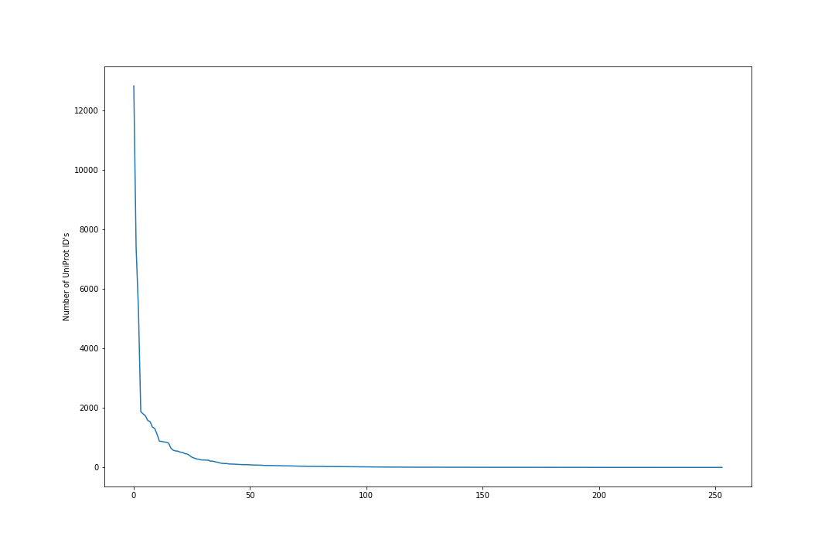
Results
1946 proteomes reduced to 254
~13.05% of input size
Is it optimal? Maybe.
54712 - 54326 unique uniProt ID’s mapped to the proteomes
386 not mapped – no proteome given

