Slide 1
Applied Machine Learning
Assignment 2
Lie Hong,Amnon Bleich, Ben Wulf

Slide 2
quick look on the dataset
Proteome I
Proteome II
Proteome III
UniParc UniProt Proteomes UPI00000BE434 Q9F867 UPI00000BA353 A0A0F6CD01 UP000002870: Plasmid pO157 UPI00000BA353 A0A0T7C0W2 UP000000558: Plasmid pO157 UPI00000BA353 O82885 UPI00000B722F A0A0H3JC22 UP000000558: Plasmid pO157 UPI00000AEE5C A0A0H3P156 UP000008084: Plasmid pYV03 UPI00000AEE5C O52162 UPI00000BE4A0 O87495 UPI00000B95E0 A0A0H3NX29 UP000008084: Plasmid pYV03 UPI00000B95E0 Q56844 UPI000000024B A0A0H3NX24 UP000008084: Plasmid pYV03 UPI000000024B Q01244 UPI000000024B Q7BRZ9 UPI0000000254 Q01253 UPI0000000254 Q7BRZ0
UniParc I
UniParc II
UniParc III
UniParc I
UniProt I
UniProt II
UniPort III
UniProt IV

Slide 3
Preprocessing
Create UniPrac_dict (UniParc as key & set of UniProt as value)
Create Proteom_dict (Proteoms as key & set of UniParc as value)

Slide 4
reduce # of Proteoms
more UniParc ID per proteom more information
add biggest proteom to nessecary proteoms

Slide 5
Substitute UniParc to UniProt

Slide 6
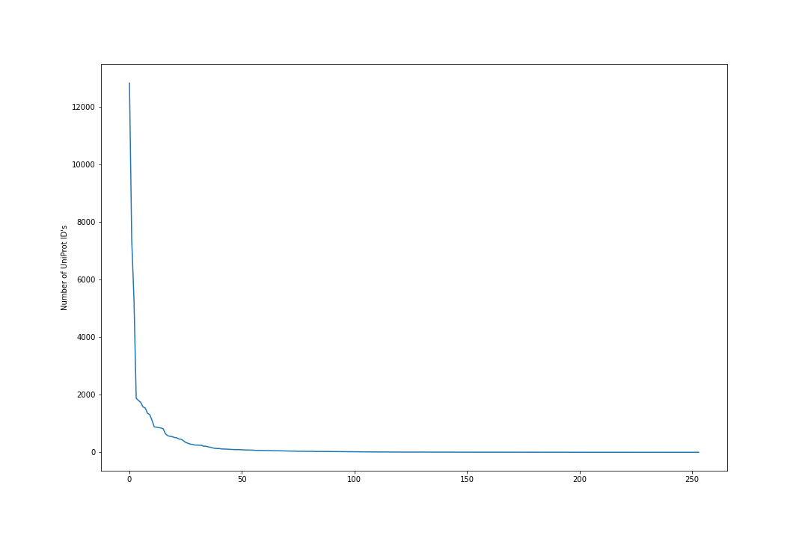
Results
1946 proteomes given
reduced to 254
13.05% of input
Is it optimal?
We don’t know!
It’s hard to find out.

