Slide 1
PML Validation

Slide 2
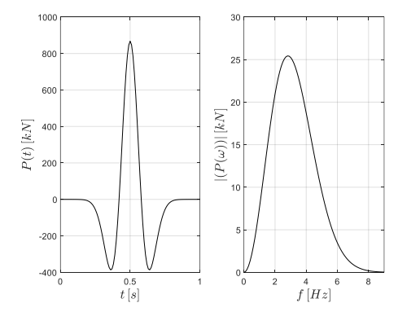
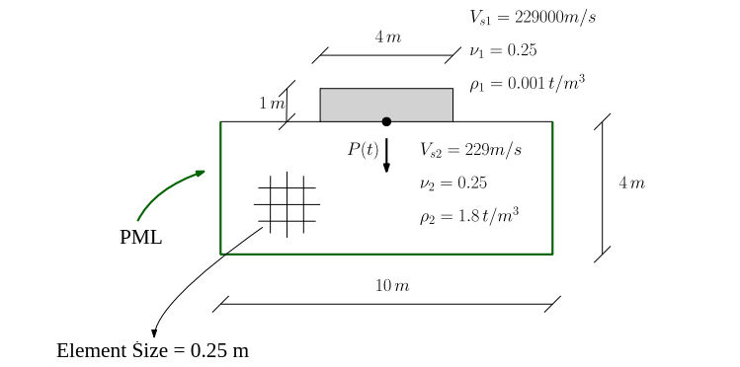
Problem
Rigid foundation on an elastic Domain
The loading is a point load on the center of the footing
Ricker wavelet load considered for the loading (the loading and the Fourier amplitude is presented)

Slide 3
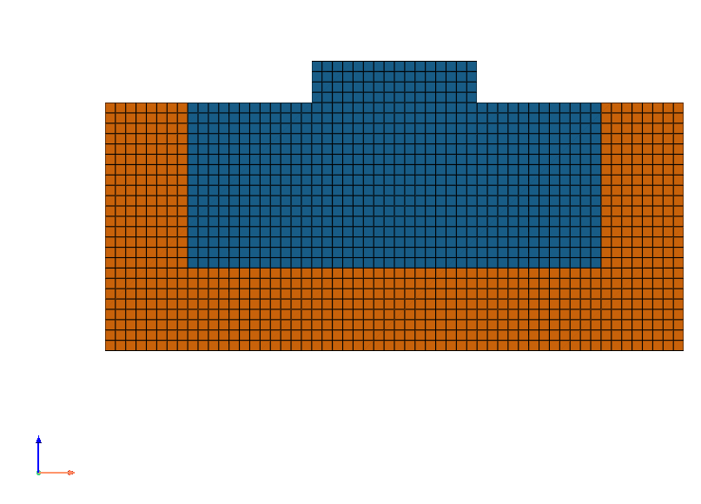
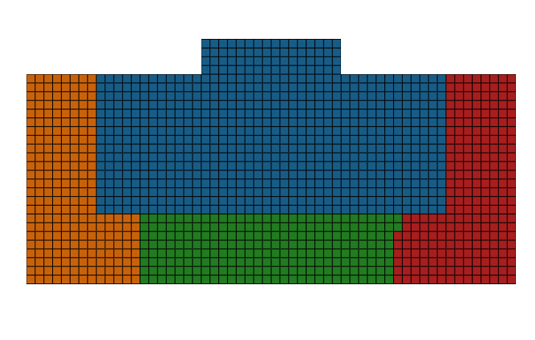
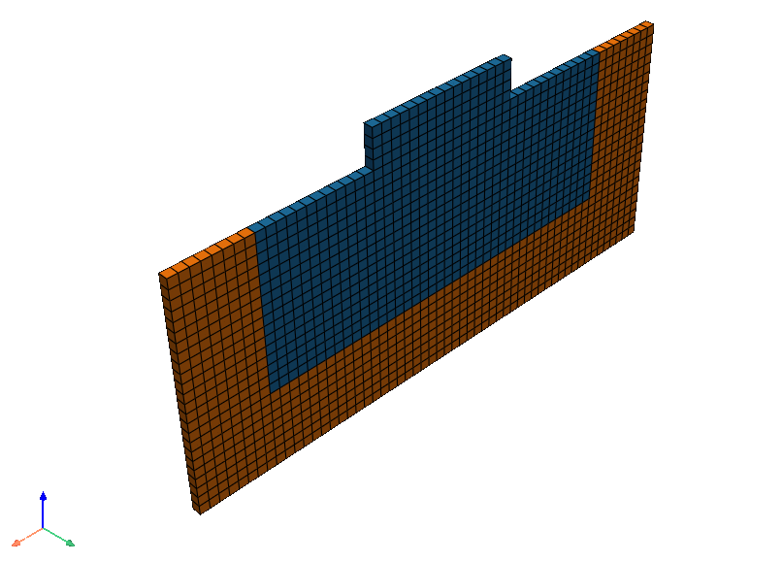
Finite element simulation
A 2D model created using 3D elements (stdBrick and 3D PML)
Thickness of the PML layer considered 2m for this case
OpenSeesMP used for analyzing the model (Each color shows the related elements in OpenSeesMP. One core for regular elements and 3 cores for PML Elements).
Finite element mesh showing regular domain and pml domain with different colors
Elements related to different cores in OpenSeesMP

Slide 4
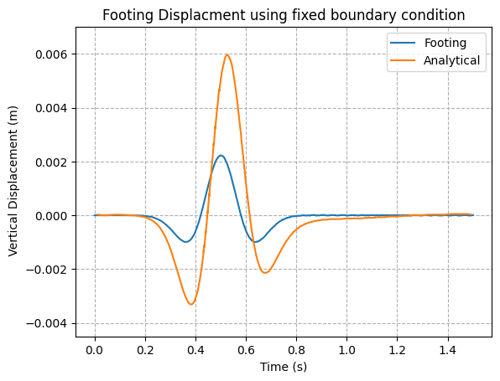
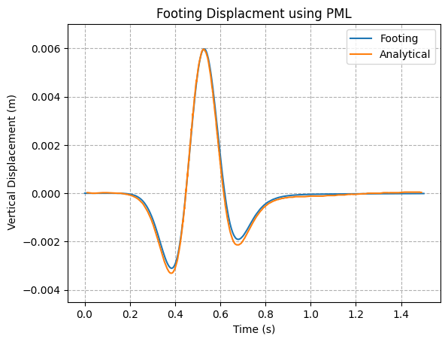
Results
Analytical solution obtained from Luco and Westmann 1972.

Slide 5
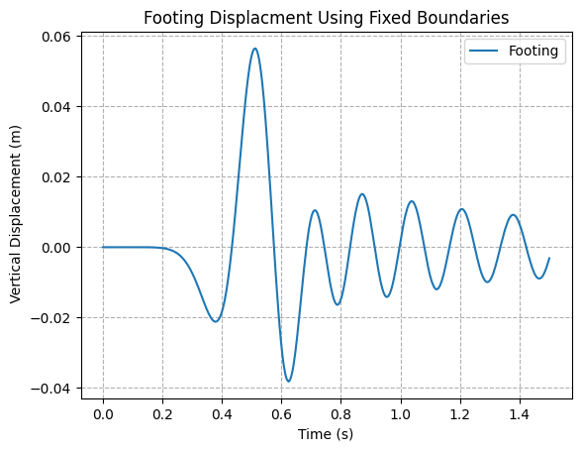
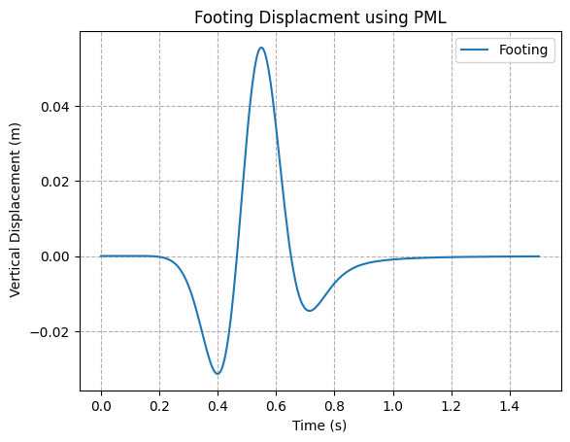
Results with changing soil properties
In this example Vs of the soil changed to 55 m/s to see the reflections from the boundaries

Slide 6
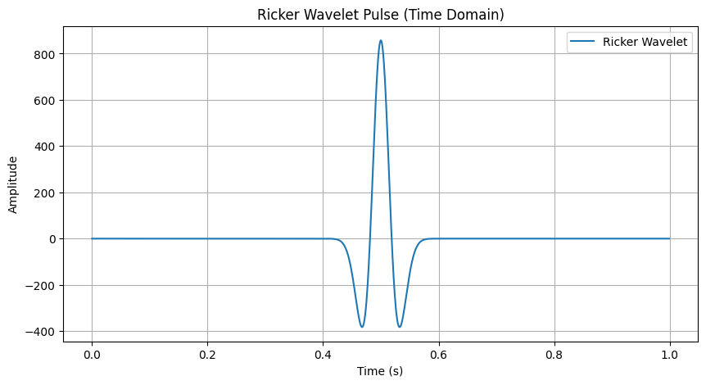
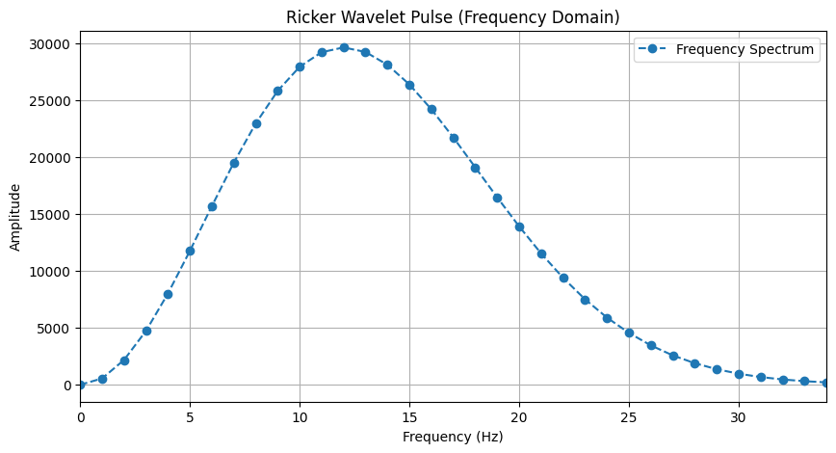
Results with new loading and different boundary conditions
The loading was changed in order to see the reflections from the boundary

Slide 7
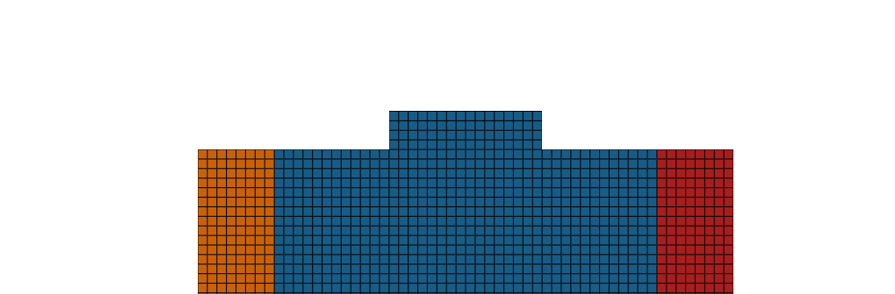
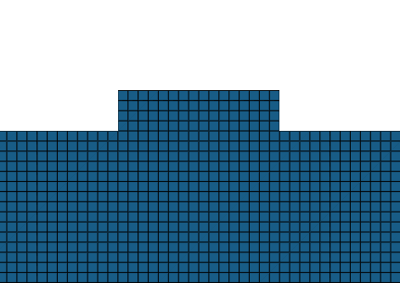
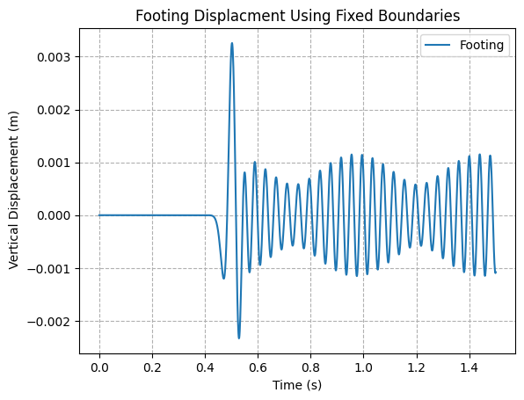
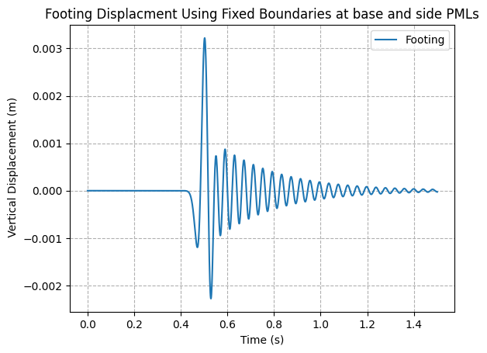
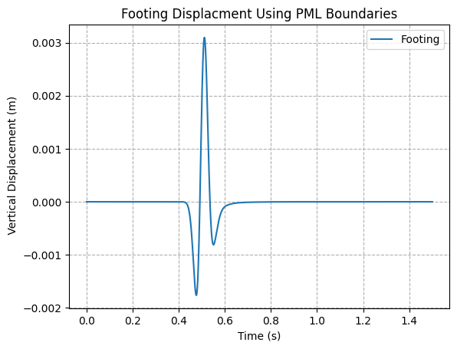
Results with new loading and different boundary conditions
Fixed boundaries
Fixed at base and pml at sides
PML all around

