Slide 1
Shaker-maker

Slide 2
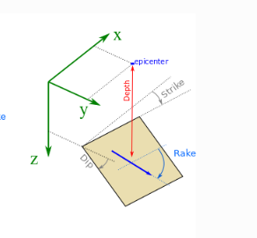
Fault information:
Fault : Including one source point
Source Point 1:
Angels:
strike = 0 degree
dip = 30 degree
Rake = -90 degree
Depth: 1 (km) below the origin
(0., 0., 1)

Slide 3




Fault and Stations Configuration:
$$x$$
30 km
$$y$$
(0,0,0)
1 km
DRM Box (200 m*200 m*100 m)
$$30°$$
$$z$$

Slide 4
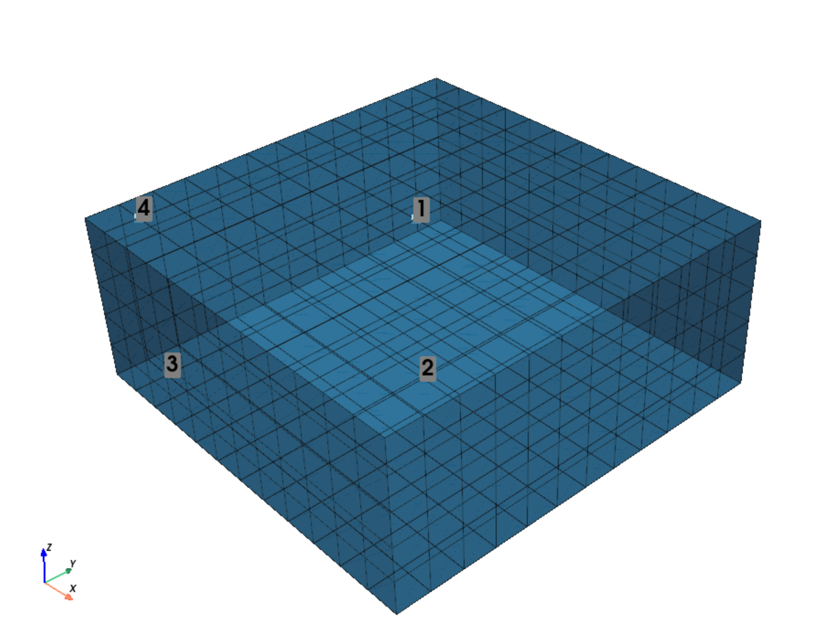
DRM Box and Nodes
DRM box:
(200*200*100) @ 5 m
Stations for controlling:
[x, y, z]
1: [0., 0., 0.]
2: [0., 0., -100]
3: [-100, -100, -100.]
4: [-100, -100, 0.]

Slide 5
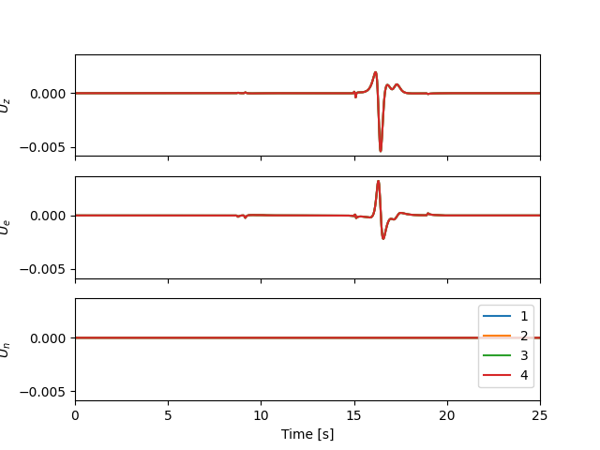
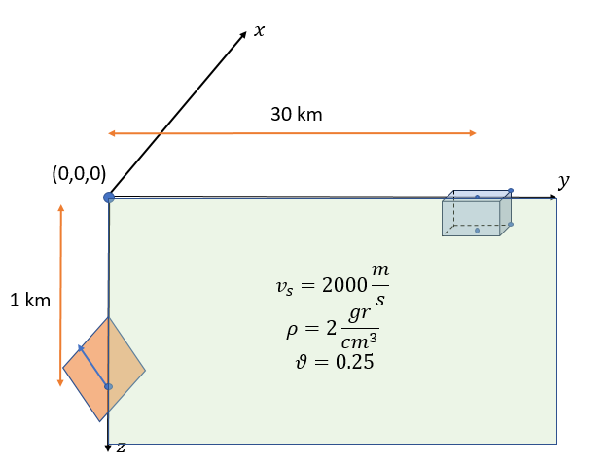
Model 1 ( One layer)
Qp = 1000. # Q-factor for P-wave
Qs = 1000. # Q-factor for S-wave
Vs = 2.000 # S-wave speed (km/s)
nu = 0.25 # Poisson
rho = 2.000 # Mass density (gr/cm**3)

Slide 6
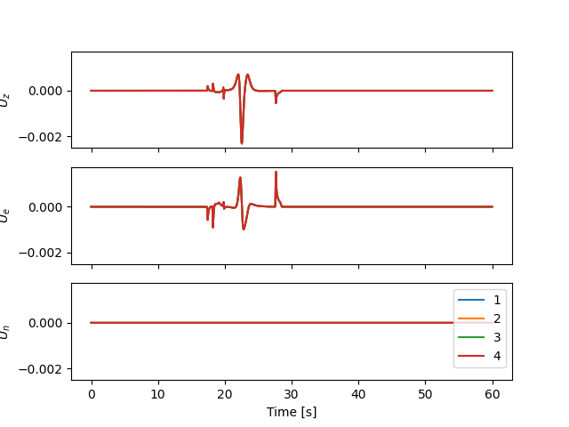
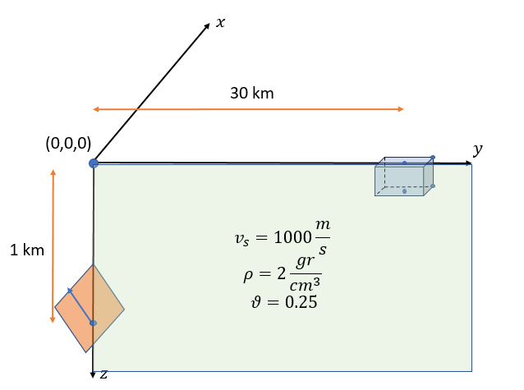
Model 2 ( One layer)
Qp = 1000. # Q-factor for P-wave
Qs = 1000. # Q-factor for S-wave
Vs = 1.000 # S-wave speed (km/s)
nu = 0.25 # Poisson
rho = 2.000 # Mass density (gr/cm**3)

Slide 7
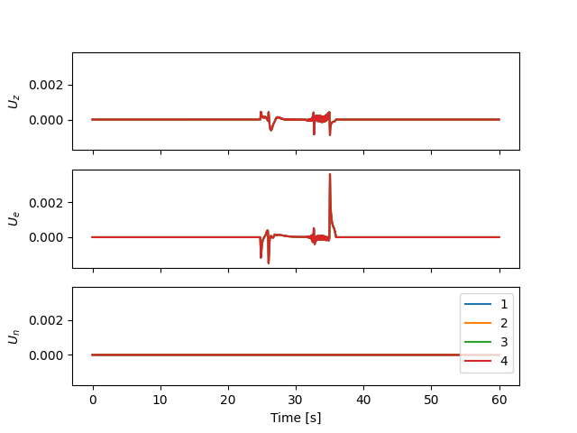
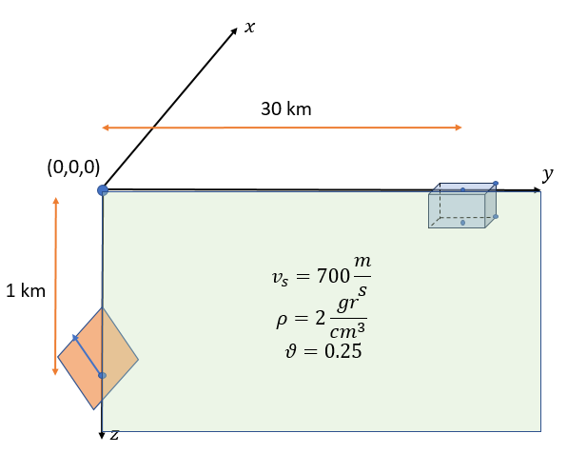
Model 4 ( One layer)
Qp = 1000. # Q-factor for P-wave
Qs = 1000. # Q-factor for S-wave
Vs = 0.700 # S-wave speed (km/s)
nu = 0.25 # Poisson
rho = 2.000 # Mass density (gr/cm**3)

Slide 8
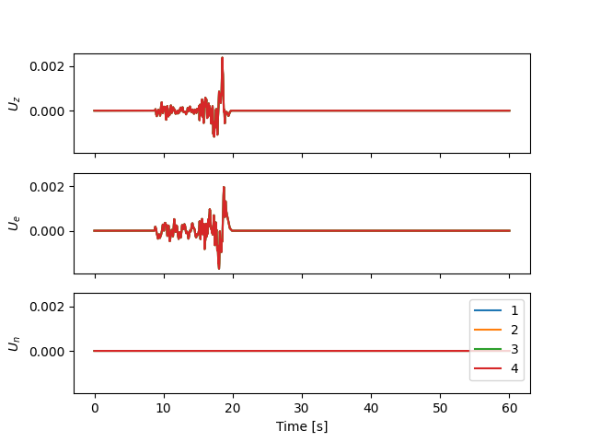



Model 5 ( two layer)
Layer 1 :
Thickness = 100 (m)
Vs, nu, rho = 0.400, 0.25, 2.0 # (km/s),Poisson,(gr/cm**3)
Layer 2:
Thickness = base layer
Vs, nu, rho = 2.00, 0.25, 2.0
$$y$$
$$v_{s}=400\frac{m}{s}, ρ=2\frac{gr}{cm^{3}} θ=0.25$$
$$v_{s}=2000\frac{m}{s}, ρ=2\frac{gr}{cm^{3}} θ=0.25$$
$$z$$

Slide 9
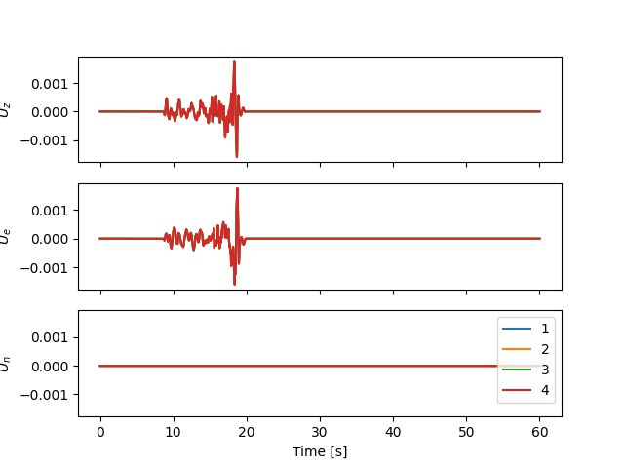



Model 6 ( two layer)
Layer 1 :
Thickness = 100 (m)
Vs, nu, rho = 0.200, 0.25, 2.0 # (km/s),Poisson,(gr/cm**3)
Layer 2:
Thickness = base layer
Vs, nu, rho = 2.00, 0.25, 2.0
$$y$$
$$v_{s}=200\frac{m}{s}, ρ=2\frac{gr}{cm^{3}} θ=0.25$$
$$v_{s}=2000\frac{m}{s}, ρ=2\frac{gr}{cm^{3}} θ=0.25$$
$$z$$

Slide 10
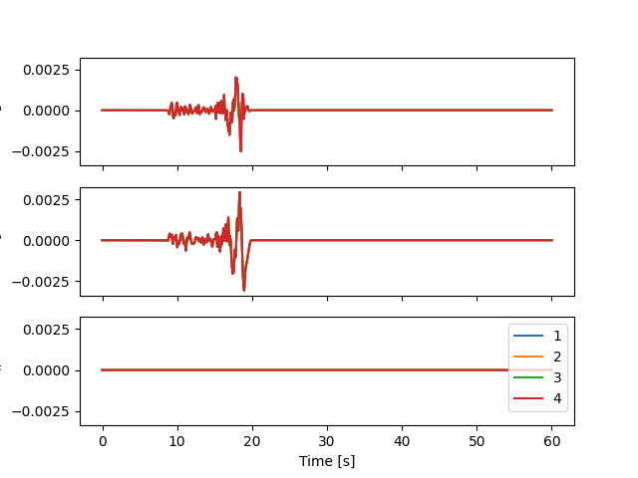



Model 6 ( two layer)
Layer 1 :
Thickness = 50 (m)
Vs, nu, rho = 0.200, 0.25, 2.0 # (km/s),Poisson,(gr/cm**3)
Layer 2:
Thickness = Base layer
Vs, nu, rho = 2.00, 0.25, 2.0
$$y$$
$$v_{s}=1000\frac{m}{s}, ρ=2\frac{gr}{cm^{3}} θ=0.25$$
$$v_{s}=1000\frac{m}{s}, ρ=2\frac{gr}{cm^{3}} θ=0.25$$
$$z$$

Slide 11
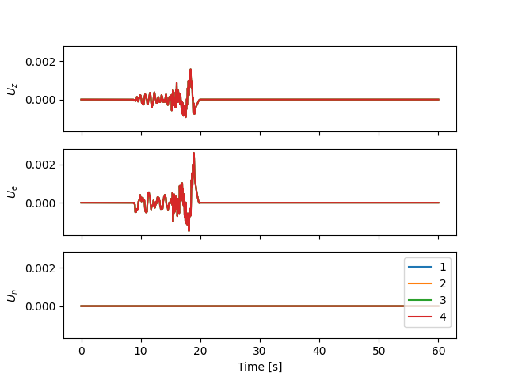




Model 7 ( three layer)
Layer 1 :
Thickness = 50 (m)
Vs, nu, rho = 0.200, 0.4, 1.6 # (km/s),Poisson,(gr/cm**3)
Layer 2:
Thickness = 50 (m)
Vs, nu, rho = 0.7, 0.35, 1.9
Layer 3:
Thickness = base layer
Vs, nu, rho = 2.00, 0.25, 2.0
$$y$$
$$v_{s}=200\frac{m}{s}, ρ=1.6\frac{gr}{cm^{3}} θ=0.4$$
$$v_{s}=700\frac{m}{s}, ρ=1.95\frac{gr}{cm^{3}} θ=0.35$$
$$v_{s}=2000\frac{m}{s}, ρ=2\frac{gr}{cm^{3}} θ=0.25$$
$$z$$

Slide 12
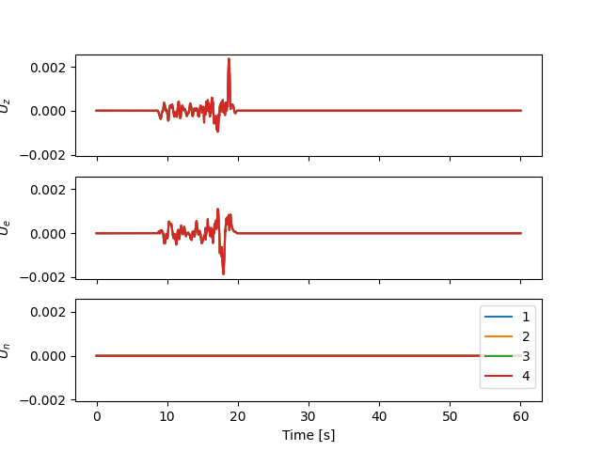




Model 9 ( three layer)
Layer 1 :
Thickness = 75 (m)
Vs, nu, rho = 0.200, 0.4, 1.6 # (km/s),Poisson,(gr/cm**3)
Layer 2:
Thickness = 25 (m)
Vs, nu, rho = 1.5, 0.3, 1.95
Layer 3:
Thickness = base layer
Vs, nu, rho = 2.00, 0.25, 2.0
$$y$$
$$v_{s}=200\frac{m}{s}, ρ=1.6\frac{gr}{cm^{3}} θ=0.4$$
$$v_{s}=1500\frac{m}{s}, ρ=1.95\frac{gr}{cm^{3}} θ=0.3$$
$$v_{s}=2000\frac{m}{s}, ρ=2\frac{gr}{cm^{3}} θ=0.25$$
$$z$$

Slide 13
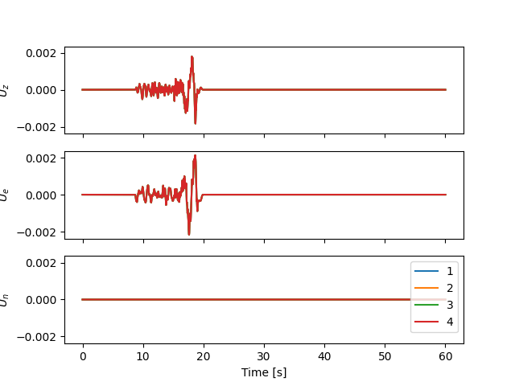


Model 8 ( three layer)
Layer 1 :
Thickness = 50 (m)
Vs, nu, rho = 0.200, 0.4, 1.6 # (km/s),Poisson,(gr/cm**3)
Layer 2:
Thickness = 50 (m)
Vs, nu, rho = 1.5, 0.3, 1.95
Layer 3:
Thickness = base layer
Vs, nu, rho = 2.00, 0.25, 2.0
$$y$$
$$v_{s}=200\frac{m}{s}, ρ=1.6\frac{gr}{cm^{3}} θ=0.4$$
$$v_{s}=1500\frac{m}{s}, ρ=1.95\frac{gr}{cm^{3}} θ=0.3$$
$$v_{s}=2000\frac{m}{s}, ρ=2\frac{gr}{cm^{3}} θ=0.25$$

Slide 14
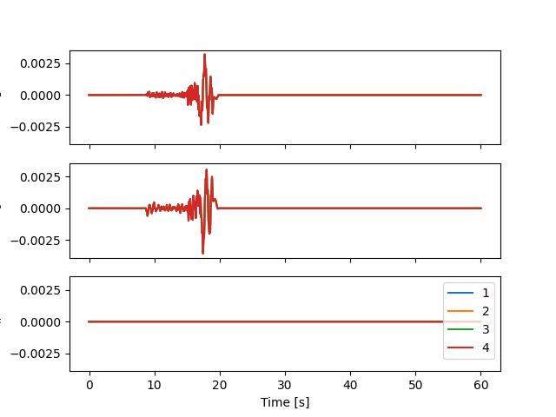

Model 9 ( three layer)
Layer 1 :
Thickness = 25 (m)
Vs, nu, rho = 0.200, 0.4, 1.6 # (km/s),Poisson,(gr/cm**3)
Layer 2:
Thickness = 75 (m)
Vs, nu, rho = 1.5, 0.3, 1.95
Layer 3:
Thickness = base layer
Vs, nu, rho = 2.00, 0.25, 2.0
$$y$$
$$v_{s}=200\frac{m}{s}, ρ=1.6\frac{gr}{cm^{3}} θ=0.4$$
$$v_{s}=1500\frac{m}{s}, ρ=1.95\frac{gr}{cm^{3}} θ=0.3$$
$$v_{s}=2000\frac{m}{s}, ρ=2\frac{gr}{cm^{3}} θ=0.25$$

Slide 15



One layer model
$$y$$
$$v_{s}=1000\frac{m}{s}, ρ=2\frac{gr}{cm^{3}} θ=0.25$$
$$v_{s}=1000\frac{m}{s}, ρ=2\frac{gr}{cm^{3}} θ=0.25$$
$$v_{s}=1000\frac{m}{s}, ρ=2\frac{gr}{cm^{3}} θ=0.25$$
$$z$$

