Slide 1
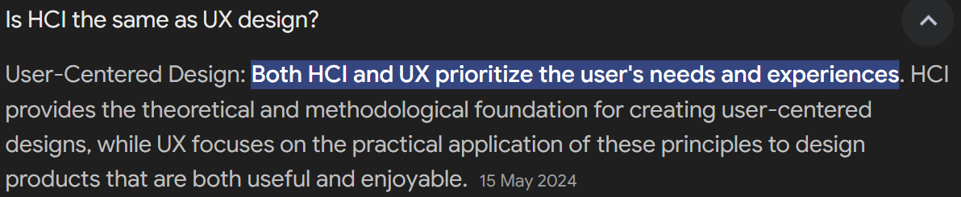
HCI

Slide 2
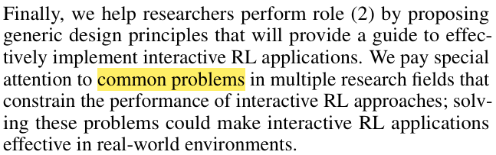
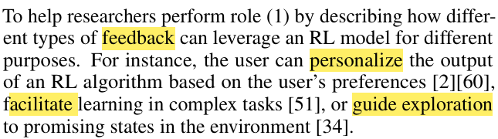
HCI researchers roles

Slide 3
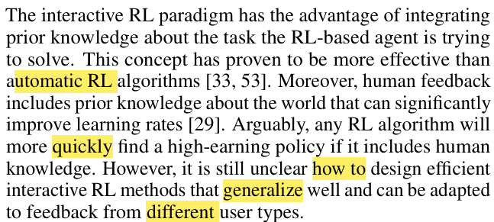
IRL features

Slide 4
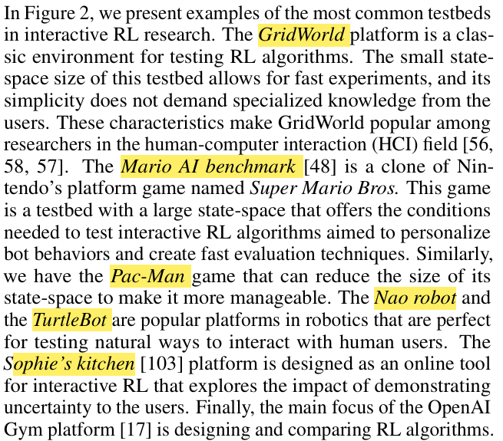
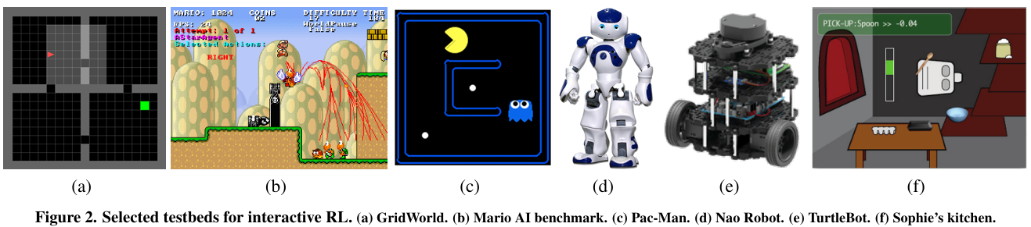
IRL testbeds

Slide 5
Reward Shaping
.
Sometimes environmental feedbacks are not available
Feedback can be the only source reward
Environment might be very Stochastic

Slide 6
Reward Shaping
.
Sometimes environmental feedbacks are not available
Feedback can be the only source reward
Environment might be very Stochastic
In state s, the action a is either good or bad. It is called Advise.
Which creates a bias in the action selection of the agent, not its policy.
Policy shaping

