Slide 1

HW4
Alireza Abbasi
403616204

Slide 2
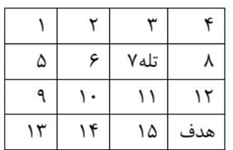
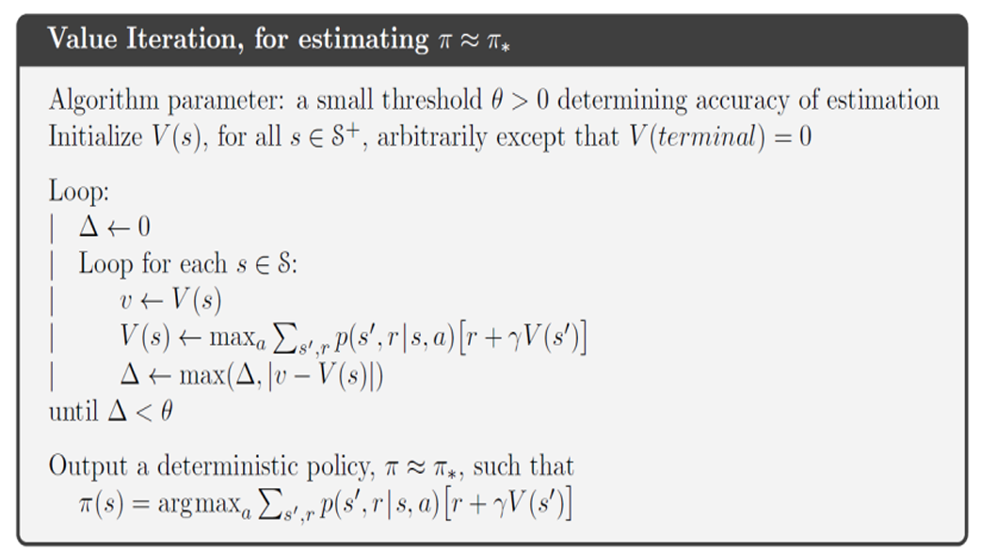
Q5 - Gridworld
VI Algorithm:

Slide 3
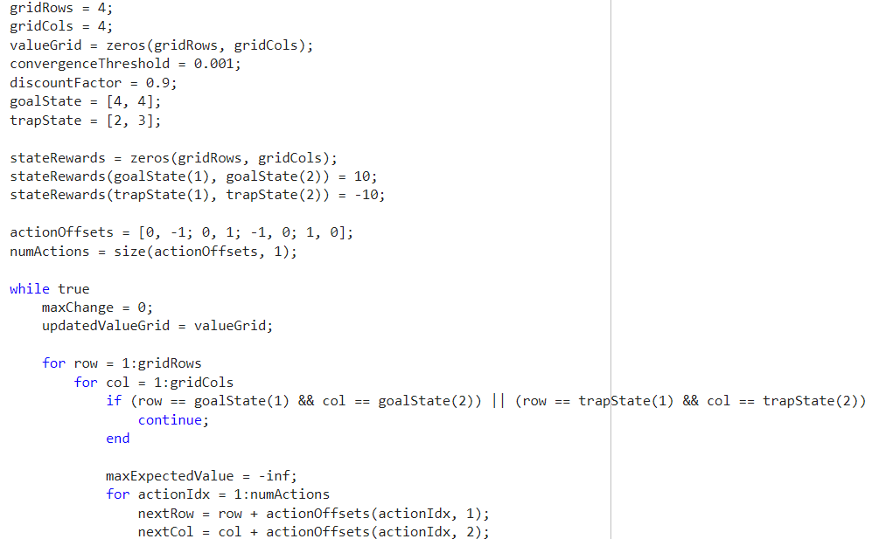
Q5 - Gridworld
Code:

Slide 4
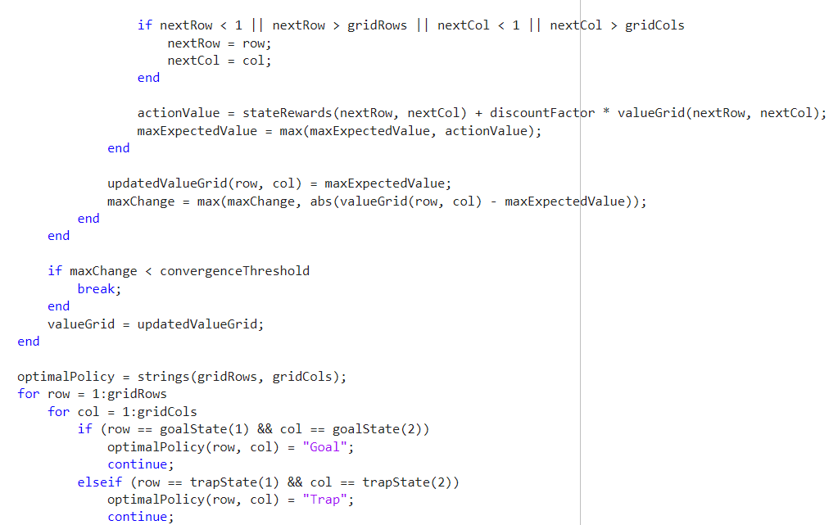
Q5 - Gridworld
Code:

Slide 5
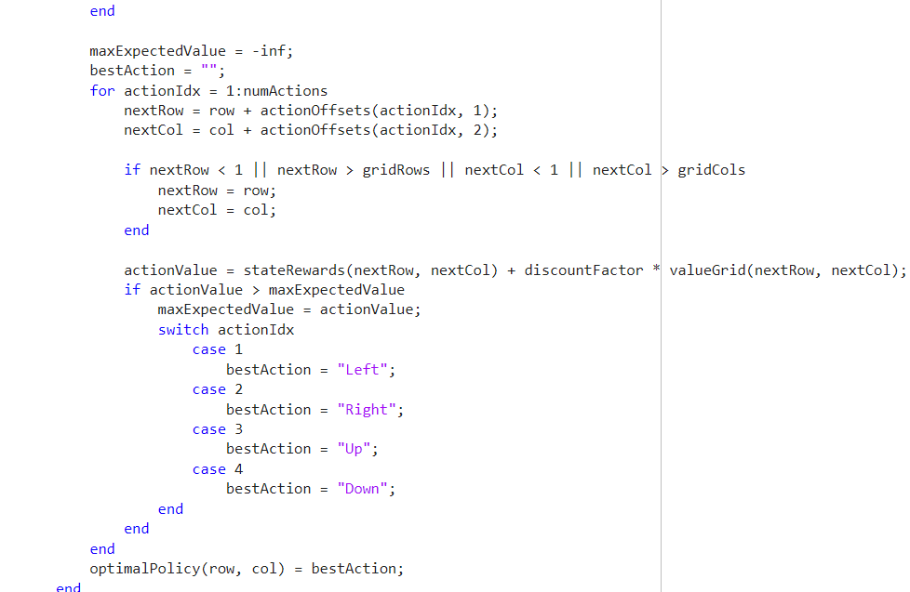
Q5 - Gridworld
Code:

Slide 6
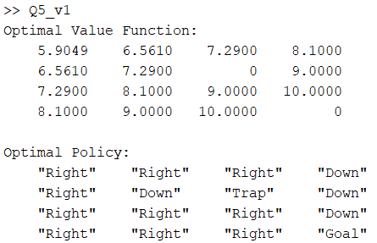
Q5 - Gridworld
Result:

Slide 7
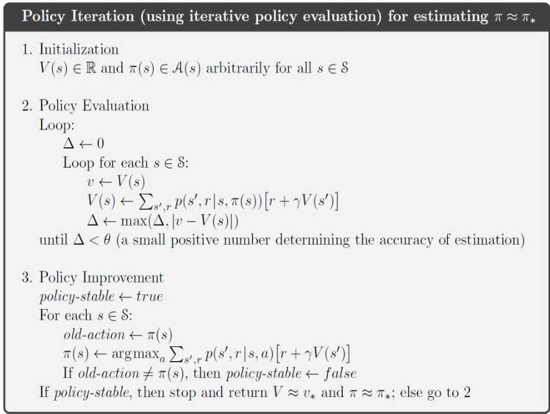
Q5 - Gridworld
PI Algorithm:

Slide 8
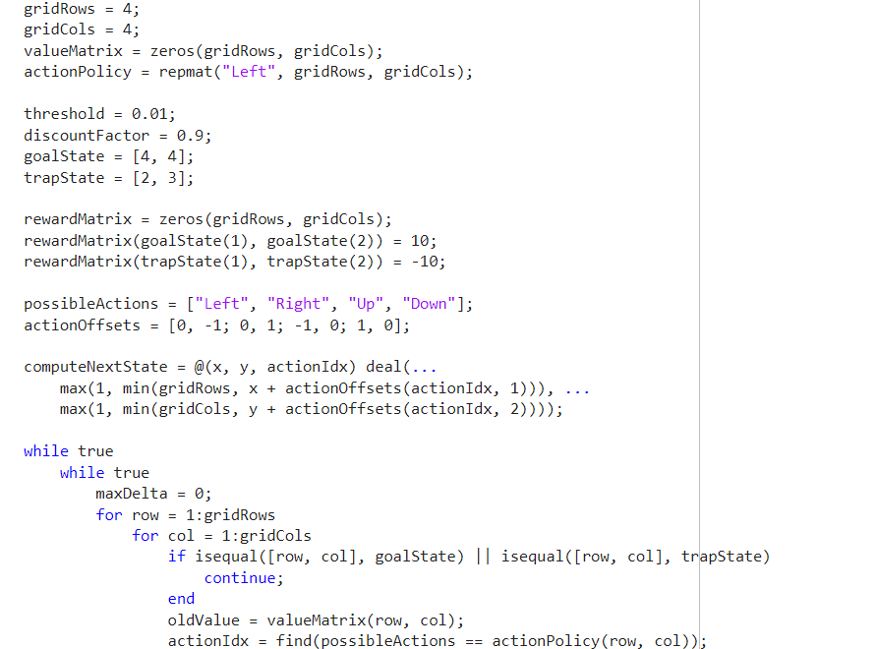
Q5 - Gridworld
Code:

Slide 9
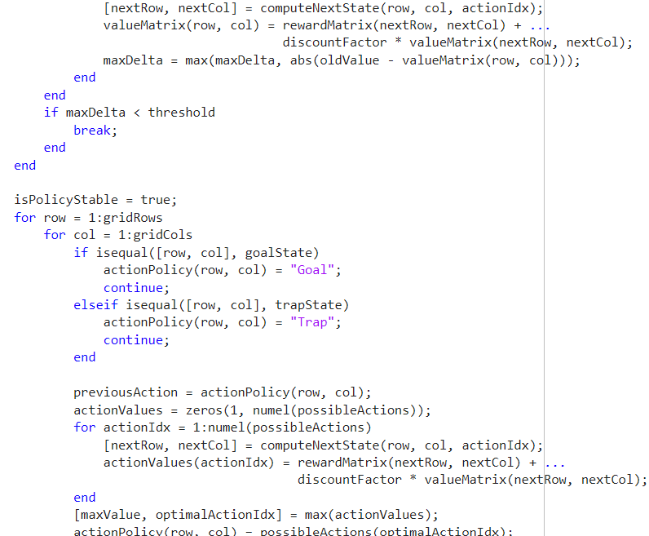
Q5 - Gridworld
Code:

Slide 10
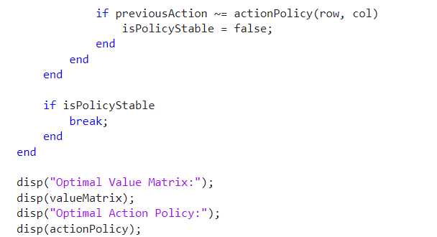
Q5 - Gridworld
Code:

Slide 11
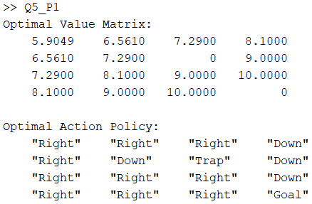
Q5 - Gridworld
Result:

Slide 12
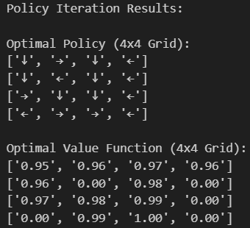
Q6 - Frozenlake
PI Algorithm- results:

Slide 13
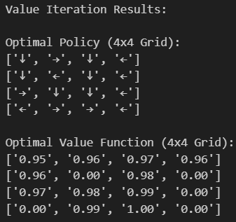
Q6 - Frozenlake
VI Algorithm- results:

Slide 14
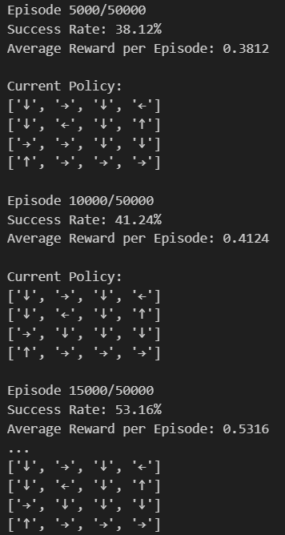
Q6 - Frozenlake
On-policy Monte Carlo - results:

Slide 15
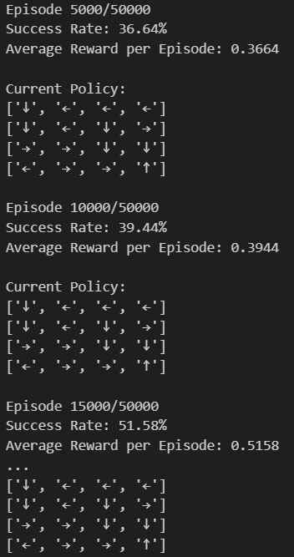
Q6 - Frozenlake
Off-policy Monte Carlo - results:

