Slide 1

Team Othello
Joseph Pecoraro
Adam Friedlander
Nicholas Ver Hoeve

Slide 2

Our Proposal
Implement MTD(f), a minimax searching algorithm, on a simple two player game, such as Othello.
We were interested in seeing how much can we improve performance on a Non-Massively Parallel Problem.

Slide 3
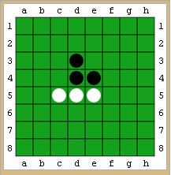
Othello
Simpler than Go; only 64 squares
Capture by controlling either end of a line of
enemy pieces vertically, horizontally, or
diagonally.
Must capture each move.
Whichever color is in the majority
when neither player can move wins.
Also called “Reversi.”

Slide 4
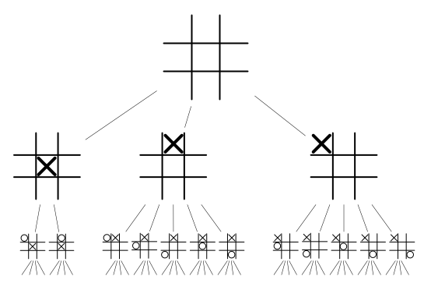
Game Trees
Consider all possible variations of the next several moves in a game.
Arrange the hypothetical positions in a tree.

Slide 5
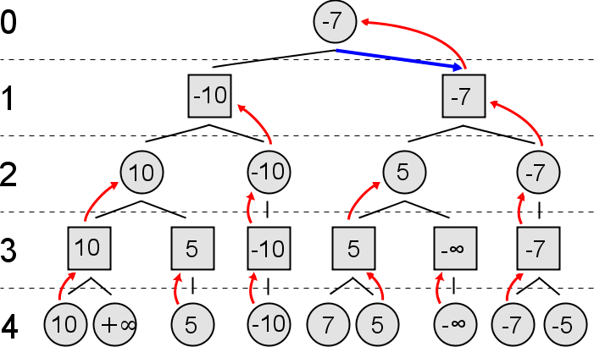
Negamax and Minimax Scores
-Evaluate Score by backtracking from leaves; choose the best score among fully evaluated subtrees and backtrack.

Slide 6
Negamax and Minimax Scores
Players ‘oppose’ each other.
  What is good for one player is bad for the other
  This leads to pruning opportunities that do not exist in general for search trees.
In Minimax scoring, player A tries for -∞ and player B tries for +∞.
In Negamax scoring, both players try for +∞, but the score is ‘negated’ when switching between which player we are considering.

Slide 7
Alpha-Beta Pruning
Consider only a “window” of acceptable scores, called (α, β)
Often initialized to (-∞, +∞) at root node
With Negamax scoring:
With Negamax scoring, an entire branch terminates early when a move is found with score >= β
When recursing to child node, window becomes (-β, -α)
Although α does not prune, it will become the ‘next’ β.
If we happen to look at the correct moves first, the problem changes from O(b^n) to O(b^(n/2))
Thus, presorting ‘likely’ good moves is likely to boost performance.

Slide 8
Transposition Table
A table designed for memoization
  A term used when identical nodes in a recursion tree are identified
Stores any known (α, β) about a position
Usually implemented as a hash table
For a large search, there are too many nodes to store in memory at once
  usually we stop storing nodes 1-2 levels away from the leaf

Slide 9
Advanced Alpha-Beta
Trees can be search with custom (α, β)
  If it turns out that α < score < β, the search returns score
  Tighter window prunes more aggressively
‘Fail low’ and ‘fail high’
  If it turns out that score <= α, an arbitrary value v is returned where v <= α and v <= score.
  If it turns out that score >= β, an arbitrary value v is returned where v >= β and v >= score.
Extreme case: null-Window (β-1, β)
    Can never return score, but very fast and can be applied.

Slide 10
MTD(f)
Introduced in Best-First Fixed-Depth Minimax Algorithms (1995).
MTD(f) is a reformulation of notoriously monstrous and inapplicable SSS*
  SSS* searches fewer nodes than Alpha-Beta, but is faster only in theory.
  By reformulation we mean the exact same set of nodes is scanned.

Slide 11
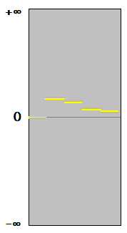
MTD(f)
Relies only on null-Window αβ searches
score window is ‘divided’ at the point of a null window Search.
Thus we can ‘divide and conquer’ until the score window converges.
Faster in both theory and practice than Alpha-Beta
Relies heavily on transposition table for performance

Slide 12
Parallel Game-Tree Search
NOT massively parallel
Coveted for competitive play
Notoriously tricky and full of communication overhead
  Tricky to balance synchronization overhead with possibility of doing significant redundant work
Any noticeable speedup is considered a success

Slide 13
Paper #1
Efficiency of Parallel Minimax Algorithm for Game Tree Search (2007).
Conference paper aimed at parallelization of minimax. Explores cluster and hybrid parallelism. Hybrid combines cluster and shared memory.

Slide 15
Paper #3
Distributed Game-Tree Search Using Transposition Table Driven Work Scheduling (2002).
An attempt to improve the performance of parallel algorithms in two player games.
Suggested a number of problems a parallel game-tree creates, their ideas to solve these problems, and their final decisions.

Slide 16

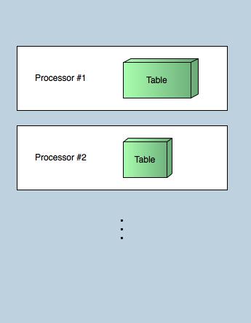
Local Tables
Each processor keeps their own table. Less communication but repeated work.
Our analysis showed that we could take this approach.

Slide 17
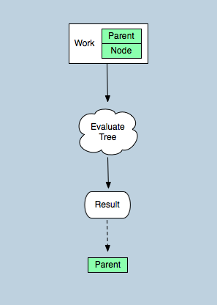
New Work
Processing work is handled at the terminal level. Results are sent to back to the home processor.

Slide 18
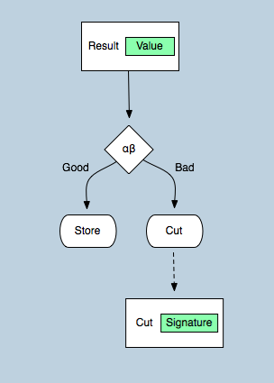
Incoming Result
Check incoming results against the current αβ values and act accordingly.

Slide 19
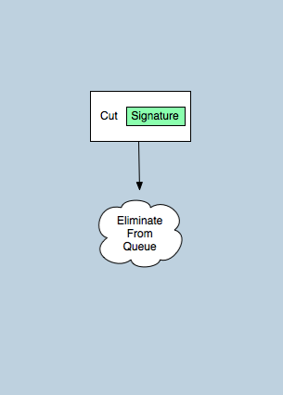
Cut-Off
In this processors queue remove the subtree rooted with the given signature.

Slide 20
Sequential Program
Our Sequential Program is an Iterative-deepening MTD(f) search for Othello

Slide 21
Foundational Code
Othello move generation and move execution
  Both are computed using a state-of-the-art rotated bitboard method
  Results are computed in fixed constant time for any input
  A 512kb pre-computed lookup table is applied
  About 13 times faster than naive loop-based method
Board Hashing (For Transposition Table)
  Board rows are transformed by a pre-computed highly-random lookup table and xor’ed together.
  This is equivalent to a technique called ‘Zobrist hashing’, if a row is considered a single state.

Slide 22
Alpha-Beta Implementation
Uses NegaMax Scoring
Uses transposition table to variable depth down the tree
Sorts movelist on high-level nodes to increase likelihood of early cutoffs
Can retrieve the actual move paired with score
  This is achieved using a (score-1, score+1) re-search

Slide 23
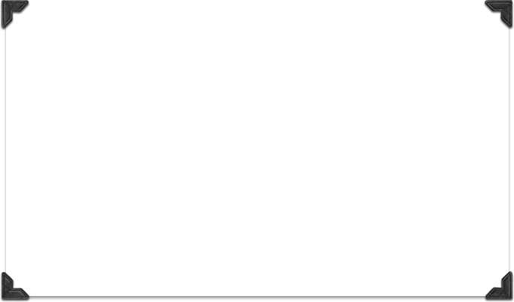
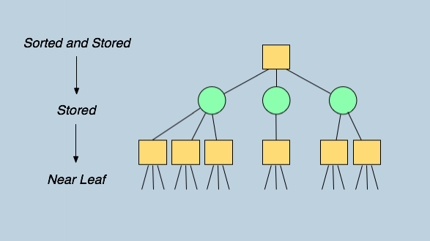
Sequential Tree Levels

Slide 24
MTD(f) implementation
MTD(f) Simply makes a series of null-Window Alpha-Beta calls.
Makes use of fast, compact transposition table
Exists in an iterative-deepening framework
  Begins at shallow depths and applies results for movelist sorting to increase likelihood of cutoffs

Slide 25
Artificial Intelligence
The Heuristics our algorithm uses are simple, fast, and effective. It values the piece count and position (pieces on the edges and corners are stronger).
The algorithm has customizable look ahead options. Normal conditions look ahead about 12 moves. It is fast and performs well.

Slide 26
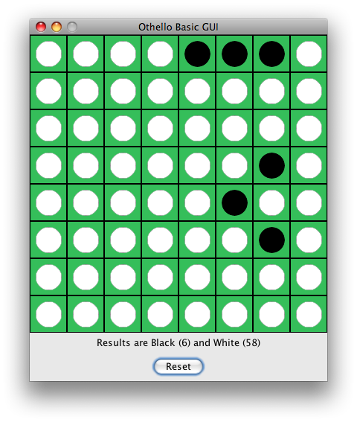
It Destroys Me

Slide 27
SMP
A single Job Queue of all Board Positions is created. This Queue is synchronized between all of the threads.
Threads pull Jobs from the Job Queue.
A Global Transposition Table exists for the higher levels of the Game Tree. Per Thread Tables exist for lower levels.

Slide 28
SMP Alpha-Beta
Similar to Table-driven strategy
Top-level states (1-3 levels) are shared and stored in several data structures
  Transposition table (hash table)
  Job Queues
  Nodes are linked into a tree for communication

Slide 29
SMP Alpha-Beta
Each thread has its own job queue
Topmost jobs unroll into other jobs
  At a specified cutoff point (1-3 levels), a job makes a sequential Alpha-Beta call
About 5 levels (customizable) of the Transposition Table are shared across all Threads.
Each thread also has a local Transposition Table
We allow job stealing

Slide 30
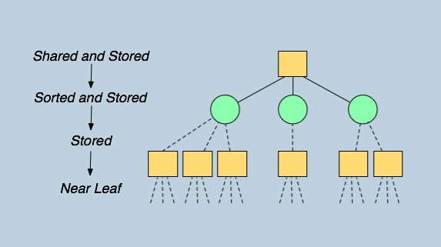
Parallel Tree Levels

Slide 31
SMP MTD(f)
Implemented overtop SMP Alpha-Beta
MTD(f) jobs unroll into Alpha-Beta jobs
Iterative MTD(f) job unrolls into MTD(f) job
Overall, a simple extension of the existing SMP-AlphaBeta framework

Slide 32
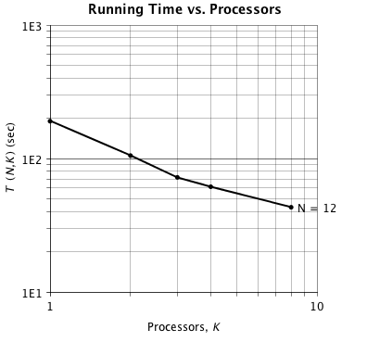
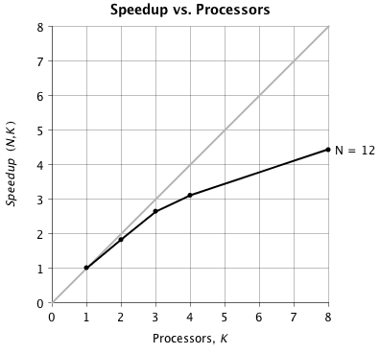
SMP Metrics - Version 1

Slide 33
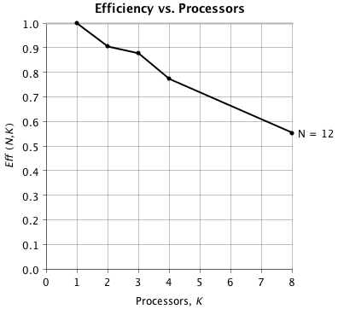
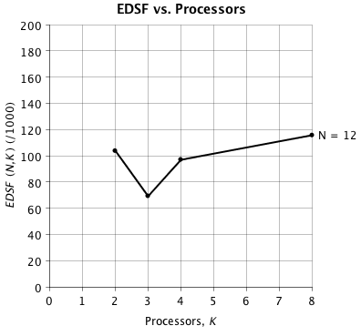
SMP Metrics - Version 1

Slide 34
Analysis of Job Stealing:
  Some form of Job stealing is a must, since performance here is extremely erratic on the per-job basis (often 20:1 variance or worse!)
  Due to local Transposition Tables, A Thread may become ‘specialized’ for one major branch of the tree. Thus, if a ‘newbie’ thread steals the job, performance can be lost since it is ill-equipped to do the job
  In extreme cases, a job can evaluate 30 times slower in the wrong thread
  Sophisticated, tweaked heuristics and rules are needed to make the best of this awkward situation
    Likely the possibility of allowing two threads to attempt the same job

Slide 35
Cluster Design
Emulates the SMP approach. A Master processor generates the Job Queue.
Worker threads pull work from the Job Queue (simple load balancing).
Per Thread Transposition tables and full evaluation of lower level game trees.

Slide 36
What We Learned
Implementing the algorithm is very tedious. Knowing when to negate values, when to get the Max or Min of values, etc.
Load balancing is difficult if you intend to send work to different processors. They would end up needing to steal work.
Parallel Runtimes may be very erratic.

Slide 37
What We Learned
The way Othello plays, game positions are unlikely to happen multiple times.
  Making it feasible to use the local tables concept at low levels.

Slide 38
Future Work
Employ Killer-Move Heuristic
Mitigate the ‘horizon’ effect
Improve strategic heuristics
  Identify stable discs!
  Evaluate mobility
Restructure to function in a time-limit setting (as in, competitive gameplay)
Learn to identify rotations and reflections when finding transpositions

Slide 39
Future Work : SMP
Implement sophisticated Job stealing protocol
Improve thread synchronization
  investigate relaxing certain exclusive-access data
When sequentially searching, allow the in-use Search Window to tighten asynchronously

Slide 40
Future Work : Cluster
Implement our Cluster Design on top of the existing SMP Design.
Experiment with Load Balancing techniques to reduce Communication overhead.

