Slide 1
College Recommendation Engine
Case Study in Unsupervised Learning
Amie Davis, amodavis@my365.bellevue.edu, DSC680, Bellevue University, 9 April 2021

Slide 2
Overview
Business Problem
Feature Reduction
Exploratory Data Analysis
Special Interest Questions
Modeling Objective
Data Preparation
Model Results
Recommendation Application
Q&A

Slide 3
Business Problem
College Selection is Overwhelming
Searching for a college is too time consuming and often only includes limited features. A college visit or interview is the only good way to find a college that “fits,” but it is impossible to visit all college campuses.

Slide 4
Business Objective
Make it easier to find a college that “fits.”

Slide 5
Special Interest Questions
Collected from prospective college students and parents
Given ACT/SAT score, to which schools am I likely to be admitted?
Are my admission chances better if ACT or SAT scores are submitted?
Which schools offer what fields of study?
Do the larger universities offer more degree options?
Which schools can I afford?
Which out-of-state colleges offer in-state comparable tuition?
What is the likelihood I can earn enough after I graduate to pay back my student loan?
Is the tuition related to the size of the university?

Slide 6

Data Source
College Scorecard data from the US Department of Education
Includes assessments of colleges to decipher the value of education
Files
Institutional
Field of Study
Costs, graduation rates, aggregated demographics, standardized test scores.
School year 2018-19 selected
Latest available year intentionally excluded
Data dictionary available
College Scorecard. (n.d.). Retrieved March 15, 2021, from https://collegescorecard.ed.gov/data

Slide 7
Data Summary
Original dataset included 6,806 institution records from 2018-19 with 2,383 features
Supplemental dataset included 260,531 field of study records.
Several fields marked as “PrivacySuppressed”
Restricted to institutions that primarily offer bachelor's degrees

Slide 8
Feature Reduction
Original dataset 2,383 features
All empty/zero-value
Over 50% null
Correlation (70%+)
Percentage formulas
Near-zero variance
Descriptions
Website addresses
Reduced to 48 features.

Slide 9
Descriptive Statistics Observations
Average net price for low-income families at private institutions
Negative outlier identified; Replaced with 0
794 null values; Either private or public
Replaced null private values with public value
Instruction Expenses Per Employee
4 records had zero value
Appear to be private religious schools; funding could come from alternate sources
Longitude
2 Outliers with positive longitudes
Pacific Islands
Repayment Rates
Entire 3rd quartile over 100%
Possible if payments ahead of schedule per technical documentation

Slide 10
EDA Surprises
Some large universities accepted over 50% of applicants
Syracuse University
University of Georgia
Vast number of colleges in US Territories
Puerto Rico
75% of schools same in-state and out-of-state tuition

Slide 11
Data Analysis
Given ACT/SAT score, to which schools am I likely to be admitted?

Slide 12
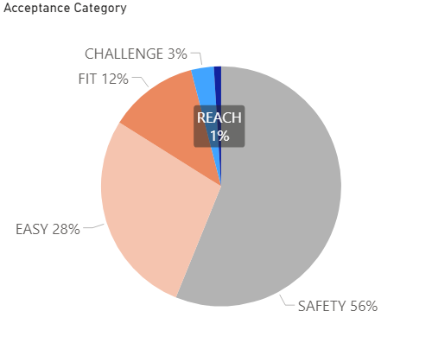
Acceptance
1% of schools accept only 10% of applicants or less (REACH)
3% accept between 10 and 25% (CHALLENGE)
12% accept between 25 and 50% (FIT)
28% accept between 50 and 70% (EASY)
56% accept between 70 and 100% (SAFETY)
Notes:
Breakdown of Schools by Acceptance Category:
It may be best to answer this by looking at how difficult it is to get into a school. 1% of schools, labeled as “REACH” schools in the graphic, accept less than 10% of applicants, whereas over 50% of schools, labeled as “SAFETY” schools, accept over 70% of applicants.

Slide 13
Data Analysis
2) Are my admission chances better if ACT or SAT scores are submitted?

Slide 14
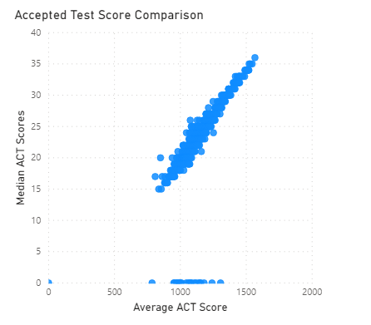
ACT v SAT
No, same chances
Direct correlation between ACT scores and SAT scores
Notes:
Comparison of Accepted ACT and SAT Scores:
As you can see, there is a direct correlation between the ACT and SAT scores, so it does not matter which score is submitted. However, if you score better on one test than the other, that is the better score to submit.

Slide 15
Data Analysis
3) Which schools offer what fields of study?

Slide 16
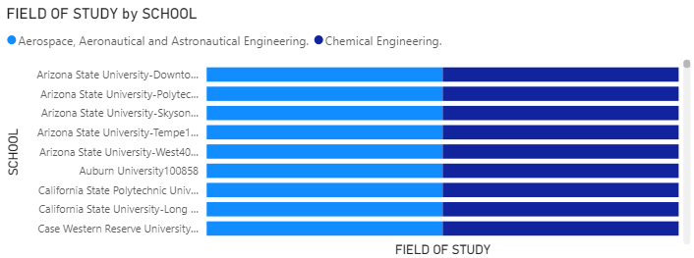
Fields of Study
PowerBI Interactive tool
Select field(s) of study
Schools display
Notes:
Interactive Field of Study Tool:
I created an interactive tool in PowerBI to display a list of schools after selecting specific fields of study.

Slide 17
Data Analysis
4) Do the larger universities offer more degree options?

Slide 18
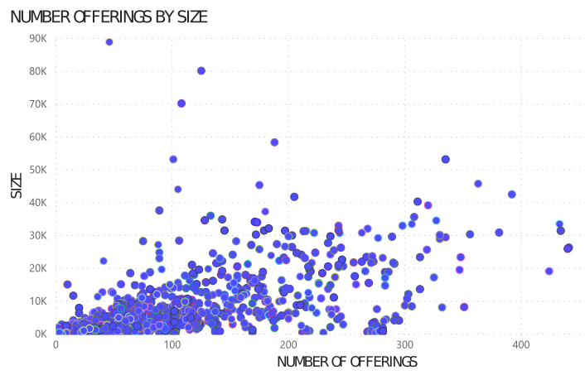
Versatility
Yes
Positive correlation
As size increases, so does the number of degree options
Notes:
Amount of Degree Offerings by School Size:
With the exception of a few universities, this holds true.

Slide 19
Data Analysis
5) Which schools can I afford?

Slide 20
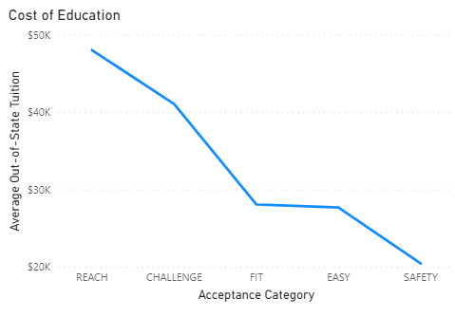
Affordability
Tuition for REACH schools will cost you over $45K per year
FIT schools may be the better bargain
Notes:
Tuition Based on Acceptance Rates:
Be prepared to pay over $45,000 per year if you attend a REACH school. A FIT school may be a better bargain.

Slide 21
Data Analysis
6) Which out-of-state colleges offer in-state comparable tuition?

Slide 22
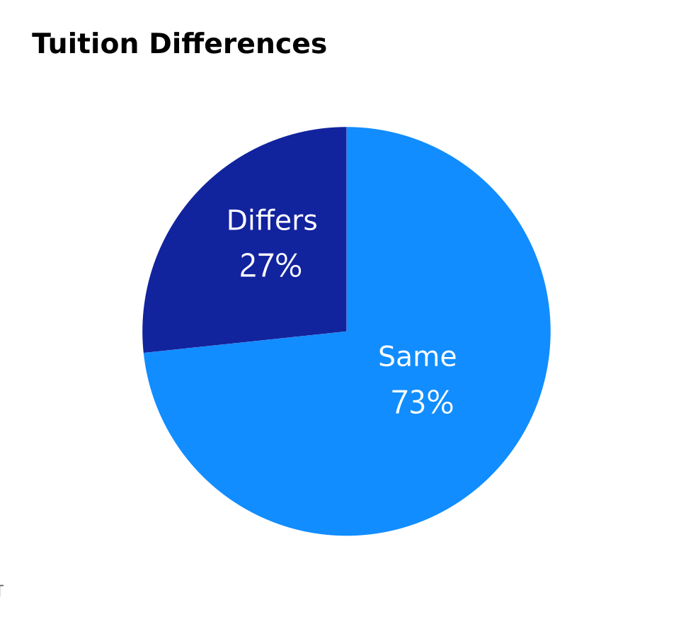
Intrastate Cooperation
73% of schools offer the same tuition for out-of-state students
Notes:
Most Schools Don't Charge More for Out-of-State Students:
Surprisingly, almost 75% of colleges offer the same tuition for out-of-state students that they offer for in-state students.

Slide 23
Data Analysis
7) What is the likelihood I can earn enough after I graduate to pay back my student loan?

Slide 24
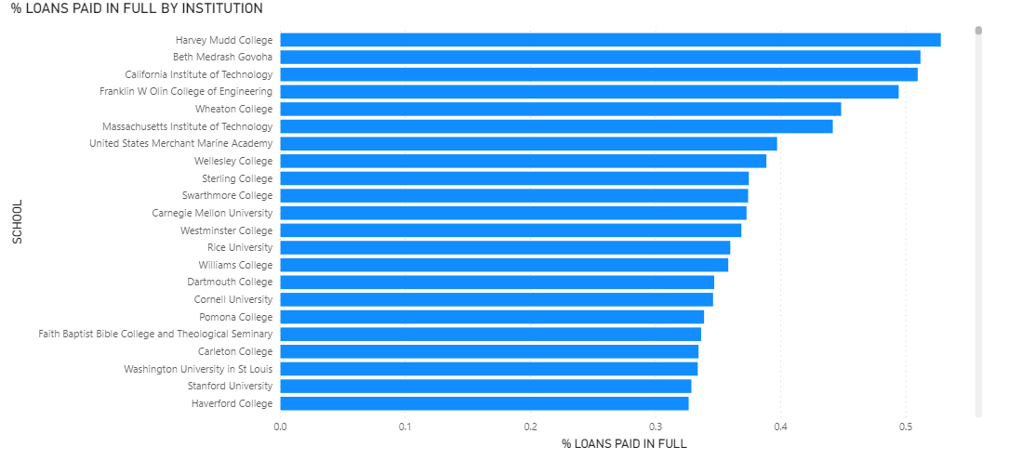
Loan Payment
List of schools most likely to earn enough to pay back student loan
Notes:
Schools with High Likelihood of Loan Payback :
Almost 50% of undergraduates from a handful of schools were able to pay back their loans in full just two years after graduating and even more had a 30% payoff rate. It is assumed that graduates from those schools earn even to pay back their loans.

Slide 25
Data Analysis
8) Is the tuition related to the size of the university?

Slide 26
Large School Costs
No
No correlation
Small schools can cost just as much as large
Notes:
Tuition Not Based on School Size:
There appears to be no correlation. Small schools can cost just as much as large schools.

Slide 27
Modeling Objective
Perform unsupervised learning to form school clusters.

Slide 28
Model Selection
K-Means
Notes:
Clustering
Unsupervised Learning

Slide 29
Data Preparation
Eliminated non-numeric features
Handled null values
Set rate, monetary data to 0
Imputed aggregated median fields to median of values from other schools
Scaler Standardization

Slide 30
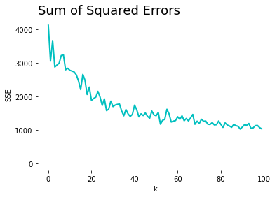
k-Means Optimization
Model trained using multiple values of k.
Each value of k plotted against the computed Sum of Squared Error (SSE) values
The curve “elbows” around k=30
Notes:
Used Python to run though k-Means algorithm using various values of k.
Computed and Plotted Sum of Squared Errors for each value of k.
“Elbow Curve”

Slide 31
Deployment
Stored model-assigned cluster labels for each school
Given school, returns model’s predicted cluster label
Prompt users for their preferred school.
Unique school identification numbers required
Unit IDs are available at the College Scorecard website

Slide 32
Recommendation Application
User enters a school in which they have already researched and determined will be a good fit, the recommendation engine provides a list of other schools that might also be worth investigating.

Slide 33
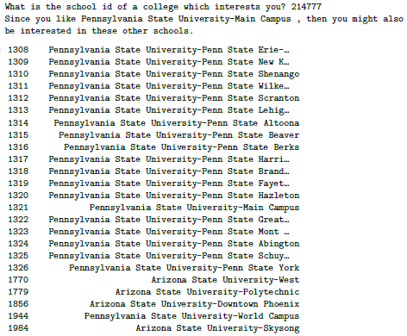
Recommendation Example
Notes:
Sample Recommendations – Penn State example

Slide 34
Future Recommendations
Adjust model to look at main campuses only
Scorecard Application Program Interface (API)
Re-assess annually

Slide 35
References
College Scorecard. (n.d.). Retrieved March 15, 2021, from https://collegescorecard.ed.gov/
Finding Your College Fit. (n.d.). Retrieved March 16, 2021, from https://bigfuture.collegeboard.org/find-colleges/how-find-your-college-fit
Fiske, E. B. (2019). Fiske Guide to Colleges 2020. Naperville, IL: Sourcebooks.
PrepScholar. (n.d.). Retrieved March 15, 2021, from https://www.prepscholar.com/
Staff Writers. (2020, June 04). What makes a college a good value? Retrieved March 16, 2021, from https://www.collegechoice.net/what-makes-a-college-a-good-value/

Slide 36
Q & A
Q: What factors were considered when making recommendations?
A: Factors included: location, size, completion rate, acceptance rate, several rates, various loan amounts and repayment rates.
Q: Why are there so many schools with similar names on my recommendation list?
A: Scorecard data tracks each campus separately.
Q: Did you find commonalities within clusters?
A: The k-Means algorithm takes all factors into account and converts them into vectors.
Q: Are the college groupings named?
A: The algorithm labels each cluster with a number. I chose not to name them further.
Q: Does your program handle feedback? For example, was this a good recommendation?
A: Not at this time, but that is a great future recommendation.

Slide 37
Q & A (cont.)
Q: What is a unit id and how do I find it?
A: School unit IDs can be found at the College Scorecard website (https://collegescorecard.ed.gov/data).
Q: How do I decide which initial school to use?
A: I recommend starting with the College Board’s search engine (https://bigfuture.collegeboard.org), investigate school websites, and plan a campus visit.
Q: How did you handle null values?
A: It depends. Most were set to zero. Median debt values were set to the median of other median values. Private rate values were combined with public rate values.
Q: k-Means does not work well if your classes are imbalanced. Did you experience any imbalanced classes?
A: The largest imbalanced class was a categorical feature denoting online-only schools.
Q: What criteria was used to designate a school as a “reach” school?
A: This can depend on the student. For this study, a “reach” school was defined as one that accepted less than 10% of the students who applied.

