Slide 1
Crime Finder
A Predictive Analytics Project
Amie Davis, amodavis@my365.bellevue.edu, DSC630, Bellevue University, 7 August 2020

Slide 2
Business Problem
Too many reports of Excessive Force
There has been an increase in reported incidents of excessive use of force by police. This increase has heightened visibility, and communities across the country are calling for change. The police have a reputation for targeting minorities, making some afraid to call the police when needed. Change is needed to deter crime while providing a sense of protection to the entire community.

Slide 3
Business Objective
Lower the number of Justifiable Homicides

Slide 4
Critical Questions
Research questions considered using visualizations, such as histograms, boxplots, and scatterplots
What area in the US has the highest crime rate?
Are crimes reported only against certain demographics?
What is the most common crime reported?
What reasons are given for justifiable homicides?
In what areas are justified homicides committed most frequently? reports of suspicious activity?

Slide 5



Data Sources
Uniform Crime Reporting Program Data: National Incident-Based Reporting System (NBIRS), 2016; United States Federal Bureau of Investigation; Inter-university Consortium for Political and Social Research (ICPSR), University of Michigan; https://www.icpsr.umich.edu/icpsrweb/NACJD/NIBRS/;
https://www.icpsr.umich.edu/icpsrweb/NACJD/NIBRS/
US Cities Database: https://simplemaps.com/data/us-cities
State Geodetic Centers: https://www.latlong.net

Slide 6
Data Summary
Original dataset included 6,034,725 victim records from 2016.
Reviewed correlation, relevancy, and significant features to limit to 15 features.
Final, cleaned dataset consisted of 1,983,864 records for the top 6 states reporting with 15 incident and location features.
Most features are categorical.
The top officer activity reported was for “Suspicious Activity.”
Approximately 20% of victims were not residents of the area in which the crime occurred.
There was a large disproportion of incidents reported by states.
Counts for Top 6 offenses Incidents for 2016 reporting:
290 Destruction/Damage/Vandalism of Property
13B Simple Assault
23H All Other Larceny
35A Drug/Narcotic Violations
220 Burglary/Breaking and Entering
23F Theft From Motor Vehicle

Slide 7
Data Analysis
1) What area in the US has the highest crime rate reported?

Slide 8
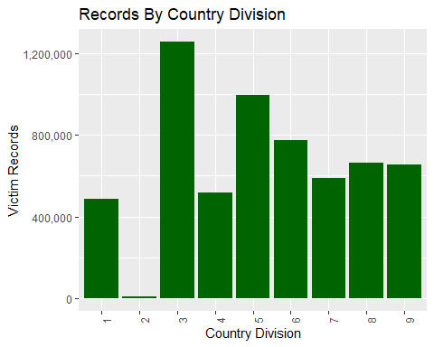
Where?
Note the top area reporting incidents in the UCR system were from the East North Central Region of the US.
1=New England 2=Middle Atlantic 3=East North Central 4=West North Central 5=South Atlantic 6=East South Central 7=West South Central 8=Mountain 9=Pacific

Slide 9
Data Analysis
2) Are crimes reported only against certain demographics?

Slide 10
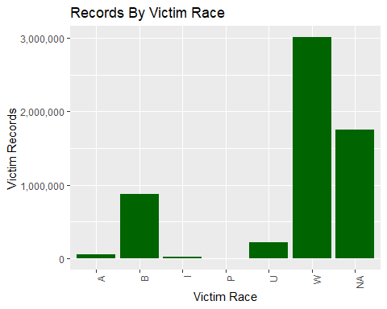
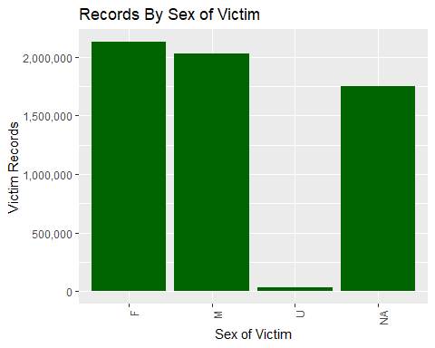
Demographics
More crimes reported were committed against whites, almost 30% more than other races reported. This is half of what is representative of the US population.
More crimes were committed against females, although the gender distribution is close.

Slide 11
Data Analysis
3) What is the most common crime reported?

Slide 12
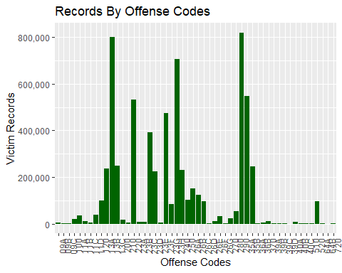
Types of Offenses
Note the top six reported offenses below.
290: Destruction/Damage/ Vandalism of Property
13B: Simple Assault
23H: Other Larceny
35A: Drug/Narcotic Violations
220: Burglary/Breaking and Entering
23F: Theft From Motor Vehicle

Slide 13
Data Analysis
4) What reasons are given for justifiable homicides?

Slide 14
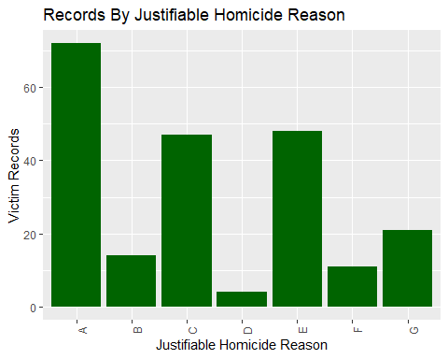
Justifiable?
Note the top three reasons provided for justifiable homicides
Criminal Attacked Police Officer and That Officer Killed Criminal
Criminal Killed In Commission of a Crime
Criminal Attacked a Civilian
A=Criminal Attacked Police Officer and That Officer Killed Criminal B=Criminal Attacked Fellow Police Officer and Criminal Killed by Another Police Officer C=Criminal Attacked a Civilian D=Criminal Attempted Flight From a Crime E=Criminal Killed In Commission of a Crime F=Criminal Resisted Arrest G=Unable to Determine/Not Enough Information

Slide 15
Limiting Scope
Since some states have switched over to the mandated National Incident-Based Reporting System (NIBRS), the UCR data only includes those that remain. For this reason, the following states were selected to be the focus of this study.
Tennessee, Michigan, South Carolina, Massachusetts, Ohio, and Washington.

Slide 16
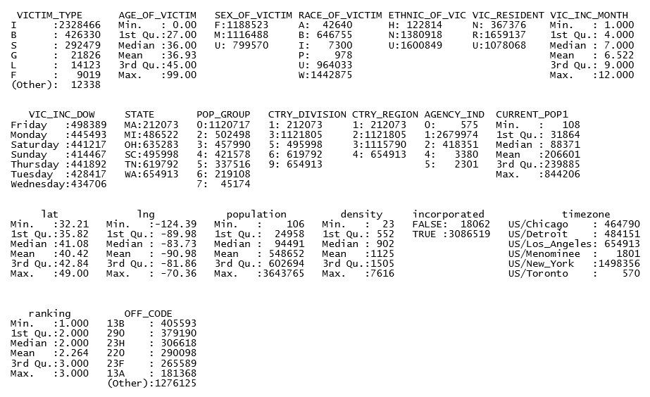
Descriptive Statistics

Slide 17
Data Analysis
5) In what areas are justified homicides committed most frequently? reports of suspicious activity?

Slide 18
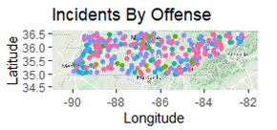
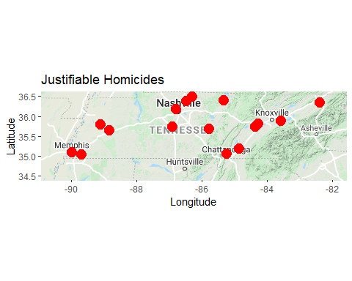
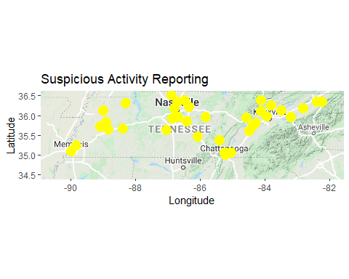
Tennesee (2016)

Slide 19
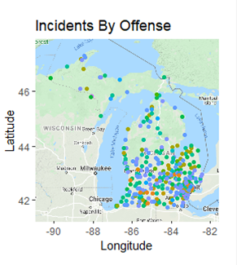
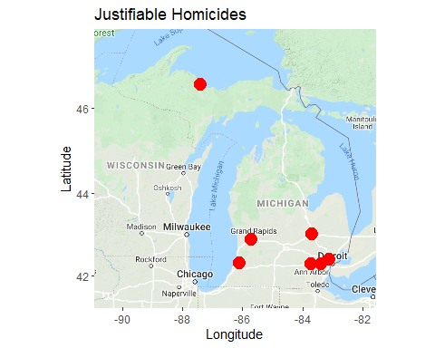
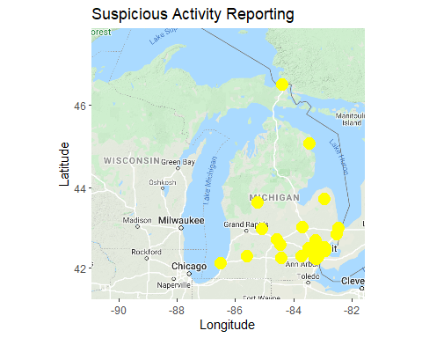
Michigan (2016)

Slide 20
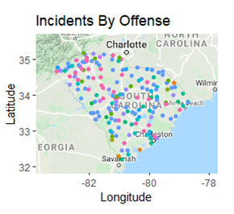
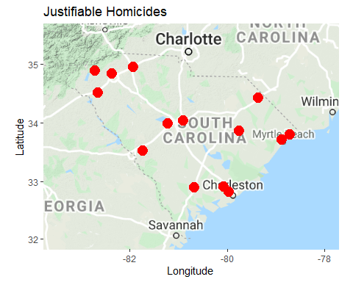
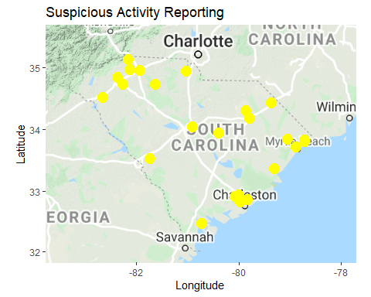
South Carolina (2016)

Slide 21
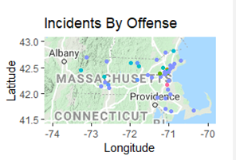
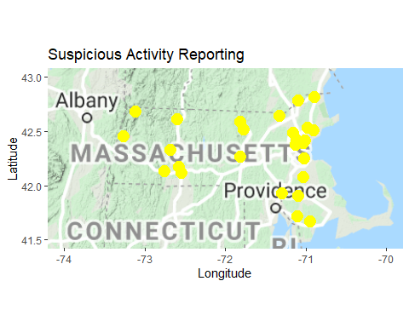
Massachusetts (2016)
There are were no Justifiable Homicides reported in MA for 2016.

Slide 22
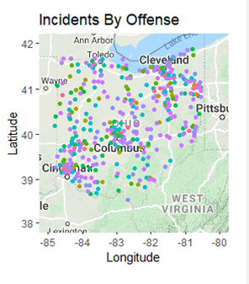
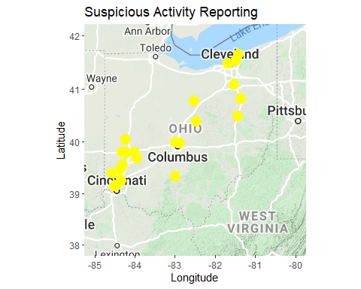
Ohio (2016)
There are were no Justifiable Homicides reported in OH for 2016.

Slide 23
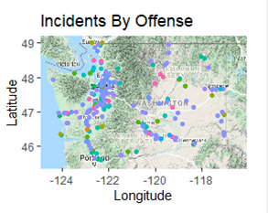
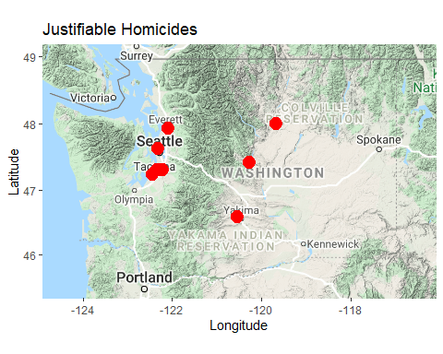
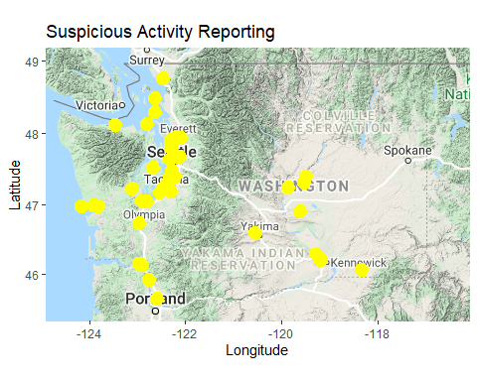
Washington (2016)

Slide 24
Modeling Objective
The predicted output of the model should be the likelihood that a specific criminal offense will occur.

Slide 25
Data Preparation
Joined victim, reporting precinct, and location data sets
Created features for month and day of week from date fields.
Converted null data to Unknown Category where applicable
Limited to records with geodetic (lat/long) coordinates
Converted categorical variables to numeric

Slide 26
Target Variable
Offense Code
Code | Description
91 | Murder/Nonnegligent Manslaughter
92 | Negligent Manslaughter
93 | Justifiable Homicide
100 | Kidnapping/Abduction
111 | Rape
112 | Sodomy
113 | Sexual Assault With An Object
114 | Fondling (Indecent Liberties/Child Molesting)
120 | Robbery
131 | Aggravated Assault
Code | Description
132 | Simple Assault
133 | Intimidation
200 | Arson
210 | Extortion/Blackmail
220 | Burglary/Breaking and Entering
231 | Pocket-picking
232 | Purse-snatching
233 | Shoplifting
234 | Theft From Building
235 | Theft From Coin-Operated Machine or Device

Slide 27
Target Variable (cont.)
Offense Code
Code | Description
236 | Theft From Motor Vehicle
237 | Theft of Motor Vehicle Parts/Accessories
238 | All Other Larceny
240 | Motor Vehicle Theft
250 | Counterfeiting/Forgery
261 | False Pretenses/Swindle/Confidence Game
262 | Credit Card/Automatic Teller Machine Fraud
263 | Impersonation
264 | Welfare Fraud
Code | Description
265 | Wire Fraud
270 | Embezzlement
280 | Stolen Property Offenses
290 | Destruction/Damage/Vandalism of Property
351 | Drug/Narcotic Violations
352 | Drug Equipment Violations
361 | Incest
362 | Statutory Rape
370 | Pornography/Obscene Material
391 | Betting/Wagering

Slide 28
Target Variable (cont.)
Offense Code
Code | Description
392 | Operating/Promoting/Assisting Gambling
393 | Gambling Equipment Violations
394 | Sports Tampering
401 | Prostitution
402 | Assisting or Promoting Prostitution
403 | Purchasing Prostitution
510 | Bribery
520 | Weapon Law Violations
641 | Human Trafficking - Commercial Sex Acts
Code | Description
642 | Human Trafficking - Involuntary Servitude

Slide 29
Model Selection
Multi-Class Classification Models
Decision Tree
k-NN
Multi-Class Logistic Regression
Artificial Neural Networks
Random Forest Classifier
Bagging Classifier
Booster Regressor

Slide 30
Feature Selection
Feature | Description
Victim Type | Type of victim (Ex: Individual, Business)
Victim Age | Age of victim
Victim Sex | Sex of victim
Victim Race | Race of victim
Victim Ethinicity | Ethnicity of victim
Victim Residency | Flag indicating if victim is redident of reporting area.
Month | Month offense committed
Day of the Week | Day of the week offense committed
State | US state in which the offense occurred
Population Group | Population group of the area associated with the law enforcement agency reporting the offense
Feature | Description
Country Division | Geographic division in which the state of the offense occurred is located. (Ex: New England, Middle Atlantic)
Country Region | Geographic Region in which the Country Division of the offense occurred is located. (Ex: North East, South)
Agency Indicator | Distinguishes counties and colleges and universities from cities.
Latitude | Geodetic latitude of the city in which the offense occurred
Longitude | Geodetic longitude of the city in which the offense occurred
Population | Population of the area associated with the law enforcement agency reporting the offense
Density | The estimated population per square kilometer of the city in which the offense occurred
Incorporated | Indicates if the place where the offense occurred is a city/town or just a commonly known name for a populated area.
Time Zone | Time zone in which the offense occurred
Ranking | Integer indicating the importance of the city in which the offense occurred (1 is most important, 5 least important)

Slide 31
Multi-class Model Evaluation
k-NN far out-performed the remaining models.
The performance of k-NN was poor in Python, so I opted to use R.
I was able to increase the neural network to 31% by adjusting hyperparameters and adding hidden layers.
Accuracy of random forest was initially lower at 38%, but I was able to improve to 40% by optimizing hyperparameters.
Final Model Selection: k-NN
Model | Accuracy
k-NN (R) | 84%
Boosting Regressor | 50% (MAE)
Bagging Classifier | 40%
Random Forest | 40%
Decision Tree | 38%
Keras Neural Network | 31%

Slide 32
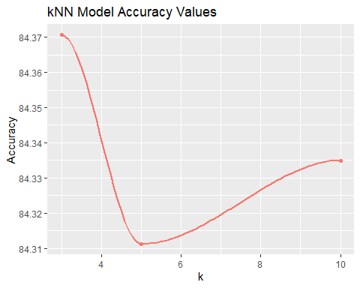
k-NN Optimization
The accuracy peaks when k=3

Slide 33
Justifiable Homicide Model Evaluation
Single decision tree model predicts the likelihood of a justifiable homicide being committed.
Measurement
Accuracy | 99.8%
Sensitivity | 25%
Specificity | 99.8%
This model only has a 25% chance of correctly identifying justifiable homicides.

Slide 34
Aggravated Assault Model Evaluation
Single decision tree model predicts the likelihood of an aggravated assault being committed.
Measurement
Accuracy | 72.4%
Sensitivity | 9%
Specificity | 99.6%
This model only has a 9% chance of correctly identifying justifiable homicides.

Slide 35
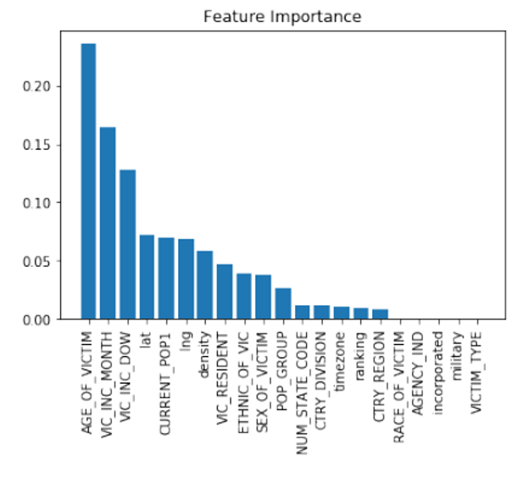
Feature Importance
Note the top three features that have the most influence on the determination of the type of offense, per the Random Forest model. Each have over 10% influence on the model.
Victim’s Age (25%)
Month of Incident (17%)
Day of the Week of Incident (13%)

Slide 36
Deployment
Deployment method will be in the Predictive Modeling software
No additional resources required
Data prep already complete
No model translation required
Recommend reassessment annually
Data from precincts reporting can be applied to other precincts for predictions
Data from previous years can be applied to current year for predictions

Slide 37
Decisions
Threshold: 2 Justifiable Homicides per
10,000
If a city is predicted to have over 2 Justifiable Homicides per 10,000 people, take action for change.
Population Group | Avg City Population (thousands) | Justifiable Homicides | Over Threshold?
100,000 thru 249,999 | 175000 | 9 | N
50,000 thru 99,999 | 75000 | 11 | N
25,000 thru 49,999 | 37500 | 8 | Y
10,000 thru 24,999 | 17500 | 2 | N
2,500 thru 9,999 | 6250 | 6 | Y
Under 2,500 | 1250 | 0 | N

Slide 38
Continual Assessment
As change is made, we the number of justifiable homicides to go down in those areas
Re-assess annually
Decrease threshold to identify new “hot spots” requiring focus

Slide 39
The Prediction Effect
The Prediction Effect: A little prediction goes a long way.
- Eric Siegel
Although the accuracy of most of my models were low, value was obtained by determining the importance of features towards the types of offenses committed.
Predicting better than pure guesswork, even if not accurately, delivers real value.
- Eric Siegel

Slide 40
References
Abbott, D. (2014). Applied predictive analytics: Principles and techniques for the professional data analyst. Indianapolis, IN: Wiley.
Albon, C. (2018). Machine learning with Python cookbook: practical solutions from preprocessing to deep learning. O'Reilly.
Kahle, D. and Wickham, H. (2013). ggmap: Spatial Visualization with ggplot2. The R Journal, 5(1), 144-161. Retrieved November 6, 2019, from http://journal.r-project.org/archive/2013-1/kahle-wickham.pdf
Resource Guide: National Incident-Based Reporting System. (n.d.). Retrieved June 7, 2020, from https://www.icpsr.umich.edu/icpsrweb/NACJD/NIBRS/
Siegel, E. (2016). Predictive analytics: The power to predict who will click, buy, lie, or die. Hoboken, NJ: Wiley

Slide 41
Backup Slides

Slide 42
Random Forest Model Evaluation By State
State | Accuracy
Tennessee | 23%
Michigan | 25%
South Carolina | 25%
Massachusetts | 27%
Ohio | 25%
Washington | 36%
Random forest prediction models by state
Accuracy decreased from joint model, with the exception of Washington state

