Slide 1
Flying Is Safe!

Slide 2
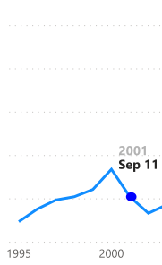
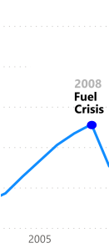
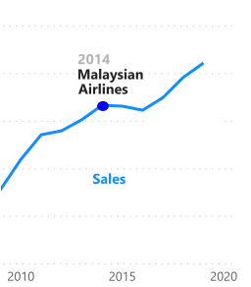
Worldly Impacts
The airline industry continues to be defined by world events.
Airline Sales
Data Source: Economic Impact of Commercial Aviation By State (U.S. Airline Traffic and Capacity), Airlines for America.
Notes:
The airline industry continues to be defined by world events. Misinformation was spread in 2014 following the downing of Malaysian Flight 17 and the disappearance of Malaysian Flight 370. Although 2014 was a bad year for the airline industry, so was 2001, 2008, and now 2020. The impact of the events of September 11, 2001 were devastating to the airlines. The 2008 Recession caused fuel prices to soar, affecting the airline industry. The mass media coverage of the Malaysian Airlines flights in 2014 impacted air travel. The current pandemic is certainly impacting air travel more than ever right now.

Slide 3
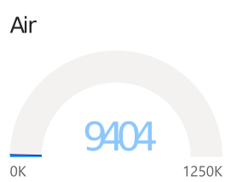
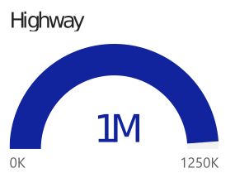
Saving Lives Historically
Highway fatalities have far outnumbered airline fatalities for years.
Fatalities 1985-2014
Data Source: Airline Safety, Aviation Safety Network. Fatality Analysis Reporting System (FARS), NHTSA.
Notes:
Highway fatalities have far outnumbered airline fatalities for years. It is clear, given the statistics, that flying is still safer than driving. As you can see, highway travel resulted in over 1 million deaths in the 30-year period from 1985 to 2014.

Slide 4
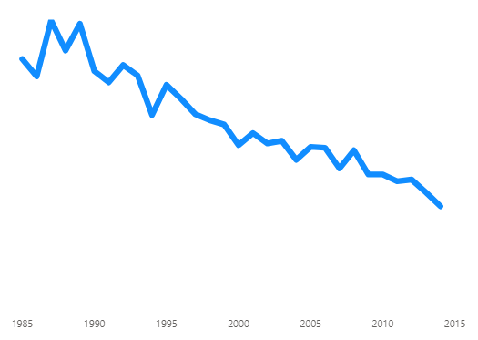
Air Fatalities Steadily Decline
There has been a steady decline of fatalities from air travel since 1985.
Declining Fatalities
Data Source: Statistics, Bureau of Aircraft Accident Archives..
Notes:
There has been a steady decline of fatalities from air travel since 1985. Highway fatalities, however, did not start to decline until 2006 with the impact of texting and driving campaigns. Airlines have always sought continual improvement in safety, resulting in the overall decline in fatalities throughout the years. In contrast, highway fatalities did not start to decline until 2006.

Slide 5
Differences in the Last Decade
Fatalities on the highway have increased over 2000% this decade compared to the last.
’85-’89 vs. ’00-’14
Highway
Air
+2116%
-51%
Data Source: Airline Safety, Aviation Safety Network. Fatality Analysis Reporting System (FARS), NHTSA.

Slide 6
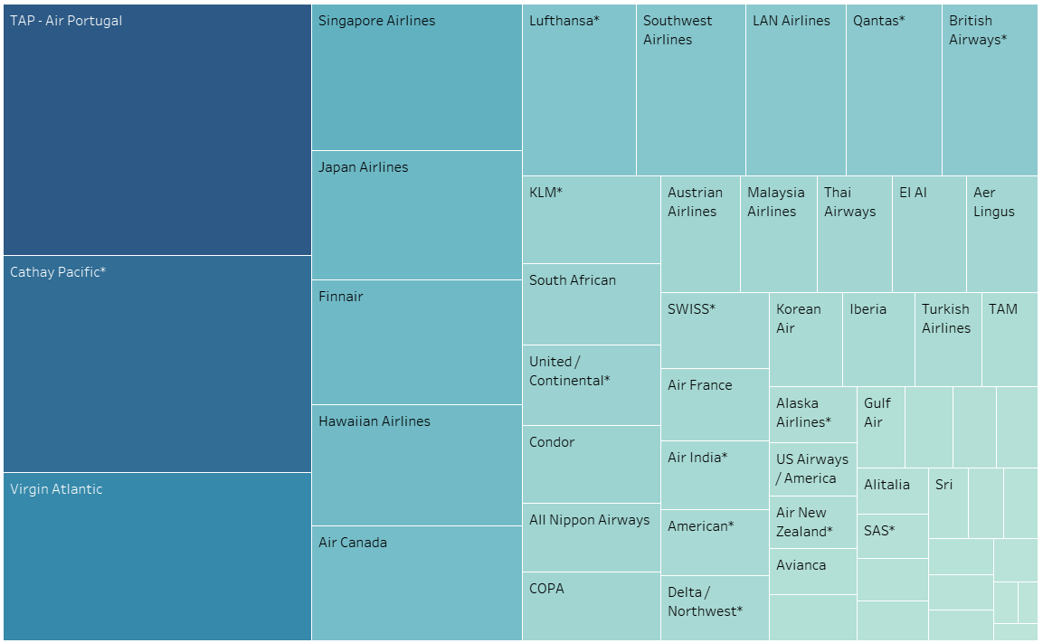
Safest Airlines
These airlines have been ranked on a safety score, based on the incidents per passenger capacity in the last 30 years.
Data Source: Airline Safety, Aviation Safety Network.

Slide 7
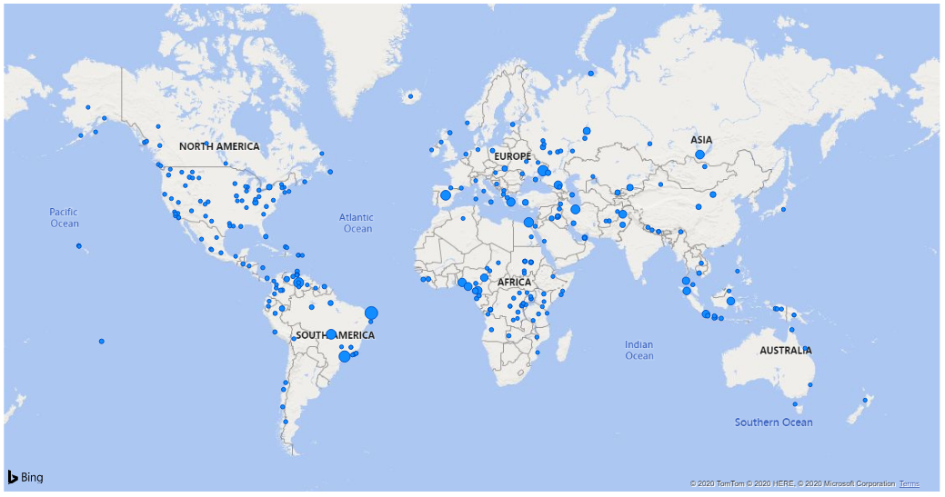
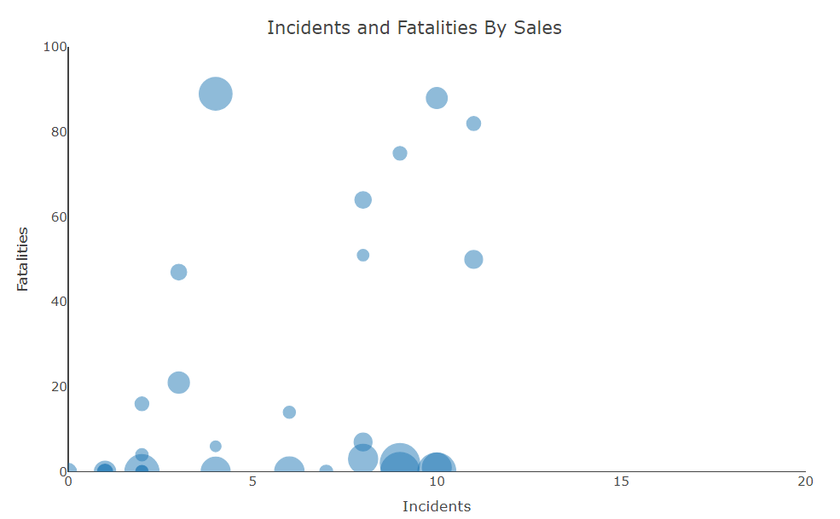
Safe Crashes
Many airlines have had very few incidents and no deaths.
Data Source: data.world, Airplane Crashes 1908-2009.
Data Source: Statistics, Bureau of Aircraft Accident Archives. Fatality Analysis Reporting System (FARS), NHTSA.
Notes:
Contrary to popular belief, airline crashes do not always result in death. Aeroflot has had over 80 crashes with around 200 fatalities. Whereas, China Airlines has had far less crashes with almost 3 times the number of deaths. As you can see, many airlines have had very few incidents and no deaths. What car company can say that?

Slide 8
Don’t Be Afraid to Fly

Slide 9
Data Sources
Airline Safety, Aviation Safety Network. Retrieved September 21, 2020, from https://github.com/fivethirtyeight/data/tree/master/airline-safety
Fatality Analysis Reporting System (FARS), NHTSA. Retrieved September 21, 2020, from https://www.nhtsa.gov/research-data/fatality-analysis-reporting-system-fars
Economic Impact of Commercial Aviation By State (U.S. Airline Traffic and Capacity), Airlines for America. Retrieved September 23, 2020, from https://www.airlines.org/data/
Haveliwala, H. (2018, July 12). Airplane Crashes 1908-2009 - dataset by hhaveliw. Retrieved November 02, 2020, from https://data.world/hhaveliw/airplane-crashes-1908-2009
Traffic and Capacity by Operating Region (Total System Passenger Revenue), Airline Data Project. Retrieved September 22, 2020, from http://web.mit.edu/airlinedata/www/Traffic&Capacity.html
Statistics, Bureau of Aircraft Accident Archives. Retrieved September 24, 2020, from http://www.baaa-acro.com/statistics

Slide 10
Amie Davis
amodavis@my365.bellevue.edu Bellevue University 16 November 2020

