Slide 1
Flying Is Safer
Impact and Recovery of our Airline
Amie Davis, amodavis@my365.bellevue.edu, DSC640, Bellevue University, 9 October 2020

Slide 2
Business Problem
Media Reporting Flying No Longer Safer Than Driving
Due to recent unfortunate airline crashes, the media has been promoting statistics stating air is no longer a safe way to travel. The news and media outlets have been bombarding the public with reports and figures about the trends of airline safety and that things are not looking good. What was previously thought as the safest way to travel, especially when compared to automobiles, is now being presented as one of the most dangerous to the public. But are any of these claims based on facts?

Slide 3
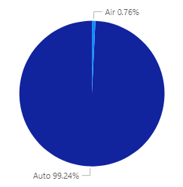
Saving Lives Historically
Automobile Fatalities have far outnumbered Airline Fatalities for Years.
Fatalities 1985-2014
Data Source: Airline Safety, Aviation Safety Network. Fatality Analysis Reporting System (FARS), NHTSA.

Slide 4
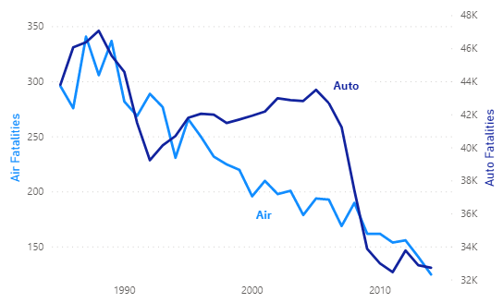
Air Fatalities Steadily Decline
There has been a steady decline of fatalities from air travel. Auto fatalities, however, did not start to decline until 2006 with the impact of texting and driving campaigns.
Fatalities 1985-2014
Data Source: Statistics, Bureau of Aircraft Accident Archives. Fatality Analysis Reporting System (FARS), NHTSA.

Slide 5
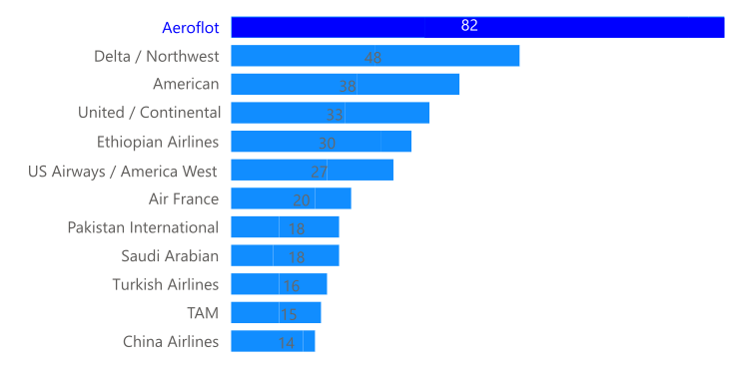
Not Our Airline
Aeroflot incidents far exceed other airlines with 82 fatal crashes since 1985.
Fatal Crashes By Airline 1985-2014
Data Source: Airline Safety, Aviation Safety Network.

Slide 6
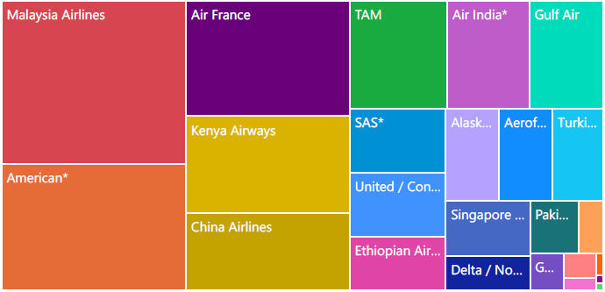
Still Not Our Airline
In more recent years, our company continues to be impacted by the failure of other airlines.
Fatalities By Airline 2000-2014
Data Source: Airline Safety, Aviation Safety Network.

Slide 7
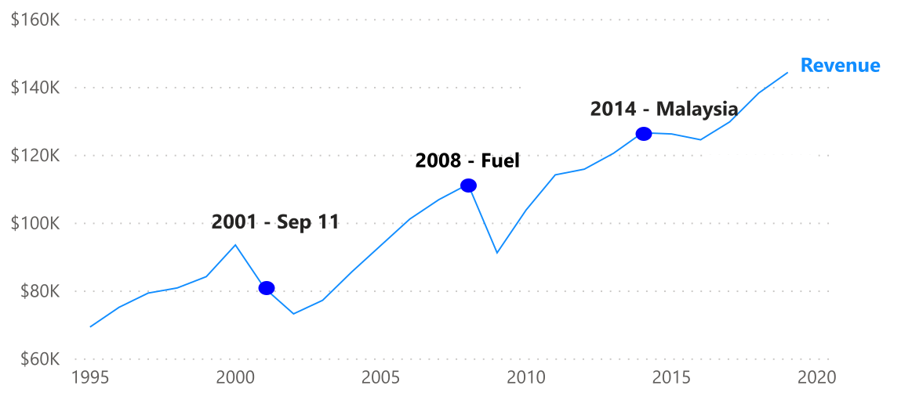
We Will Recover
The Airline Industry continues to be defined by World Events. We will recover, as we have done in the past.
Passenger Revenue
Data Source: Traffic and Capacity by Operating Region (Total System Passenger Revenue), Airline Data Project. Economic Impact of Commercial Aviation By State (U.S. Airline Traffic and Capacity), Airlines for America.

Slide 8
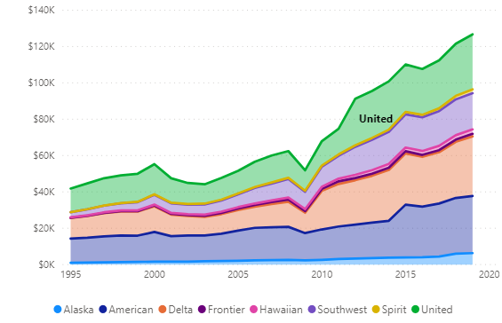
Recovery Plan
Recommend modeling our Recovery Plan after United Airlines, due to their quick recovery historically.
Passenger Revenue By Airline
Data Source: Airline Safety, Aviation Safety Network.

Slide 9
Data Sources
Airline Safety, Aviation Safety Network. Retrieved September 21, 2020, from https://github.com/fivethirtyeight/data/tree/master/airline-safety
Fatality Analysis Reporting System (FARS), NHTSA. Retrieved September 21, 2020, from https://www.nhtsa.gov/research-data/fatality-analysis-reporting-system-fars
Economic Impact of Commercial Aviation By State (U.S. Airline Traffic and Capacity), Airlines for America. Retrieved September 23, 2020, from https://www.airlines.org/data/
Traffic and Capacity by Operating Region (Total System Passenger Revenue), Airline Data Project. Retrieved September 22, 2020, from http://web.mit.edu/airlinedata/www/Traffic&Capacity.html
Statistics, Bureau of Aircraft Accident Archives. Retrieved September 24, 2020, from http://www.baaa-acro.com/statistics

