Slide 1
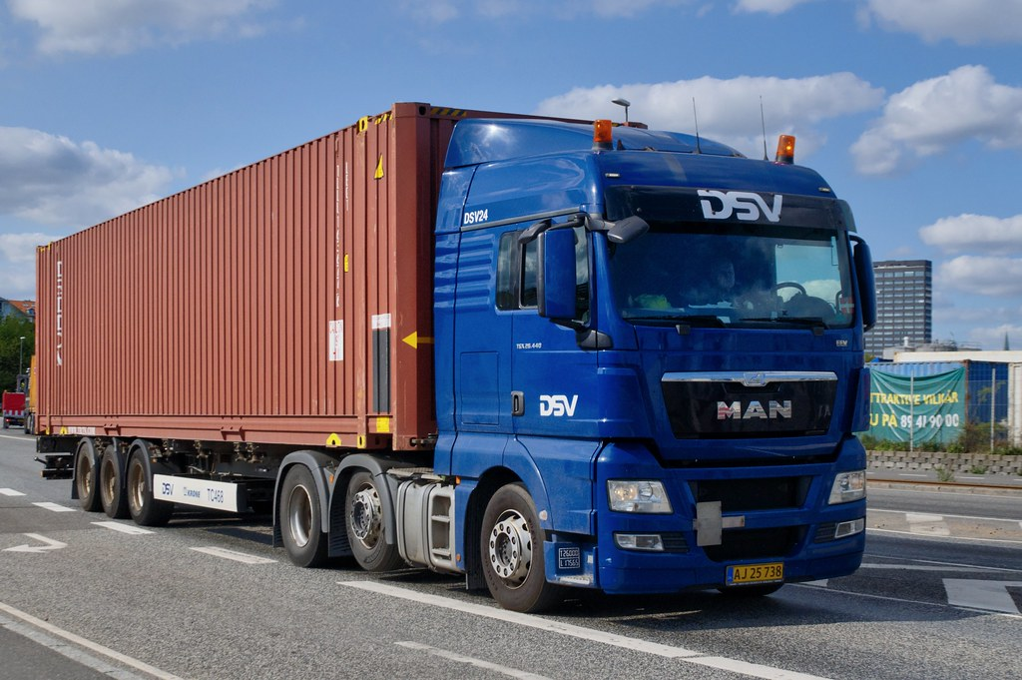


Data on the Move in Transportation Amie Davis, amodavis@my365.bellevue.edu
Introduction
Data continues to evolve in the transportation industry. Transporters were at the forefront of data collections and have paved the way for location tracking. This impacts everyone today with location settings on their phones, increasing our everyday sense of security.
Deliverable
During this project, I will determine additional public data sources available and point out the benefits of collecting and consolidating the data. I intend to submit a corresponding white paper to members of the National Defense Transportation Association (NDTA) encouraging the sharing, collection, and analysis of big data. The intent is to impact priorities of Information Technology (IT) in transportation logistics, enabling Big Data.
Conclusions
For several years, data has been collected from inventory, trucks, trailers, Global Positioning Systems (GPS), Radio-Frequency Identification (RFID) tags, and other sources. Adding publicly available information, such as fuel, traffic, and weather, along with analyzing unused data already collected, will improve delivery times, route planning, and safety, resulting in more reliable services at lower costs.
Why is this Data Science?
This project involved several stages of the CRISP-DM life-cycle. Research on this topic involved gathering information on the transportation industry to acquire domain knowledge, discussion of data gathering techniques, envisioning aggregation of data from different sources, and determining the analysis and visualization capabilities to enable decision making.
Inventory Tracking
Maintenance
Fleet Tracking
Route Planning
Incident Management
Efficiency Identification
Forecasting
Telematics
RFID
GPS
Big Data
Acknowledgments
I want to thank my Air Force Institute of Technology instructor, Eric Glover, for guiding my interest into Operational Research. Special thanks to my daughter for making dinner while I worked on my project.
Evolution of Transportation Data Technologies
Decision Making
Literature
Big Data and the New Fleet Management. 2019. ThomasNet News, Jan. 2019, p. N.PAG. EBSCOhost, search.ebscohost.com/login.aspx?direct=true&db=edb&AN=134092583&site=eds-live.
Aaron Huff. 2017. Towing big data: trailer tracking suppliers look to deliver new insights. Retrieved 3 July, 2019 from https://www.ccjdigital.com/towing-big-data-trailer-tracking-suppliers-look-to-deliver-new-insights/
AARON HUFF. 2018. ENERGIZING INFORMATION: Crestwood Transportation Re-Engineers Technologies to Drive Efficiency, Safety. Commercial Carrier Journal, vol. 175, no. 6, pp. 43–44. EBSCOhost, search.ebscohost.com/login.aspx?direct=true&db=b9h&AN=130371079&site=eds-live.
AARON HUFF. 2018. Moving beyond EXCEPTIONS: A Four-Step Guide to Proactive Fleet Management. (Cover Story). Commercial Carrier Journal, vol. 175, no. 7, pp. 46–50. EBSCOhost, search.ebscohost.com/login.aspx?direct=true&db=b9h&AN=131000819&site=eds-live.
Kevin Jessop. 2016. What Is the Impact of Big Data in the Transportation & Supply Chain Industries? 11 Possibilities with Big Data. Retrieved 3 July, 2019 from https://cerasis.com/big-data-in-the-transportation.
Deborah Lockridge. 2018. Emerging and Future Fleet Data Technologies. Retrieved 3 July, 2019 from https://www.truckinginfo.com/279737/emerging-and-future-fleet-data-technologies.

