Slide 1
A Hybrid Approach to Polarization Detection: Replacing Traditional NLP tasks with Large Language Models
Supervisor:
Marios Dikaiakos
Doctoral Student Supervisor:
Demetris Paschalides

Slide 2
Table Of Contents
Introduction
POLAR Framework
Implementation
Evaluation
Results & Analysis
Conclusion
Future Work
Large Language Models
Objectives

Slide 3
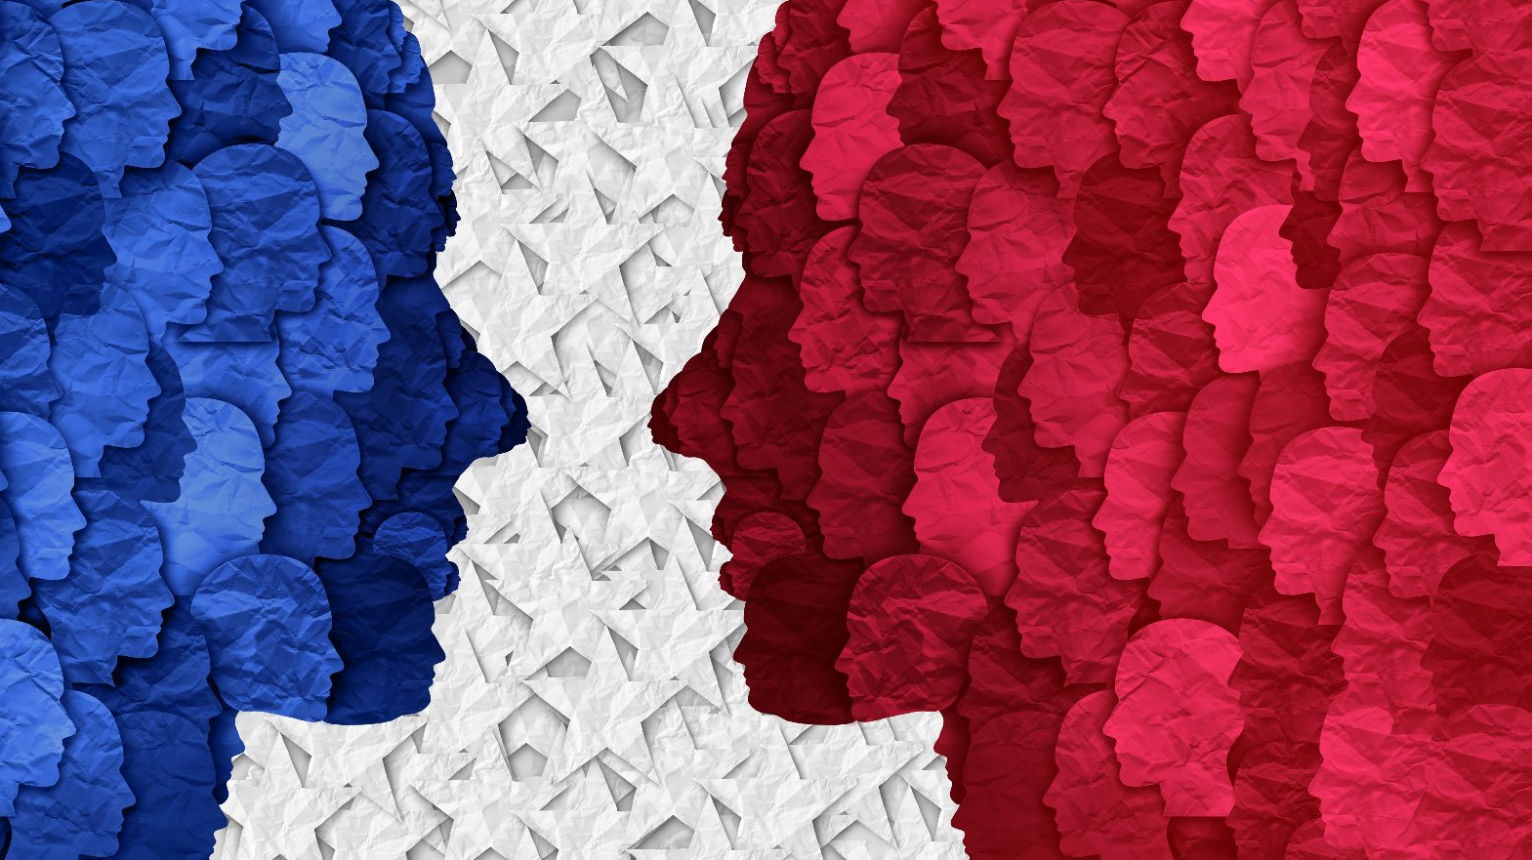
Introduction

Slide 4
What is Polarization?
The term polarization can refer either to a state of political dividedness, or to a process toward such a state [7]
Characterized by ideological extremes, far ends of agreement/disagreement [3]
Leads to strong discourse and mistrust, fueled by misinformation [4]

Slide 5
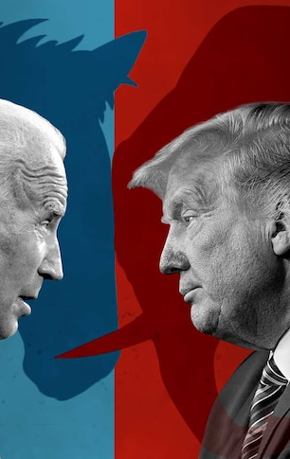
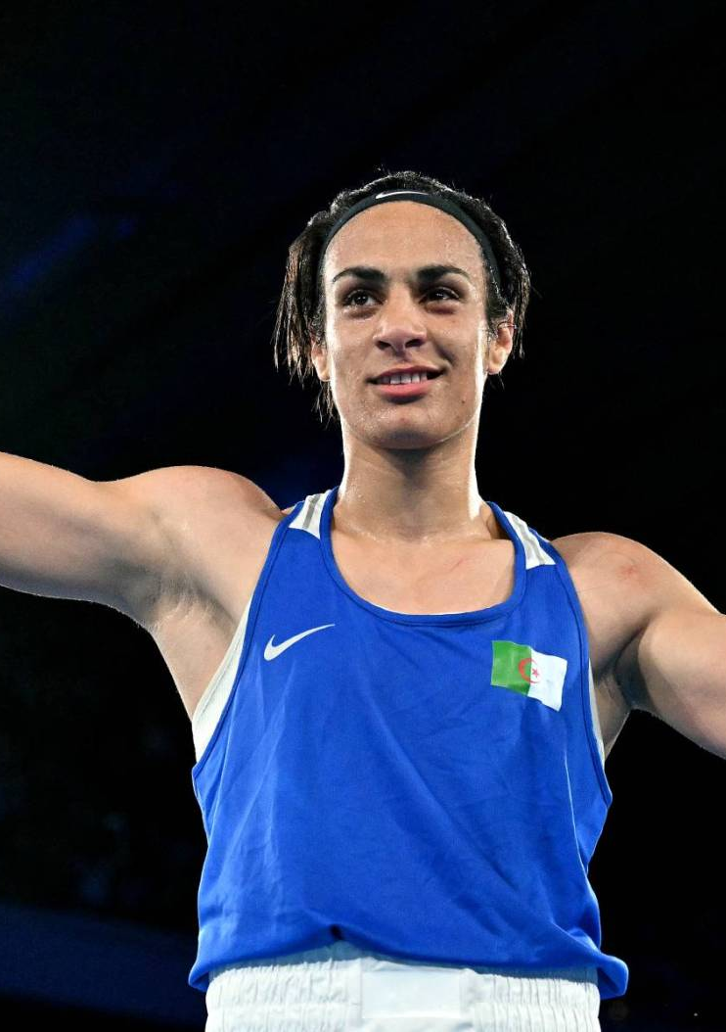
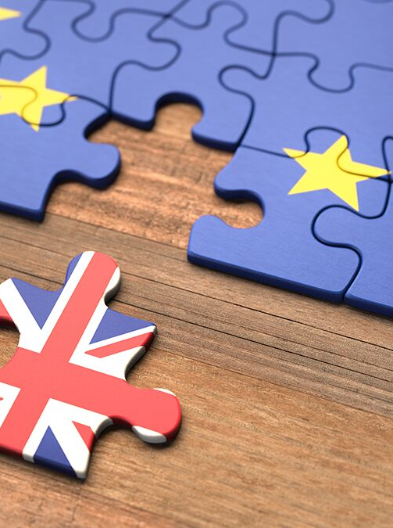
Real World examples of Polarization
US Elections 2024
France Olympics 2024
Brexit 2016-2020

Slide 6
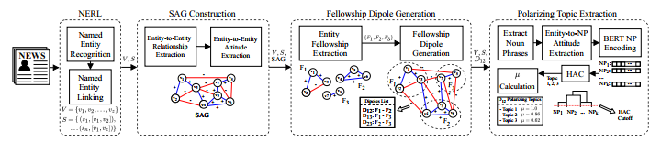
POLAR Framework
POLAR - an unsupervised, large-scale framework for modeling and identifying polarizing topics
In any domain without prior domain-specific knowledge[1]. Constructing a Hierarchical knowledge
Graph modeling Polarization[1].

Slide 7
POLAR Limitations
Entity/Noun Phrase Extraction rely on SpaCy, an NLP component error prone to Dictionary errors and Dependency Parsing Errors:
Example:
entity1: “Howard” -> reference: "http://dbpedia.org/resource/John_Howard" entity2: "Schneider" -> reference: “http://dbpedia.org/resource/Schneider_Electric” Sentence: “…Parliament Square in London Thomson Reuters By David Lawder and Howard Schneider Advertisement WASHINGTON (Reuters)…"
Problem: Assigns Pair Howard -> Schneider when Howard Schneider is the full name of the person
Dependency Parsing Error: Splits “Howard Schneider” into “Howard” and “Schneider” and assigns different links to them (“John_Howard” and “Schneider_Electric”).
Dictionary Error: Does not correctly link the Entity “Howard Schneider” to a pre-existing dbpedia link, as it does not exist.

Slide 8
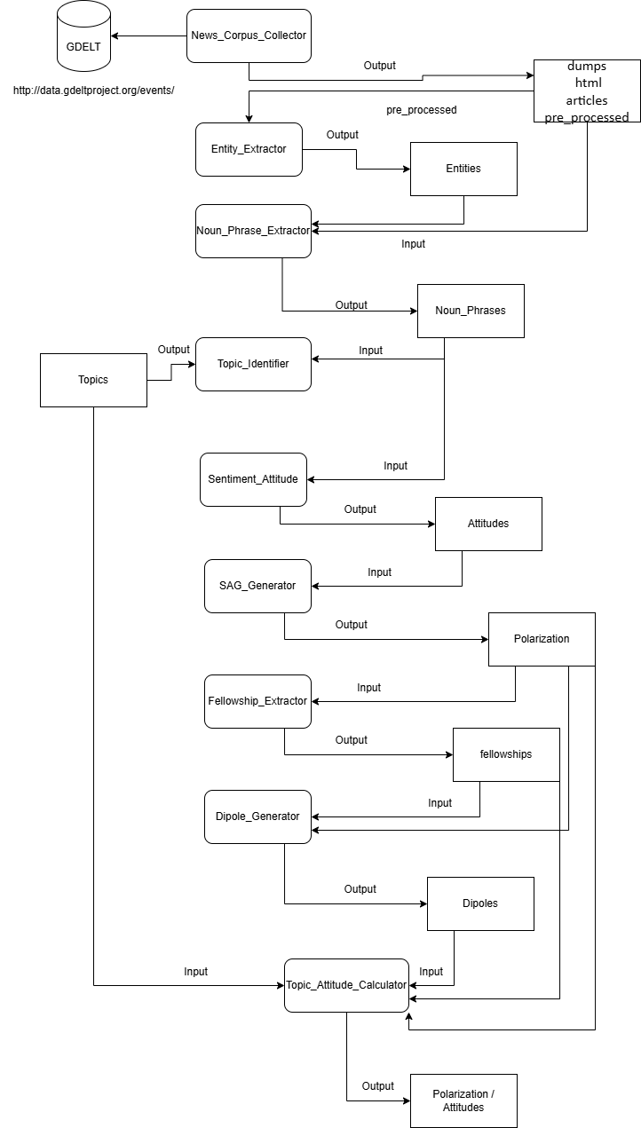
Objectives
Address the limitations of the POLAR Pipeline
Integrate LLMs into the POLAR Pipeline for Attitude Detection
Evaluate the Effectiveness of LLMs in detecting Polarization.
Fine-Tune Mistral to replicate GPT locally

Slide 9
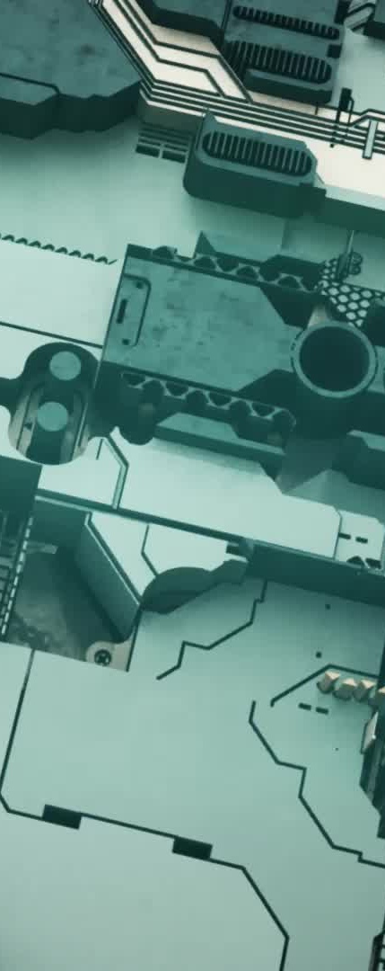
Large Language Models (LLMs)
LLMs attempted for this thesis include:
GPT-3.5-turbo
A Fine-Tuned model of Mistral-7B
Deepseek-R1-8B

Slide 10

GPT-3.5-turbo
Powerful closed-source model by OpenAI, optimized for fast and cost-effective inference via API, with capabilities in various NLP tasks [9].
Used as the Benchmark for other LLMs for this thesis, follows the prompt very well.
Currently ~64.7% slower than POLAR, approximately 18.26 seconds vs POLAR’s 11.82 seconds per-article.

Slide 11

Deepseek-R1-8B
Recent open-source model developed by Deepseek, excelling at instruction following and reasoning [8].
Yielded promising results, similar to GPT, following the prompt well, while being local.
Extremely slow implementation (~ 17-30 minutes per article).

Slide 12

Fine-Tuned Mistral-7B
Fine-Tuned the Open-Weight Mistral model using the GPT Responses as a training set to achieve a similar performance.
Fine-Tuning performed using Low Rank Adaptation (LoRa).
Slow but Local implementation: ~1-2 minutes per-article

Slide 13
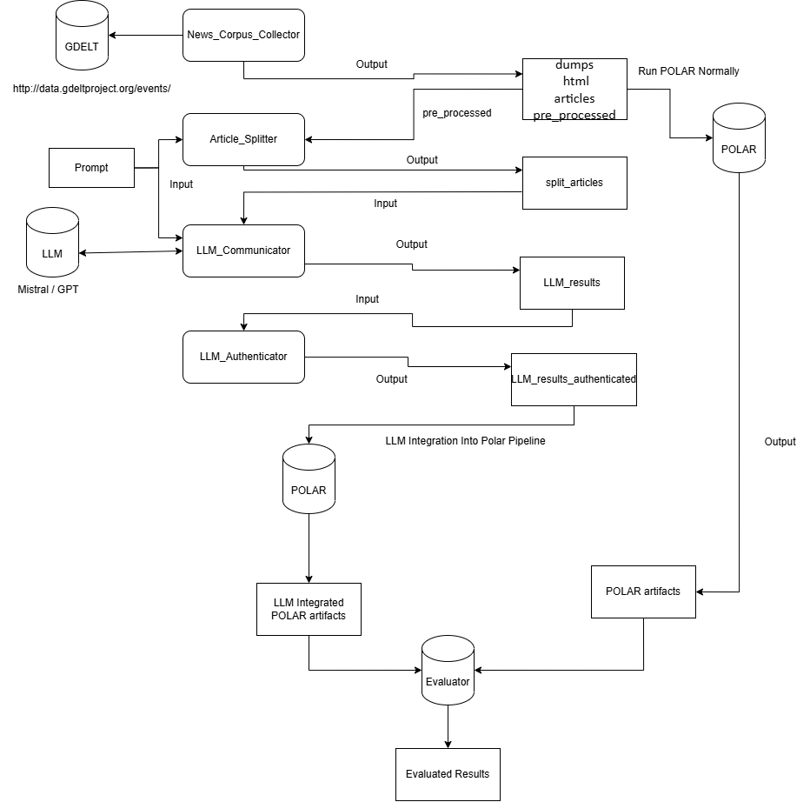
Implementation
Utilizing LLMs, Attempt to gather all the data computed by the NLP POLAR tasks and Calculate Sentiment.
Inject the information in the POLAR Pipeline.

Slide 14
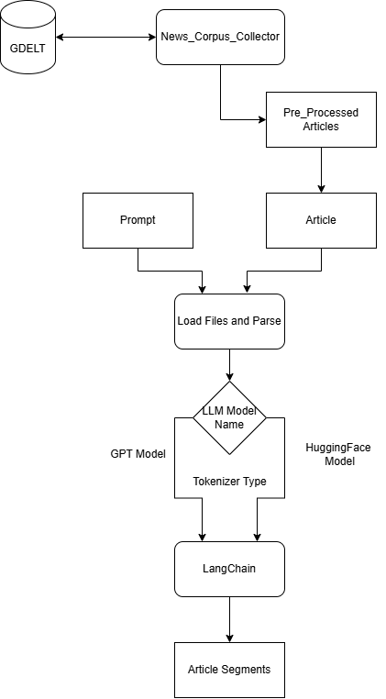
Article Gathering
Utilizes POLAR’s News Corpus Collector to gather Articles from the GDELT Database
Articles Split to fit Window size of LLMs
Uses LangChain to Semantically split Articles

Slide 15
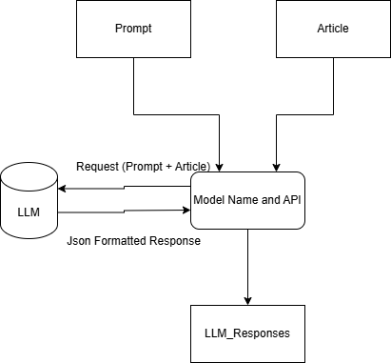
LLM Communicator
This component is responsible for Communicating with the Large Language Model (LLM).
Sequentially Request the API or execute locally depending on the LLM, combining Prompt and Article as the payload.
Save the LLM Responses as Json files per-article

Slide 16
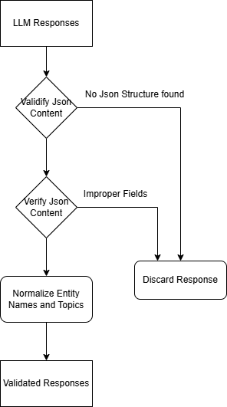
LLM Authenticator
Important step, validating LLM Responses:
Check for Malformed Structure
Remove Comments
Check Formatting
Normalize Names and Topics

Slide 17
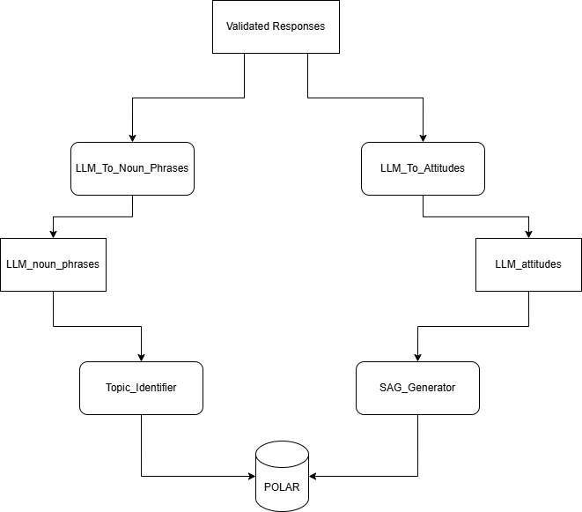
Injection into POLAR
The LLM Responses are Restructured to follow POLAR’s structure and replace the Sentiment Attitude Calculations of POLAR and continue the Pipeline like normal.

Slide 18
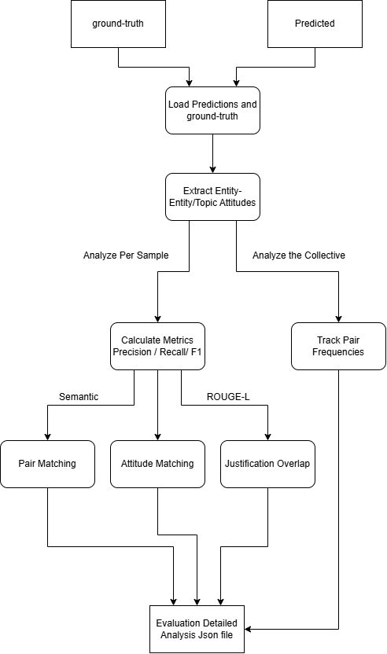
Evaluation
Evaluate the Models’ performance compared to each other.
Evaluation was done on a dataset of ~400 articles of varying polarizing topics.
An extensive analysis was done on a known polarizing topic of ~700 articles, Brexit(2016) [6], to test the polarization detection of the models.

Slide 19
Metrics Used
Pair Matching:
Precision: The Accuracy of predicted Pairs, how often a predicted pair is found in the Ground Truth
Recall: Model’s Coverage of the Ground Truth Pairs
F1: Mean average of Precision and Recall
Attitude Prediction:
Accuracy: Percentage of matched Attitudes (Negative/Neutral/Positive)
Justification Overlap:
Overlap: Utilizing ROUGE-L detect the similarity of the Justification texts

Slide 20
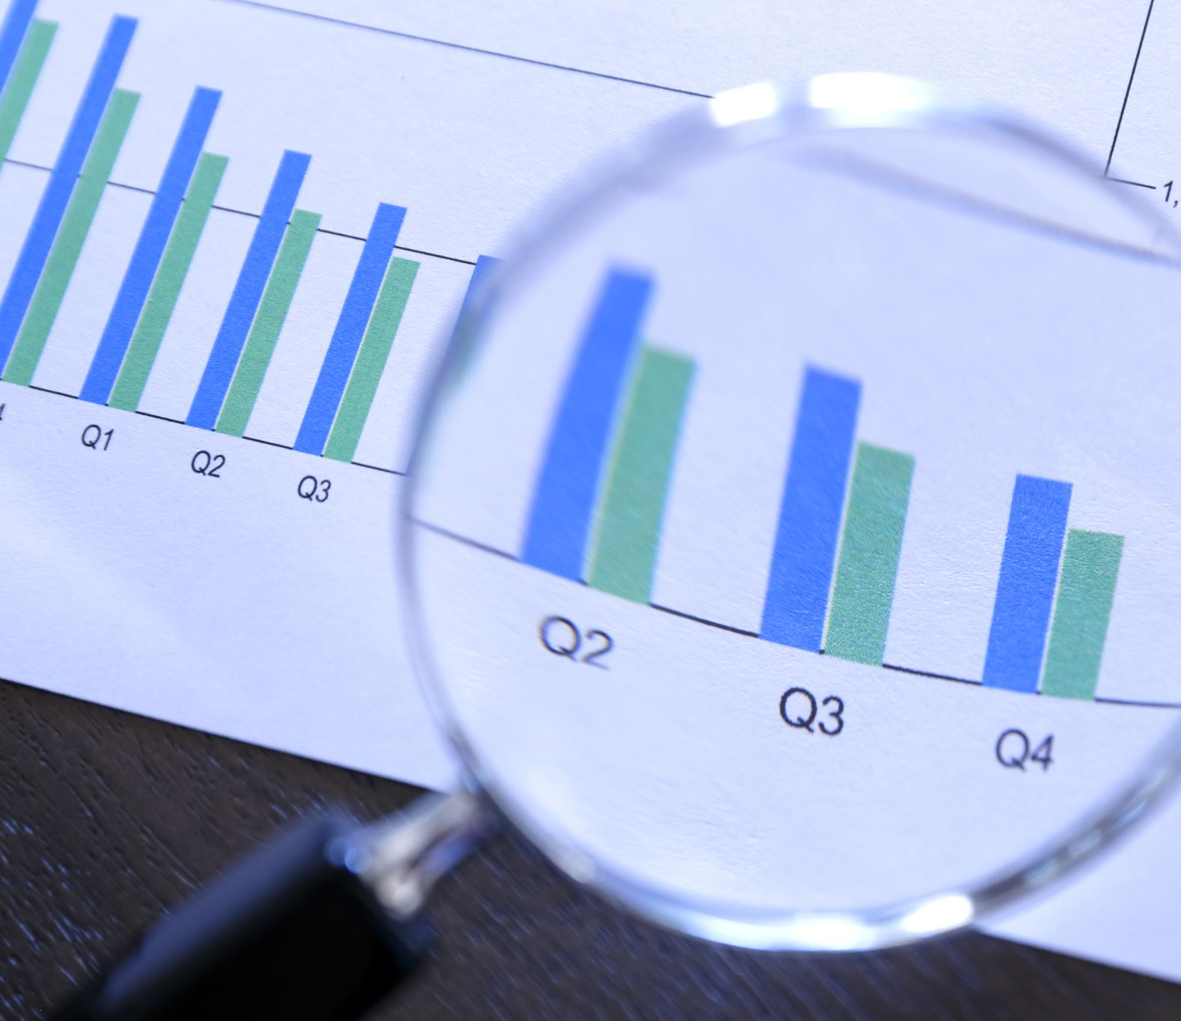
Results & Analysis
Mistral Fine-Tuning Evaluation
POLAR Compared to LLM Hybrid approach for Attitude assignment and SAG Comparisons

Slide 21
Mistral Attitudes Comparison
Metrics | Entity | Topical
Pair Matching
Precision | 0.8725 | 0.8658
Recall | 0.9418 | 0.9365
F1 | 0.9059 | 0.8998
True Positives | 664 | 826
False Positives | 97 | 128
False Negatives | 41 | 56
Attitude Prediction
Accuracy | 0.9771 | 0.9750
True Positives | 683 | 820
False Negatives | 16 | 21
Justification Overlap
Overlap | 0.8581 | 0.8785
Matched Justifications | 798 | 477
Total Justifications | 930 | 543
Incredibly similar to GPT’s outputs
High Recall with more Overall predictions than GPT
Extremely viable replacement

Slide 22
Mistral Usage Conclusion
Attribute | GPT-3.5 (API) | Mistral-7B (Fine-Tuned)
Hosting | Cloud (OpenAI) | Local
Internet Dependency | Required | None
Prompt Length | Long (1200+ characters) | Minimal
Latency per Request | ~15–35 seconds | ~1–2 minutes
Multithread-ability | Minimal | None
Cost per Use | Usage-based fees | Local
Fine-tune Time | N/A | ~3 hours
System Requirements | N/A | Nvidia GPU

Slide 23
POLAR / GPT Attitudes Comparison
Metrics | Entity | Topical
Pair Matching
Precision | 0.0787 | 0.0300
Recall | 0.0295 | 0.0528
F1 | 0.0429 | 0.0383
True Positives | 20 | 44
False Positives | 234 | 1422
False Negatives | 658 | 789
Attitude Prediction
Accuracy | 0.35 | 0.1591
True Positives | 7 | 7
False Negatives | 13 | 37
Justification Overlap
Overlap | 0.1379 | 0.0
Matched Justifications | 4 | 0
Total Justifications | 29 | 0
Comparing POLAR’s fields with LLMs per-article.
The Results show that the 2 Models are Very Dissimilar.

Slide 24
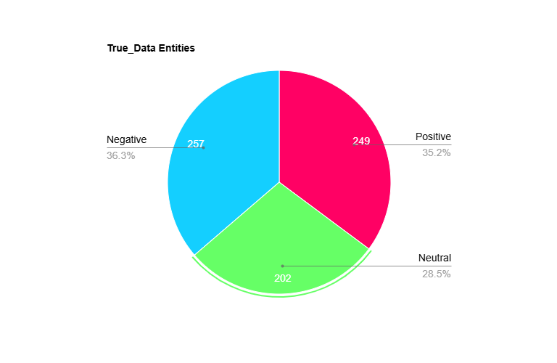
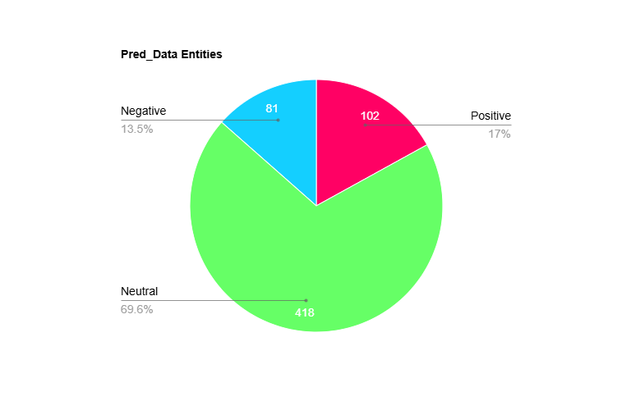
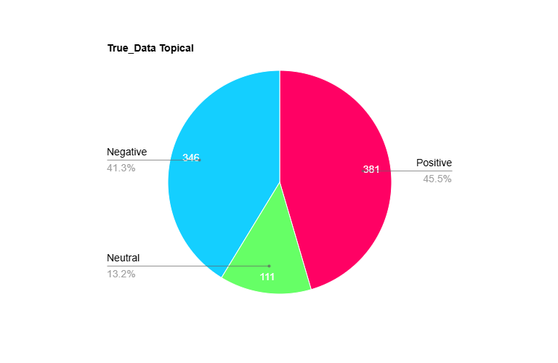
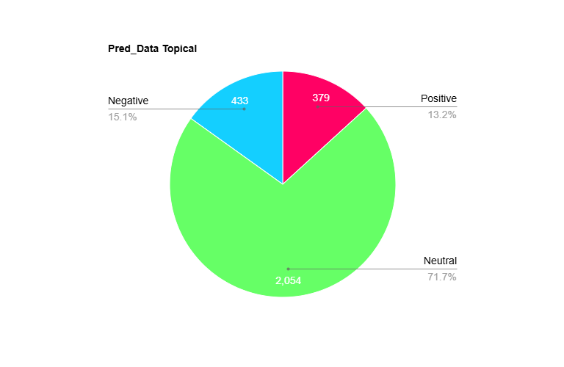
Overall Attitude Summary
GPT Predictions
POLAR Predictions

Slide 25
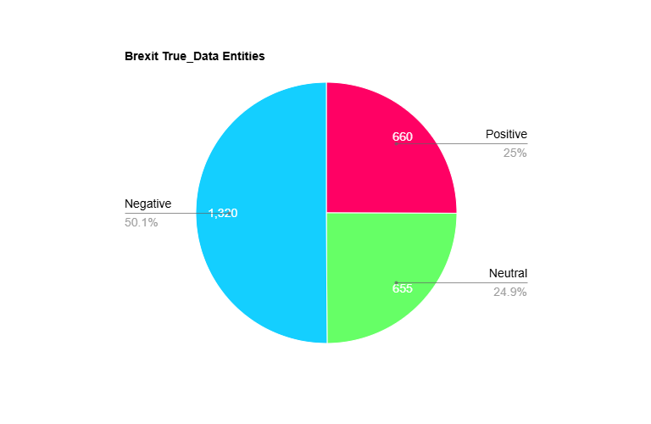
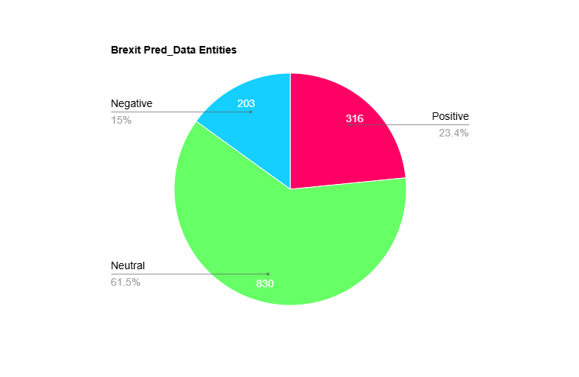
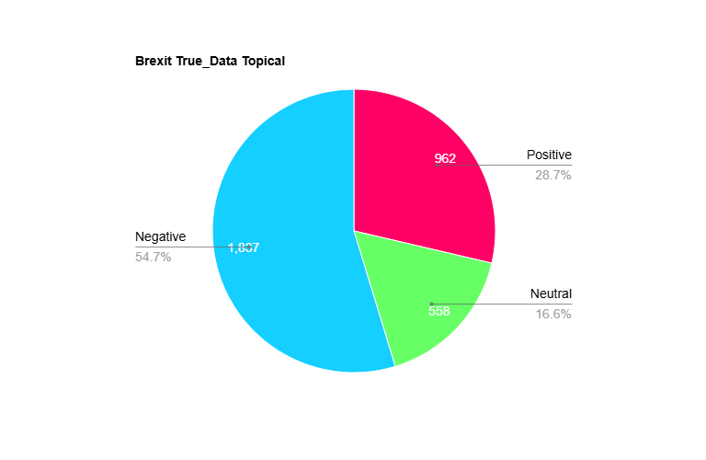
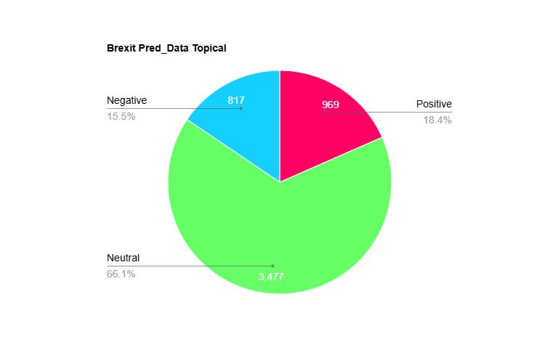
Attitude Summary: Brexit Dataset
GPT Predictions
POLAR Predictions

Slide 26
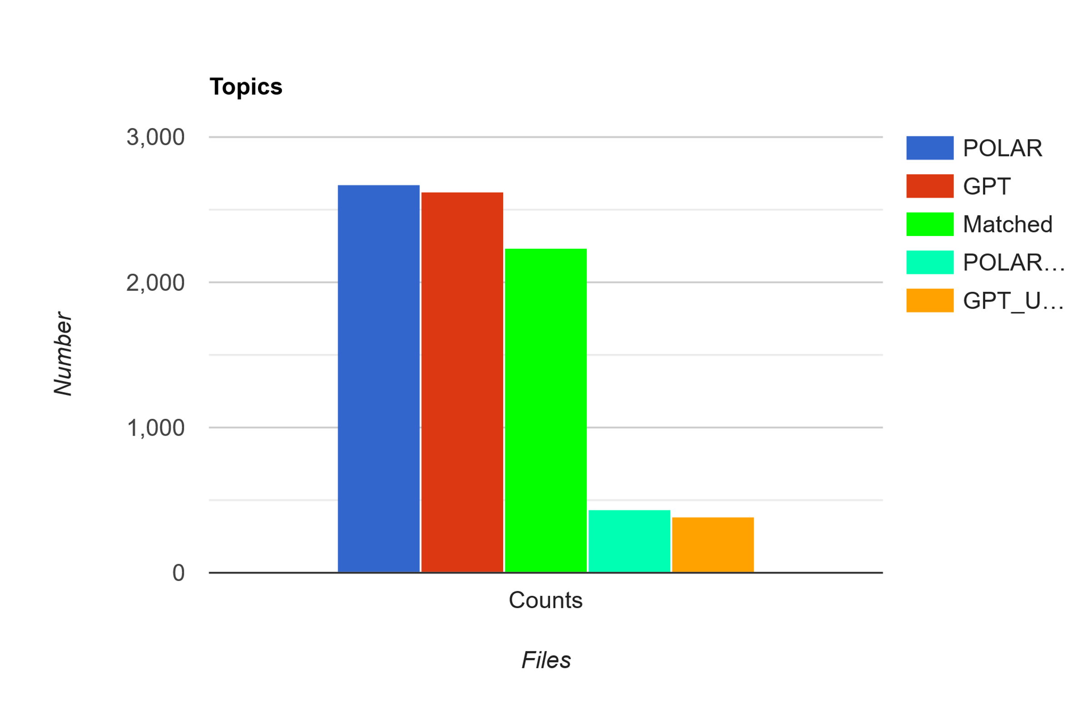
Topics Coverage: Brexit Dataset
Metrics | Values
Recall | 0.7294
True Positives | 2235
False Negatives | 829
POLAR Topics | 2671
GPT Topics | 2628
Unmatched POLAR | 436
Unmatched GPT | 393
The Models show relative similarity in topics.
Metrics align with POLAR calculations[1] (~73%)

Slide 27
Pair Frequencies: Brexit Dataset
Entity Pairs
Topical Pairs
Pairs | True_Attitudes (GPT) | Pred_Attitudes (POLAR)
('european union', 'united kingdom') | TRUE: 72 (Neg: 47, Neu: 18, Pos: 7) | PRED: 109 (Neg: 14, Neu: 80, Pos: 15)
('brexit', 'european union') | TRUE: 7 (Neg: 7, Neu: 0, Pos: 0) | PRED: 44 (Neg: 10, Neu: 24, Pos: 10)
('brexit', 'united kingdom') | TRUE: 5 (Neg: 1, Neu: 2, Pos: 2) | PRED: 43 (Neg: 9, Neu: 28, Pos: 6)
('united kingdom', 'united states') | TRUE: 29 (Neg: 5, Neu: 6, Pos: 18) | PRED: 6 (Neg: 0, Neu: 5, Pos: 1)
('barack obama', 'european union') | TRUE: 11 (Neg: 1, Neu: 4, Pos: 6) | PRED: 13 (Neg: 4, Neu: 6, Pos: 3)
Pairs | True_Attitudes (GPT) | Pred_Attitudes (POLAR)
('brexit', 'european union') | TRUE: 70 (Neg: 58, Neu: 10, Pos: 2) | PRED: 20 (Neg: 6, Neu: 14, Pos: 0)
('european union', 'united kingdom') | TRUE: 12 (Neg: 7, Neu: 5, Pos: 0) | PRED: 47 (Neg: 6, Neu: 34, Pos: 7)
('brexit', 'united kingdom') | TRUE: 34 (Neg: 22, Neu: 9, Pos: 3) | PRED: 21 (Neg: 2, Neu: 16, Pos: 3)
('barack obama', 'brexit') | TRUE: 24 (Neg: 14, Neu: 8, Pos: 2) | PRED: 1 (Neg: 0, Neu: 1, Pos: 0)
('brexit', 'united states') | TRUE: 15 (Neg: 8, Neu: 4, Pos: 3) | PRED: 9 (Neg: 1, Neu: 4, Pos: 4)
The Models show similarity in finding the same pairs from the Articles
Attitude Assignment is very dissimilar

Slide 28
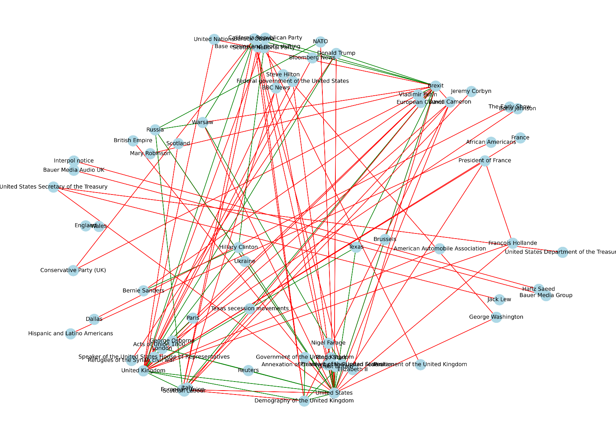
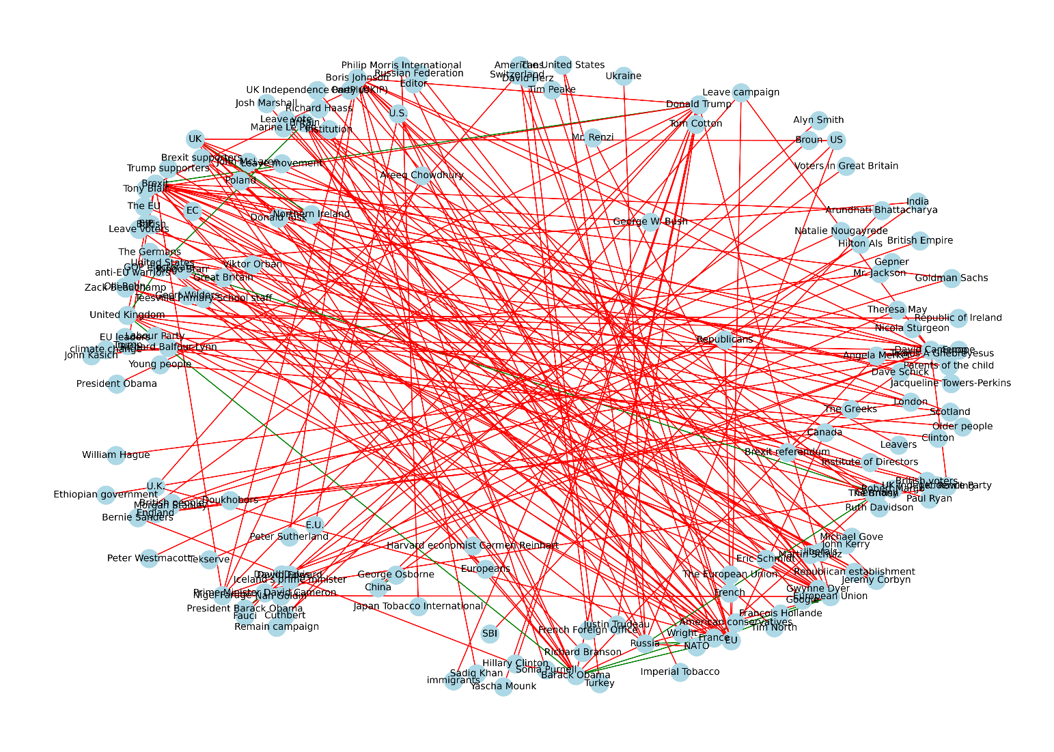
Signed Attitude Graphs (SAG)
Green: Positive Attitudes Red: Negative Attitudes
POLAR
GPT

Slide 29
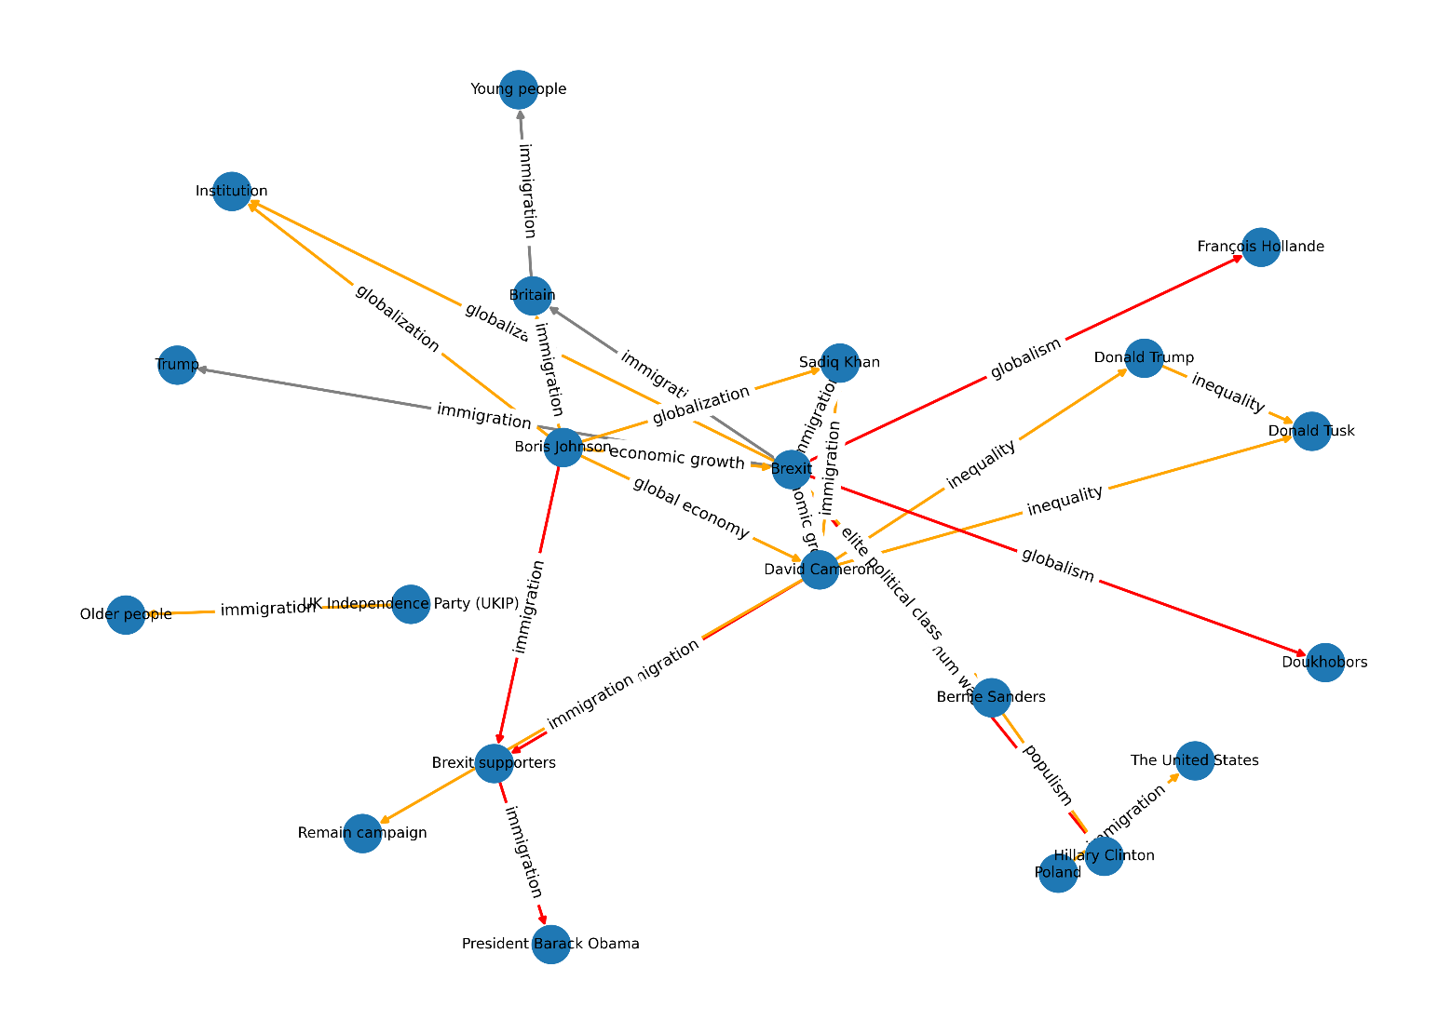
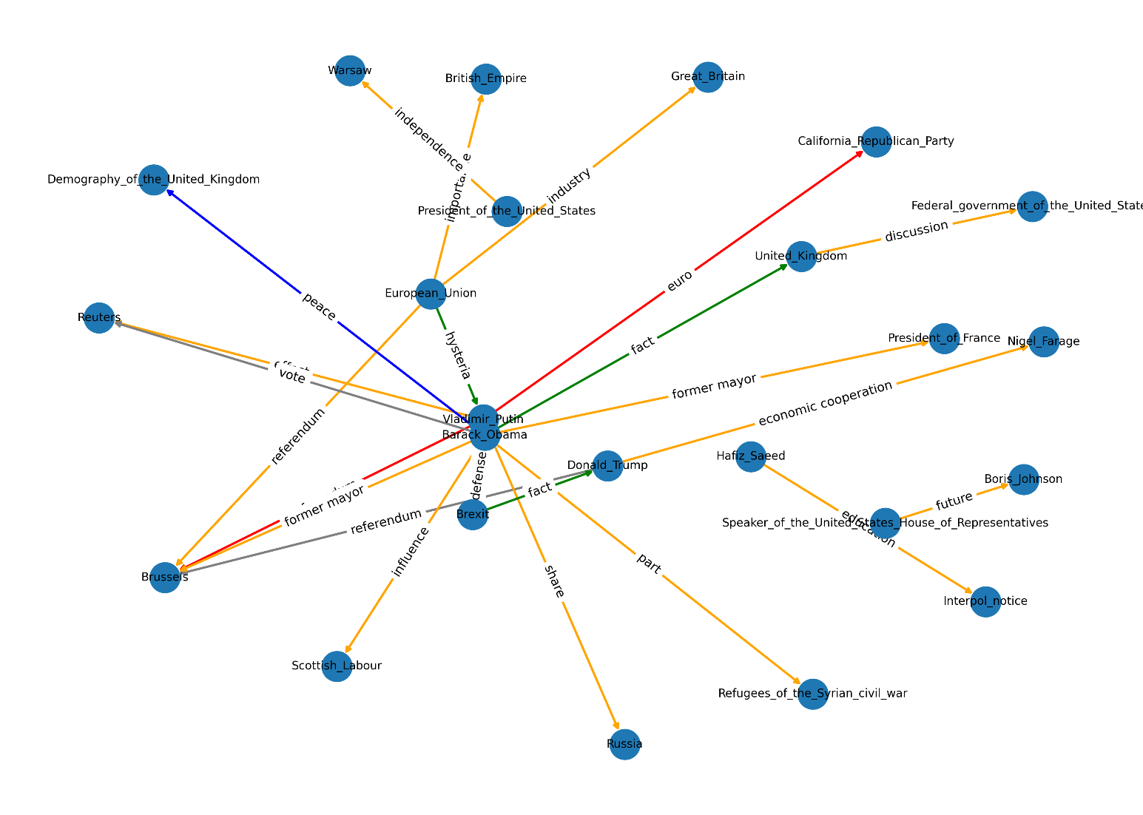
Polarization Dipole Graph
Blue: Neutral to slight Agreement on the Topic Gray: Mixed to Neutral on the Topic Green: Positive Agreement on the Topic Orange: Negative Agreement on the Topic Red: Polarization on the Topic
POLAR
GPT

Slide 30
Polarization Topics Analysis
Dipole Topics sent to LLMs to rate as Sociopolitical or not.
POLAR having vague dipole topics: (“Part”, “Share”, “Fact”, “Former Mayor”…)
GPT having less topics but more sociopolitical: (“immigration”, “globalization”, “inequality”, “global economy”…)
Model | GPT Percentage of Matches | POLAR Percentage of Matches
GPT-4.0 | 100% | 45.1%
Deepseek-V3 | 76.7% | 40.7%
Claude-3.7 Sonnet | 74.4% | 29.7%
Gemini-2.0 Flash | 76.7% | 44.0%
Le Chat - Mistral | 72.1% | 31.9%
Average Overall: | 80.0% | 38.3%

Slide 31
Conclusion
Successfully integrated and replicated NLP Sentiment tasks of POLAR using LLMs.
Current Implementation:
Outperformed POLAR in Semantic understanding and attitude depth
Demonstrated that LLMs offer improvements in polarization detection
Showed that Open-Weight models like Mistral can be utilized as alternatives to API based LLMs

Slide 32
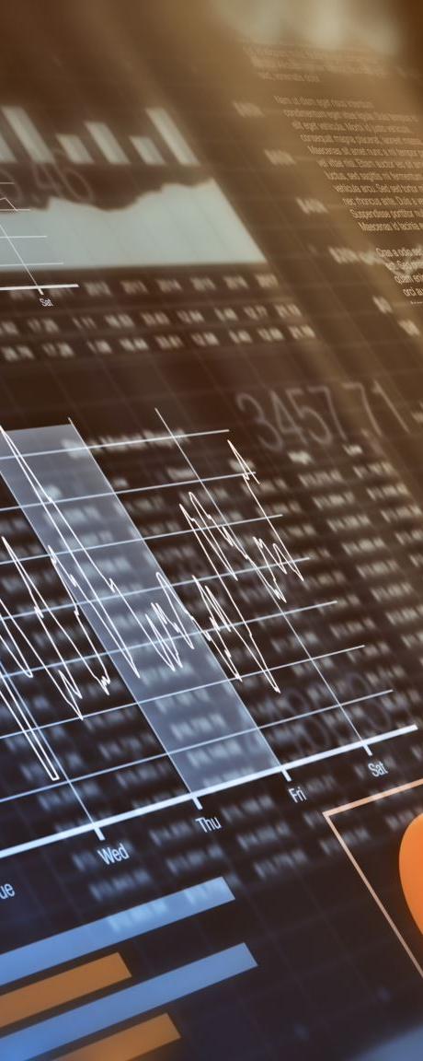
Future Work
Dataset Expansion, this thesis worked on ~800 articles per topic due to resource constraints.
Evaluate the model in different domains (healthcare, climate change).
Utilize a more dynamic Sentiment Scoring.
Additional Training and Evaluation of Fine-Tuning Mistral
Expand the datasets and logic for non-English corpora

Slide 33

Thank you for your Attention! Do you have any Questions?

Slide 34
References
[1] Paschalides, Demetris, George Pallis, and Marios D. Dikaiakos. "Polar: a holistic framework for the modelling of polarization and identification of polarizing topics in news media." Proceedings of the 2021 IEEE/ACM International Conference on Advances in Social Networks Analysis and Mining. 2021.
[2] Resta, Raffaele, and David Vanderbilt. "Theory of polarization: a modern approach." Physics of ferroelectrics: a modern perspective. Berlin, Heidelberg: Springer Berlin Heidelberg, 2007. 31-68.
[3] Fiorina, Morris P., Samuel J. Abrams, and Jeremy Pope. "Culture war? The myth of a polarized America." (2004).
[4] Vicario, Michela Del, et al. "Polarization and fake news: Early warning of potential misinformation targets." ACM Transactions on the Web (TWEB) 13.2 (2019): 1-22.

Slide 35
References
[6] Hobolt, Sara B., Thomas J. Leeper, and James Tilley. "Divided by the vote: Affective polarization in the wake of the Brexit referendum." British Journal of Political Science 51.4 (2021): 1476-1493.
[7] Rekker, Roderik. "Political polarization over factual beliefs." Knowledge resistance in high-choice information environments. Routledge, 2022. 222-236.
[8] Guo, Daya, et al. "Deepseek-r1: Incentivizing reasoning capability in llms via reinforcement learning." arXiv preprint arXiv:2501.12948 (2025).
[9] Mitsa, Oleksandr, et al. "A Comparative Study of Machine Learning Algorithms and the Prompting Approach Using GPT-3.5 Turbo for Text Categorization." International Conference on Computer Science, Engineering and Education Applications. Cham: Springer Nature Switzerland, 2024.

