Slide 1

Quantization
Amod Malviya
Notes:
Caveats:
Is designed to be an easy intro to the space. Not a substitute for reading the papers
First half is all basics & intuition – primary goal. 2nd half is stretch target
Not a comprehensive review of the space. I’ll miss names.
Any corrections to this talk can be found at the github link

Slide 2
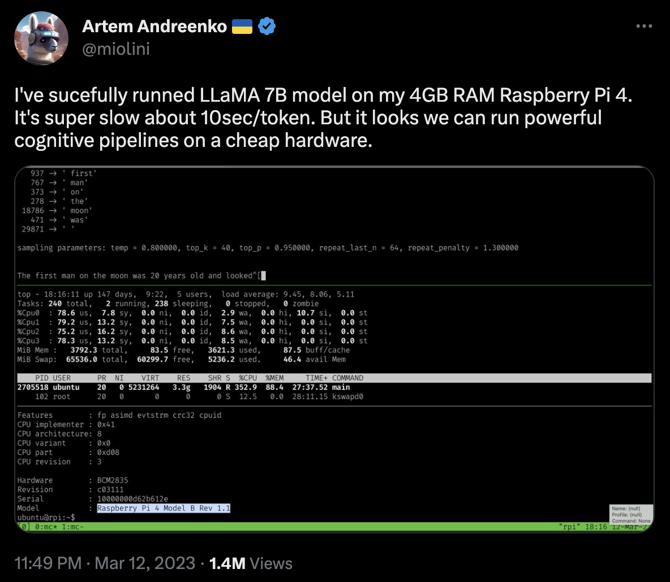

LLaMA 7B on a Raspberry Pi
Notes:
7B parameters = ~13GB @f16
More practically – larger/richer models on your laptop, TV, mobiles, watches etc.

Slide 3
What’s inside a model?

Slide 4

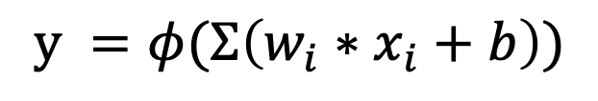
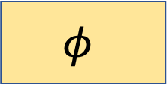
Essence of Neural Networks
b
1
$$y =φ(Σ\left(w_{i}∗x_{i}+b\right))$$
x1
w1
$$Σ$$
$$φ$$
x2
w2
Output
Activation Function
x3
w3
Weighted Sum

Slide 5
Essence of Neural Networks

Slide 6
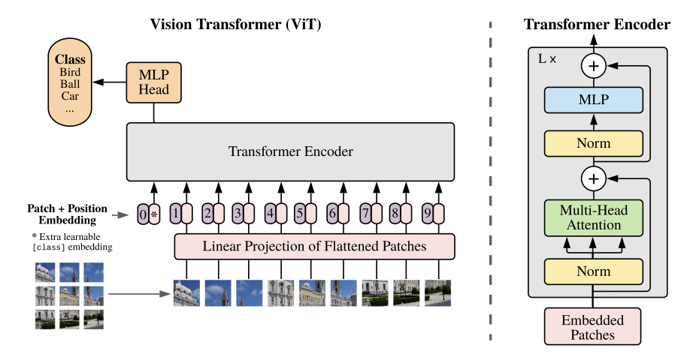


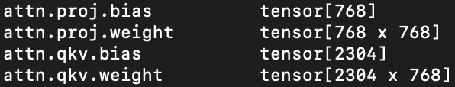



Vision Transformers
~18 BFLO
86M params
@f32: 320 MB
@f16: 160 MB
@i8: 80 MB
@i4: 40 MB
ViT Paper
Scaling Laws
Notes:
Who here has built a model?
Individual layers
86M params translating to 18-20B FLOs
Model sizes

Slide 7
Why reduce model size?
System DRAM
GPU HBM
150-400 GB/s
1-3 TB/s
Memory Controller
SM
SM
SM
SM
SM
SM
SM
SM
CPU
Core
CPU
Core
CPU
Core
CPU
Core
SM
SM
SM
SM
SM
SM
SM
SM
PCIE Bus
SM
SM
SM
SM
SM
SM
SM
SM
CPU
Core
CPU
Core
CPU
Core
CPU
Core
SM
SM
SM
SM
SM
SM
SM
SM
Notes:
Super-simplified view – ignores DMA, cache hierarchies, registers etc.
Can take up a talk of its own
All that parallelization needs to be feedable by memory throughput
Model needs to fit in memory
Quantization vs dimensionality reduction, or memory compression
Other ways – pruning, distillation, better arch, sparsity, etc

Slide 8

More than just memory reduction
Type of Compute | A100 (TFLOPs) | H100 SXM5 (TFLOPs)
FP16 | 78 | 120
FP16 Tensor Core | 312 | 1000
BF16 Tensor Core | 312 | 1000
TF32 Tensor Core | 156 | 500
FP64 Tensor Core | 19.5 | 60
INT8 Tensor Core | 624 TOPS | 2000
INT4 Tensor Core | 1248 TOPS | 4000
4x faster inference compute with INT8 as compared to FP16
and higher cache-hit!
Notes:
Lower bit-width directly translates to faster compute
Higher cache-hit ratio, so lesser stalls

Slide 9
Let’s Quantize!
Notes:
We’ll discuss quantization during inference for now

Slide 10





Basic sensitivity study by Truncation
Sign
Exponent (8-bits)
Fractional (23-bits)
FP32
$2^{−1}$ = 0.5
$2^{−2}$ = 0.25
$2^{−3}$ = 0.125
Sign
Fractional (10-bits)
Exp (5-bits)
FP16
IEEE 754 Playground
FP formats in NNs
Notes:
Fractional gives us precision, while exp gives us dynamic range
We’re already quantizing real numbers, but with high precision
In the demo, we simulate reduced precision
Demo time!

Slide 11
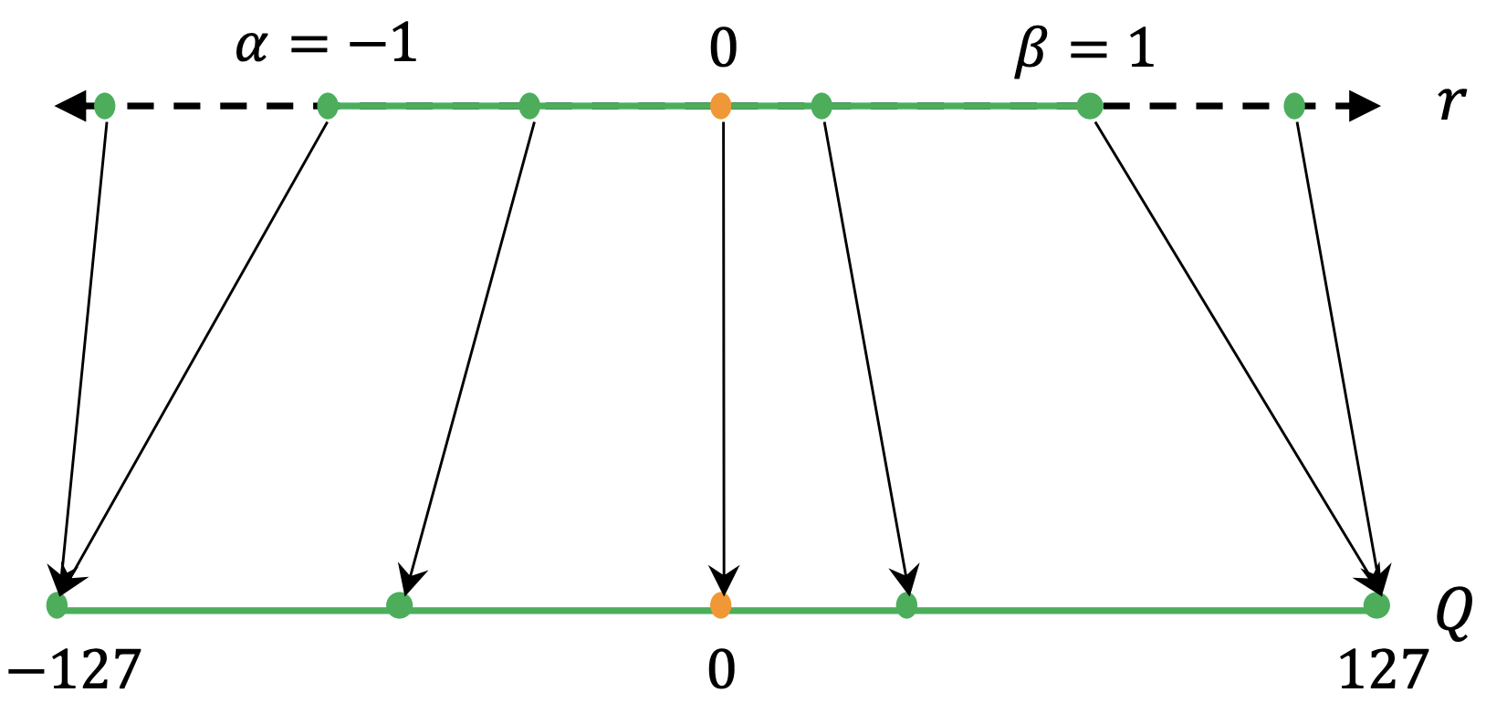



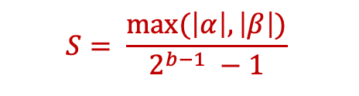
Uniform Quantization – INT8
$$S= \frac{max⁡(\left|α\right|, \left|β\right|)}{2^{b−1} −1}$$
Clipping Range
Resolution
$$Q\left(r\right)=Int\left(\frac{r}{S}\right)$$
$$\overline{r}=S(q)$$
2
Notes:
Let’s say we need to map range a-b to INT8
Let’s say we have a point 2, it’ll map to a resolution
Range of a-b is called clipping range – process is called calibration
Scaling is happening S. This is the absmax variant. Another one is zeropoint (ignored here)
Quantization and dequant operators get defined naturally
Two questions here: 1) How to deal with outliers? 2) What happens for skewed distributions?
INT4 is the same logic (show in llama.cpp)

Slide 12
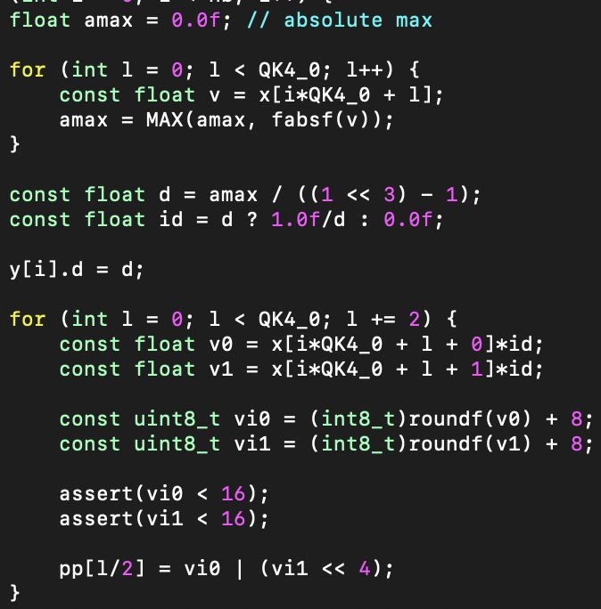

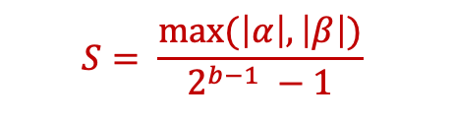
INT4 in llama.cpp (Q4_0)
$$S= \frac{max⁡(\left|α\right|, \left|β\right|)}{2^{b−1} −1}$$
$$Q\left(r\right)=Int\left(\frac{r}{S}\right)$$
Notes:
Q4_0 is the absmax variant
Q4_1 is the zeropoint variant

Slide 13



Distribution of weights matters
$$S= \frac{max⁡(\left|α\right|, \left|β\right|)}{2^{b−1} −1}$$
$$α$$
$$β$$
Notes:
We can imagine quantization as drawing a grid on a distribution like this

Slide 14




The Outlier Problem
2. Reduce granularity to per-tensor
than whole model ?
3. Reduce granularity even further to
per-row/col of the tensor ?
4. Use non-uniform quantization
$$α$$
$$β$$
1. Clip to create better $α$ and $β$ ?
Notes:
Distributions are not always favourable. Here, we lose diversity.
Clip? Percentile, KL divergence, sensitivity analysis (works on small models)
Non-uniform – optimization based (min error), log distribution, binary code based, k-means clustering with hessian weighted
BASICS COVERED!

Slide 15
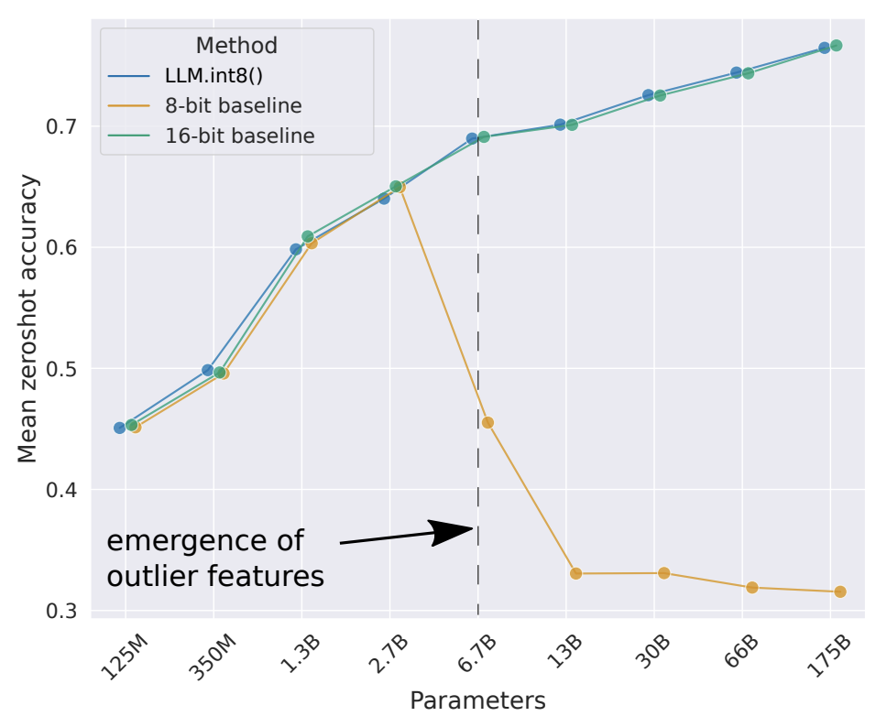

LLM.int8 – vector quantization limits
We quantize individual vectors
X
W
“Outlier features are probabilistic in smaller models, and systematic in larger”
Notes:
Dettmers – Nov 2022
We quantize individual vectors (granularity)
Works up to 2.7B, vector quantization works (inner product), beyond that outlier features come up in hidden dimensions
The outliers are important for accuracy ! Can’t clip!
Outlier features are probabilistic in smaller models, systematic in larger

Slide 16
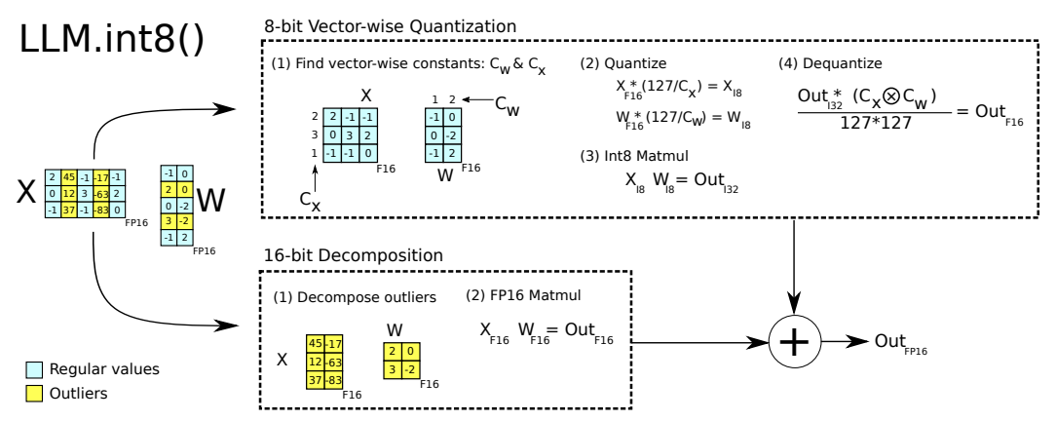
LLM.int8 – decompose outliers
Notes:
LLM.int8 decomposes the operations to mixed precision
SmoothQuant has an even better approach to this

Slide 17
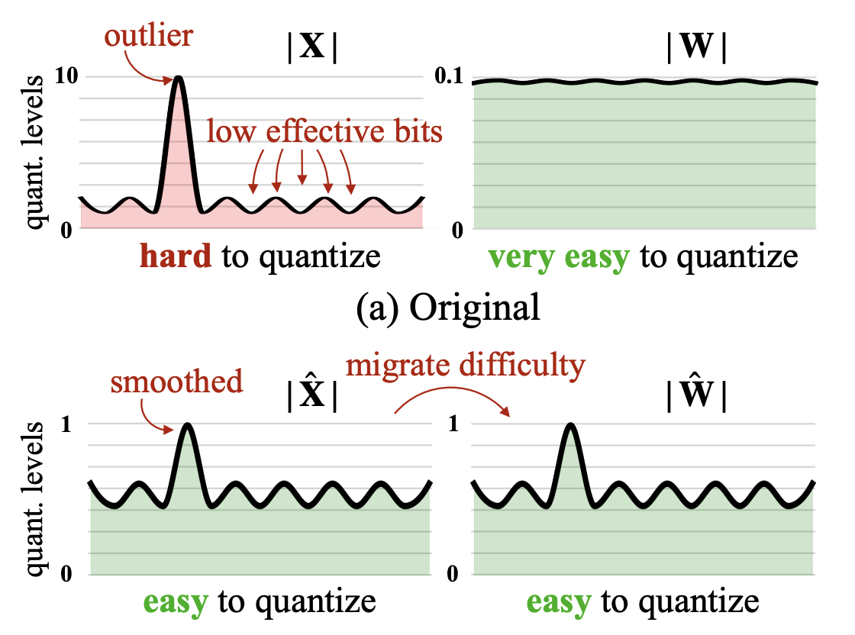


SmoothQuant – a different approach
X
W
$$Y=XY≅(X {diag\left(s\right)}^{−1})(diag\left(s\right)W)$$
Notes:
Moves spikiness out of activation into the weight in a smooth enough fashion
Offline convert (X,W) to (X^,W^) in such a way that smoothens out the outlier

Slide 18
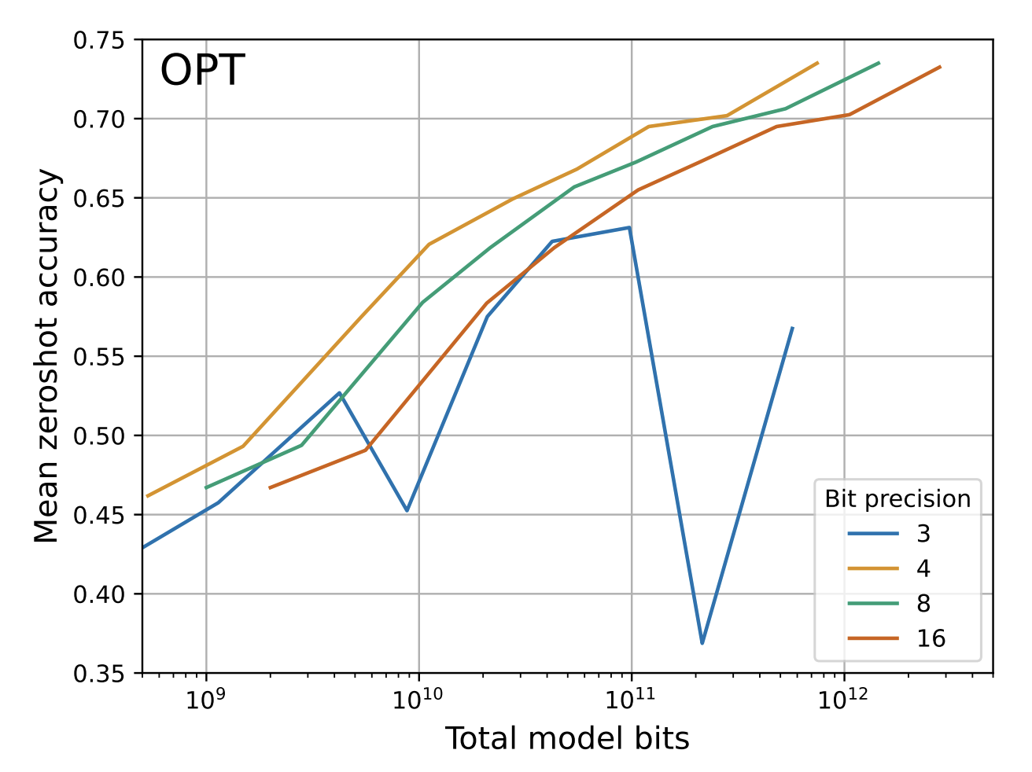

k-bit scaling laws
4-bit precision FTW !
Handle outliers via small block size
Outlier dependent quantization improves stability, but not scalability
Notes:
Small block size: going from block of size 1024 to 64 adds 0.25 bits per parameter, but accuracy is almost going from 4 -> 5 bits

Slide 19
Quantization Phases

Slide 20

PTQ: Post Training Quantization
GPTQ
AdaQuant
AdaRound
BitSplit
ZeroQuant
SmoothQuant
Pretrained
Model
Calibration
Data
Quantized
Model
Calibrate
Notes:
We’ve already seen a few PTQs earlier, some of which are zero-shot
When PTQs need additional calibrating data, they’re 1/n-shot
Majority of the names below are optimization solvers
AdaRound – computes a data dependent rounding by annealing a penalty term that encourages shift towards quantized levels
AdaQuant – performs direct optimization minimizing error between quantized layer vs full precision layer
ZeroQuant – layer-by-layer knowledge distillation (LKD) + group-wise weights + dynamic-per-token activation quant
SmoothQuant we’ve already covered

Slide 21
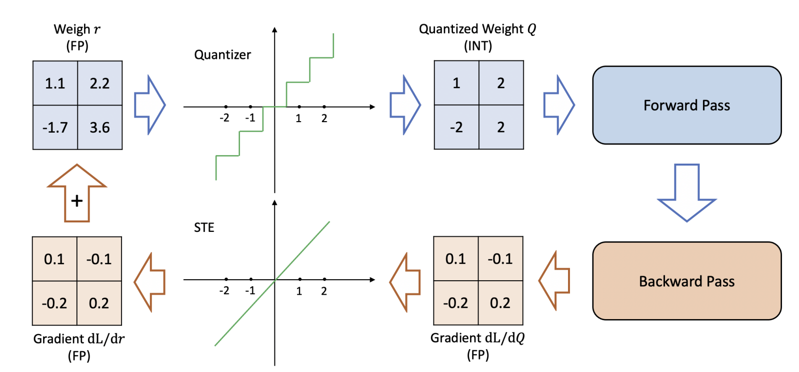
QAT: Quantization Aware Training
Notes:
Forward quantization happens after weight update is done
Backward loss propagation is done in FP
Straight Through Estimator is needed to ensure differentiability

Slide 22
Questions?
Notes:
References to papers in the link above
Please send corrections/enhancements to the github repo

Slide 23
Addendum
Notes:
If required

Slide 24


DNNs are significantly over-parametrized

