Slide 1

Revisiting Abstractions For Fun & Profit
Amod Malviya
Notes:
Abstractions are great but people can get stuck
Understanding helps us unblock

Slide 2
History
Emergent Trends
Preparing Ourselves
Notes:
3 parts to this talk
Definition & history
Review recent changes as a way to understand how abstractions change
What we can do

Slide 3
What’s an “Abstraction”
Exposes “higher” primitives
“An abstraction is a simplified way of thinking about something complex
by hiding unnecessary details so we can focus on solving bigger problems.”
Hides “lower” primitives
Makes choices & tradeoffs
⇒ cost
Notes:
Cost – not necessarily bad, but should always be a conscious choice
Different from systems thinking

Slide 4





Abstractions can unlock massive potential
Massive tech
accessibility
Javascript
2000
2010
2020
https://amodm.com/blog/2024/04/14/the-cost-of-abstraction
Notes:
One of the consequences was that people were getting introduced to “distributed systems” without first knowing how to make really good use of a single system

Slide 5
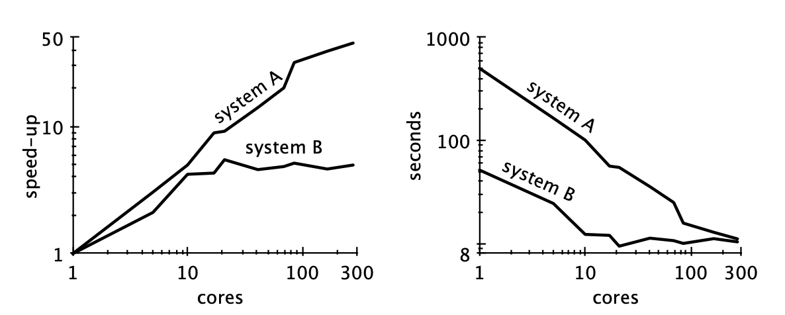

Scalability! But at what COST?
A always performs
worse than B
System A
unoptimised
A “scales” better despite
(or because of) its poor
performance
System B
optimised
“You can have a second computer once
you’ve shown you know how to use the first one”
- Paul Barham
https://www.frankmcsherry.org/assets/COST.pdf
Notes:
COST: Configuration that Outperforms a Single Thread
Pic: System A is unoptimized, while B is optimized. Unoptimized “scales” far better, despite (or rather, because of) its poor performance

Slide 6
Abstractions have a half life
Thread as a parallelism concurrency primitive
Replaced with userspace cooperative concurrency primitives
5ms
5us
5ms
99.9% useful work
5us
5us
Only 50% useful work
5us
5us
5us
A change in circumstances leads to a change in abstraction

Slide 7
Hardware Abstractions History
Relative cost of memory access is a LOT higher today !
Notes:
CPU: 2003 (x64), 2004 (dual core), 2007 (iPhone), 2009 (integ. northbr), 2011 (integ GPU), 2020 (M1)
IO: 2004 (PCIe 1.0), 2008 (SSD), 2012 (NVMe), 2022 (PCIe 5.0)
Memory: 2015 (HBM), PCIe 5.0 CXL
Data here: https://docs.google.com/spreadsheets/d/1LJoXVYLtMSSz18LLeqvMgc_egKCJgUcYv-cF-kJ3bUQ/edit?usp=sharing

Slide 8
History
Emergent Trends
Preparing Ourselves
Notes:
Indicative, not exhaustive

Slide 9
Pervasive use of VMs
eBPF
WASM
Notes:
Reason: Memory access cost. Pluggability, performant low-overhead platform neutrality
Two examples that have very different design goals
eBPF –Katran, Cilium. More than just network now, hot pluggable kernel logic.
WASM – more than just web, cross-platform container images. Also see Zig’s interesting use of WASM for compiler build.

Slide 10
A shift of concurrency primitives
promise / future
coroutines
async / await
event loops
Cost of a context switch has actually been going up!
Notes:
Reason: massively concurrent tasks, lower cost of switching, encouraged by primitives like io_uring on I/O side
Threads just won’t scale to millions
Cost of a context switch has actually been going up!
More criminal to not let your thread run through to the completion of its time slice today, than 20y back

Slide 11
A new class of Systems Programming Languages
Rust
Zig
ownership model
explicit allocators
Notes:
Reason: Need for more control over hardware efficiency, Better understanding of footguns.
Better in the sense that instead of hiding complexity, they give you better primitives to deal with them
Rust: zero-cost abstractions via the ownership model
Swift is somewhere in there too

Slide 12


Tigerbeetle: breaking all abstractions !
No dynamic allocation
1000x faster!
Optimising the system as a whole
Debit/Credit primitives
https://www.infoq.com/presentations/redesign-oltp/
Notes:
Reason: DBs designed in mid 90s, early 2000s can last only so long at current scales.
Primitives:
Debit/credit primitives, so ledger API
Separate control plane (metadata) from data plane (txn entries): allows 1000x higher scale
Rethinking abstractions across network, storage and consensus
Fixed sizing -> No dynamic allocations at all
1 query = 8k txns = 4 syscalls + 4 memcpy + 3 network req
Protocol aware recovery wouldn’t be possible if they weren’t going across abstractions

Slide 13
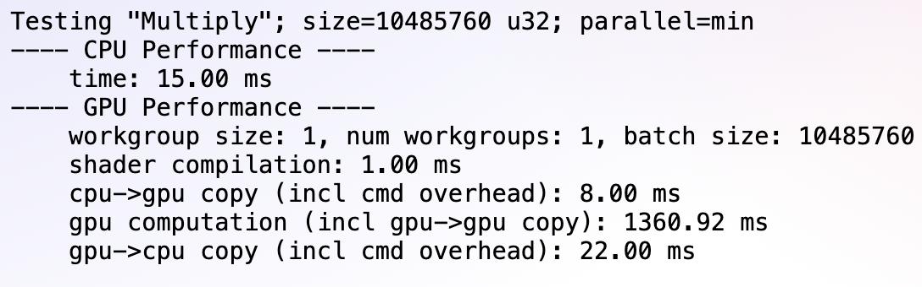
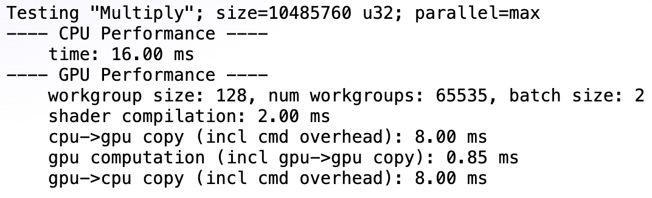

Massive Parallelism w/ xPUs
Throughput used
to hide latency
https://github.com/amodm/talks/blob/main/lecture-series-hwsw/lecture-2-inside-the-gpu/cpu-vs-gpu.html
Notes:
Reason: iGPU/NPU adoption mainstream, along with standardized APIs
Single cores now limited by physics (node size)
Throughput has historically been used to hide latency
Software workflows for these have very different patterns

Slide 14
AI – the dark horse
Notes:
Javascript era for things like classifiers, NLP & other fuzzy logic.
More accessibility increase
Cost might be high today, but TCO could look quite appealing

Slide 15
History
Emergent Trends
Preparing Ourselves

Slide 16
"Education is what, when, and why to do things, Training is how to do it. Either one without the other is not of much use.” - Hamming
Preparing Ourselves
Notes:
Foundations are the key
Not all at once – small steps are fine
We can arrive at foundations no matter where start
Homogeneity in foundations, only tradeoffs differ

Slide 17
Summary
Abstractions are useful but can create walls
They have half lives, so can’t build forever castles on top of them
Understanding their decisions & internals informs us about their half lives
Foundations help increase longevity. “Tech changes fast, but foundations remain the same.”

Slide 18
Thank You
https://github.com/amodm/talks/discussions/3
Notes:
Which abstraction would you revisit?

