Slide 1

Inside the GPU
Amod Malviya

Slide 2
Mindset & Principles
Reasoning >> facts
Thinking is mandatory!
We cannot reason without asking questions. So question!
I will lie!
I will lie only about “facts”, not about “method of reasoning”.
You cannot counter with a looked-up fact. Only reasoning.

Slide 3
Review
Amdahl’s Law
Everything has a latency
Throughput hides latency (when correctly used)

Slide 4


A simplified model
of GPU
CPU
Memory
Nature of CPU – GPU talk?
async !
x16 lanes
Core
Core
Core
Core
What kinds of talk?
100+ns
PCI Express
Initialization
Memory alloc/dealloc
Data Transfer
Execute Code
Core
Core
Core
Core
Core
Core
Core
Core
Core
Core
Core
Core
GPU
PCIe 4.0: 16Gbps/lane
Notes:
Device vs Host timeline
Demo: CPU vs GPU – which is faster? Multiply with min parallelisation

Slide 5
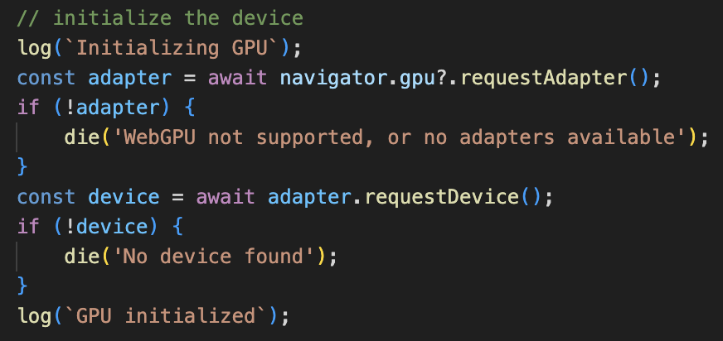
Initialization
The main reference through which we interact with the GPU
File: vec-multiply.html

Slide 6
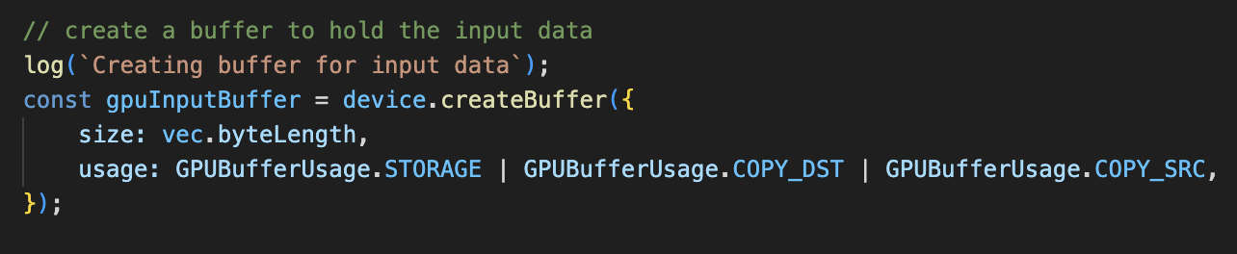
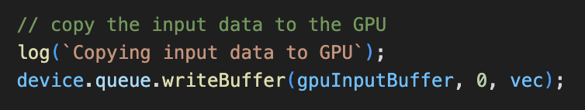
GPU Memory Allocation & Data Copy
Allocate memory on GPU
Size of memory
Purpose
CPU → GPU data copy
File: vec-multiply.html
Notes:
Other kinds of buffers – UBO, Vertex etc.

Slide 7
Splitting code on GPU?
start_index
Execute in parallel?
Yes!
Infinitely?
Kernel / Shader
Unit of work
width

Slide 8
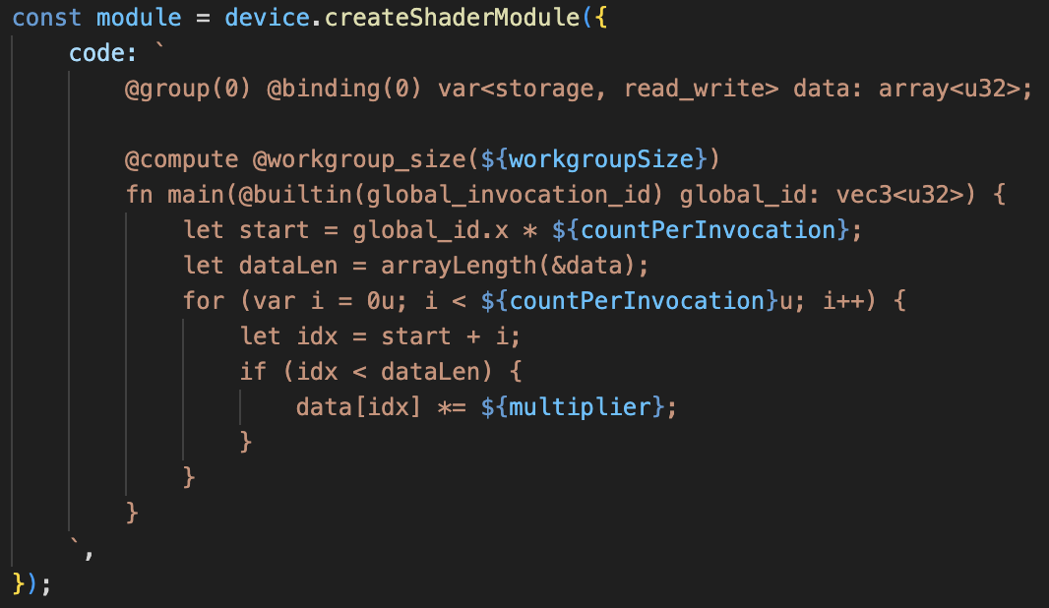
GPU code – shaders / kernels
WGSL
input array
somehow we get the
start_index
width
Notes:
WGSL: Rust-y syntax
Q: How does it get compiled to GPU’s machine code?

Slide 9
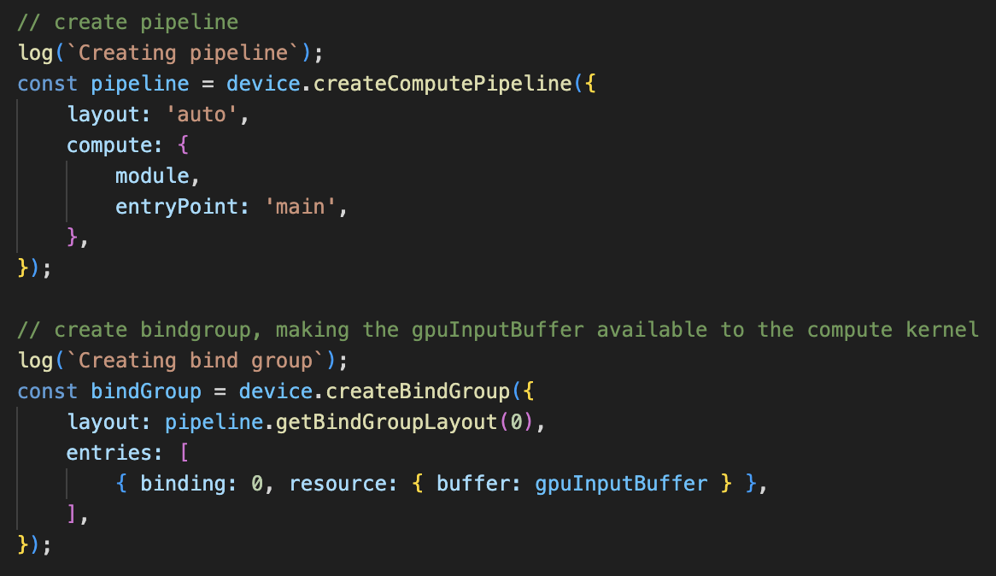
GPU code – kernels need context

Slide 10
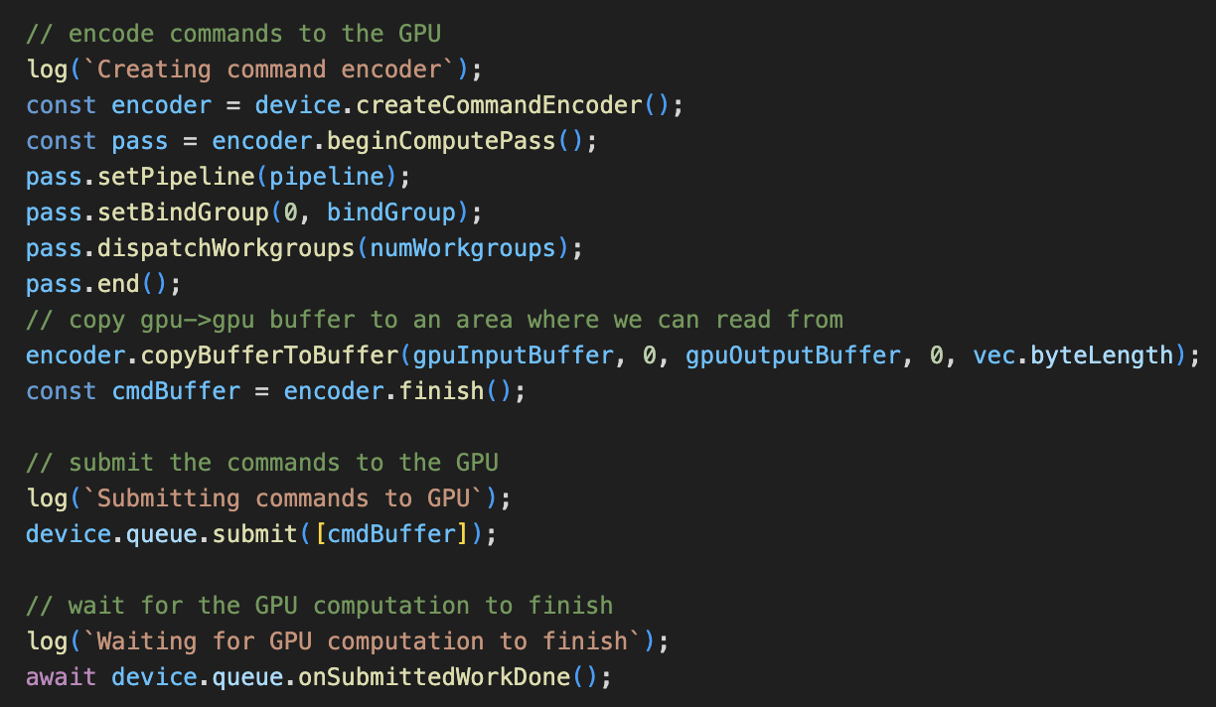
GPU code – get cranking!
Data context for
kernel
Execute kernel
‘n’ number of times
GPU → GPU
data transfer

Slide 11
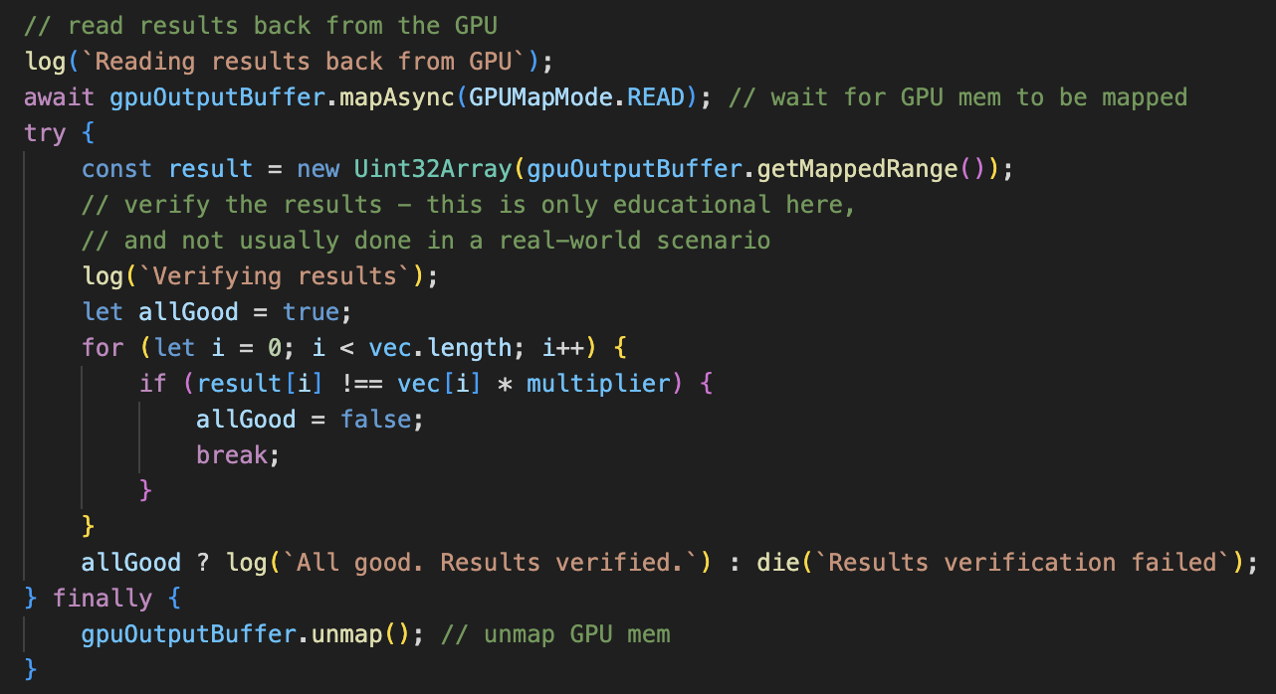
Data Transfer: GPU → CPU
File: vec-multiply.html
Notes:
Q: Why does CPU -> GPU copy have a dedicated method, while GPU -> CPU does not?
Assignment: Why GPU memory needs to be mapped before copy to CPU?

Slide 12
WebGPU basic demo

Slide 13
Break

Slide 14
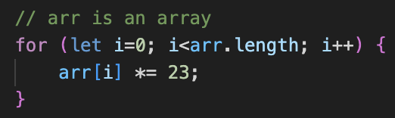
Multiplying an array
CPU core
%eip
%ebx
%edx
%eax
…
23
…
SISD
imul %ebx, %edx, %eax
x
=
…
ALU (INT EU)
…
Machine Code
The true “compute” provider
Notes:
Demo: doubling array size doubles CPU time, but not GPU time (Amdahl’s Law in case of GPU)

Slide 15
SIMD
64x 8-bit numbers
32x 16-bit numbers
16x 32-bit numbers
ZMM0 – 512-bit register
x
_mm512_mul_epu32 ( __mm512i array1, __mm512i array2)
ZMM1 – 512-bit register
filled with ”23”
=
16x 32-bit multiplications!
Still on CPU
Requires more EUs
ZMM2 – 512-bit register
ALU (INT EU)
Notes:
History on x86: MMX -> SSE (1/2/3/4) -> AVX (1/2/512)
Limitations – less flexible, control flow missing, exposes width

Slide 16

CPU vs GPU
Is it really so simple? What are the tradeoffs?
Control
Control
Control
Control
Control
Control
ALU
ALU
ALU
ALU
ALU
ALU
ALU
ALU
ALU
ALU
ALU
ALU
ALU
ALU
ALU
ALU
ALU
ALU
ALU
ALU
ALU
ALU
ALU
ALU
ALU
ALU
ALU
ALU
ALU
ALU
ALU
ALU
ALU
ALU
ALU
ALU
ALU
ALU
ALU
ALU
ALU
ALU
ALU
ALU
ALU
ALU
ALU
ALU
ALU
ALU
ALU
ALU
ALU
ALU
ALU
ALU
ALU
ALU
ALU
ALU
ALU
ALU
ALU
ALU
ALU
ALU
ALU
ALU
ALU
ALU
ALU
ALU
ALU
ALU
ALU
ALU
ALU
ALU
ALU
ALU
ALU
ALU
ALU
ALU
PCIe
PCIe
CPU core
CPU core
GPU Global Memory
Memory
Notes:
Latency vs throughput oriented design
Q: How good are CPUs in latency?
Demo: min parallelization
Q: Cost of high memory bandwidth in GPUs? Higher latency.

Slide 17
GPU Core
GPU Global Memory
Control
Control
Register Files
Register Files
INT32
FP32
Tensor Core
INT32
FP32
Tensor Core
INT32
FP32
Tensor Core
INT32
FP32
Tensor Core
INT32
FP32
Tensor Core
INT32
FP32
Tensor Core
L2 Cache
INT32
FP32
Tensor Core
L1 Cache
INT32
FP32
Tensor Core
L1 Cache
INT32
FP32
Tensor Core
INT32
FP32
Tensor Core
INT32
FP32
Tensor Core
INT32
FP32
Tensor Core
INT32
FP32
Tensor Core
INT32
FP32
Tensor Core
INT32
FP32
Tensor Core
INT32
FP32
Tensor Core
RT Core
RT Core
FFU
RT Core
RT Core
FFU
RT Core
RT Core
SFU
RT Core
RT Core
SFU
Notes:
Cores: INT, FP, RT cores, Tensor cores
Need deep queues of kernels to keep this many cores fed.
Need high bandwidth of memory to feed this many ALUs
Assignment: What would happen if we don’t keep pipelines fed with a lot of threads?

Slide 18
SIMT
Registers →
Divergent Control Flow
Thread 1
Thread 2
Thread 3
Thread 4
Thread 5
→
…
An executing thread group will block on
longest thread (e.g. for loop)
→
…
→
if (…)
→
…
if/else are executed serially
(in the same executing thread group)
→
…
→
else
→
…
→
// end if
→
…
Notes:
Demo: Heavy workload demo
Once started, cannot stop
Assignment: Reflect on how SIMD is different from SIMT. Both seem to be doing the same job, isn’t it?

Slide 19
Grouping kernel invocations
Advantages?
Instance 1
Instance 2
Instance N
Control
Register Files
INT32
FP32
Tensor Core
Deployed on
1 workgroup of
N instances
INT32
FP32
Tensor Core
INT32
FP32
Tensor Core
Deployed on another SIMT
INT32
FP32
Tensor Core
workgroup 2
L1 Cache
INT32
FP32
Tensor Core
Instance 1
Instance 2
Instance N
INT32
FP32
Tensor Core
INT32
FP32
Tensor Core
INT32
FP32
Tensor Core
RT Core
RT Core
FFU
RT Core
RT Core
SFU
workgroup M
Instance 1
Instance 2
Instance N
Notes:
Spatial locality advantage for instances in the same workgroup
Cooperation advantage
Q: index of instance ‘x’ in workgroup ‘y’ ?
Assignment: Implement a kernel logic that uses bad spatial locality within the same workgroup

Slide 20
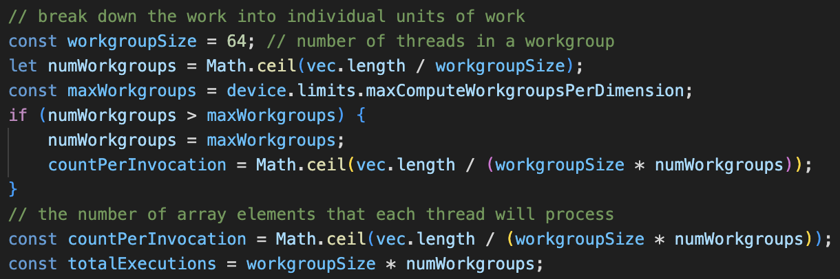
Grouping kernel invocations - code
What if the SIMT unit doesn’t have sufficient capacity?
Notes:
Q: Why do we set 64, even though there isn’t enough capacity in a single SIMT core?

Slide 21
Revisit - GPU code – shaders / kernels
WGSL
input array
we calculate start_index
from our global thread id
somehow we get the
start_index
width
Notes:
Assignment: What does the `if` guard do?

Slide 22
Revisit - GPU code
Data context for
kernel
Execute kernel
‘n’ number of times
GPU → GPU
data transfer

Slide 23
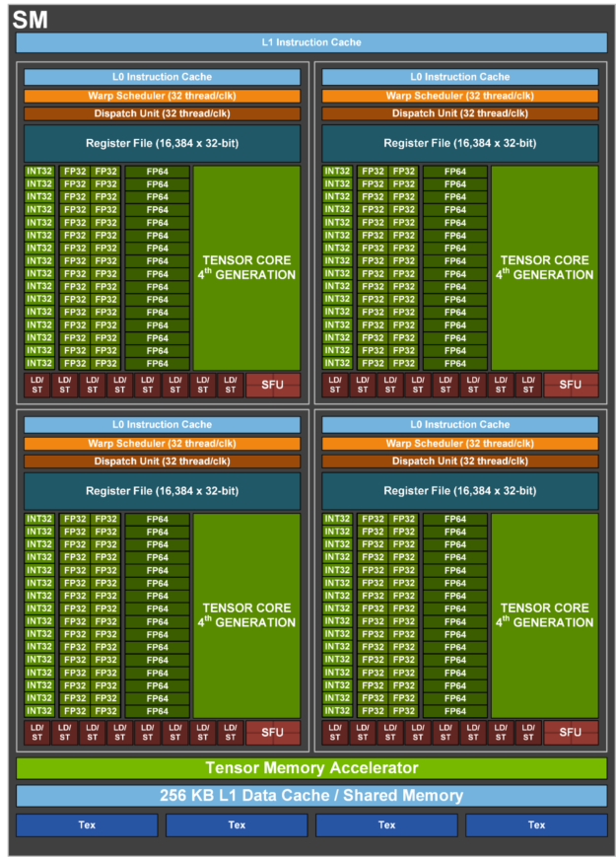
NVIDIA H100 SM

Slide 24
GPUs for AI
A
B
C
x
+
Notes:
Assignment: basic matrix multiplication in WebGPU
Q: Steps that are not parallelizable?

Slide 25
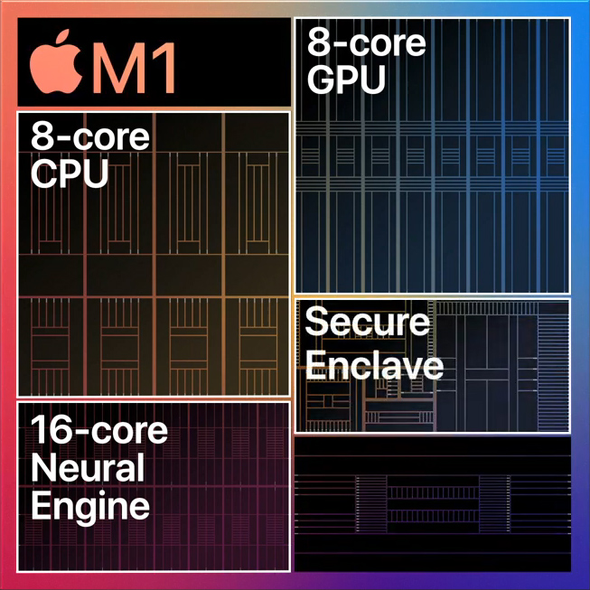
Apple – GPU vs Neural Engine
Shader cores, RT cores
Metal / MPS
Usual CPU
Std languages/runtime
Tensor core type stuff
INT8, INT16, FP16
CoreML
Source: https://apple.fandom.com/wiki/Neural_Engine
Notes:
Why – more efficient (specialized) than GPU, and leaves GPU free for graphcis
No public info – assumed to have INT8, INT16 and FP16 support
Most NPUs are designed for inference, not training.

Slide 26
WebGPU Shader Flow
Browser
WGSL
Compiler
Microsoft
HLSL
Direct3D
Apple
MSL
Metal
Others
SPIR-V
Vulkan

Slide 27
Summary
SISD → SIMD → SIMT
WebGPU – basic workflow
Shader/Kernel – the basic unit of code
Thread organization hierarchy - workgroups
GPU core vs CPU core
Why GPUs work well for AI
“Neural Engines” trend, and focus on inference

Slide 28
Thank you
Notes:
Congratulations: now you know more about GPUs than 99% of BLR’s software engineers!
Assignment: (Puzzle) Idx-Add-Mul vs Num-Add-Mul – CPU vs GPU. Explain.

