Slide 1

Revisiting Abstractions For Fun & Profit
Amod Malviya
Notes:
Abstractions are great but can be a wall
3 parts to this talk
Definition & history
What leads to changes (with recent examples)
How to prepare ourselves

Slide 2
Definition & History

Slide 3
What’s an “Abstraction”
Programming Languages?
Frameworks?
Runtimes?
Command line tools?
Notes:
We focus on getting a “sense” of it, instead of a rigorous definition

Slide 4
What’s an “Abstraction”
Exposes “higher” primitives
“An abstraction is a simplified way of thinking about something complex
by hiding unnecessary details so we can focus on solving bigger problems.”
Makes choices & tradeoffs
Hides “lower” primitives
⇒ cost
Notes:
Cost – not necessarily bad, but should always be a conscious choice
Different from systems thinking

Slide 5





Abstractions can unlock massive potential
Massive tech
accessibility
Javascript
2000
2010
2020
https://amodm.com/blog/2024/04/14/the-cost-of-abstraction
Notes:
One of the consequences was that people were getting introduced to “distributed systems” without first knowing how to make really good use of a single system

Slide 6
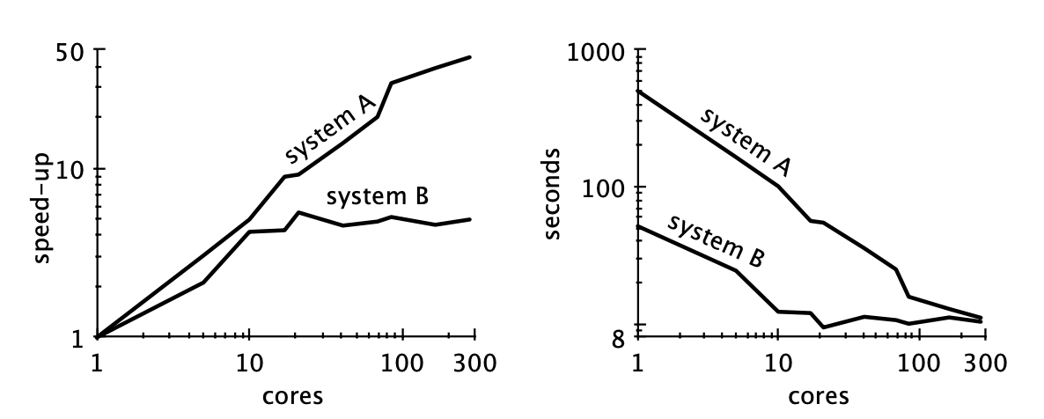

Scalability! But at what COST?
“You can have a second computer once
you’ve shown you know how to use the first one”
- Paul Braham
https://www.frankmcsherry.org/assets/COST.pdf
Notes:
COST: Configuration that Outperforms a Single Thread
Pic: System A is unoptimized, while B is optimized. Unoptimized “scales” far better, despite (or rather, because of) its poor performance

Slide 7
Abstractions have a half life
Notes:
Example: synchronous I/O – as CPU’s bandwidth increased significantly, and more internet users implied more workload, the simplicity of synchronous I/O had its timer ticking.
Linux introduced AIO in early 2000s
Some modifications to support higher throughput of NVMe in 2016: https://lwn.net/Articles/743714/
io_uring in 2019
https://lwn.net/Articles/810414/
https://nick-black.com/dankwiki/index.php/Io_uring

Slide 8
Hardware Abstractions History
Memory
HBM
Unified
Memory
CXL
I/O
PCIe 1.0
SSD
NVMe
PCIe 5.0
Multicore CPUs
Integ
Northbr
CPU
iGPU
Apple M1
2000
2010
2020
Notes:
Northbridge: Memory controller was pulled into the CPU by AMD in early 2000s (AMD K8), but by Intel only in 2008 (Nehalem)
Apple M1: Heterogenous Computing
CXL: While technically not just a memory thing, it’s most talked in the context of memory pools
Currently, IO b/w ~= memory b/w. Implications?

Slide 9
Emergent Trends
Notes:
Indicative, not exhaustive.

Slide 10
A new class of Systems Programming Languages
Rust
Zig
ownership model
explicit allocators
comptime
Notes:
Reason: Better understanding of footguns, need for more control over hardware efficiency
Better in the sense that instead of hiding complexity, they give you better primitives to deal with them
Rust: zero-cost abstractions via the ownership model
Swift is somewhere in there too

Slide 11
Reimagining Existing Software
Tigerbeetle
Bun
Ladybird Browser
Rustls
librsvg
Notes:
Reason: Memory safety, old software
Note: a programming language on its own doesn’t make anything “faster”, but when used right, helps significantly.

Slide 12

Better domain primitives
Tigerbeetle
https://www.infoq.com/presentations/redesign-oltp/
Notes:
Reason: DBs designed in mid 90s, early 2000s can last only so long at current scales.
Primitives:
Debit/credit primitives, so ledger API
Separate control plane (metadata) from data plane (txn entries): allows 1000x higher scale
Rethinking abstractions across network, storage and consensus
Fixed sizing -> No dynamic allocations at all
1 query = 8k txns = 4 syscalls + 4 memcpy + 3 network req
Protocol aware recovery wouldn’t be possible if they weren’t going across abstractions

Slide 13
A shift of concurrency primitives
async / await
coroutines
event loops
Notes:
Reason: massively concurrent tasks, lower cost of switching, encouraged by primitives like io_uring on I/O side
Threads just won’t scale to millions

Slide 14
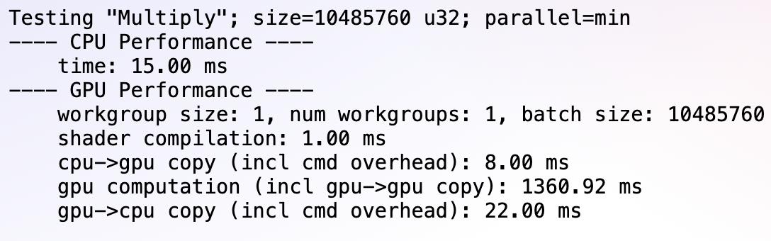
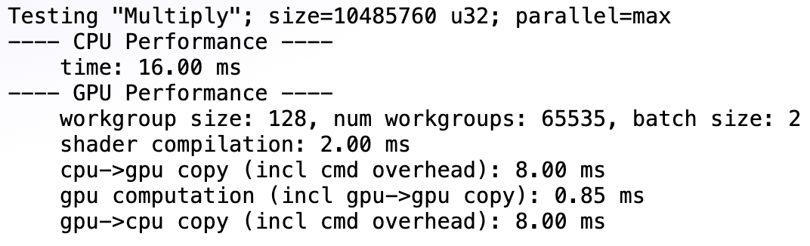

Massive Parallelism w/ xPUs
Throughput used
to hide latency
https://github.com/amodm/talks/blob/main/lecture-series-hwsw/lecture-2-inside-the-gpu/cpu-vs-gpu.html
Notes:
Reason: iGPU/NPU adoption mainstream, along with standardized APIs
Single cores now limited by physics (node size)
Throughput has historically been used to hide latency
Software workflows for these have very different patterns

Slide 15
Pervasive use of VMs
eBPF
WASM
Notes:
Reason: Pluggability, performant low-overhead platform neutrality
Two examples that have very different design goals
eBPF –Katran, Cilium. More than just network now, hot pluggable kernel logic.
WASM – more than just web, cross-platform container images. Also see Zig’s interesting use of WASM for compiler build.

Slide 16

A return to Formalism
https://blog.resonatehq.io/deterministic-simulation-testing
Notes:
Reason: when low hanging fruits are gone, usually new ideas need to be approached foundationally, which means formalism tends to play a bigger role.
Seeing this a lot more in the distributed systems and database world right now, e.g. DST

Slide 17
AI – the dark horse

Slide 18
"Education is what, when, and why to do things, Training is how to do it. Either one without the other is not of much use.” - Hamming
Preparing Ourselves
Notes:
Foundations are the key
Not all at once – small steps are fine

Slide 19
Summary
Abstractions are useful but can create walls
They have half lives, so can’t build forever castles on top of them
Understanding their decisions & internals informs us about their half lives
Foundations help increase longevity. “Tech changes fast, but foundations remain the same.”

Slide 20
Thank You
https://github.com/amodm/talks/discussions/2
Notes:
Which abstraction would you revisit?

