Slide 1

Boundary Conditions
Reviewing Mental Models of Hardware & Software
Amod Malviya
Notes:
QR code: https://github.com/amodm/talks/discussions/1

Slide 2
Preamble
We use code to study CPU architecture
Code deliberately designed to amplify specific behaviours
“Reasoning “ >> “knowing facts”
Participation is mandatory
Designed to provoke study of CPU Arch, not a substitute for it
Hardware dependent results (but trends should be same)
Compiler: clang -O2 -g -fno-slp-vectorize
Notes:
Goal is to show that hardware has real world implications on software
Peak performance can be achieved only if we understand how things work

Slide 3
Amdahl’s Law
Performance improvement is dominated by
the slowest poke

Slide 4
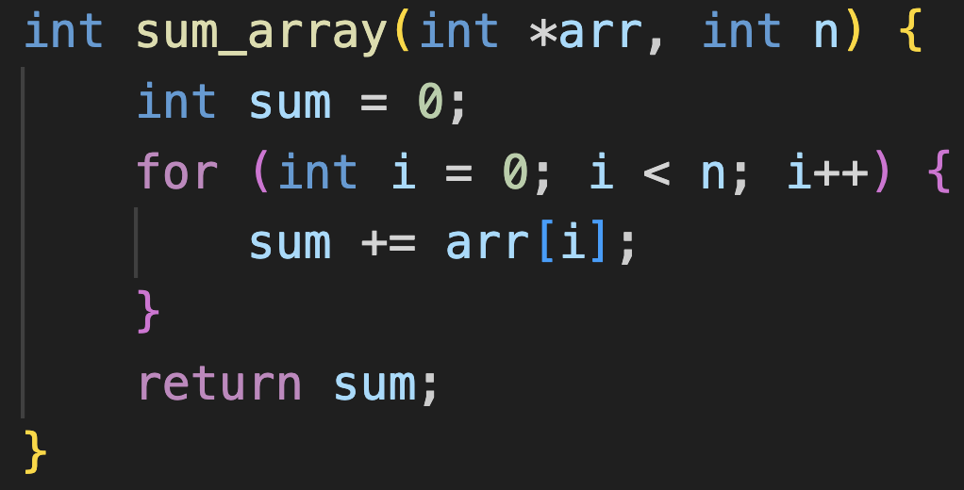
Stack vs Heap
sum_array(heap_arr, n)
~=
?
sum_array(stack_arr, n)
Notes:
Which is faster?
Or does it depend on `n`?
Incorrect model: stack is “closer”, heap is “farther”
Correct model: subject to same caching pattern, all memory addresses are the same distance away.
Source: stack-heap.c

Slide 5
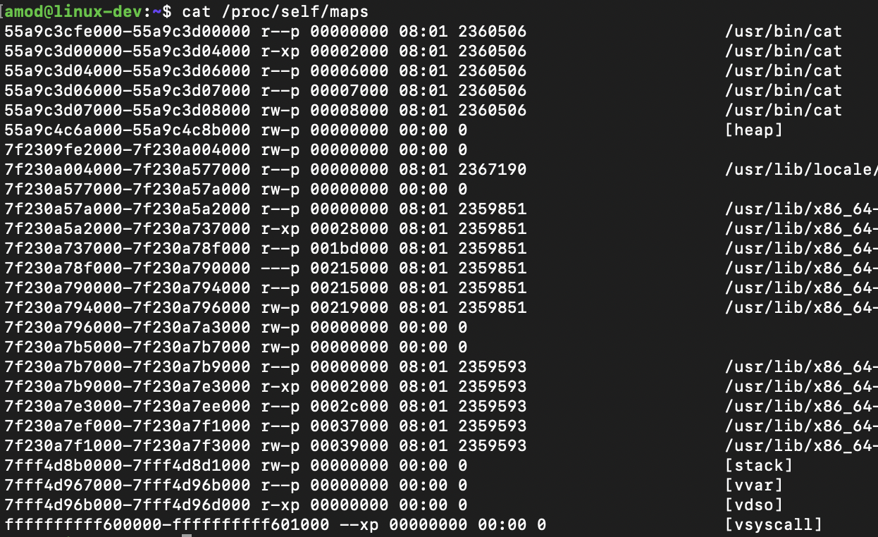
heap
stack

Slide 6
CPU Backend

Slide 7
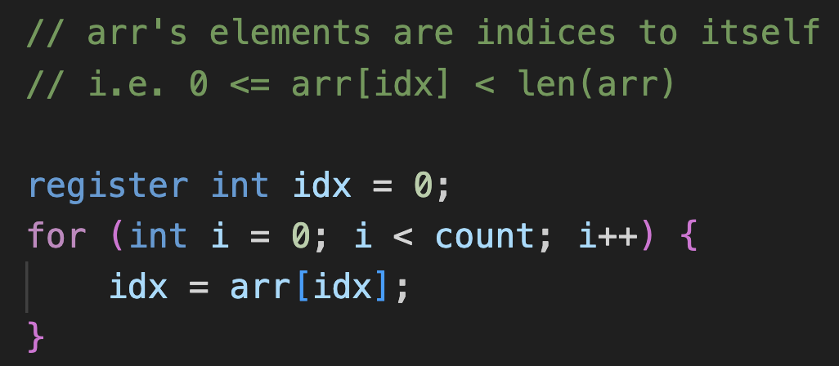
Consecutive: 1.3ns/iter
~100x difference ??
Random: 126 ns/iter
How much time should this take per iteration? (assume large count)
Notes:
Source: memory-access.c
How much time per iteration? Depends? On what?

Slide 8
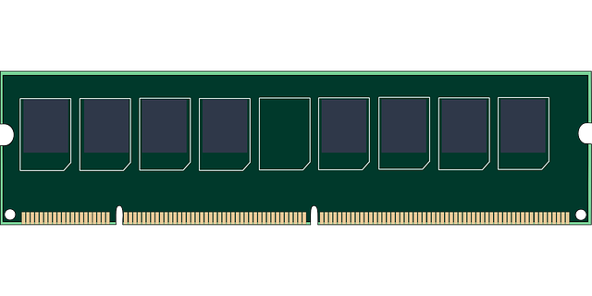

Memory is SLOOOOWWWWWW
CPU
Memory Bus
Latency: 50-100 ns
Bandwidth: 25-50 GB/s /channel

Slide 9
Memory Hierarchy
Register
1 cycle
> 1 TB/s
L3
L1
5 cycles
1 TB/s
L2
15 cycles
1 TB/s
Register File
L3
75 cycles
500 GB/s
L1
Core 0
Memory Controller
L2
Core 1
DRAM
50ns
25 GB/s
L1
Register File
CPU
Notes:
The “cycles” here are CPU clock cycles
Note that while DRAM latency is ~50ns, actual latency would be L3 latency + DRAM latency.

Slide 10
Memory is SLOOOOWWWWWW
CPU
Memory Bus
Latency: 50-100 ns
Bandwidth: 25-50 GB/s /channel
100ns: 16 bytes
= 160 MB/s
??
req1
50ns
8 bytes
req2
50ns
8 bytes
Burst!
req1
50ns
8 bytes (x8) = 64 bytes
BL8
Throughput hides latency by ammortising cost!
Notes:
Link between BL and cache line size
Channel count increase is another example of using throughput to hide latency

Slide 11
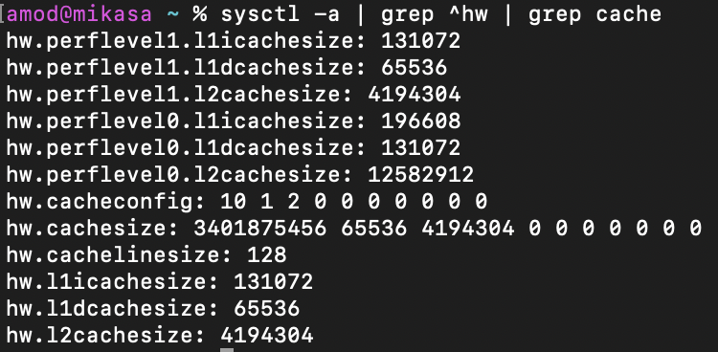
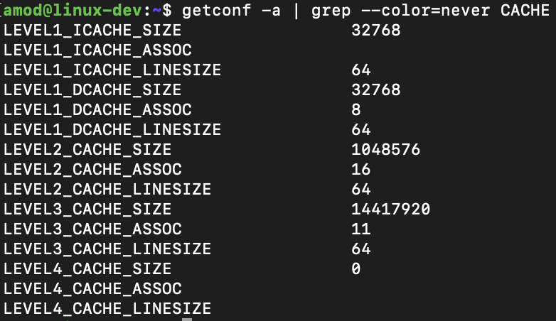
Cache Configuration
macOS (M1 Max)
Linux (x64)
Notes:
Notice the differing caches in perf vs efficiency cores of M1
Notice the Instruction vs Data cache segregation for L1

Slide 12
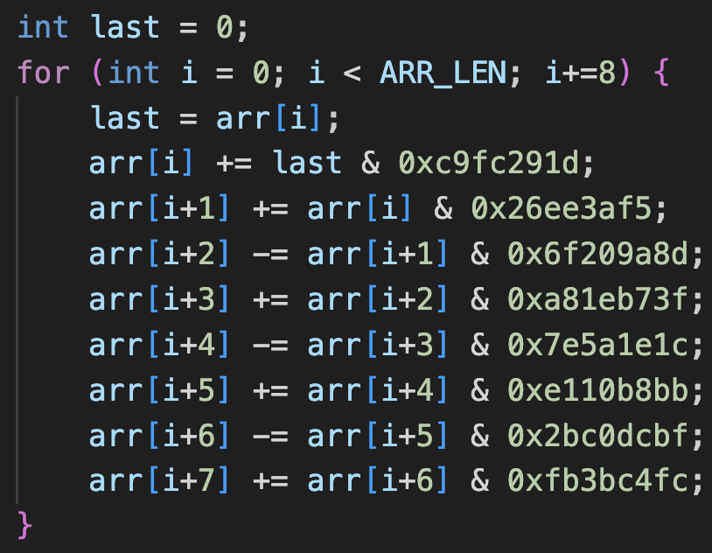
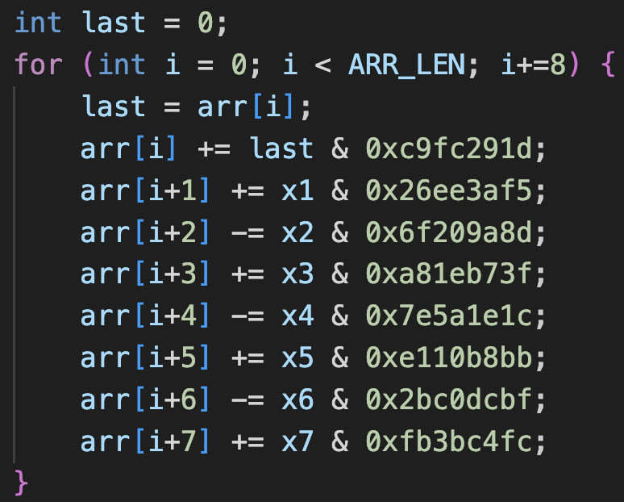
Exact same execution speed?
Faster by 10-50 %
Notes:
Source: superscalar.c
x1-x7 are random numbers initialized at runtime.

Slide 13
Instruction Fetch & Decode
High level
CPU Architecture
Frontend
L1 Instruction
μops
Reorder Buffer
Scheduler
Execution
….
LDST
LDST
ALU
ALU / VEC
AGU
ALU
L1 Data
L3
Memory
L2

Slide 14
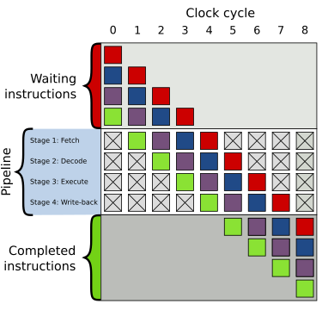
Credit: https://en.wikipedia.org/wiki/Instruction_pipelining

Slide 15
CPU Frontend

Slide 16
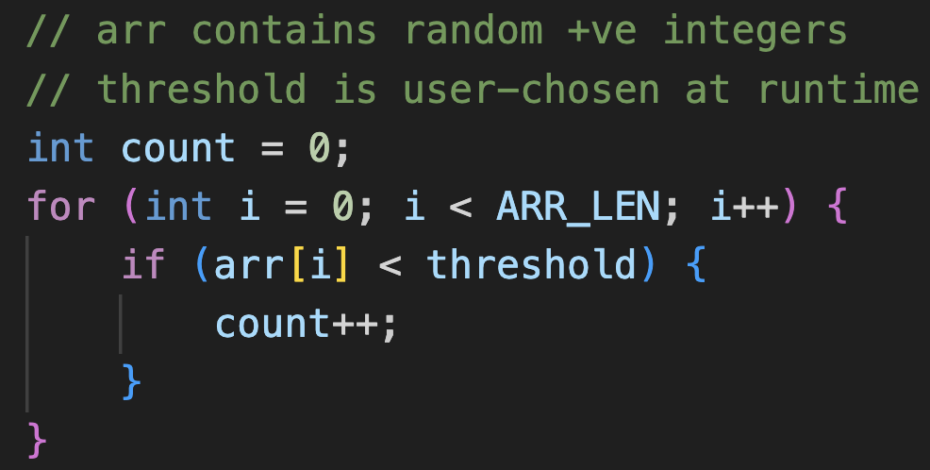
Consistent execution speed?
Notes:
Source: bp.c
Is it existence of a condition that creates a problem?

Slide 17
Branch Predictor
Fetch Queue
Frontend
L1 Instruction
Instruction Decoder
μops
Reorder Buffer
Scheduler
Execution
….
LDST
LDST
ALU
ALU / VEC
AGU
ALU
L1 Data
L3
Memory
L2
Notes:
If there’s a branch predictor keeping track of taken branches, can we create a test to overflow its state?

Slide 18
CPU Frontend is limited by control flow
CPU Backend is limited by memory access

Slide 19
CPU vs GPU
Notes:
Source: cpu-vs-gpu.html at https://github.com/amodm/talks/tree/main/lecture-series-hwsw/lecture-2-inside-the-gpu
Show single core comparison
Show multiple core comparison
Show divergent control flow
CPUs are optimized for latency, while GPUs are optimized for throughput oriented workloads

Slide 20
CPU vs GPU
Control
Control
Control
Control
Control
Control
EU
EU
EU
EU
EU
EU
EU
EU
EU
EU
EU
EU
EU
EU
EU
EU
EU
EU
EU
EU
EU
EU
EU
EU
EU
EU
EU
EU
EU
EU
EU
EU
EU
EU
EU
EU
EU
EU
EU
EU
EU
EU
EU
EU
EU
EU
EU
EU
EU
EU
EU
EU
EU
EU
EU
EU
EU
EU
EU
EU
EU
EU
EU
EU
EU
EU
EU
EU
EU
EU
EU
EU
EU
EU
EU
EU
EU
EU
EU
EU
EU
EU
EU
EU
PCIe
PCIe
CPU core
CPU core
GPU Global Memory

Slide 21
SIMT
Registers →
Divergent Control Flow
Thread 1
Thread 2
Thread 3
Thread 4
Thread 5
→
…
An executing thread group will block on
longest thread (e.g. for loop)
→
…
→
if (…)
→
…
if/else are executed serially
(in the same executing thread group)
→
…
→
else
→
…
→
// end if
→
…
Notes:
Demo: Heavy workload demo
Once started, cannot stop
GPUs aren’t good at divergent control flow situations

Slide 22
Books
Computer Architecture – Hennessy & Patterson
Programming Massively Parallel Processors, 4th ed – Hwu & Kirk

Slide 23
Questions?
Notes:
QR code: https://github.com/amodm/talks/discussions/1
Why did we not discuss I/O ?

Slide 24
Memory is SLOOOOWWWWWW
CPU
Memory Bus
RAS (Activate Row)
tRP
Row Activated
CAS (Activate Col)
tRCD
Col Activated
Command: Read
CL
Send Data
DDR4-3200 is 3200 MT/s, means 1600MHz clock, means 0.625ns clock.
Timing of 32-32-32 (CL-tRCD-tRP) means CL = tRCD = tRP = 32 cycles = 20ns

Slide 25
Advanced
Notes:
SIMD
Memory Alignment
TLB flush
Cache associativity
Cache coherency as a distributed systems problem

