Slide 1

The VMs around us
Amod Malviya
Notes:
What kind of reasoning can be explored here?

Slide 2
Mindset & Principles
Reasoning >> facts
Thinking is mandatory!
We cannot reason without asking questions. So question!
I will lie!
I will lie only about “facts”, not about “method of reasoning”.
You cannot counter with a looked-up fact. Only reasoning.

Slide 3
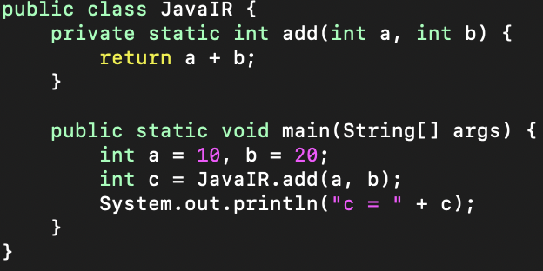
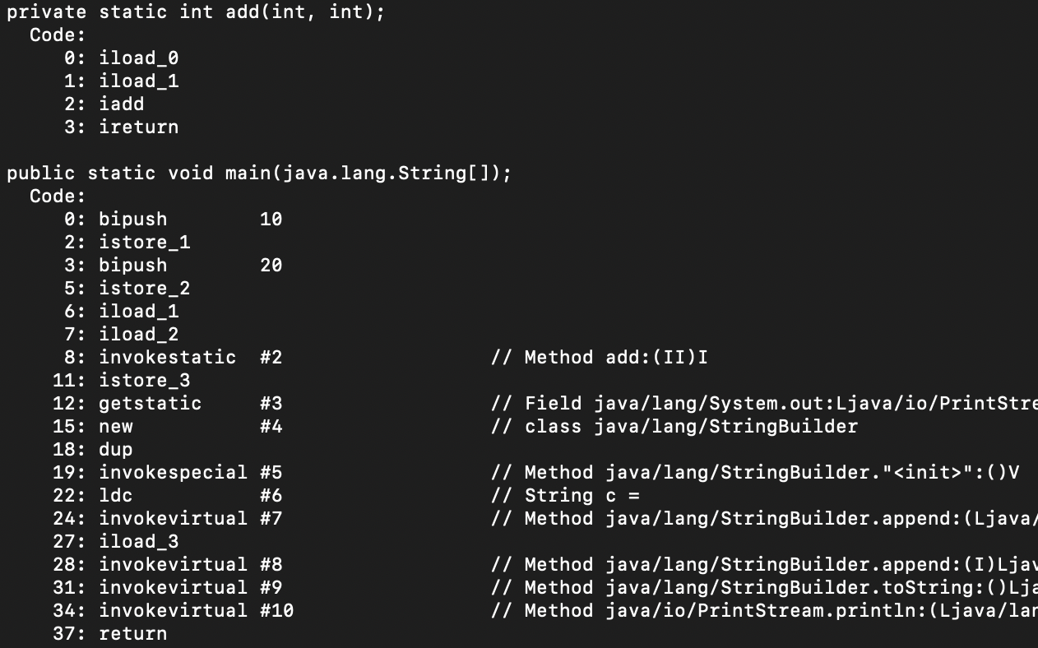
File: JavaIR.java
javap –c -p JavaIR.class
load “a”
load “b”
add a + b
a = 10
b = 20
call “add(a, b)”
java “new”?
Notes:
Q: What are the things you note? Machine code? Functions? “load/add” ?

Slide 4
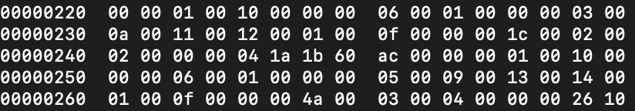
What is Machine Code?
hexdump –C JavaIR.class
Binary?
while (i < 10) { i++; }
Notes:
Get students to verify opcodes

Slide 5
What is Machine Code?
Terse?
Lower level?
Brainfuck
++++++++[>++++[>++>+++>+++>+<<<<-]>+>+>->>+[<]<-]>>.>---.
+++++++..+++.>>.<-.<.+++.------.--------.>>+.>++.
Notes:
Code is from Wikipedia (Brainfuck)
Demonstrate correctness by script

Slide 6
Brainfuck
>
Increment the data pointer by 1
ISA
<
Decrement the data pointer by 1
+
Inc value at current DP by 1
Brainfuck has an 8-instruction ISA
-
Dec value at current DP by 1
.
Output byte at current DP
,
Read byte & store at current DP
[
If value@DP is zero, jump to instruction after matching ]
]
If value@DP is non-zero, jump to instruction after matching [
Notes:
8 instructions – smaller than RISC-V (~50 instructions)

Slide 7
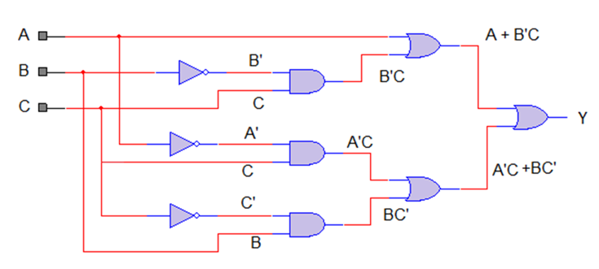
What is ISA?
How do we know an ISA is exhaustive?
Source Code
Compiler Intermediate
Representation
“Distance” of optim
Programmability
Semantics
Hardware Optim
ISA
(Fixed)
Decoder
ISA?
Fixed
Physical Circuits
Notes:
CISC vs RISC
R64IMAFD

Slide 8
Computation
Is Brainfuck a Turing Machine?
No-state
Combinational Logic
linear circuits, e.g. adder circuit
Finite States
Finite State Machine
if / else, foreach ?
Regular Language
Stack
Pushdown Automaton
function calls, recursion?
Context free Language
Addr Memory
Turing Machine
any logic?
Recursively Enumerable
Notes:
Computation hierarchy as number of states needed
FSM – foreach vs for loop – logic vs “finite memory”

Slide 9
Brainfuck – Turing Machine?
>
Increment the data pointer by 1
<
Decrement the data pointer by 1
+
Inc value at current DP by 1
-
Dec value at current DP by 1
.
Output data at current DP
,
Read data & store at current DP
[
If value@DP is zero, jump to instruction after matching ]
]
If value@DP is non-zero, jump to instruction after matching [
Notes:
Q: Where's the memory for Brainfuck if it's a TM?
Q: How would you add two numbers?
Q: How would you do multiplication?
Q: How would you do division?
Assignment: Implement multiply for Brainfuck. You can use the provided python script to test.
Q: How small can you go?

Slide 10
What makes a VM?
ISA
Memory Model

Slide 11
add (10, 20) - registers
…
pc
mov r1, [r5]
mov r1, $10
r1
r2
r3
mov r2, [r6]
mov r2, $20
10
20
30
add r3, r1, r2
add r3, r1, r2
…
Register based Machine
Notes:
mov, load

Slide 12
add (10, 20) - stack
+
pc
30
…
push $10
20
push $20
10
add
…
…
Stack based Machine
Notes:
Q: Advantages/disadvantages of stack based machine vs register based machine?
Assignment: think about as many differences as you can find between stack vs register based machines. Don’t just read them, do try to “understand” them.

Slide 13
What makes a VM?
Machine Model
ISA
I/O ?
Memory Model
Concurrency?
Notes:
Machine Model == Execution Model
Q: What’s the concurrency model of modern processors? What about their memory model?

Slide 14
ISA → ISA
Methods of Running
ISA 1
Interpreted
JIT
Software emulated
ISA 1
Hardware assisted
AOT
ISA 2
Notes:
Q: So why aren’t we able to run Windows binaries on Linux?

Slide 15
Break

Slide 16
JVM

Slide 17
Notes:
Q: What hints can we gather about the JVM- machine model, memory model etc.

Slide 18
Thread 1
Thread 2
Thread 3
Heap Memory
pc
Eden
Space
Young gen
Space
Oldgen
Space
Survivor Space
Stack frames
Local Variable Array
Code Cache
Permgen Space
Operand Stack
References
…
Notes:
References are to constant pool
CLR is very similar
Q: how is memory allocated?
Q: how is throw implemented?
Assignment: how does the JVM interact with the “external world”, e.g. how is System.io.println implemented?

Slide 19
Notes:
Walk through the byte code

Slide 20
WASM

Slide 21
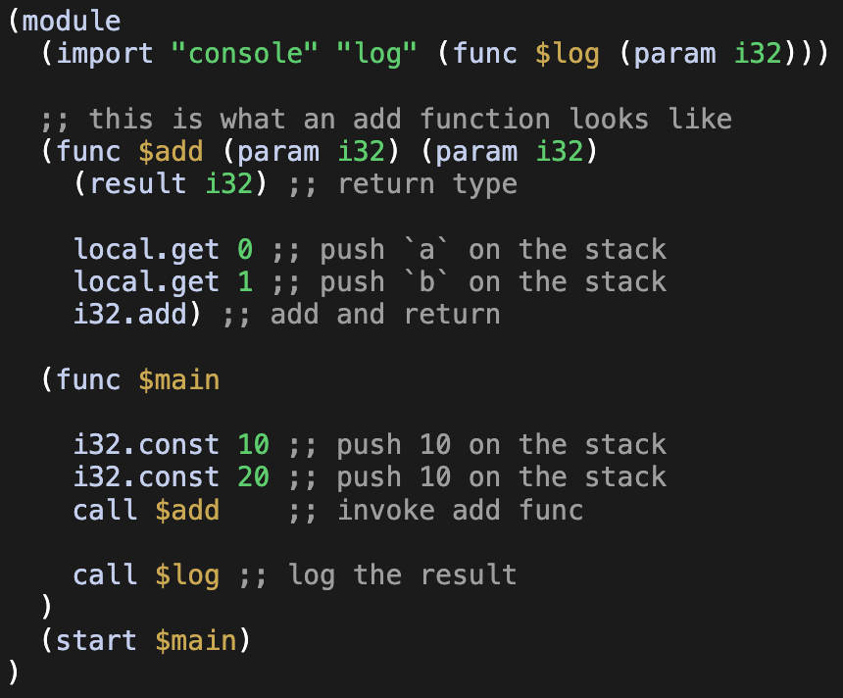
WASM
Notes:
WAT (WASM Text) – textual representation of ISA
Q: Why have WASM?
Differences from JVM
“Structured” control flow
Lighter
More “web”-ish security model
Simpler machine & memory model allow for much more languages to be supported.
Ability to “import” functions from other modules
Concurrency? WIP.

Slide 22
WASM
Module 1
Module 2
Linear Memory
Linear Memory
Instructions
Instructions
Stack
Stack
Notes:
Multiple memories possible
Memory can be segment into different data segments
Frame activations similar to JVM
Safety via memory separation
Q: Why do VMs seem to prefer stack based machines?

Slide 23
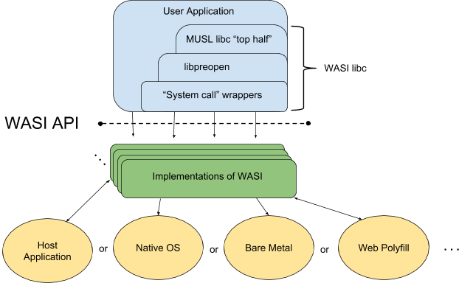
WASI - not just “Web” Assembly
Credit: https://github.com/bytecodealliance/wasmtime/blob/main/docs/WASI-overview.md
Notes:
Examples: `path_open`, `sock_recv`
Fully self-contained containers as a deployment & distribution mechanism

Slide 24
PTX
Notes:
* PTX = Parallel Thread eXecution

Slide 25
GPU
Source Code
nvcc
PTX File
driver
SASS
Notes:
Q: What pieces of information about design can we deduce?

Slide 26
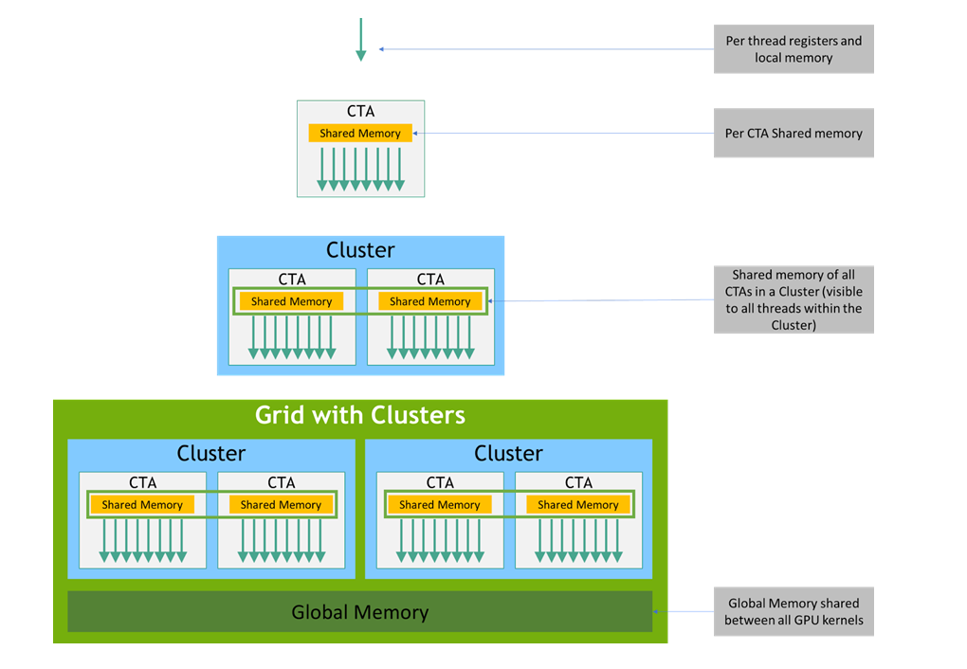
Credit: https://docs.nvidia.com/cuda/parallel-thread-execution/index.html
Notes:
CTA = Cooperative Thread Array, correlates to workgroup in webgpu
Memory Model is tiered & directly reflects GPU’s abstract architecture
ISA reflects vector ops, vector types,
Special registers for thread id etc: %tid, %ntid, %clusterid, %nclusterid, and %gridid

Slide 27
Grouping kernel invocations
Instance 1
Instance 2
Instance N
Control
Register Files
INT32
FP32
Tensor Core
Deployed on
1 workgroup of
N instances
INT32
FP32
Tensor Core
INT32
FP32
Tensor Core
Deployed on another SIMT
INT32
FP32
Tensor Core
workgroup 2
L1 Cache
INT32
FP32
Tensor Core
Instance 1
Instance 2
Instance N
INT32
FP32
Tensor Core
INT32
FP32
Tensor Core
INT32
FP32
Tensor Core
RT Core
RT Core
FFU
RT Core
RT Core
SFU
workgroup M
Instance 1
Instance 2
Instance N
Notes:
From Lecture 2 – Inside the GPU

Slide 28
SIMT
Registers →
Thread 1
Thread 2
Thread 3
Thread 4
Thread 5
→
…
→
…
→
if (…)
→
…
→
…
→
else
→
…
→
// end if
→
…
Notes:
From Lecture 2 – Inside the GPU

Slide 29
PTX
Register based – every thread needs to reserve registers
Tiered Memory – reflecting GPU’s abstract architecture
ISA has types for vector, and ops for vectors
Special registers for thread id etc.

Slide 30
eBPF
Notes:
High performance
Safety oriented

Slide 31
eBPF
Designed to run dynamic code inside Linux Kernel
High performance (fixed number of registers)
Safety oriented (verifiable to terminate)
Designed for AOT transpilation (always run native)
Restrictive (to allow the above)
Notes:
Limited number of instructions
Concurrency – often per-cpu maps, but also has atomic instructions now

Slide 32
Summary
VMs are all around us – often not fully visible
Basic structure remains the same
ISA
Machine Model
Memory Model
I/O
Concurrency Model

Slide 33
Thank You

