Slide 1
Systems Resurgent?
Amod Malviya
Systems Distributed ‘24

Slide 2
Outline
Defining Systems Engineering.
20yrs: accessibility of programming vs systems thinking.
Recent developments & near future.

Slide 3
Definition & Properties

Slide 4

Systems Engineering is designing & using abstractions that help make a problem computationally tractable.
abstractions
computationally tractable
subject to reasoning & analysis

Slide 5
Tractability
+++++++++[>+++++++++>++++++++++++>++++++++++++>++++>+++++<<<<<-]>---.>+++.+++++.>----.+.+++++.-------.>----.<<.-----.>>.<<++++.>--..>.<+++.---.<-.>.>>-.<.<<-----.++.+++++++.>.>.<----.<----------.+++.-.-------.>>+.

Slide 6


Abstractions that enable computational tractability
unlock true value

Slide 7
Abstractions are layered & contextual
"Computational thinking means more than being able to program a computer.
It requires thinking at multiple levels of abstraction." - Jeannette M. Wing

Slide 8
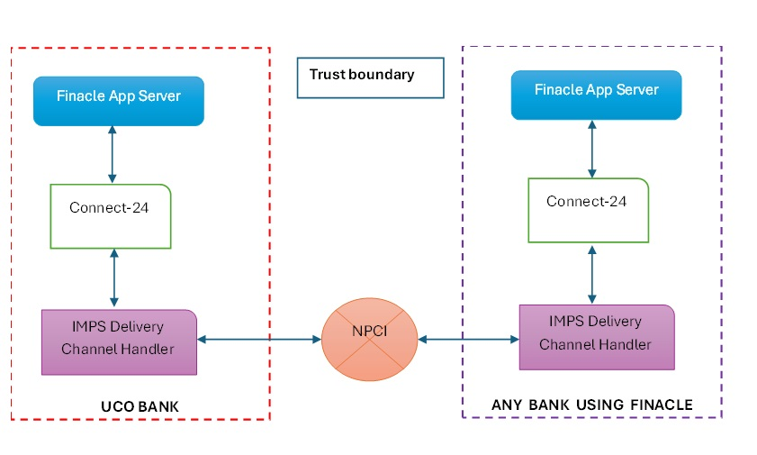

Printing Money – the UCO bank issue
Abstractions have cascading effects
on how we model & design

Slide 9
Last 20 yrs

Slide 10




Javascript
2000
2010
2020
ZIRP?

Slide 11
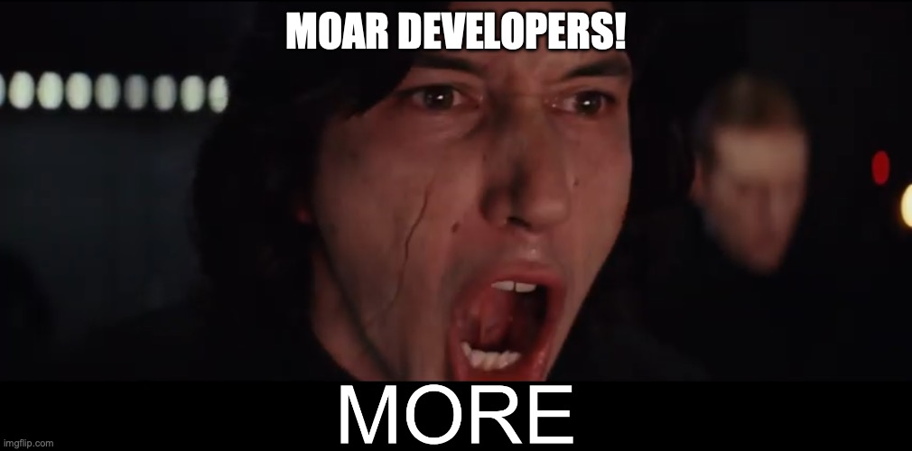



LEGO-like assembly
computational thinking was not a necessary criteria to be productive.
“There’s an app for that!”

Slide 12

Center a div
The rise of the
“full-stack engineer”
Knows “React”
Knows JS & uses npm
Instruments & observes op metrics
Knows “backend”
Administer Kubernetes
Knows some kernel stuff

Slide 13
"Education is what, when, and why to do things, Training is how to do it. Either one without the other is not of much use.” - Hamming
Training != Education

Slide 14
Recent Developments & Near Future

Slide 15
4 driving factors
Abstractions keep getting better
“Programming” is commoditized
AI
Hardware is interesting again – new patterns!

Slide 16
3 fronts of increased systems engineering
A betterment of abstractions.
Rebuilding of existing products.
New abstractions that reflect a changed reality.

Slide 17
Thank you

