Slide 1
The Image Game: Exploit Kit Detection Based on Recursive Convolutional Neural Networks
S. Yoo, S. Kim, B. B. Kang
A presentation by:
Shreeniwas Chate (A38)
Amod Manjarekar (A50)
Sumedh Borde (A53)

Slide 2
Table of Contents
Introduction
What is an Exploit Kit?
What are ConvNets?
The Image-based model
Design
Evaluation
Conclusion

Slide 3
Introduction
Exploit Kits (EKs) have been widely used in malware propagation. They are hard to detect and extremely time consuming to analyse by machine-learning based detection.
This paper proposes an image-based EK classification model using convolutional neural networks (CNNs or ConvNets), which are known to provide high accuracy and performance in image classification. Thus this model provides fast performance and a high detection rate.
The proposed model is 38 times faster than previous machine learning models, and achieved a 98.2% accuracy in exploit-kit and family classification while reducing training time by 77.8%.

Slide 4
WHAT IS AN EXPLOIT KIT?
McAfee defines an Exploit Kit as “an off-the-shelf software package containing easy-to-use attacks against known and unknown vulnerabilities”.
EKs are provided by their developers as a SaaS business model, with one-time or a subscription payment system.
These exploit kits are bought and used by attackers to inject emails and websites with malicious code such as trojan or ransomware. They require varying levels of skill, and can be used to target from a single individual to an entire organization.
EKs are constantly being updated and obsfucated by developers, and thus are hard to detect for antivirus tools.
Some of the most widely used EKs include Angler variants, Blackhole, Neutrino, RIG, GF Sundown, and many more.

Slide 5
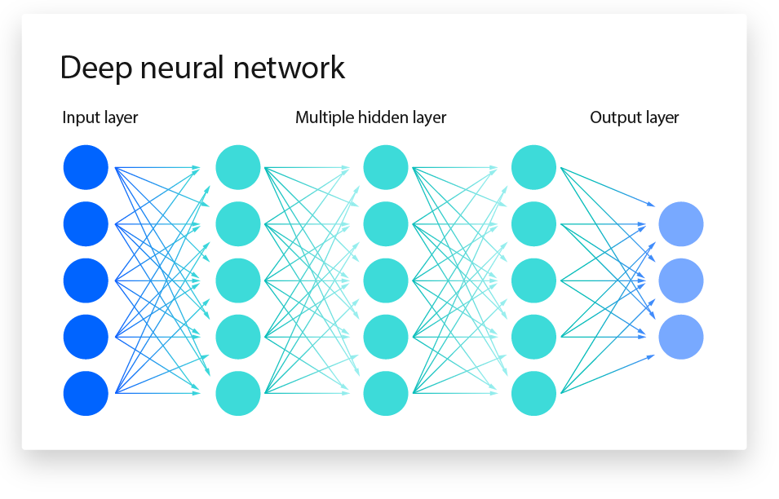
WHAT ARE ConvNets?
ConvNets (Convolutional Neural Networks) are a type of neural network used for classification and computer vision. They excel in identifying and classifying images and recognizing objects.
This image shows a layout of a basic neural
network.
ConvNets have three main types of layers:
- Convolutional Layer
- Pooling Layer
- Fully Connected (FC) Layer

Slide 6
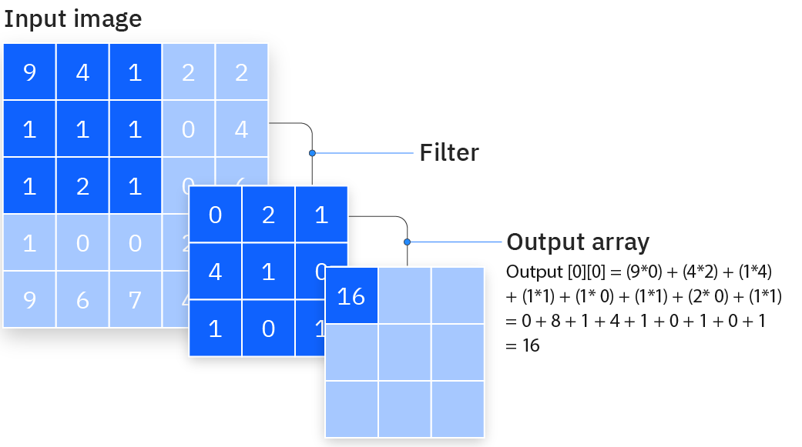
WHAT ARE ConvNets?
Convolutional Layer
Pooling Layer
FC Layer
Core building block
Includes input data, a filter and a feature map
Feature detector moves across the image and checks if feature is present (convolution)
Pooling or downsampling conducts dimensionality reduction
Similar to Convolutional layer, but without weights
It takes multiple pixels and sends single pixel to output array
Max pooling & average pooling
Less information for reduced complexity and higher efficiency
Each node in the output layer connects directly to a node in the previous layer
Performs the task of classification based on the features extracted through the previous layers and their different filters
Produce a final value of probability from 0 to 1

Slide 7
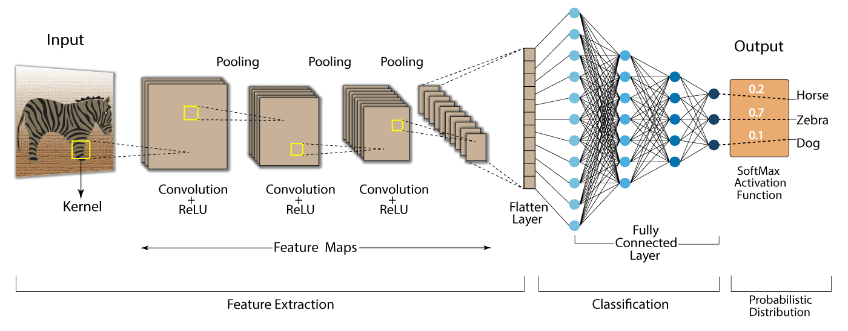
WHAT ARE ConvNets?
ConvNet Processing Lifecycle

Slide 8
THE IMAGE-BASED MODEL
The optimized model considers four approaches:
COLOR range of color types
SIZE resolution of the image
CLASSIFIER the RCNN model
HYBRID combination of approaches

Slide 9
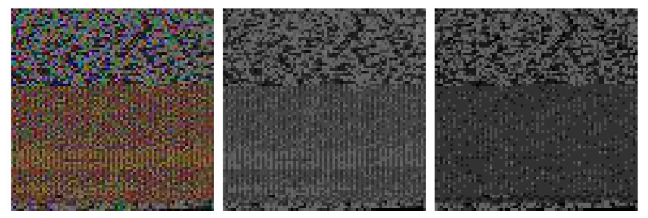
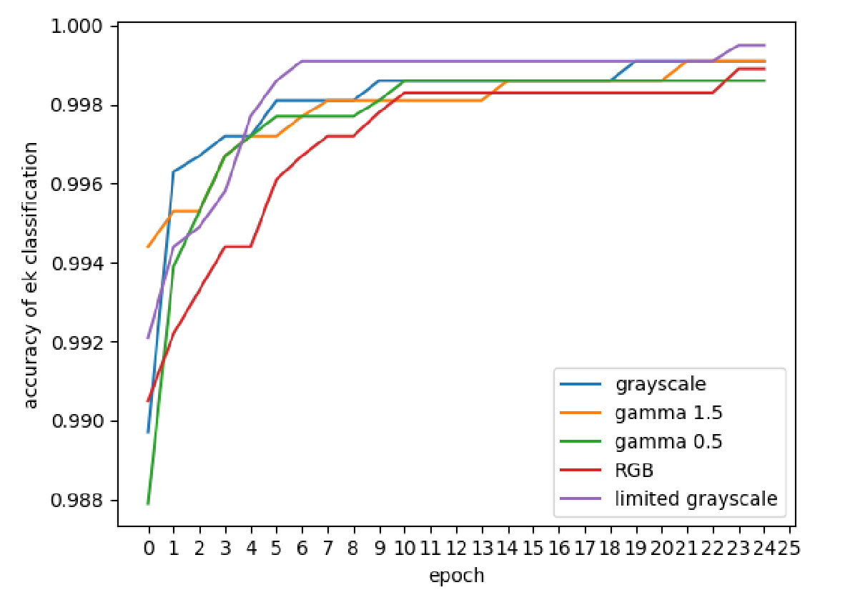
THE IMAGE BASED MODEL
Color
Selection must be done between multiple color variants
The selected color variant must produce highest accuracy; efficiency is trivial
5 different variants were tested: RGB, grayscale, limited grayscale, gamma 1.5, gamma 0.5
The limited grayscale variant produced the highest accuracy at 99.91%
Thus, limited grayscale was adopted as the primary color variant

Slide 10
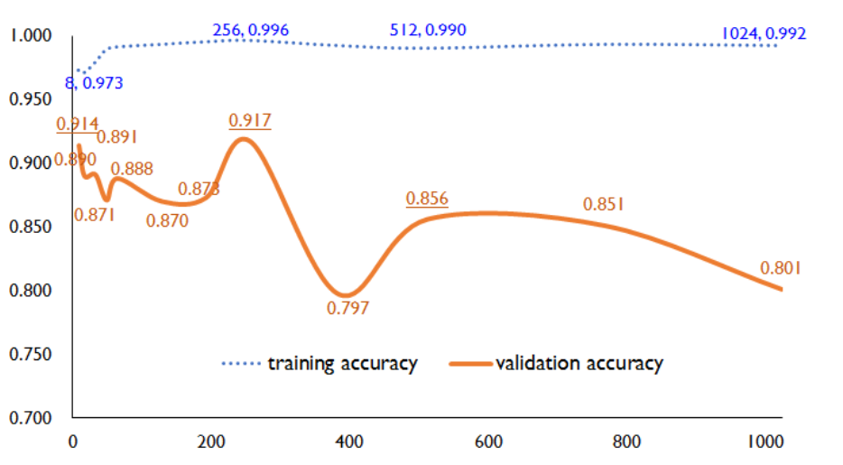
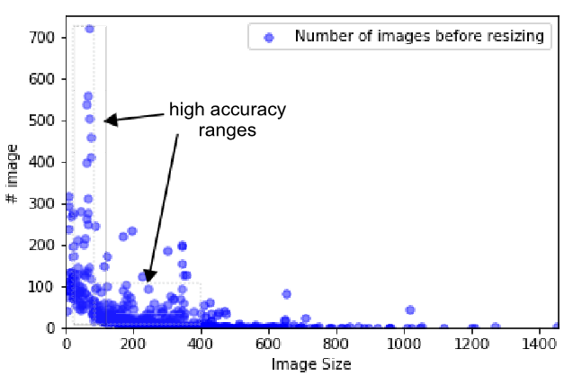
THE IMAGE BASED MODEL
Size
Selection must be done between multiple image sizes, from the range 8x8 to 1024x1024
Accuracy must be high, and efficiency is taken into slight consideration
17,593 training images and 2,326 test images of varying sizes from the given range were tested
Accuracy peaked for sizes 8x8, 256x256, & 512x512
Thus, consequent images were resized to these three sizes

Slide 11
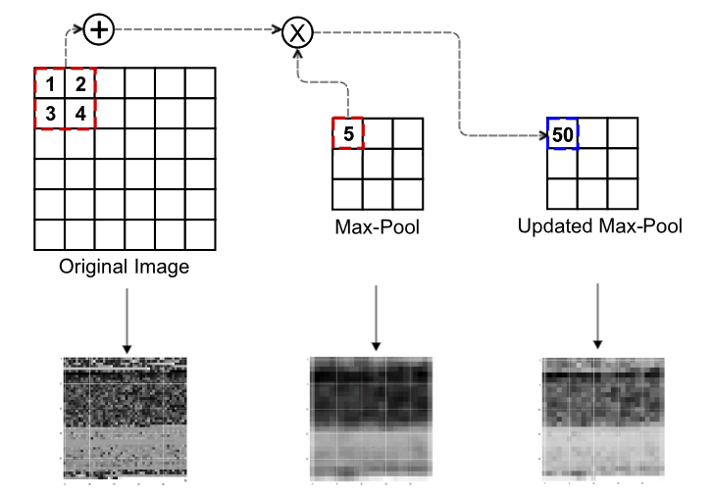
THE IMAGE BASED MODEL
RCNN
An RCNN model, based on ConvNet, was adopted to increase classification accuracy
This model recursively updates the original input image
The basic concept is to multiply the feature maps created through a convolution layer with the original image and to update the feature map
The general feature map are stated by the equation:
G[m,n] = (i×h)[m,n]
where,
i = input image,
n = RCNN kernel

Slide 12
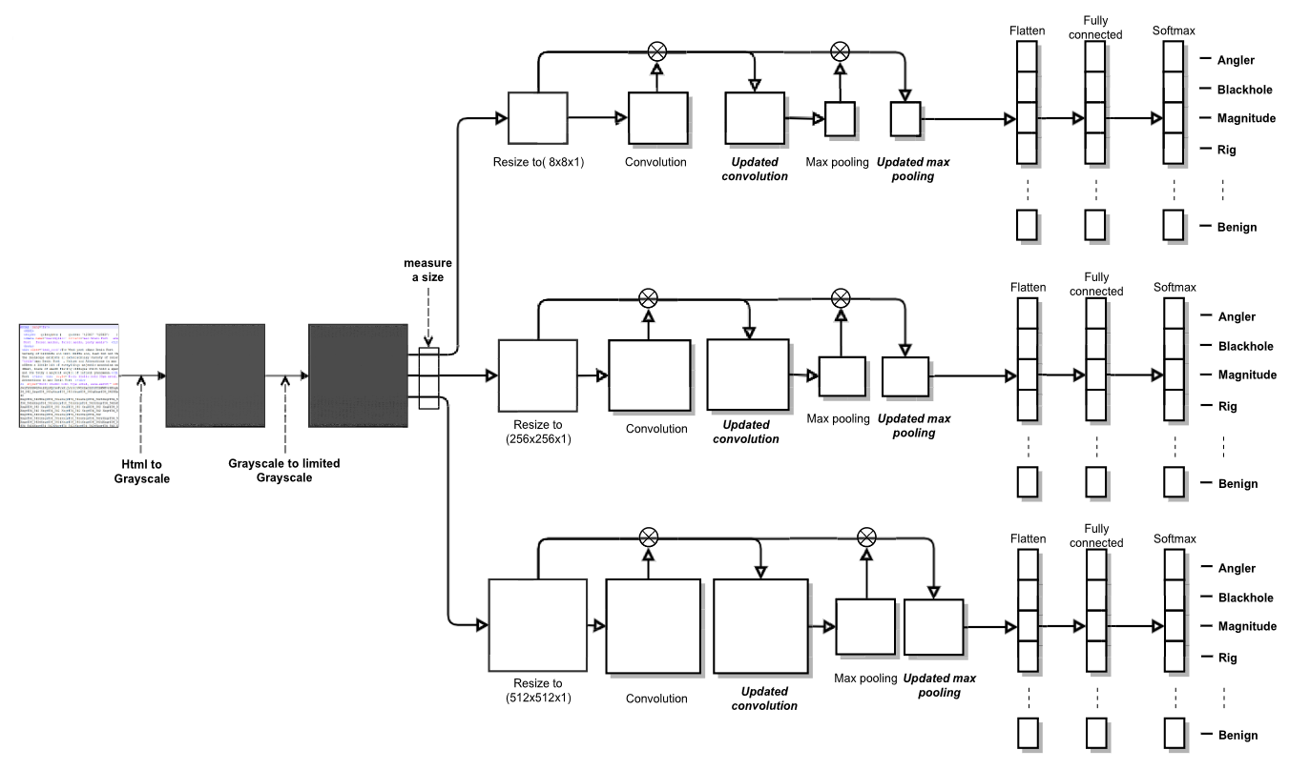
THE IMAGE BASED MODEL
Hybrid Model
A hybrid RCNN model was built based on the previous three factors.

Slide 13
EVALUATION
This section evaluates the RCNN model and compared it with other EK detection models.
Dataset Used & Setup
The model’s performance was tested with 15,617 benign and 17,709 EK files. This dataset comprises of:
35,616 samples from VirusChaser, an antivirus company
3.4% of the combined dataset from http://www.malware-traffic-analysis.net/
The model was programmed using Python3 with the TensorFlow and Keras libraries.

Slide 14
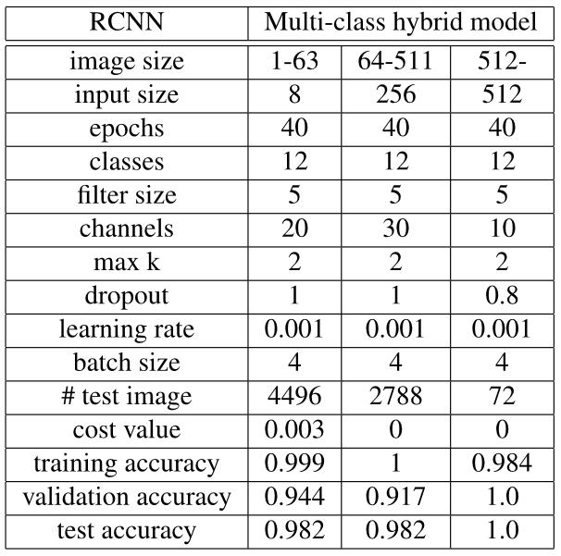
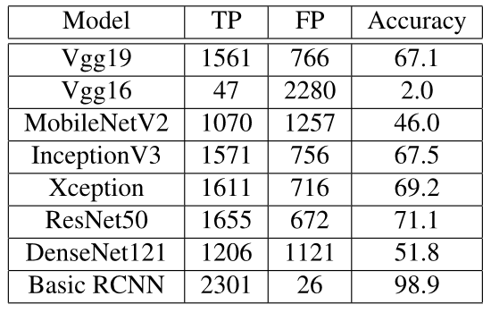
EVALUATION
Accuracy
Table 1 compares the accuracy of the RCNN model to other EK detection models
Table 2 depicts the accuracy for each 3 unique classes of input sizes
Table 1
Table 2

Slide 15
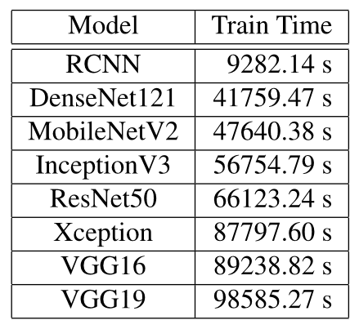
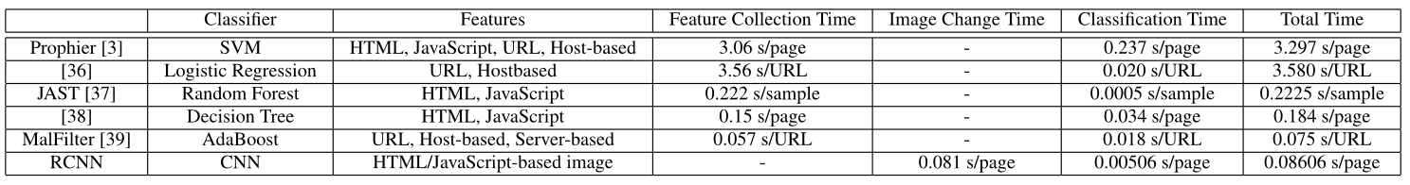
EVALUATION
Performance
Table 1 compares the training time of the RCNN model with other CNN models used for similar purpose
Table 2 compares the performance of the RCNN model with other state-of-the-art EK detection models
Table 1
Table 2

Slide 16
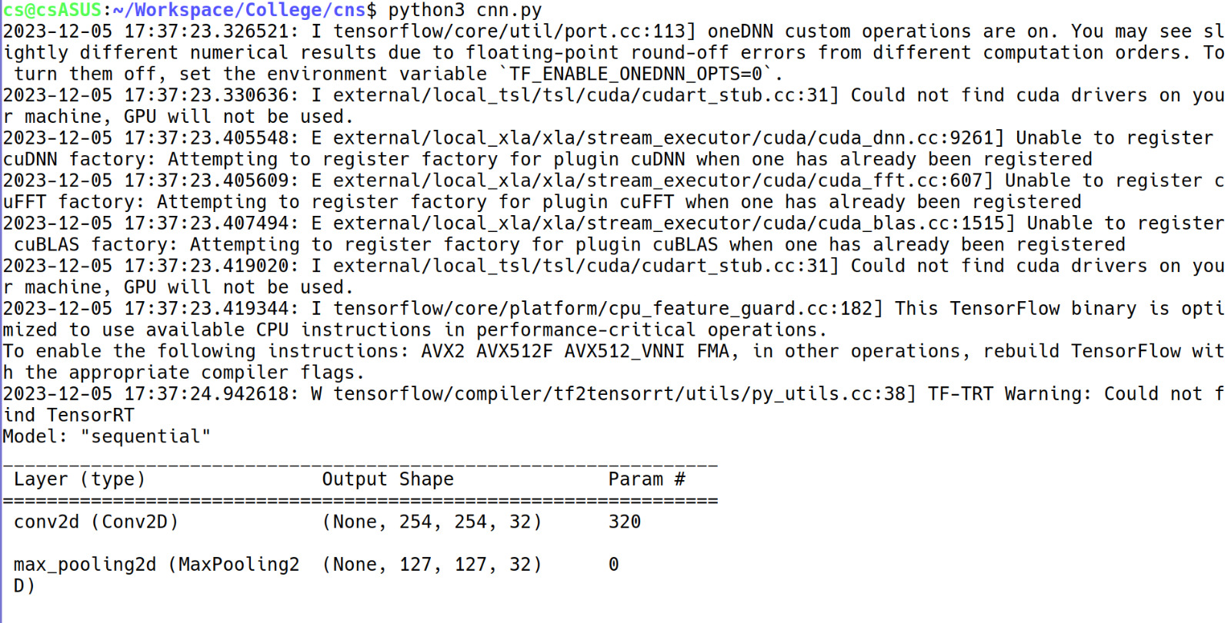
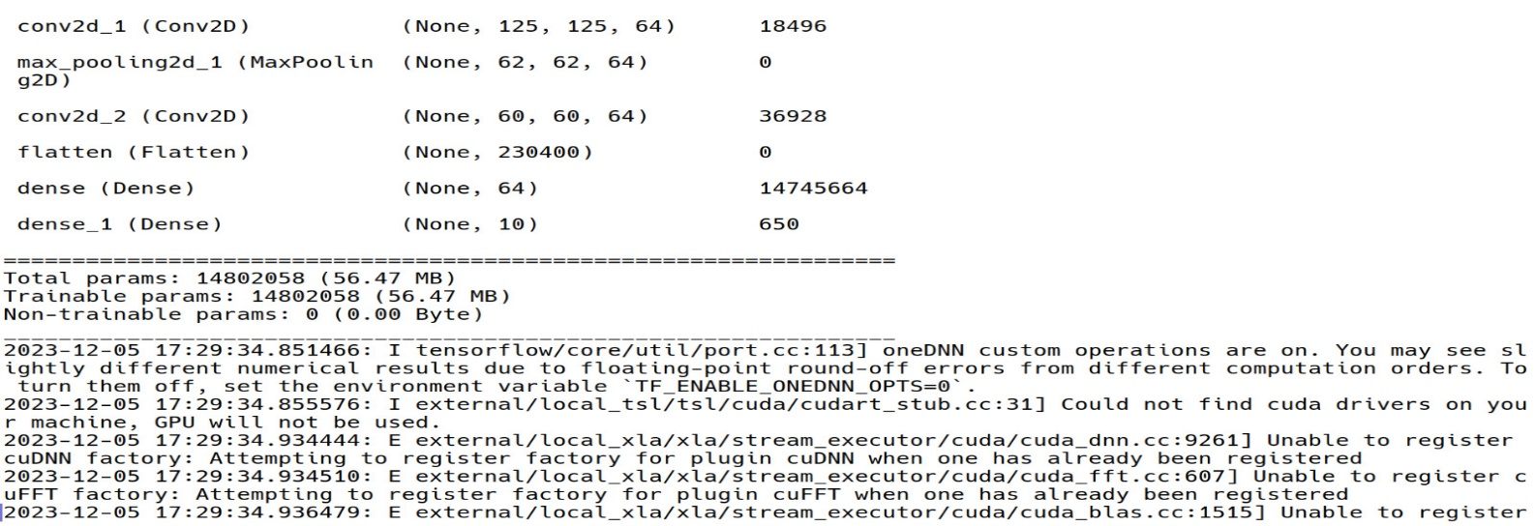
IMPLEMENTATION
Command & Output

Slide 17
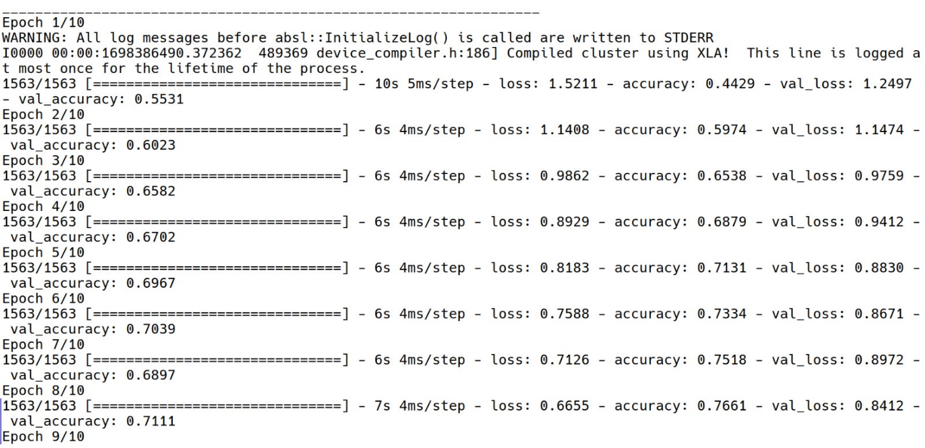
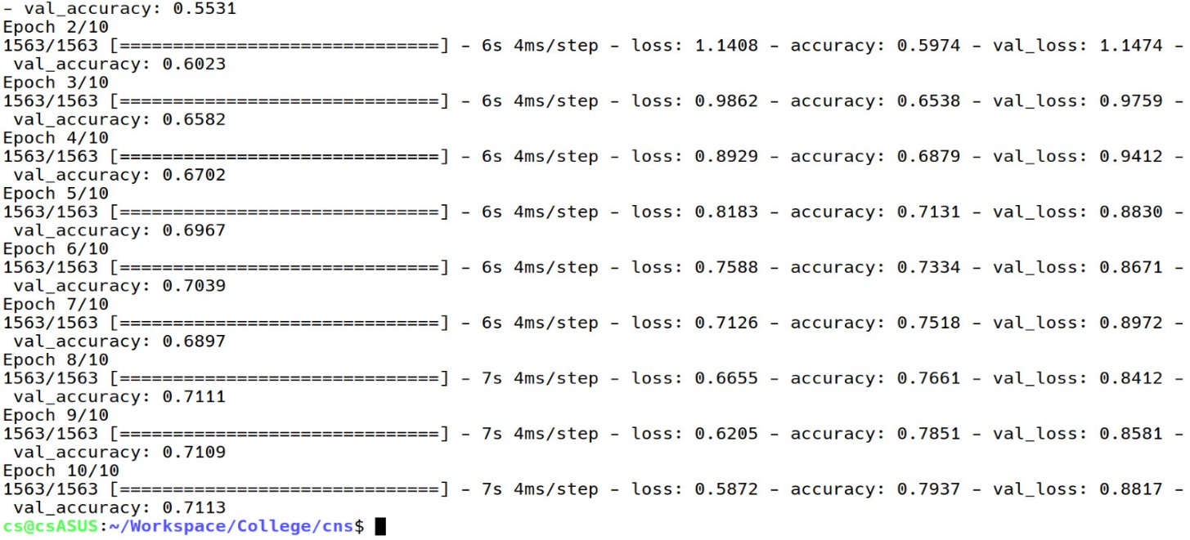

Slide 18
Conclusion
Exploit Kit attacks are rapidly increasing, but the detection rate in antivirus products still remains low. The RCNN model combats this issue.
The RCNN model exhibits high performance in a deep model with high image complexity. This model boasts a low computational cost due to limited grayscale images, high performance which is upto 38 times faster than previous machine learning models, and high detection rate and accuracy due to recursive image updates.
The RCNN model provides useful insight into EK classification via the filter of a CNN model because this model is based on features distinguished from benign HTML/JavaScript codes.

