Slide 1
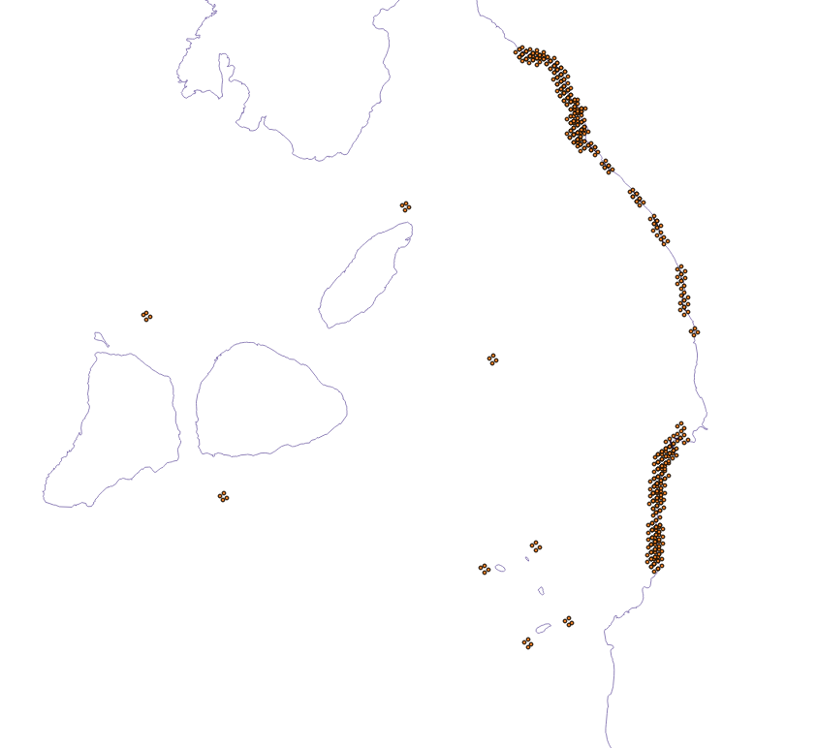
Sand flat 1
Sand flat 2
Sand flat 3
Sand flat 4
Sand flat 5
Sand flat 6

