Slide 1
Big Data Project
Moeed BSDSF21A004
Soban BSDSF21A007
Nauman BSDSF21A044

Slide 2
Crew Mates
M. Soban Anjum
Soban is a problem solver, solves the big data problems.
Abdul Moeed
Nauman Sameja
Moeed is the big data expert and provide with robust solutions.
Nauman creates big data problems that needs to be solved.

Slide 3
Table of Contents
01
02
03
04
Problem & Solution
Urban crime pattern and high-risk area prediction
Tools and Technology
What tools and technology did we used?
Our Process
What is the process for building the robust system?
Conclusion
What did we accomplish from this project?

Slide 4
01
MOTIVE
What are we trying to achieve?

Slide 5
Crime Pattern Analysis
To analyze historical crime data, identify patterns, and predict high-risk areas to aid law enforcement in optimizing resource allocation and enhancing public safety.

Slide 6
Significance
Crime Prevention
Law Enforcement
Identify vulnerable Areas
Supports proactive crime prevention strategies by analyzing past crime trends.
Helps optimize law enforcement resources and patrol routes.
Contributes to safer urban environments by identifying vulnerable areas.

Slide 7
02
REQUIREMENTS
What are the requirements and data characteristics?

Slide 8
Volume
Velocity
Variety
Large-scale historical crime records spanning years and real-time reports.
Periodic updates or real-time ingestion from crime reporting systems.
Structured data unstructured data

Slide 9
Requirements
Data Ingestion
Data Processing
1
2
3
4
Data Storage
Visualization

Slide 10
03
DESIGN
What is the architecture design?

Slide 11
Architecture Design
Data Ingestion Layer
Data Storage Layer
01
02
Public datasets (Kaggle, government crime databases), live feeds.
HDFS as a data lake to store raw and processed
datasets.
Processing Layer
Visualization Layer
03
04
Apache Spark for data cleansing, trend analysis, and predictive
modelling.
Power BI for creating dashboards and interactive visualizations.

Slide 12
04
Technology
What techology stack are we using?

Slide 13
Maybe You Need to Divide the Content
01
02
HDFS
Spark
Hadoop Distributed File System
Act as a data lake to store raw data and processed results.
Cleans and preprocess the data for analysis

Slide 14
Maybe You Need to Divide the Content
03
04
Python
Flask
We are using python for processing of data and for spark jobs
Using flask as backend and to connect the frontend.

Slide 15
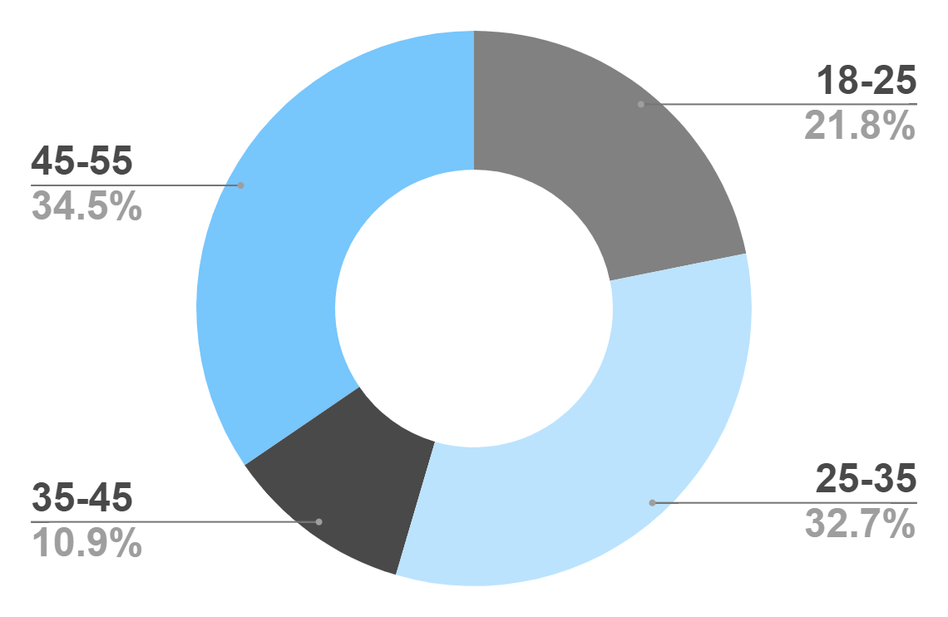
GOALS
Age
Gender
50%
50%
Interests
Security
Usability
To modify this graph, click on it, follow the link, change the data and paste the new graph here
Interface

Slide 16
Our Methodology
Analysis & Design
Implementation
Project needs and software architecture.
Design is transformed into functional app
Maintenance
Testing
Maintained to ensure it meets with end user
Testes for bugs and performance.

Slide 17
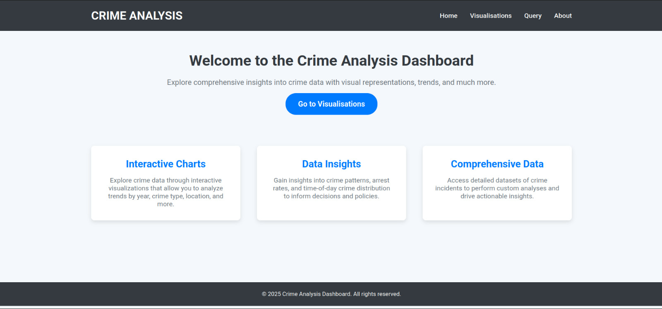
Welcome Screen
This is the main screen where the user will land

Slide 18

Thanks!
Do you have any questions?
amoeed@gmail.com
msobananjum786@gmail.com

