Slide 1
ETL cryptocurrencies Versus tech stocks Analysis
Team 1:
Abtin Moeini
Marcus Echols-Booth
Nada Rashid

Slide 2
What Is ETL ?
ETL = Extract + Transform + Load
ETL is the process of Extracts data from one or more data-sources, Transforms it and cleanses it to be optimized, and Loads it into a data store or data warehouse.

Slide 3


ETL
In This project we used ETL to collect data to perform analysis on cryptocurrencies and tech stocks :
Bit coin
IBM

Slide 4
Data Sources
For data sources we downloaded two different data source from Kaggle.com in CSV format.
1. bitcoin_price.csv
2. IBM.csv

Slide 5
ETL Tools
Python :Panda for Transform and Load, and Matplotlib data visualization.
My SQL : To Store the data

Slide 6
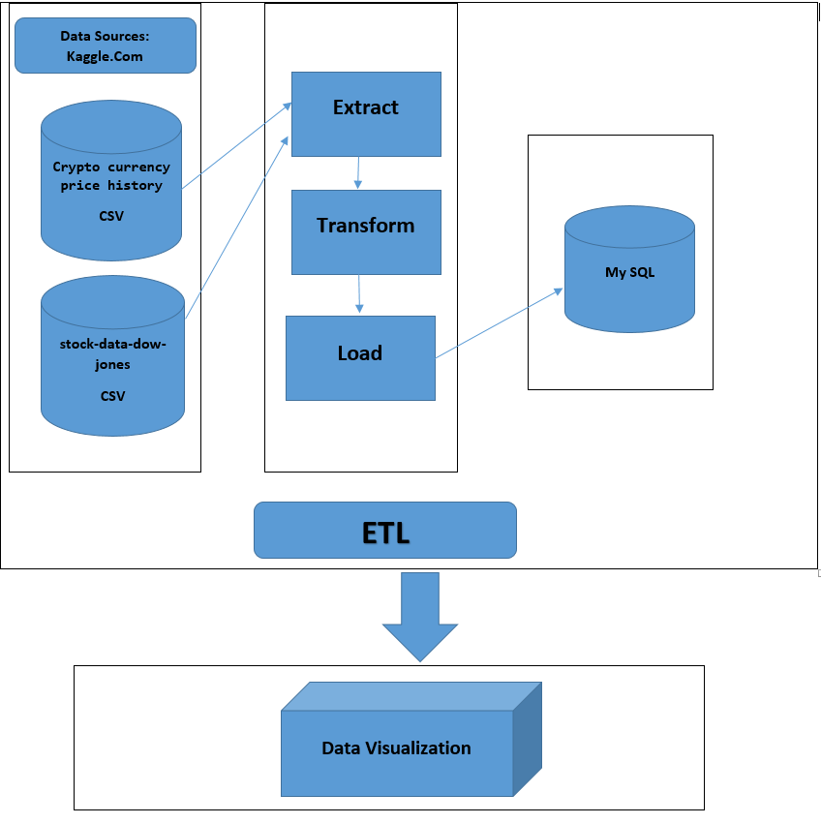

Slide 7
ETL Steps
Extract:
We extracted the data from .csv files downloaded from kaggle.com, called "cryptocurrencypricehistory" and "stock-data-dow-jones" respectively. To do this we used the read_csv feature from Pandas to make DataFrames for Bitcoin and IBM, the stocks we chose for analysis. Before the transformation phase, we also loaded this data into SQL to serve the purpose of the project, since in real world circumstances we might originally be retrieving it from a database for the extraction. We retrieved it from the database and put it back into DataFrames using Pandas.

Slide 8
ETL Steps
Transform:
There was no functional need to transform the data at the level of file type, since it was already in .csv format, which can be readily manipulated in Python. We also chose to use the time interval by which the data was originally presented (daily), so we didn't need to filter for particular dates. We cleaned the data, removing the parts we were not going to use for analysis (everything except price and volume) or as the index (date). We then used Pandas to merge (on date) the two cleaned DataFrames, ibm_df and bitcoin_df, into comparison_df.

Slide 9
ETL Steps
Load:
For the final step in the ETL process, we loaded comparison_df into SQL using Panda,pd.to_sql().

Slide 10
Data Visualization
For Data Visualization,we plotted Bitcoin Price by Date and IBM Price by Date separately. The graphs showed that while Bitcoin and IBM (perhaps cryptocurrencies and tech stocks in general, if we had had more time to analyze them) both experienced sharp increases over short periods of time. Bitcoin has fluctuated much more in general and still experiences price swings that IBM no longer seems to experience so drastically.

Slide 11
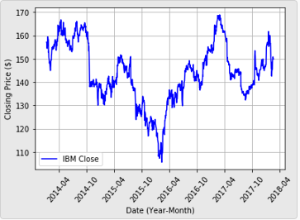
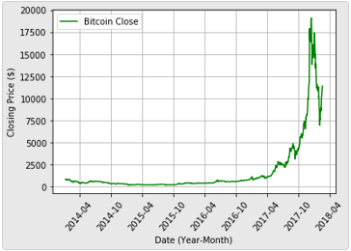
Data Visualization

Slide 12
Conclusion
This Analysis showed that while Bitcoin and IBM (perhaps cryptocurrencies and tech stocks in general, if we had had more time to analyze them) both experienced sharp increases over short periods of time. Bitcoin has fluctuated much more in general and still experiences price swings that IBM no longer seems to experience so drastically.

