Slide 1
Web Development & Design Foundations with HTML5
Flow & Positioning
Copyright © Terry Felke-Morris

Slide 2
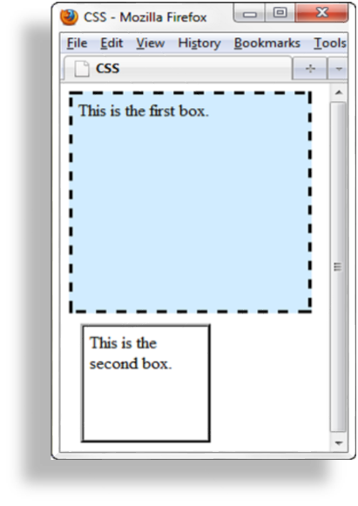
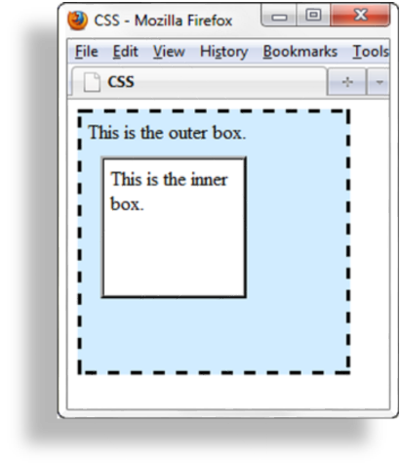
Normal Flow
Browser display of elements in the order they are coded in the Web page document
Nested div elements
Two div elements

Slide 3
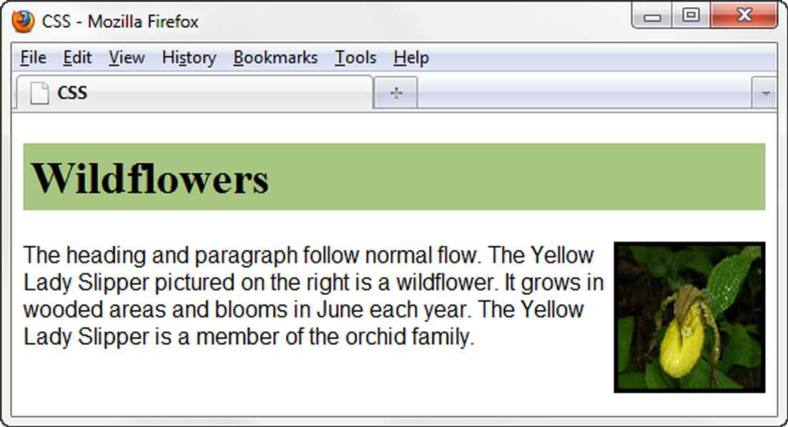
float Property
Elements that seem to “float" on the right or left side of either the browser window or another element are often configured using the float property.
Two values only: right and left.
h1 { background-color:#cccccc;
padding:5px;
color: #000000;}
p { font-family:Arial,sans-serif;}
#yls {float:right;
margin: 0 0 5px 5px;
border: solid;}

Slide 4
float Property
HTML source code is:
<body>
<h1>Wildflowers</h1>
<img id="yls" src="yls.jpg" alt="Yellow Lady Slipper" height="100" width="100">
<p>The heading and paragraph follow normal flow. The Yellow Lady Slipper pictured on the right is a wildflower. It grows in wooded areas and blooms in June each year. The Yellow Lady Slipper is a member of the orchid family.</p>
</body>
Use:
  float: right; to float the element on the right side.
  float: left; to float the element on the left side.
  The elements are pushed as far as possible within their container (usually either the browser viewport or a div element)
  Remember: The <div> tag is used to group block-elements to format them with CSS.

Slide 5
Tutorial Video
https://www.youtube.com/watch?v=xara4Z1b18I

Slide 6
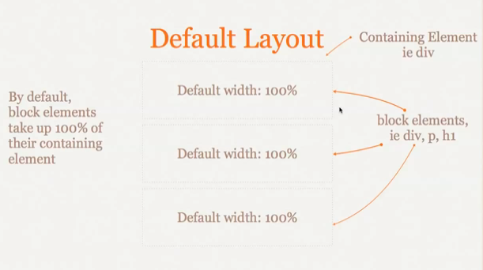
To clarify more..
By Christopher Stein

Slide 7
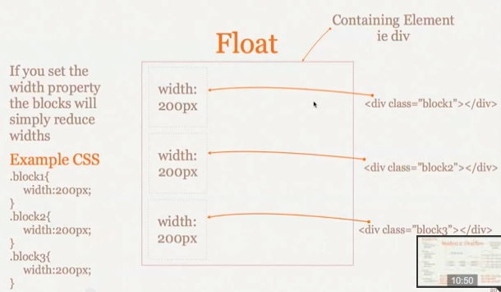

Slide 8
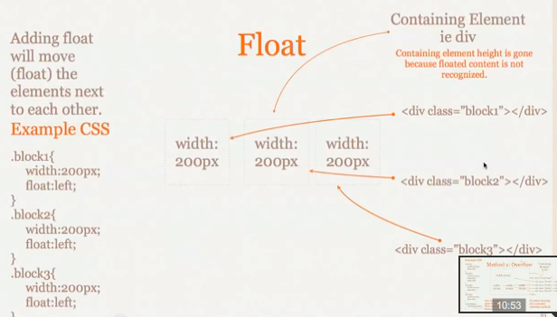
If there is room after the first block, the next block will float up next to it.

Slide 9
Let us practice
Download the practice folder from Moodle “float.html” or Code a page with 1 heading 1 paragraphs and 1 image.
Add a CSS to float your objects to the left then test your page.
Change the size of your browser, what happens?
Now edit your CSS to float the last object to the right, notice the difference.

Slide 10
clear Property
“Float” allows the elements that appear after it to float around your objects.
You can restrict that according to your requirements.
  Left: No floating elements allowed on the left side
  Right: No floating elements allowed on the right side
  Both: No floating elements allowed on either the left or the right side

Slide 11
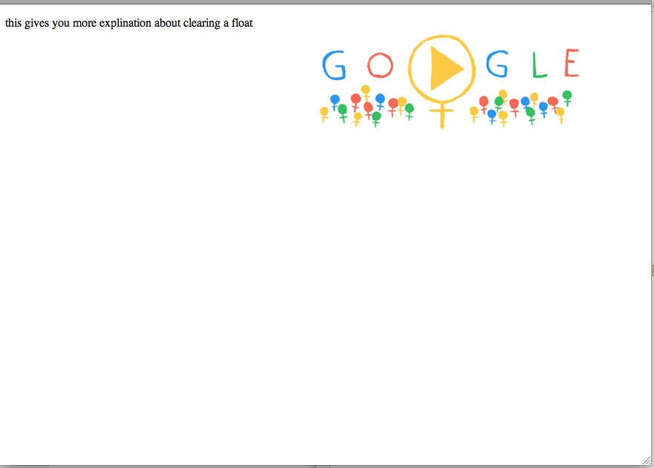
clear Property
Code a page with an image floated to the left and a paragraph. (the image is coded first)
Your page should look like:
<!DOCTYPE html>
<html lang="en">
<head>
<title> Lecture 6 </title>
<meta charset="utf-8">
<style>
img {float: right;}
</style>
</head>
<body>
<img src="google.png" alt="google logo";>
<p> this gives you more explanation about clearing a float </p>
</body>
</html>

Slide 12
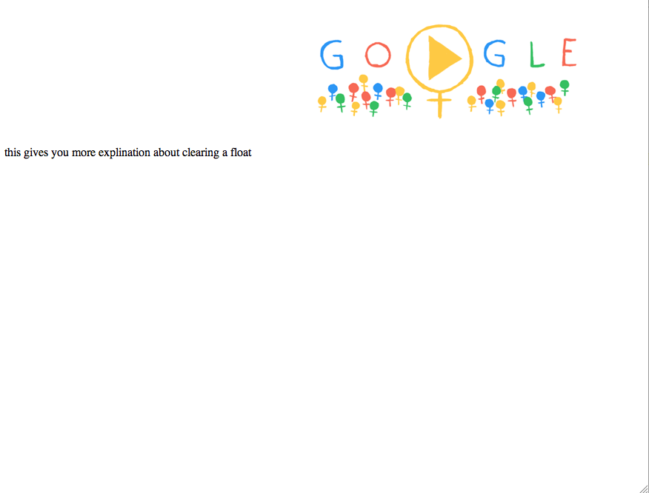
clear Property
Now let us edit the code:
Restrict the paragraph so it does not float around the image. Do this by adding this rule to your CSS p{ clear: both;}
Notice that the image floats but the text remain where it is.

Slide 13
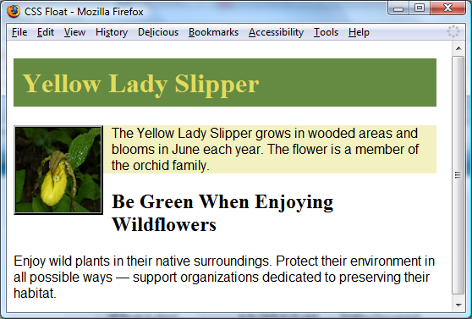
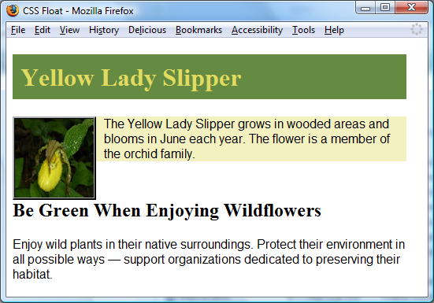
clear Property
The h2 text is displayed in normal flow.
Useful to “clear” or terminate a float
Values are left, right, and both
clear: left; was applied to the h2. Now the h2 text displays AFTER the floated image.

Slide 14
clear Property – Another technique
You can also use another technique which is adding a line break element <br> configured with the clear property after the floating object.
Example:
In HTML
<br class=“clearleft”>
In CSS:
.clearleft {clear:left;}

Slide 15
The overflow property
The overflow property specifies what to do if the content of an element exceeds the size of the element's box/

Slide 16
overflow Property
Visible: Default Value, the content is displayed and if it is too large it will overflow and extend outside the area allocated to it.
hidden: The content is clipped to fit the area allocated to the element in the browser viewport.
auto: The content fills the area allocated to it and if needed, scrollbars are displayed to allow access to the remaining content.
scroll: the content is rendered in the area allocated to it and scrollbars are displayed.
div {
overflow: auto;
}

Slide 17
overflow Property
http://www.w3schools.com/cssref/tryit.asp?filename=trycss_overflow

Slide 18
Video Tutorial
https://www.youtube.com/watch?v=P72JaLgu8Ns

Slide 19
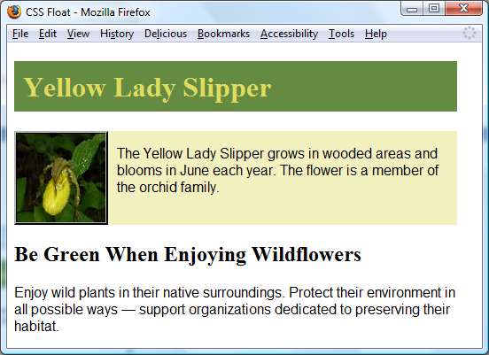
overflow Property
The background does not extend as far as you’d expect.
Intended to configure the display of elements on a Web page.
However, it is useful to “clear” or terminate a float before the end of a container element
Values are auto, hidden, and scroll
overflow: auto; was applied to the div that contains the image and paragraph. Now the background extends and the h2 text displays AFTER the floated image.

Slide 20
overflow Property
Example of configuring scroll bars with the overflow property:
This will automatically display scrollbars if the content exceeds the space allocated to it:
div {
Background-color: #F3F1BF;
overflow: scroll;
width: 300px;
height: 100px;
}

Slide 21
CSS Layout properties
Specify location of elements
More control over the position of an element
Properties:
  Relative
  Absolute

Slide 22
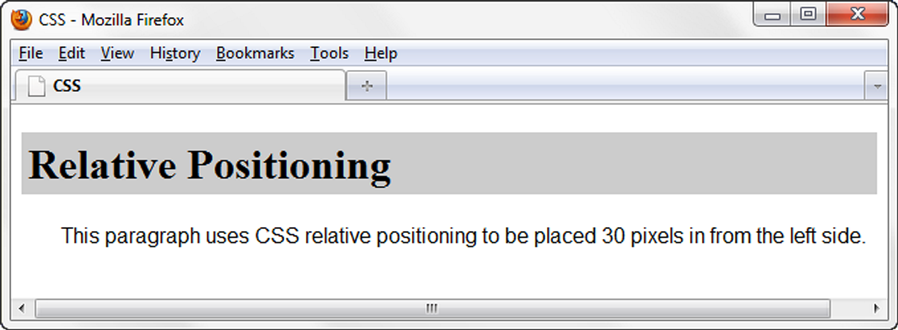
1.Relative Positioning
Changes the location of an element in relation to where it would otherwise appear with the normal flow.
Properties: top, left, right & bottom
h1 { background-color:#cccccc;
padding: 5px;
color: #000000; }
#myContent {
position: relative;
left: 30px;
font-family: Arial,sans-serif; }

Slide 23
1.Relative Positioning
HTML source code is:
<h1>Relative Positioning </h1>
<div id=“myContent”>
<p> This paragraph uses CSS relative positioning to be placed 30 pixels in from the left side.</p>
</div>

Slide 24
Let us practice
Code a page with one heading, one paragraph and one image.
Check how the browser renders the page.
Now change the position of the heading to:
h1 {position: relative;
top: 40px;}
Notice how changing the position did not affect the position of other elements the in the page, the rest of the page acts like nothing changed at all.

Slide 25
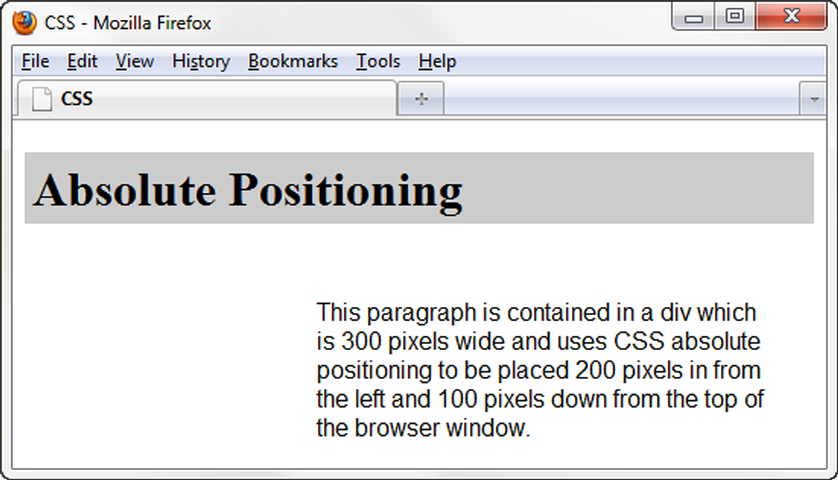
2.Absolute Positioning
Precisely specifies the location of an element in the browser window
h1 { background-color: #cccccc;
padding: 5px;
color: #000000; }
#content {position: absolute;
left: 200;
top: 100;
font-family: Arial,sans-serif;
width: 300; }

Slide 26
2.Absolute Positioning
HTML source code is:
<h1>Absolute Positioning </h1>
<div id=“content”>
<p> This paragraph is contained in a div…...</p>
</div>

Slide 27
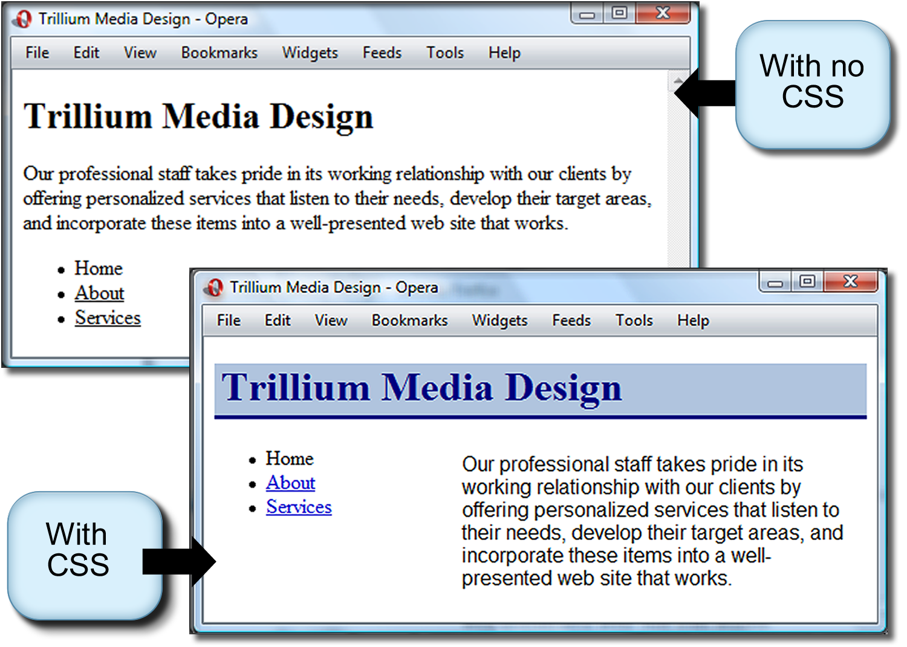
Absolute Positioning Example

Slide 28
Absolute Positioning Example
The CSS:
.content { position: absolute;
left: 200px;
top: 75px;
width: 300px; }

Slide 29
Let us practice
Using the html code you just created for the relative position, have your image located at the very top left corner of the page by editing your CSS
img {
position: absolute;
top: 0px;
left: 0px;
}

Slide 30
The End

