Slide 1
Web Development & Design Foundations with HTML5

Slide 2
Learning Outcomes
In this chapter, you will learn how to ...
  The box model
  Apply borders properties to an element
  Apply paddings properties to an element
  Apply margin and properties to an element

Slide 3
Borders, Paddings & Margins

Slide 4
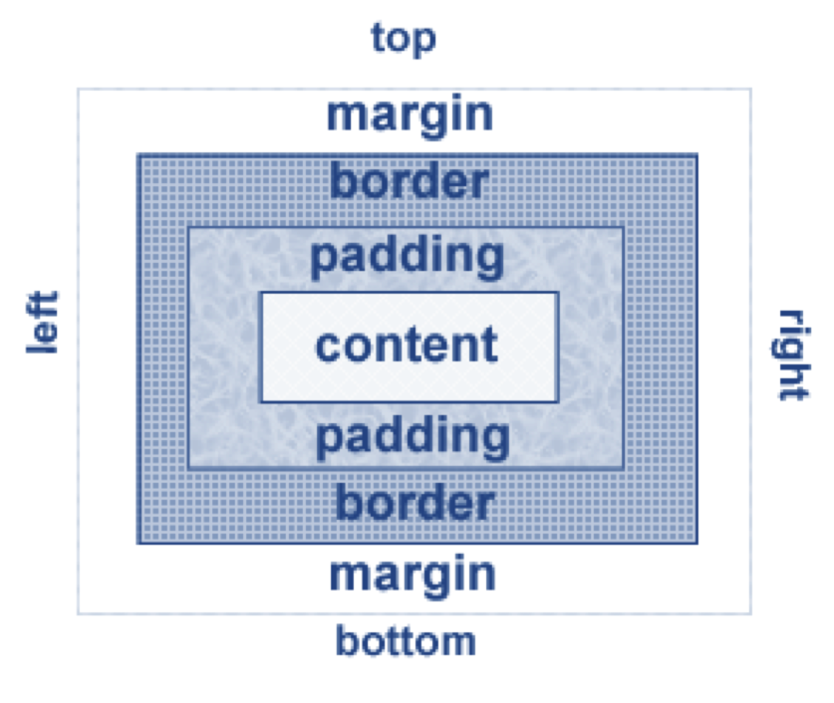
The Box Model
Content
  Text & web page elements in the container
Padding
  Area between the content and the border
Border
  Between the padding
  and the margin
Margin
  Determines the empty space between the element and adjacent elements

Slide 5
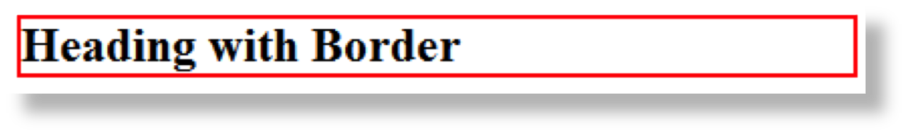
CSS border Property
Configures a border on the top, right, bottom, and left sides of an element
Consists of
  border-width
  border-style (inset, outset, double, groove, ridge, solid, dashed, dotted)
  border-color

Slide 6

CSS border Property
  A shorthand notation allows you to configure all border properties in one style rule:
h2 { border: 2px solid #ff0000 }

Slide 7
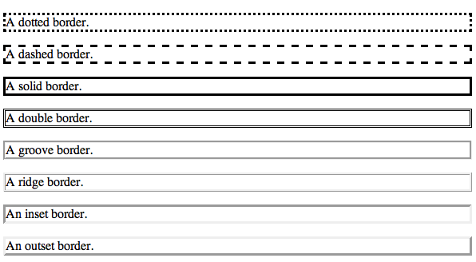
CSS border Property

Slide 8
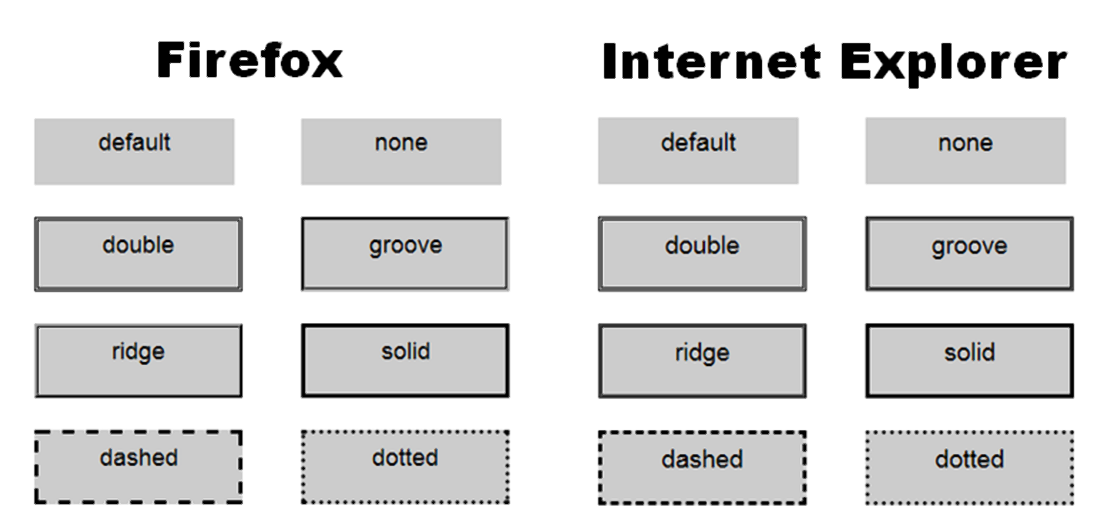
Browser Display Can Vary

Slide 9
Block & Inline Elements
HTML Block Elements
Block level elements normally start (and end) with a new line when displayed in a browser.
Examples: <h1>, <p>, <ul>, <table>
HTML Inline Elements
Inline elements are normally displayed without starting a new line.
Examples: <b>, <td>, <a>, <img>

Slide 10
Block & Inline Elements
Q: Block or inline element?
<Span> ?
<div> ?

Slide 11
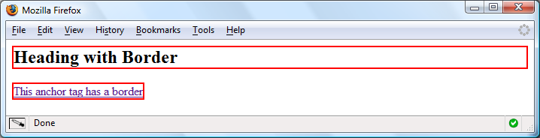
CSS Borders:
Block / Inline Elements
Block display element
  default width of element content extends to browser margin (or specified width)
Inline display element
  Border closely outlines the element content
  h2 { border: 2px solid #ff0000; }
  a { border: 2px solid #ff0000; }

Slide 12

Configuring Specific
Sides of a Border
Use CSS to configure a line on one or more sides of an element
  border-bottom
  border-left
  border-right
  border-top
h2 { border-bottom: 2px solid #ff0000 }

Slide 13
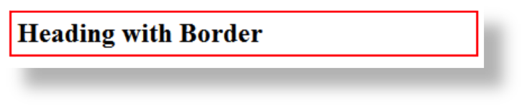
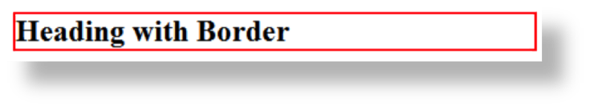
CSS padding Property
Configures empty space between the content of the HTML element and the border
Set to 0px by default
h2 { border: 2px solid #ff0000;
padding: 5px; }
No padding property configured:

Slide 14
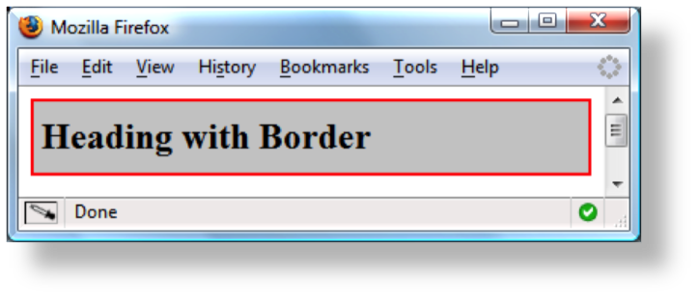
Configure Padding on
Specific Sides of an Element
Use CSS to configure padding on one or more sides of an element
  padding-bottom
  padding-left
  padding-right
  padding-top
h2 { border: 2px solid #ff0000;
background-color: #cccccc;
padding-left: 5px;
padding-bottom: 10px;
padding-top: 10px; }

Slide 15
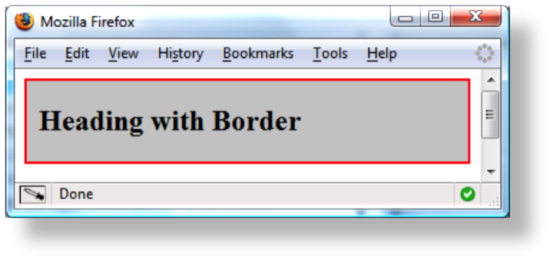
CSS padding Property Shorthand: two values
Two numeric values or percentages
  first value configures top and bottom padding
  the second value configures left and right padding
    h2 { border: 2px solid #ff0000;
    background-color: #cccccc;
    padding: 20px 10px;
    }

Slide 16
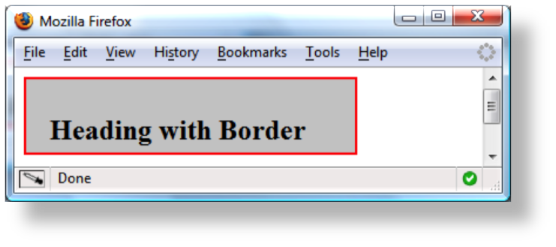
CSS padding Property Shorthand: four values
Four numeric values or percentages
  Configure top, right, bottom, and left padding
    h2 { border: 2px solid #ff0000;
    width: 250px;
    background-color: #cccccc;
    padding: 30px 10px 5px 20px;
    }

Slide 17
Hands-On Practice
Code an HTML page with an h1 and h2 elements.
Rules for h1 elements selector are:
Padding: 15px;
Border-style: solid;
Rules for h2 elements selector are:
Border-bottom: 2px dashed #191970;
Padding-top: 20px;

Slide 18
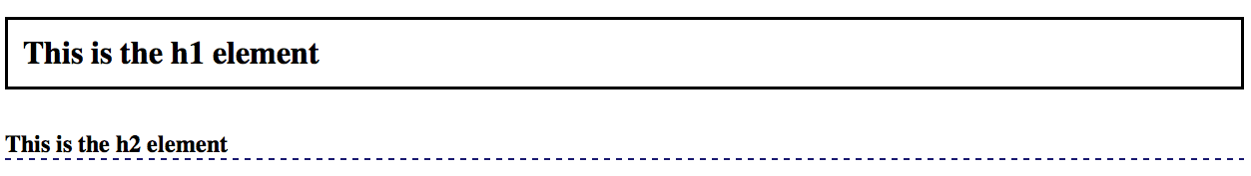
Your page should look similar to:

Slide 19
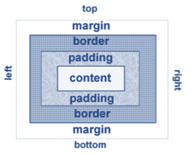
Configure Margin with CSS
  The “margin” property
  Related properties:
    margin-top, margin-right, margin-left, margin-bottom
  Configures empty space between the element and adjacent elements
  Syntax examples
    h1 { margin: 0; } configure all sides
    h1 { margin: 20px 10px; } 1st value: top & bottom, 2nd value: right & left
    h1 { margin: 10px 30px 20px; } 1st value: top, 2nd value: right & left, 3rd value: bottom
    h1 { margin: 20px 30px 0 30px; } 1st value: top, 2nd value: right, 3rd value: bottom, 4th: left

Slide 20
Configure Margin with CSS
  The margin is always transparent, the background color of the webpage or the parent element shows in this area.
  use numeric value (px or em)
  To eliminate the margin configure it to 0 (with no unit).
  Use the value auto to indicate that the browser should calculate the margin. Example: configuring a centered page:
  Margin-left: auto;
  Margin-right: auto;

Slide 21
Configure Padding with CSS
  The padding property
  Related properties:
    padding-top, padding-right, padding-left,
    padding-bottom
  Configures empty space between the content of the HTML element (such as text) and the border
  Default padding value is: 0
  Syntax examples
    h1 { padding: 0; }
    h1 { padding : 20px 10px; }
    h1 { padding : 10px 30px 20px; }
    h1 { padding : 20px 30px 0 30px; }

Slide 22
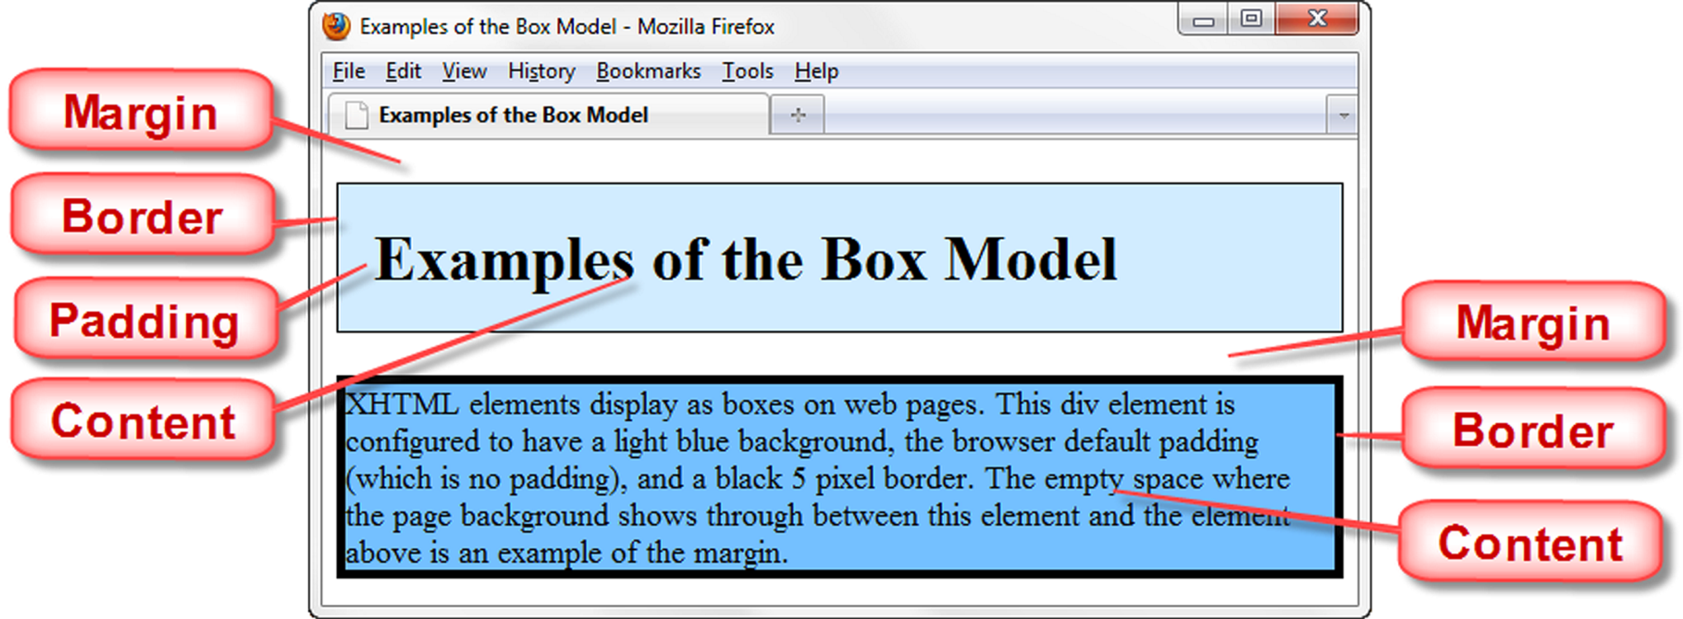
Box model in Action

Slide 23
More on borders
The border-radius property

Slide 24
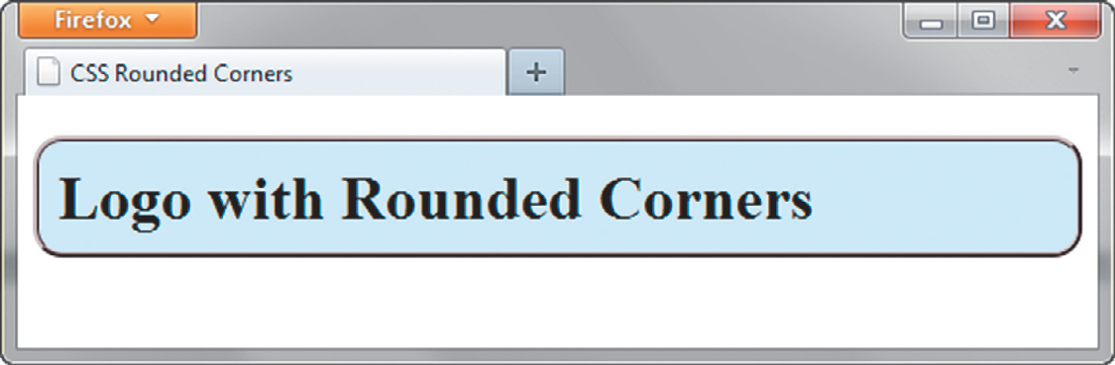
CSS3 Rounded Corners
border-radius property
  Configures the horizontal radius and vertical radius of the corner
  Numeric value(s) with unit (pixel or em) or percentage
Browser vendor proprietary properties:
  -webkit-border-radius (for Safari & Chrome)
  -moz-border-radius (for Firefox)
  border-radius (W3C syntax)
Example
h1 { -webkit-border-radius: 15px;
-moz-border-radius: 15px;
border-radius: 15px; }

Slide 25


Examples of Rounded Corners
One value for border-radius configures all four corners
Example:
border-radius: 15px;
Four values for border-radius configure each corner separately
Ordered by top left, top right, bottom right, bottom left
Example:
border-radius: 15px 30px 100px 5px;

Slide 26
Thank You

