Slide 1
Web Development & Design Foundations with HTML5
JavaScript

Slide 2
Learning Outcomes
In this chapter, you will learn how to:
  Overview of JavaScript
  Describe common uses of JavaScript in web pages.
  Create a simple JavaScript using the script element.
  Debugging JavaScript.
  Describe the purpose of the Document Object Model.
  Events & Event Handlers.
  Variables
  JS data types
  Using the prompt method

Slide 3

What is JavaScript?
JavaScript allows web authors to create dynamic pages that react to user interaction.
It is an Object-based because it works with the objects associated with a web page: the browsers window, web page elements such as forms, images and links.

Slide 4
What is JavaScript?
It is considered to be a client-side scripting language (a type of programming language)
Client-side processing: JavaScript code is embedded in the HTML and rendered by the web browser. All the processing is performed by the client (the web browser).

Slide 5
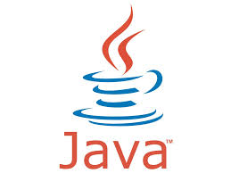
JavaScript & Java
JavaScript is NOT Java.
Java is very technical and can be used to build large applications for business such as inventory control systems.
Run on operating systems such as Windows or Unix.
Java was build by Sun Microsystems in the 1990’s

Slide 6
The Development of JavaScript
The developers wanted flexibility.
A team at Netscape developed liveScript scripting language then partnered with Sun Microsystems and produced JavaScript on 1996.

Slide 7
Lynda.com video lesson
http://www.youtube.com/watch?v=955L9-NoBoE

Slide 8
Common Uses of JavaScript
Display a message box
Select list navigation
Edit and validate form information
Create a new window with a specified size and screen position
Image Rollovers
Status Messages
Display Current Date
Calculations

Slide 9
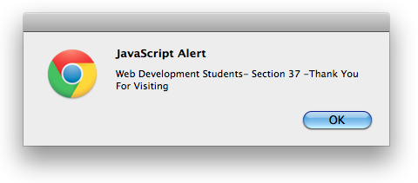
Alert Message
Used to draw the users attention. Example:
This is an alert message that is displayed when the user is leaving the page.

Slide 10
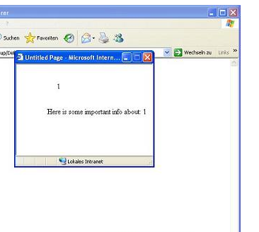
Popup window
A web browser window that appear when you interact with a web page.
Popup windows have been abused that most browsers allow users to block popups!

Slide 11


Mouse Movement Techniques
Perform a task based on mouse movement in the browser.
Example: Rollover images, the mouse movement triggered the image-swapping.

Slide 12
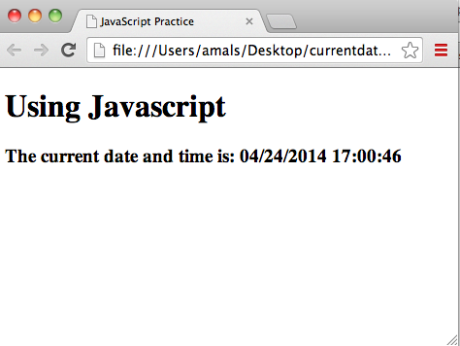
Display Date & Time
You can display current date and time or display a clock on your window and much more.

Slide 13
Coding JavaScript
JavaScript statements can be coded on a web page using two different techniques:
  Place JavaScript code between <script> tags
  OR
  2. Place JavaScript code as part of an event attached to an HTML element

Slide 14
1.Using The script Element
The script element
  A container tag <script>…</script>
  May be placed in either the head or the body section of a web page
  Requires a type attribute
<script type="text/javascript">
</script>

Slide 15
1.Using The script Element
The statement block template:
Use HTML comments before and after JavaScript statement block to hide JavaScript from older browsers. Older browsers (Netscape 1.x, MIE 3 and AOL browsers before version 4) don’t understand JavaScript.
<script type="text/javascript">
<!--
JavaScript code goes here
// -->
</script>

Slide 16
Coding js
To comment in JavaScript use the //
Each command line ends with a semicolon ;
Web Pages are rendered from top to bottom, the scripts will execute wherever they are located in the document.
JavaScript is case sensitive

Slide 17
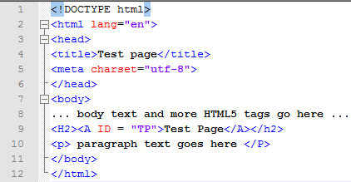
JavaScript Is CASE
SENSITIVE!
HTML 5 IS NOT CASE SENSITIVE
alert("Welcome to Our Site");✓
Alert("Welcome to Our Site"); x

Slide 18
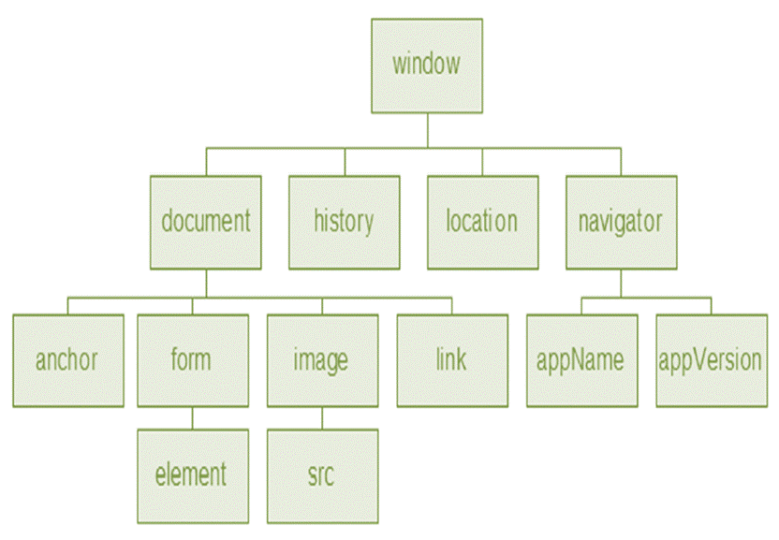
Document Object Model (DOM)
Jscript manipulate the elements of HTML doc.
DOM is a collection of objects, properties & methods.

Slide 19
Object
An object is an entity or a “thing”. Any HTML element is considered to be an object. e.g. window, images, forms,..etc
The webpage is considered to be a document. (the document is an object too)
The objects may have properties that can be manipulated, e.g background-color.

Slide 20
Property
A property is a characteristic or attribute of an object.
  The background color of a web page document
  document.bgcolor
  The date the web page file was last modified
  document.lastmodified

Slide 21
Method
A method is an action (a verb) that can be performed on some objects.
  write()
  close()
  open()
  alert()
  Writing text to a web page document
    document.write()

Slide 22
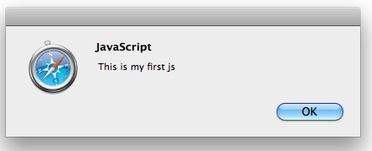
Hands-on Practice 1
In this practice your are required to display an alert message box that says “This is my first js” using the alert method.
<script type="text/javascript">
<!—
alert (“ This is my first js”);
//-->
</script>

Slide 23
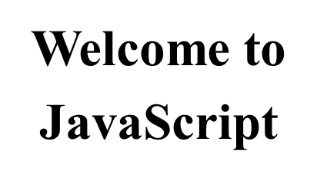
HTML in javaScript
<script type="text/javascript">
document.write("<h1>Welcome to<br>JavaScript</h1>")
</script>

Slide 24
Difference between write() and writeln():
<p>Note that write() does NOT add a new line after each statement:</p>
<script>
document.write("Hello World!");
document.write("Have a nice day!");
</script>
-------
<p>Note that writeln() add a new line after each statement:</p>
<script>
document.writeln("Hello World!");
document.writeln("Have a nice day!");
</script>

Slide 25
Debugging JavaScript
If your JavaScript code doesn’t work you will need to debug the code to find the errors by going to: Tools → Web Developer → Error Console.
If we edit the code and introduced a typing error “aalert” instead of “alert”
    The Error Console will indicate an issue and the line number
    This may not be exactly where the problem is
    Sometimes the error is a one or two lines above the indicated line number.

Slide 26
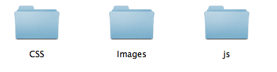
JavaScript Source File
You can also save JavaScript code in an external file called a source file .js
The source file cannot include HTML tags and will not contain the <Script> tags.
<script type="text/javascript”
src=“sourcefile.js”>
nothing in between will be executed!
</script>

Slide 27
JavaScript Source File
Your HTML document will be neater
The JavaScript code can be shared among multiple HTML documents.
JavaScript source file hide JavaScript code from incompatible browsers.
JavaScript source files help hide your JavaScript code.

Slide 28
Events & Event Handlers
Events:
actions taken by the web page visitor
Event handlers:
Indicates which event to target
  clicking (onclick),
  placing the mouse on an element (onmouseover),
  removing the mouse from an element (onmouseout),
  loading the page (onload),
  unloading the page (onunload), etc.
  Submitting a form.

Slide 29
Events
Event | Event Handler
click | onclick
load | onload
mouseover | onmouseover
mouseout | onmouseout
submit | onsubmit
unload | onunload

Slide 30
Working With Events
https://www.youtube.com/watch?v=wYaNV88TaZM

Slide 31
2.Using The Event Handlers
JavaScript can be configured to perform actions when events occur.
  The event name is coded as an attribute of an HTML tag
  The value of the event attribute contains the JavaScript code
<a href="home.htm"
onmouseover="alert('Click to go home');">Home</a>

Slide 32
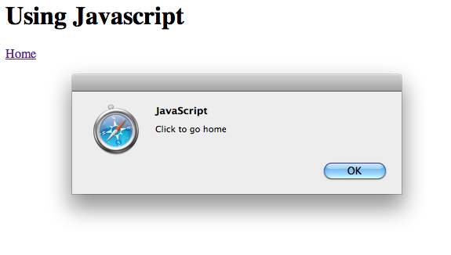
2.Using The Event Handlers
Example:
Display an alert box when the mouse is placed over hyperlink.
<!DOCTYPE html>
<html lang="en">
<head>
<title>JavaScript Practice</title>
<meta charset="utf-8">
</head>
<body>
<h1>Using Javascript</h1>
<a href="home.html"
onmouseover="alert('Click to go home');">Home</a>
</body>
</html>

Slide 33
Variable
A variable is a placeholder for information.
The variable is stored in the computer’s memory (RAM).
e.g. prompting the user for his name and writing the name to the document:
To create a variable in js:
  We declare the JavaScript variable with the var word
  We assign a value to our variable (if we need to)
var userName;
userName = ”Ms. Amal";
document.write(userName);

Slide 34
Creating variables in JS
Create a variable name that describes the data it contains.
You can have: uppercase, Lowercase, numbers, underscore and the dollar sign.
Variable names cannot contain spaces.
Do no use JS reserved words or keywords such as var, return, function. A list of JS key words can be found at:
http://www.javascripter.net/faq/reserved.htm

Slide 35
JavaScript Data Types
There are many types of JavaScript variables. In this course we will use numbers & strings.
When assigning a number to your variable all what you have to do is type the number. e.g. var x=6;
When you assign a text to your variable you need to place a double or single quotes around the value. e.g. var x=“Web Development”; or var y= ‘Web Development’;

Slide 36
Variables
Variable can be empty: var userName;
Or has a value: var userName=“Noura”;
One statement can have many variables:
var userName=“Noura”, age=25, job=“lecturer”;

Slide 37
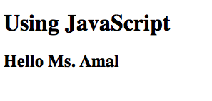
Example
<!DOCTYPE html>
<html lang="en">
<head>
<title>JavaScript Practice</title>
<meta charset="utf-8">
</head>
<body>
<h1>Using JavaScript</h1>
<h2>Hello
<script type="text/javascript">
<!--
var userName;
userName = "Ms. Amal";
document.write(userName);
// -->
</script>
</h2>
</body>
</html>

Slide 38
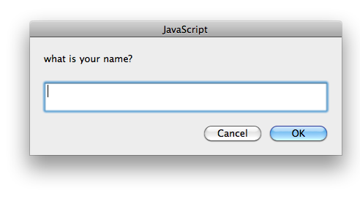
Prompts
prompt() method
  The prompt() method displays a dialog box with a message, a text box, an OK button & a Cancel button.
  It requests a data from the user.
  var myName;
  myName = prompt(“prompt message”);
  The value typed by the user is stored in the variable myName

Slide 39
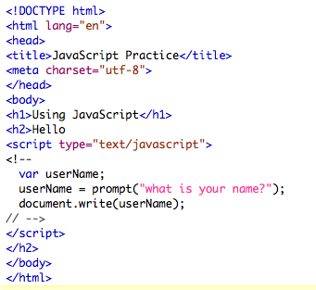
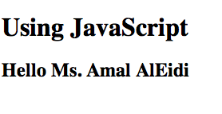
Prompts

Slide 40
Hands-on Practice 1
Ask the user for his favorite dish and second favorite dish using two prompt methods.
Next, place the sentence “Your two favorite dishes are “ before your script.
Then write his two favorite dishes to your document.

Slide 41
Hands-on Practice 1: The Code
<body>
<h1>Using JavaScript</h1>
<h2>You two favorite dishes are:
<script type="text/javascript">
<!--
var bestDish, bestRes;
bestDish= prompt("What is your Favorite dish?");
bestRes= prompt("How about your second favorite dish?");
document.write(bestDish," ", bestRes);
// -->
</script>
</h2>

Slide 42
Event handling Resources
http://www.youtube.com/watch?v=_cLvpJY2deo
http://www.youtube.com/watch?v=wYaNV88TaZM

