Slide 1
Web Development & Design Foundations with HTML5
JavaScript – Part 3

Slide 2
Learning Outcomes
  All about Functions
  Working with dates

Slide 3
Functions
Allow the user to decide when a particular script should be run by the browser in stead of running as long as the page loads.

Slide 4
Functions
A function is a block of one or more JavaScript statements with a specific purpose, which can be run when needed.
Every function must be given a name, and can be invoked, or called, by other parts of the script.
Function can be called as many times as needed during the running of the script.
function function_name() {
... JavaScript statements …
}

Slide 5
Remember the form buttons?
Three types of buttons:
1-<input type=“submit”>
2-<input type=“reset”>
3-<input type=“button”> does not have any default action related to forms
Or <button> </button>

Slide 6
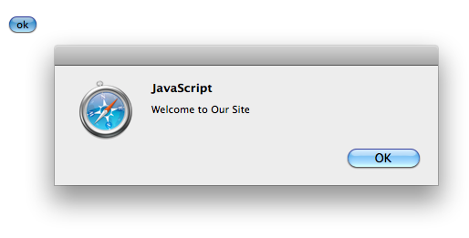
Using Functions
Defining the Function (head)
<script type=“text/javascript”>
<!-- function showAlert() {
alert(”Welcome to Our Site");
}
//-->
</script>
Calling the Function (body)
<input type=“button” value=“ok” onclick=showAlert();”>

Slide 7
Same output
<head>
<script type=“text/javascript”>
<!-- function showAlert() {
alert(”Welcome to Our Site");
}
//-->
</script>
</head>
<body>
<input type=“button” value=“ok” onclick=showAlert();”>
</body>
<body>
<input type="button" value="ok" onclick="alert('Welcome to Our Site');">
</body>

Slide 8
Hands-on practice 2
Remember the hand-on practice 2 last lecture?
move the prompting script into a function with an onlick event handler to a button.
Choose meaningful function name, e.g. promptQuantity()
Code your JavaScript in the head section

Slide 9
Hands-on practice 2 (JavaScript Part2)
var quantity;
quantity = prompt("Type a quantity greater than 0");
if (quantity<=0) {
document.write("quantity is not greater than 0,please refresh the web page");
}
else{
document.write("Thank You!");
}

Slide 10
The answer
<head>
<script type=“text/javascript”>
<!–-
function promptQuantity() {
var quantity;
quantity = prompt("Type a quantity greater than 0");
if (quantity<=0) {
document.write("quantity is not greater than 0,please refresh the web page");
}
else{
document.write("Thank You!");
}
}
//-->
</script>
</head>
<body>
<input type=“button” value=“click on enter a quantity”
onclick=promptQuantity();>
</body>

Slide 11
Hands-on practice 3
Write the JavaScript code using a function to display an alert message for users who are under 18 years old and a different alert message for users who are 18 years or older.
The function will be invoked using a button.

Slide 12
The Answer
<head>
<script type="text/javascript">
<!--
function showAlert()
{
var userAge
userAge=prompt("type your age");
if (userAge< 18) {
alert("You are under age!");
}
if (userAge>=18) {
alert("you are 18 or older");}
}
//-->
</script>
</head>
<body>
<h1>You will be asked to type your age</h1>
<input type="button" value="click me" onclick=showAlert();>
</body>
</html>

Slide 13
Function Parameters
When you call a function, you can pass values to it. These values are called arguments or parameters.
Identifiers, in the function definition, are called parameters.
Multiple parameters are separated by commas:
function myFunction(parameter1, parameter2) {
code to be executed
}
http://www.w3schools.com/js/js_functions.asp

Slide 14
Function Arguments
Values received by the function, when the function is invoked, are called arguments.
The parameters and the arguments must be in the same order:
var x = myFunction(argument1, argument2);
http://www.w3schools.com/js/js_functions.asp

Slide 15
Example:
A function that will add one to a number entered by the user:
<head>
<script type="text/javascript">
<!--
function addOne(userNumber) {
userNumber++;
alert(userNumber);
} //-->
</script>
</head>
<body>
<p> A function that adds 1 to the number input by the user </p>
<script type="text/javascript">
<!--
var userNumber=prompt("Enter a number");
addOne(userNumber);
//-->
</script>
</body>

Slide 16
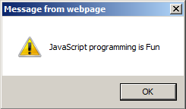
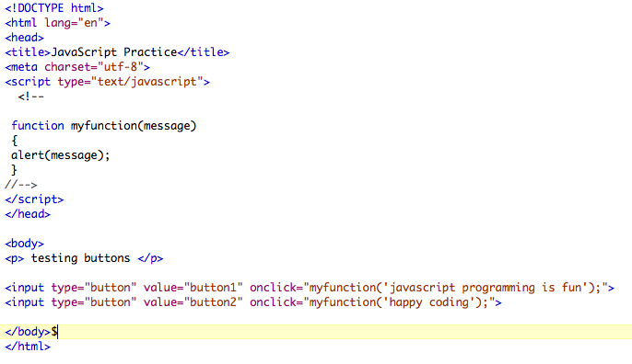

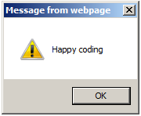
Passing information to a function

Slide 17
Soft copy code
<!DOCTYPE html>
<html lang="en">
<head>
<title>JavaScript Practice</title>
<meta charset="utf-8">
<script type="text/javascript">
<!--
function myfunction(message)
{
alert(message);
}
//-->
</script>
</head>
<body>
<p> testing buttons </p>
<input type="button" value="button1" onclick="myfunction('javascript programming is fun');">
<input type="button" value="button2" onclick="myfunction('happy coding');">
</body>
</html>

Slide 18
The Return Statement
When JavaScript reach a return statement, the function will stop executing.
If the function was invoked from a JavaScript statement , JavaScript will "return" and continue to execute the code after the invoking statement.
Functions often computes a return value. The return value is "returned" back to the "caller":
var x = myFunction(4, 3); // Function is called, return value will end up in x
function myFunction(a, b) {
return a * b; // Function returns the product of a and b}
http://www.w3schools.com/js/js_functions.asp

Slide 19
What is the output?
In the next slide you have a function that requires two values entered by the user, lets assume that the user’s input were 10 as the width and 10 as the length, what would be the output?

Slide 20
What is the output?
<head>
<script type="text/javascript">
<!--
function Area(Width, Length)
{
var Size = Width*Length;
return Size;
}
//-->
</script>
</head>
<body>
<script type="text/javascript">
<!--
var Width=prompt("enter the width");
var Length=prompt("enter the length");
var Size=Area(Width,Length);
document.write(Size);
//-->
</script>
</body>

