Slide 1
Web Development & Design Foundations with HTML5
More about hyperlinks
Mobile sites

Slide 2
Learning
Outcomes
In this chapter, you will learn how to ...
Code relative hyperlinks to web pages in folders within a website
Configure a hyperlink to a named fragment internal to a web page
Configure images with CSS sprites
Configure a three-column page layout using CSS
Configure CSS for printing
Configure CSS for mobile display
Utilize CSS3 media queries to target mobile devices

Slide 3
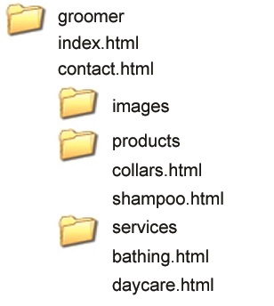
More on
Relative Linking
Relative links from the home page: index.html
<a href="contact.html">Contact</a>
<a href="products/collars.html">Collars</a>
<a href="../index.html">Home</a>
<a href="../services/bathing.html">Dog Bathing</a>
When linking file that is up one directory level from the current page use the “ ../ ” notation

Slide 4
Telephone & Text Message Hyperlinks
Tap on the phone and place a call or send SMS
Telephone Scheme
<a href="tel:888-555-5555">Call 888-555-5555</a>
Many mobile browsers will initiate a phone call when the hyperlink is clicked.
SMS Scheme
<a href="sms:888-555-5555">Text 888-555-5555</a>
Many mobile browsers will initiate a text message to the phone number when the hyperlink is clicked.
Note: Not all mobile browser and devices support this hyperlink.

Slide 5
CSS Styling for Print
Create an external style sheet with the configurations for browser display.
Create a second external style sheet with the configurations for printing.
Connect both of the external style sheets to the web page using two <link > elements.
<link rel="stylesheet" href="wildflower.css" type="text/css" media="screen">
<link rel="stylesheet" href="wildflowerprint.css" type="text/css" media="print">

Slide 6
Print Styling Best Practices
Hide non-essential content
coding Example:
  #nav { display: none; }
Configure font size and color for printing
  Use pt font sizes, use dark text color
Control page breaks
  The page break is when you break your content to the next page.
  The is a property that allow you to control on how your web content should be split, page after page.
  Coding Example:
  .newpage { page-break-before: always; }
  In the HTML assign class in the preceding element like: <p class=newpage>
Print URLs for hyperlinks
when you see the actual links for the resources when reading the printout of your web page. http://davidwalsh.name/demo/css-links.php (Pseudo elements: before & after)
  Coding Example:
  #sidebar a:after { content: " (" attr(href) ") "; }
  The “content” property generates a content. The attr(x) returns the value of an HTML attribute

Slide 7
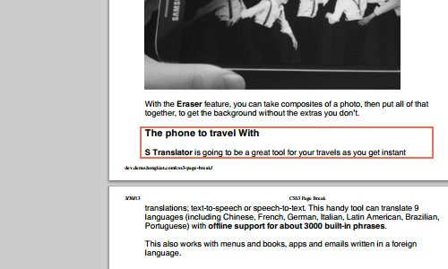
Control Page Breaks
http://www.hongkiat.com/blog/css3-page-break/

Slide 8
Mobile Web
Three methods to provide Access for mobile devices visitors:
Design & publish a second website with the mobi TLD
Example: jcp.com & jcp.mobi
2. Design & publish a separate website within your domain targeted for mobile users
Example: whitehouse.gov & m.whitehouse.gov
3.Configure website with separate style for mobile & desktop browsers.

Slide 9
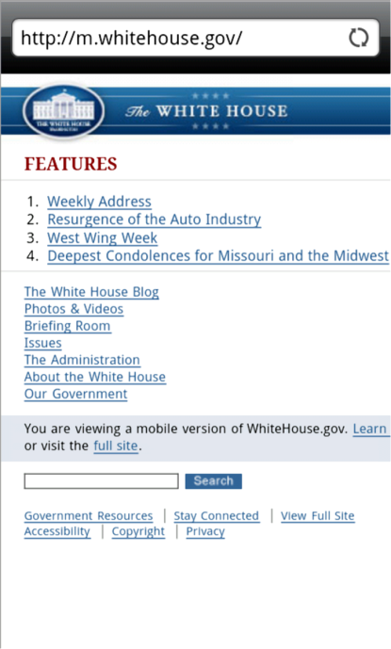
Mobile Web Design Best Practices
eMarketer.com predicts 134.3 million mobile Internet users by 2013 (http://www.emarketer.com/articles/print.aspx?1007236)

Slide 10
Mobile Web Limitations
Small Screen Size
Low bandwidth
Limited fonts
Limited color
Awkward controls
Lack of Flash support
Limited processor and memory
Cost per kilobyte

Slide 11
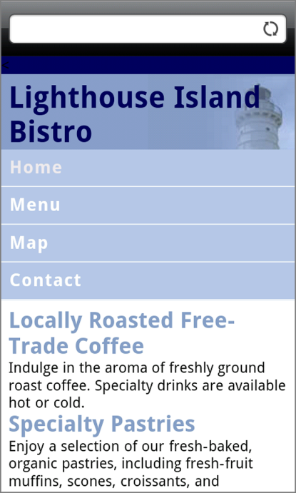
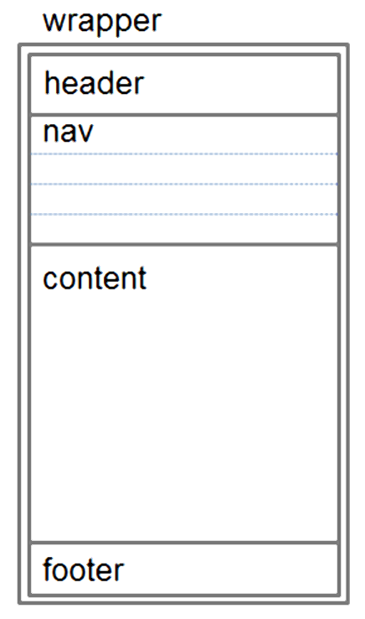
Design Techniques for Mobile Web
Single column design
Limit scrolling to one direction
Use lists to organize information
Avoid floats, tables, frames
Descriptive page title
Descriptive heading tags
Optimize images
Descriptive alt text for images
Eliminate unneeded images
Navigation in lists
Em or percentage font size units
Common font typefaces
Avoid absolute positioning
Good contrast between text and background colors
Provide “Skip to Content” hyperlink
Provide “Back to Top” hyperlink

Slide 12
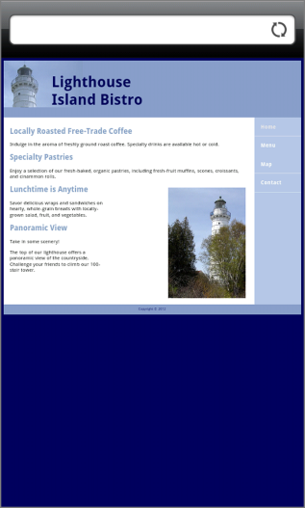
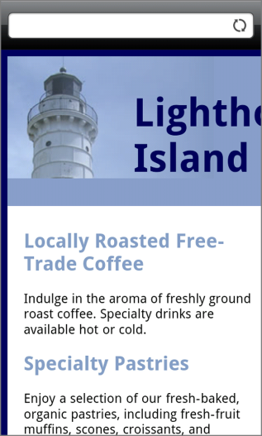
Viewport Meta Tag
Default action for most mobile devices is to zoom out and scale the web page
Viewport Meta Tag
Created as an Apple extension to configure display on mobile devices
Configures width and initial scale of browser viewport
<meta name="viewport" content="width=device-width,
initial-scale=1.0">
Initial scale set to 1 for 100%

Slide 13
CSS3 Media Queries
Media Query
  Determines the capability of the mobile device, such as screen resolution and orientation
  Directs the browser to styles configured specifically for those capabilities
Example:
<link href="lighthousemobile.css" rel="stylesheet"
media="only screen and (max-device-width: 480px)">

Slide 14
Testing Mobile Display
Publish it on the web and access it from a mobile device.
Several options for emulating a mobile display
  http://www.springbox.com/mobilizer/ (supports media queries)
  http://www.testiphone.com (does not support media queries)

Slide 15
Summary
This chapter introduced you to a variety of topics related to hyperlinks, page layout, and designing for the mobile web.

