Slide 1
Web Development & Design Foundations with HTML5
Chapter 1
Key Concepts

Slide 2
Learning Outcomes
In this chapter, you will learn how to:
Describe the evolution of the Internet and the Web
Internet Standards & Coordination
Protocols
What are usability & Accessibility
Intranet & Extranet
Define URIs and domain names
Describe HTML, XHTML, and HTML5
Describe popular trends in the use of the Web

Slide 3

WWW – The World Wide Web
The graphical user interface to information stored on computers
connected to the Internet.

Slide 4
Internet in Saudi Arabia
First introduced to KSA in 1994 (academic, medical, and research institutions)
Public access finally debuted in 1997
http://www.internet.gov.sa

Slide 5
Reasons for
Internet Growth in the 1990s
Personal computers were increasingly available and affordable
Online service providers offered low-cost connections to the Internet.
Development of Mosaic,
the first graphics-based web browser at NCSA (National Center for Supercomputing Applications)

Slide 6
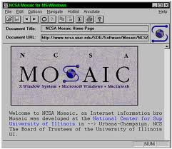
Mosaic
The first graphical web browser, became available in 1993. Developed by Marc Andereessen and graduate students working at NCSA.

Slide 7
Intranet & Extranets
Intranet
  A private network contained within an organization or business used to share information and resources among coworkers.
Extranet
  A private network that securely shares part of an organization’s information or operations with external partners

Slide 8
Who runs the Internet?
No single person or organization in charge of the internet.

Slide 9
Internet Standards & Coordination
ICANN - The Internet Corporation for Assigned Numbers & Names
W3C - Produces specifications, called Recommendations, in an effort to standardize web technologies

Slide 10
Domain Name
Q: What is “Domain Name”?
A: it is a unique name for your website. To get a domain name you have to register the name from domain name registration companies like godaddy.com.
Example: www.about.com

Slide 11
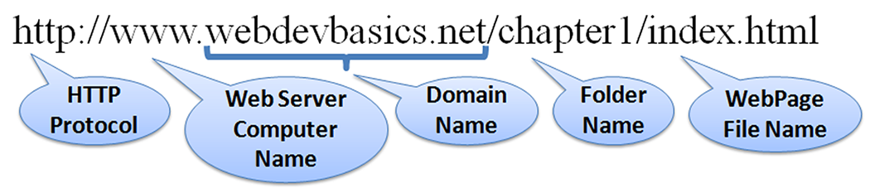
URL
URL – Uniform Resource Locator
  a type of URI (uniform resource identifier) which represents the network location of a resource such as a web page, a graphic file, or an MP3 file.
  it is a pointer to specific information on the internet. You can think of it as street address for information on the internet.
Copyright © Terry Felke-Morris

Slide 12
TLD
Top-Level Domain Name
A top-level domain (TLD) identifies the right-most part of the domain name.
Current generic TLDs:
.com, .org, .net, .mil, .gov, .edu, .int, .aero, .asia, .cat, .jobs, .name, .biz, .mobi, .museum, .info, .coop, .post, .pro, .tel, .travel.

Slide 13
County Code TLDs
Two character codes originally intended to indicate the geographical location (country) of the web site.
In practice, it is fairly easy to obtain a domain name with a country code TLD that is not local to the registrant.
Examples:
  .sa, .us , .au, .jp, .uk
  See http://www.iana.org/cctld/cctld-whois.htm

Slide 14
Quiz
Which Country?
  .ar
  .az
  .bb
  .tr
  .zw
  .ru

Slide 15
Quiz
What’s the cc tld for:
  Bahrain?
  Switzerland?
  United Arab emirates?
  United kingdom?
  States?

Slide 16
Domains with .sa
Saudi Network information center
http://nic.sa

Slide 17
Usability
Usability is a quality attribute that assesses how easy user interfaces are to use.
“Users often leave Web pages in 10-20 seconds, but pages with a clear value proposition can hold people's attention for much longer”
by JAKOB NIELSEN on September 12, 2011

Slide 18
Web Accessibility
Accessible Website
Web accessibility means that people with disabilities can perceive, understand, navigate, and interact with the Web, and that they can contribute to the Web.
WAI
  W3C’s Web Accessibility Initiative
  http://www.w3.org/WAI

Slide 19
The Client/Server Model
Client/Server can describe a relationship between two computer programs –
the "client" and the "server".
Client
  requests some type of service (such as a file or database access) from the server.
Server
  fulfills the request and transmits the results to the client over a network

Slide 20
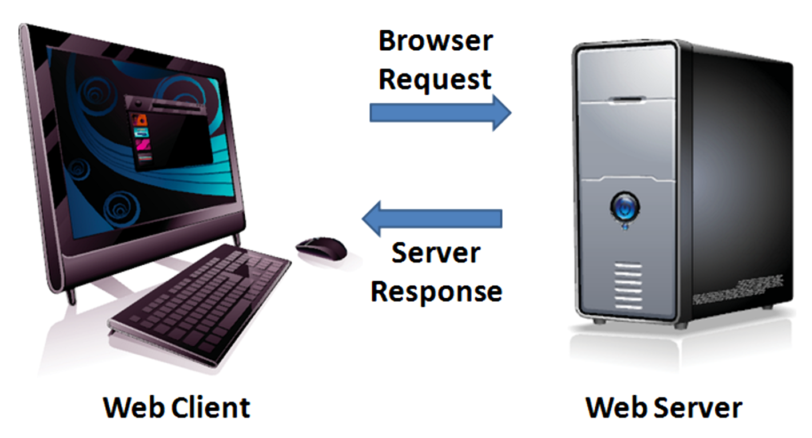
The Internet Client/Server Model
Client – Web Browser
Server – Web Server

Slide 21

Web Client
Connected to the Internet when needed
Usually runs web browser (client) software
(such as Internet Explorer or Firefox)
Uses HTTP (Hypertext Transfer Protocol)
Requests web pages from server
Receives web pages and files from server

Slide 22

Web Server
Continually connected to the Internet
Runs web server software
(such as Apache or Internet Information Server)
Uses HTTP (Hypertext Transfer Protocol)
Receives request for the web page
Responds to request and transmits status code, web page, and associated files

Slide 23
Internet protocols
Protocols
Rules that describe the methods used for clients and servers to communicate with each other over a network.
Protocols:
HTTP
Email protocols
HTTP
TCP/IP
FTP

Slide 24

HTTP
Hypertext transfer Protocols
Set of rules for exchanging files such as text, images, audio.
Web browsers send HTTP requests for web pages and their associated files.
Web servers send HTTP
responses back to the web
browsers.

Slide 25
E-mail protocols
Sending E-mail
  SMTP Simple Mail Transfer Protocol
Receiving E-mail
  POP (POP3) Post Office Protocol
  IMAP Internet Mail Access Protocol

Slide 26
IP Address
An Internet Protocol address is a numerical label assigned to each device, using the IP address you can determine the geolocation which is what country, including down to the city and post code level.
Each device connected to the Internet has a unique numeric IP address.
These addresses consist of a set of four groups of numbers, called octets.
74.125.95.104 will get you Google!
An IP address may correspond to a domain name.

Slide 27
Domain Name System (DNS)
  Divides the Internet into logical groups and understandable names
  Maintains the relationship between IP addresses and domain names.
  Associates unique computer IP Addresses with the text-based domain names you type into a web browser
  Browser: http://google.com
  IP Address: http://74.125.224.72/

Slide 28
TCP/IP
Transmission Control Protocol
  The official communication protocol of the Internet.
  how data should be formatted, addressed, transmitted, routed and received at the destination.

Slide 29
FTP
File Transfer Protocol
Web developers commonly use FTP to transfer web page files from their computers to web servers.
The hosting company will provide you the FTP access details.

Slide 30
Web hosting
Hosting is the business of housing, serving, and maintaining files for one or more websites. Its like renting a space on a computer to hold your website.
Your website files will be stored at your host computer. You buy certain amount of space (e.g 500MB) and email hosting and assign the domain name to your website files so anyone can view your website by typing the name.

Slide 31
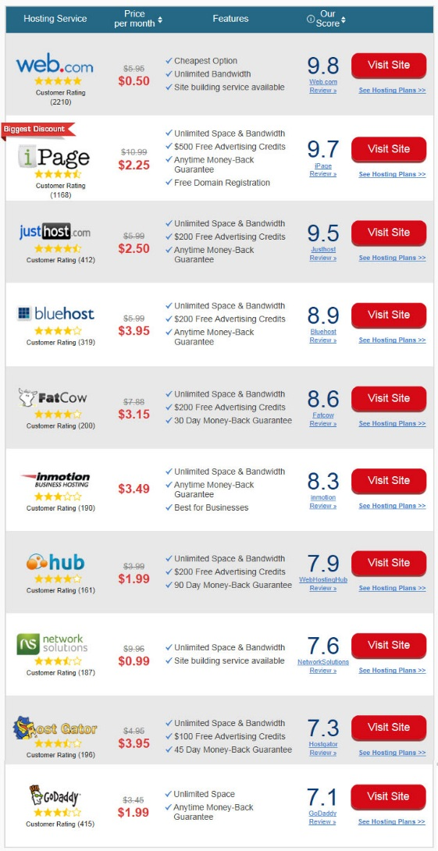
Top Ten Web - hosting companies in 2014

Slide 32
Don’t wanna pay?
Your can register a free domain and web hosting.
Your domain name will be something like:
  http://aleidi.net16.net/

Slide 33
Markup Languages
A markup language is a computer language that use tags to define elements within a document. It is human-readable, meaning markup files contain standard words, rather than typical programming syntax.

Slide 34
Markup Languages
SGML – Standard Generalized Markup Language
HTML – Hypertext Markup Language
XML – eXtensible Markup Language
XHTML – eXtensible Hypertext Markup Language
Copyright © Terry Felke-Morris

Slide 35
Markup Languages
HTML 5
  The next version of HTML 4 and XHTML
  http://www.w3.org/html/
Copyright © Terry Felke-Morris

Slide 36
Difference between HTML4, XHTML & HTML5
HTML4 has a very loose syntax - for example closing tags are often optional.
This loose syntax was great for amateur developers and made HTML very easy to adopt - however loose syntax isn't great if you want to achieve a specific result across browsers, as it makes it harder for browsers to accurately guess at what you mean

Slide 37
Difference between HTML4, XHTML & HTML5
In XHTML all tags, once opened, must be closed. There are also some restrictions about what tags can be nested inside each other

Slide 38
Difference between HTML4, XHTML & HTML5
HTML5 provides some important new functionality, especially the explosion in use of the mobile web.
some of the high-profile HTML5 Features are:
Video - HTML5 allows developers to embed video directly in to a web page without using a plugin.
Geolocation - enables the site to locate the user, either by GPS (in mobile phones, iPads etc...), by IP Address (for desktops) and also via Wi-Fi and Bluetooth
Canvas - This new feature for images allows you to manipulate graphics and photos - it uses JavaScript to allow you to draw graphics on a web page.
http://www.siliconbeachtraining.co.uk/blog/html4-v-html5-v-xhtml-differences

Slide 39
Summary
This chapter provided a brief overview of Internet, Web, and introductory networking concepts.

