Slide 1
Web Development & Design Foundations with HTML5
Chapter 3
CSS

Slide 2
Learning Outcomes
In this chapter, you will learn how to:
  What is DHTML (dynamic HTML)
  Describe the evolution of style sheets from print media to the Web
  List advantages of using Cascading Style Sheets
  Use color on web pages
  Create style sheets that configure common color and text properties
  Apply inline styles
  Use embedded style sheets

Slide 3
Dynamic HTML (DHTML)
DHTML is not a language or even a single
technology, but, rather a collection of web
page tools that, when used in various
combinations, lets designers create dynamic
effects.

Slide 4
Defining DHTML
To use DHTML you have to be familiar with three different technologies:
  HTML
  JavaScript
  Style Sheets
It’s the interaction between these three that make pages dynamic.

Slide 5
Defining DHTML
Dynamic style:
You can incorporate styles (font, size, typeface, color) that change immediately in response to user actions (mouse over).
Dynamic content:
A DHTML web page can display different content based on a user’s activities. Instead of taking the time to request, download, and display a new web page, DHTML utilities can simply hide or display blocks of text or other elements in the current page.
Positioning:
Allows you to specify precisely the location of all page elements.

Slide 6
CSS
What is CSS:
https://www.youtube.com/watch?v=s7ONvIgOWdM
starting from 00:27 → 02:42

Slide 7
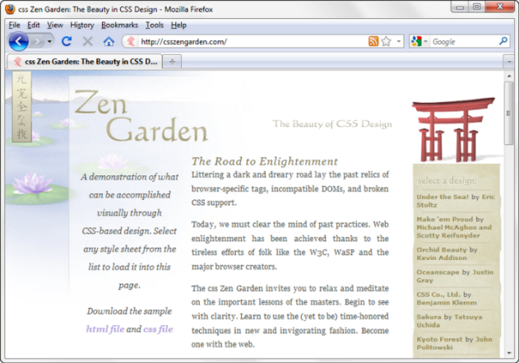
Cascading Style Sheets (CSS)
See what is possible with CSS:
  Visit http://www.csszengarden.com

Slide 8
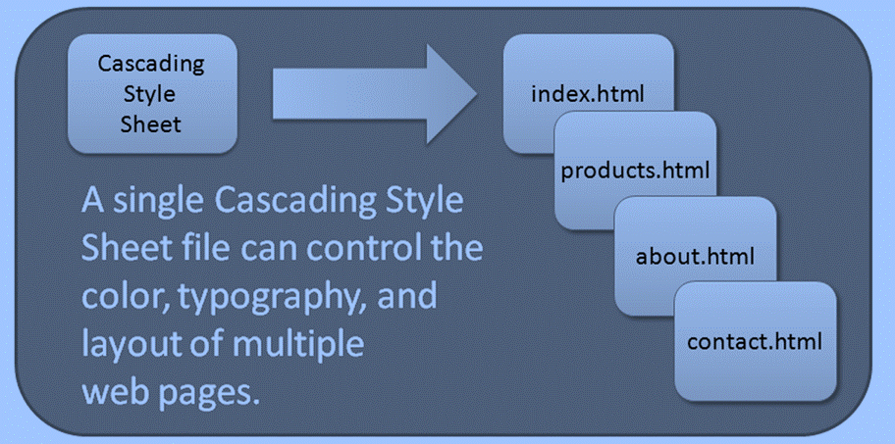
CSS
Advantages
Greater typography and page layout control
Style is separate from structure
Styles can be stored in a separate document
and associated with the web page
Potentially smaller documents
Easier site maintenance

Slide 9
Types of Cascading Style Sheets (1)
Inline Styles
Embedded Styles
External Styles
Imported Styles

Slide 10
Cascading Style Sheets
Inline Styles
  body section
  HTML style attribute
  apply only to the specific element
Embedded Styles
  head secdtion
  HTML style element
  apply to the entire web page document
External Styles
  Separate text file with .css file extension
  Associate with a HTML link element in the head section of a web page
Imported Styles
  Imported into embedded styles by using @import directive. We’ll concentrate on the other three types of styles.

Slide 11
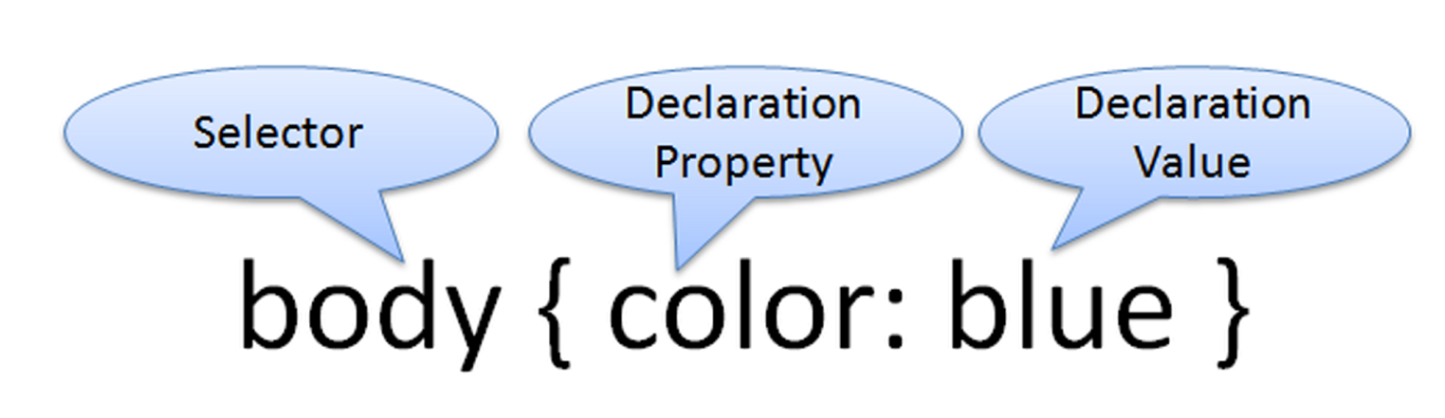
CSS Syntax
Style sheets are composed of "Rules" that describe the styling to be applied.
Style rules has two parts:
Selectors
Declaration

Slide 12
Using colors on web pages
Monitors display colors n RGB (Red, green, blue)
Hexadecimal are color codes begins with #.
CSS allows you to configure colors in many different ways. The color syntax in CSS:
By name→ {color: red;}
By hexadecimal color value→{color: #FF0000;}
Web-safe color by using shorthand hexadecimal color {color: #F00;}
Decimal color value {color: rgb(255,0,0);}

Slide 13
Where to find hexadecimal color values?
Many websites provide color pickers tools.
For example try: http://www.colorpicker.com/

Slide 14
The Color Property
The color property configures the text color of the element.
The background-color configure the background of the element.
To configure more than one property for a selector use a ;

Slide 15
Common Formatting
CSS Properties
See Table 3.1 Common CSS Properties, including:
  background-color
  color
  font-family
  font-size
  font-style
  font-weight
  line-height
  margin
  text-align
  text-decoration
  width

Slide 16
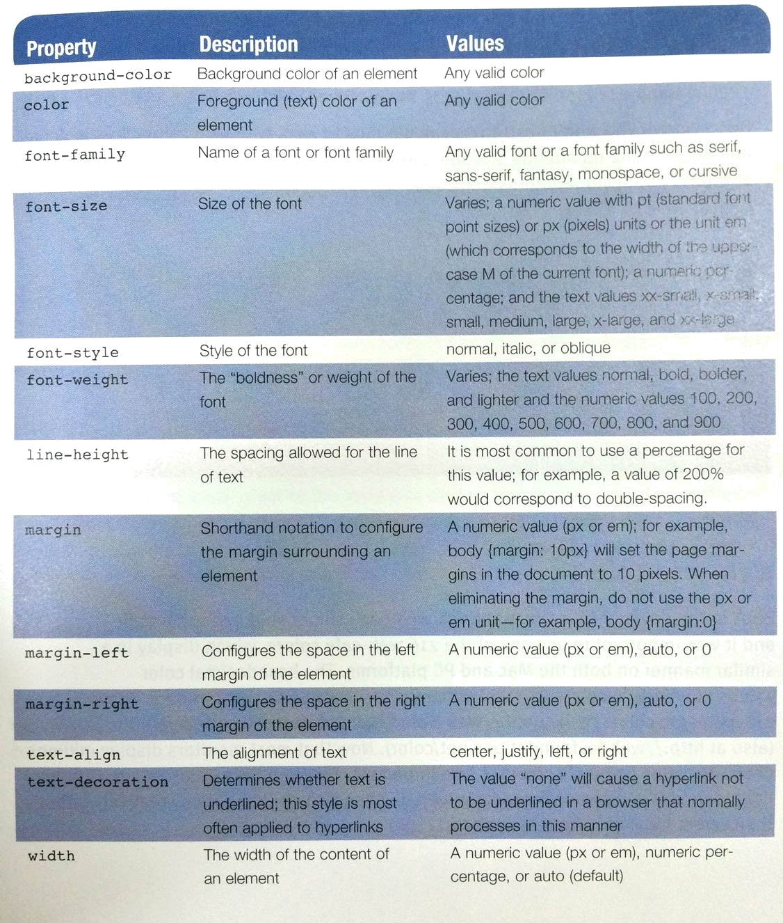

Slide 17
Inline CSS with Style attribute
Use the style attribute on an HTML tag
Inline styles is not recommended.
Example:
<!DOCTYPE html>
<html>
<body style= "color:blue; background-color: yellow;">

Slide 18
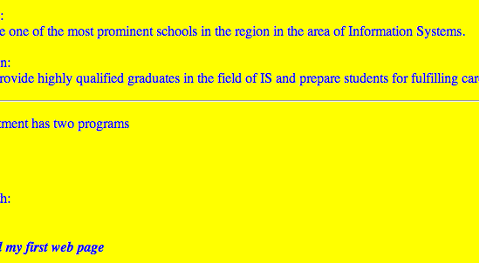
Inline CSS with Style attribute

Slide 19
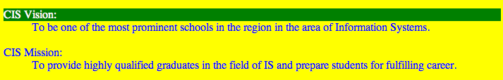
Inline CSS with Style attribute
Code
<!DOCTYPE html>
<html>
<body style= "color:blue; background-color: yellow;">
<dl>
<dt style=" color: white; background-color: green;">CIS Vision:</dt>
</dl>
Result

Slide 20
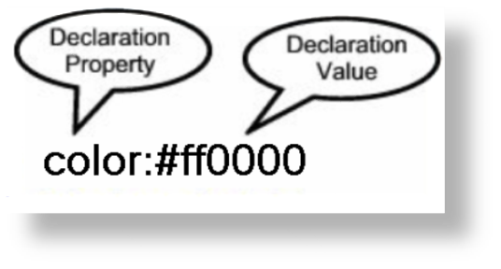

Configuring Color with Inline CSS
Inline CSS
  Configured in the body of the web page
  Use the style attribute of an HTML tag
  Apply only to the specific element
The Style Attribute
  Value: one or more style declaration property and value pairs
Example: configure red color text in an <h1> element:
<h1 style="color:#ff0000">Heading text is red</h1>

Slide 21

Configuring Color with Inline CSS
Example 2: configure the red text in the heading
configure a gray backgroundin the heading
Separate style rule declarations with ;
<h1 style="color:#FF0000;background-color:#cccccc"> This is displayed as a red heading with gray background</h1>

Slide 22

CSS Embedded Styles
Configured in the header section of a web page.
Embedded styles are place within a <style> element with style declarations in between the opening and closing tag.
<style> </style>
Apply to the entire web page document
Example: Configure a web page with white text on a black background
<style>
body { background-color: #000000;
color: #FFFFFF;
}
</style>

Slide 23
CSS Embedded Styles
<head>
<style>
Body {background-color: #CCFFFF; color: #000033;}
</style>
</head>
<body>
<p> this page is embedded style </p>
</body>

Slide 24
Embedded CSS with Style element
You can style more than one element:
Exercise: find out how the Embedded CSS style below styles the web page. Show me your result.
P.S Don’t forget to write the rest of the code
<head>
<style>
Body {background-color: #CCFFFF; color: #000033;}
h1 { background-color: #e6e6fa;}
h2 {background-color: #191970;}
</style>
</head>

Slide 25
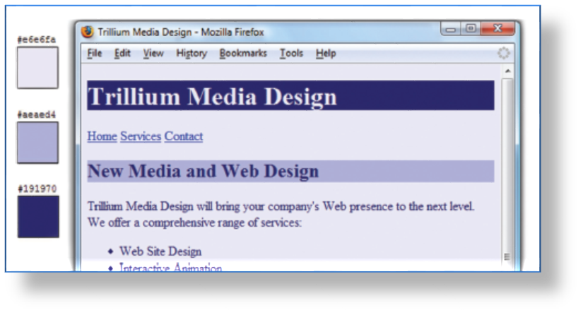
CSS Embedded Styles
The body selector sets the global style rules for the entire page.
These global rules are overridden for <h1> and <h2> elements by the h1 and h2 style rules.
<style>
body { background-color: #E6E6FA;
color: #191970;}
h1 { background-color: #191970;
color: #E6E6FA;}
h2 { background-color: #AEAED4;
color: #191970;}
</style>

Slide 26
Configuring Text with CSS
CSS properties for configuring text:
  font-weight
    Configures the boldness of text
  font-style
    Configures text to an italic style
  font-size
    Configures the size of the text
  font-family
    Configures the font typeface of the text

Slide 27
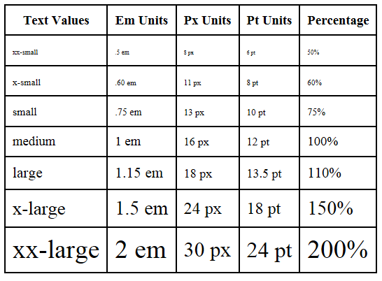
The font-size Property
Accessibility Recommendation: Use em or percentage font sizes – these can be easily enlarged in all browsers by users

Slide 28
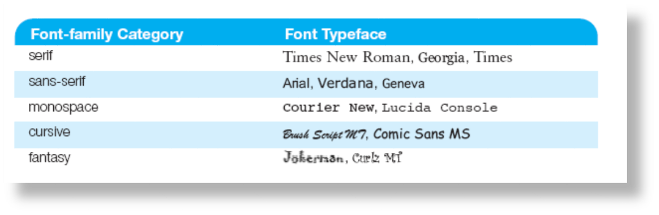
The font-family Property
Not everyone has the same fonts installed in their computer
Configure a list of fonts and include a generic family name. This creates a backup plan if the font was not installed.
p {font-family: Arial, Verdana, sans-serif;}

Slide 29

Embedded Styles Example
<style>
body { background-color: #E6E6FA;
color: #191970;
font-family: Arial, Verdana, sans-serif; }
h1 { background-color: #191970;
color: #E6E6FA;
line-height: 200%;
font-family: Georgia, "Times New Roman", serif; }
h2 { background-color: #AEAED4;
color: #191970; text-align: center;
font-family: Georgia, "Times New Roman", serif; }
p {font-size: .90em; text-indent: 3em; }
ul {font-weight: bold; }
</style>

Slide 30
External Style Sheets - 1
CSS style rules are contained in a text file separate from the HTML documents.
The External Style Sheet text file:
  extension ".css"
  contains only style rules
  does not contain any HTML tags

Slide 31
The power of External Style Sheet
Configured in a single file that can be associated with many webpages.
When styles need to be modified only ONE file needs to be changed.
Styles can be stored.
Documents are potentially smaller.
This saves the developer so much time and increases the productivity!

Slide 32
External Style Sheets - 2
  Multiple web pages can associate with the same external style sheet file.
site.css
index.html
body {background-color:#E6E6FA;
color:#000000;
font-family:Arial, sans-serif;
font-size:90%; }
h2 { color: #003366; }
nav { font-size: 16px;
font-weight: bold; }
clients.html
about.html
Etc…

Slide 33
link Element
A self-contained tag (Stand-alone)
Placed in the header section
Purpose: associates the external style sheet file with the web page.
Example:
The Value of the rel attribute is “stylesheet”
The Value of the href attribute is the name of the style sheet file
The Value of the type attribute is “text/css” the type attribute is optional is HTML5
<link rel="stylesheet" href="color.css">

Slide 34
Practice
First: Create an external stylesheet and save it with a .css file extension.
Create any style rules you want, this is an example:
body { background-color: #0000FF;
color: #FFFFFF;}
Notice that there are no HTML tags at all in the stylesheet
Second: Create your webpage using HTML with the link element in the head to link your page with the CSS file.
This is an example:
<!DOCTYPE html>
<html lang=“en”>
<head>
<title> External styles </title>
<meta charset=“utf-8”>
<link rel=“stylesheet” href=“yourStylesheetName.css”>
</head>
<body>
<p> This page uses an external style sheet </p>
</body>
</html>

Slide 35
You Just learned that..
Style sheets can be used on three different levels:
  Inline styles (local) - specific to one instance on a page
  Embedded styles (global) - specific to an entire page
  External styles (linked) - used across multiple pages

Slide 36
CSS Selectors
CSS style rules can be
configured for an:
  HTML element selector
  class selector
  id selector

Slide 37
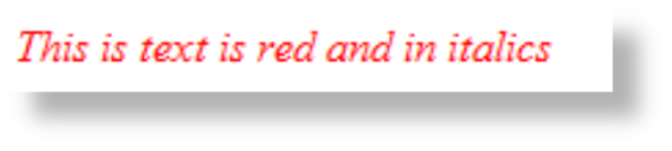
Using CSS with “class”
Class Selector
  The class selector is used when you need to apply a CSS declaration to certain elements on a web page and not necessarily tie the style to a particular HTML element.
  How to?
1. Configure with .classname
(The dot in before the name configures the class)
This is an example of a CSS code to create a class called “new” with red italic text.
.new { color: #FF0000;
font-style: italic;
}
2. Call the class:
<p class=“new”> This is text is red and in italics </p>

Slide 38
To clarify more..
Let's first start by looking at a simple rule whose selector applies to all p tags:
p {
font-family: Cambria, serif;
font-size: xx-large;
}
What this means is that if any p tags are encountered in your HTML document, this rule will get applied.
For example, the following text will fall under the influence of this rule:
<body>
<p>Do or do not...there is no try.</p>
<p>Coming Soon in 2011</p>
<p>( to a theater near you )</p>
</body>
Why? Because your browser sees a match between the p selector in the style rule and the p tag in your document. This type of a selector is known as a type selector because it applies to elements whose types match what it specifies. This lack specificity. It will apply to every p tag without discriminating. We'll see later how to address this.

Slide 39
To clarify more..
This is why we have class and id selectors. I am no longer selecting by type, I can specify the element I want the rule to apply to. And these elements could each have a different type.
First we configure the class
.cool
{
background-color: #E6F8FF;
}
Then we call it in the html
<body>
<p>Do or do not...there is no try.</p>
<p class="cool”>Coming Soon in 2011</p>
<p>( to a theater near you )</p>
</body>
This will result in having the BG for one of the Paragraphs only
(Same concept is applied to the id selectors)

Slide 40
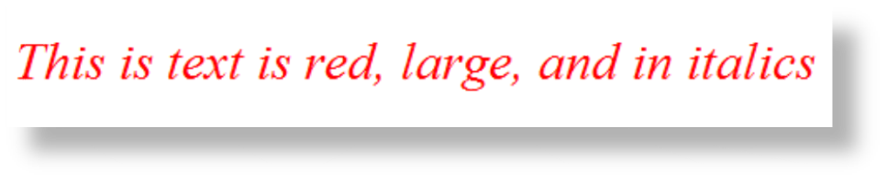
Using CSS with “id”
id Selector
  The id selector is used to identify and apply a CSS rule uniquely to a single area on a web page. For example, the copyright information in the page footer displays in small italic text with a gray color (#333333). Place a # in front of the ID because it will be used only once.
  Apply a CSS rule to ONE element on a web page.
  How to:
1. Configure with #id
Code CSS to create an id called “new” with red, large, italic text.
Example: #new{ color: #FF0000;
font-size: .75em;
font-style: italic; }
2. Apply the id:
<p id=“new”>This is text is red, large, and in italics</p>

Slide 41
CSS Contextual Selector
Specify an element within the context of its container (parent) element.
AKA descendent selector
The example configures a
green text color only for
anchor tags located within the footer id
Advantage of contextual selectors:
Reduce the number of classes and ids you need to apply in the HTML
<style>
#footer a {
color: #00ff00; }
</style>

Slide 42
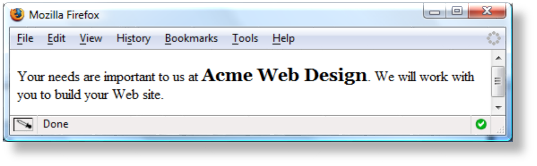
span element
Purpose:
  configure a specially formatted area displayed in-line with other elements, such as within a paragraph.
There is no additional empty space above or below a span – it is inline display.

Slide 43
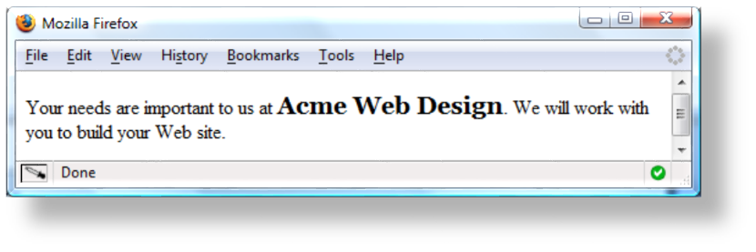
span Element Example
Embedded CSS:
.companyname { font-weight: bold;
font-family: Georgia, "Times New Roman", serif;
font-size: 1.25em;
}
HTML:
<p>Your needs are important to us at <span class=“companyname">Acme Web Design</span>.
We will work with you to build your Web site.</p>

Slide 44
Span element practice
Create this output:
        Introduction
        The use of the SPAN tag in DHTML
        CSS Positioning

Slide 45
The Answer:
The css file will contain:
.different
{font-style: italic;
color: red; }
The HTML file:
<head>
<link rel=“stylesheet”
href=“style.css”
type=“text/css”>
</head>
<body>
<ul>
<li> introduction </li>
<li> the use of the span and div tags
<span class=“different”>in dhtml</span></li>
<li> css positioning</li>
</ul>
</body>

Slide 46

Centering Page Content with CSS
#container { margin-left: auto;
margin-right: auto;
width:80%; }

Slide 47
Page layouts
Fixed Width Layouts
  The width of the page is set with a specific numerical value. (in pixels)
  They remain that width, regardless of the size of the browser window viewing the page.
  Fixed width layouts allow a designer more direct control over how the page will look in most situations.
Liquid Layouts
  layouts that are based on percentages of the current browser window's size.
  They flex with the size of the window, even if the current viewer changes their browser size as they're viewing the site.

Slide 48
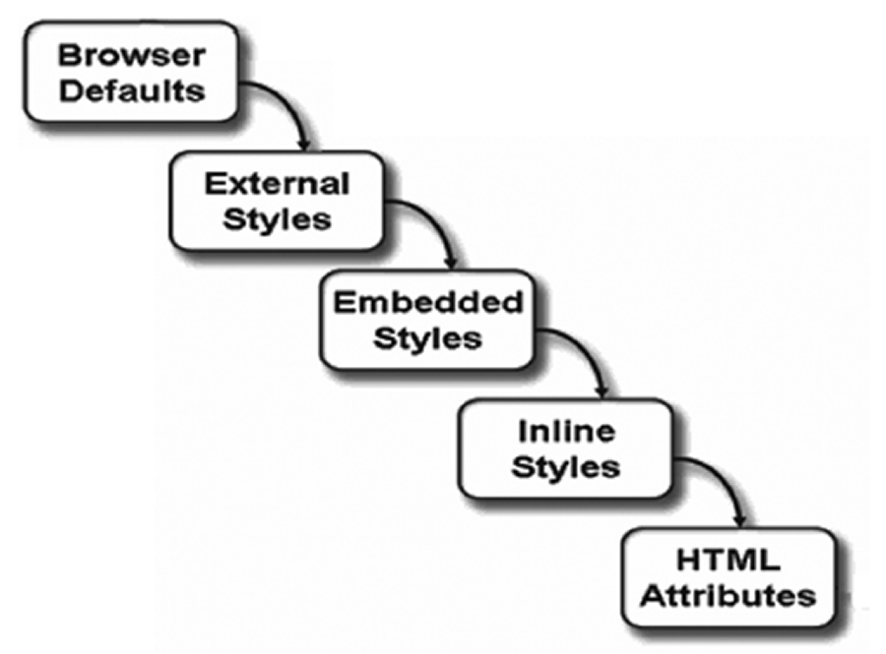
The “Cascade”

Slide 49
The “Cascade”
Suppose we have an HTML page that calls in a linked style sheet. It’s perfectly legal to add other global and local style sheet definitions to this page, but it begs the question: Which style sheet definition takes precedence? Well, the basic rule is that the most specific setting wins. Global style sheets take precedence over linked style sheets, and local style sheets take precedence over both global and linked style sheets.

Slide 50
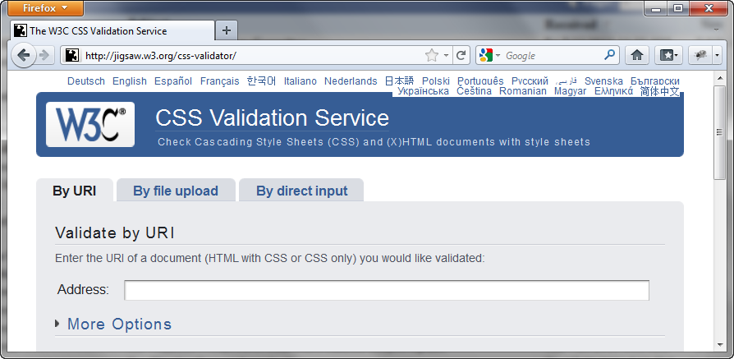
W3C CSS Validation
http://jigsaw.w3.org/css-validator/

Slide 51
Summary
This chapter introduced you to Cascading Style Sheet Rules associated with color and text on web pages.
You configured inline styles, embedded styles, and external styles.
You applied CSS style rues to HTML, class, and id selectors.
You are able to submit your CSS to the W3C CSS Validation test.

