Slide 1
Lecture 10

Slide 2
You will learn
Image maps
Iframe
Audio & video

Slide 3
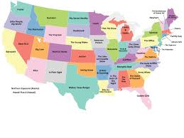
What is an Image Map?
An image map is a graphic / image that acts as a link, when clicked, takes you to one of several other pages.
Image maps usually have several regions, called hot spots, that define the route to another universal resource locator (URL; an Intranet address)

Slide 4
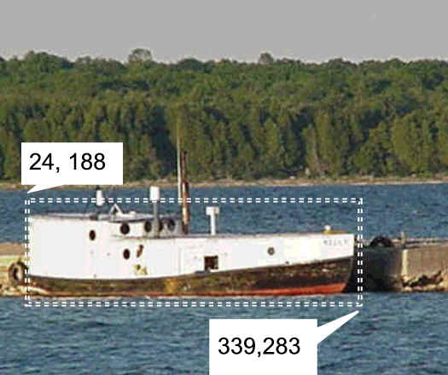
How to insert an image map?
map element
Defines the map
area element
Defines a specific area on a map
Can be set to a rectangle, circle, or polygon
href Attibute
shape Attribute
coords Attribute
<map name="boat" id="boat">
<area href="http://www.doorcountyvacations.com" shape="rect" coords="24, 188, 339, 283" alt="Door County Fishing">
</map>
<img src="fishingboat.jpg" usemap="#boat" alt="Door County“ width="416" height="350">

Slide 5
<AREA> coords and shape
Each pixel on an image has its own coordinates. For example the co-ordinates of the pixel which is 50th from the left edge and 70th from the top are “50,70”. This is how image maps read coordinates.
The different shapes however require for a different set of coordinates.
– Rectangle/default top left and bottom right e.g. “10,10,80,70”
– Polygon each corner e.g. “30,20,40,20,80,50,70,100”
– Circle center point and radius e.g. “60,60,30”

Slide 6
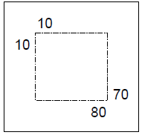
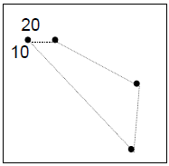
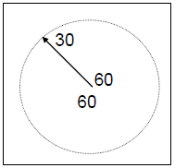
<AREA> coords and shape
Rectangle/default top left and bottom right e.g. “10,10,80,70”
Polygon each corner e.g. “30,20,40,20,80,50,70,100”
Circle center point and radius e.g. “60,60,30”

Slide 7
Assigning a map to your image
Overlapping
If two area with different URL references overlap then
the one which is listed first is the one which the
overlapped area refers to.
Assigning a map to your image
To assign a map to an image simply use the attribute
“usemap=” in the image tag. Instead of using quotation
marks you use the # sign at the start.
<img src="fishingboat.jpg" usemap="#boat" alt="Door County“ width="416" height="350">

Slide 8
Image Maps In Dreamweaver
http://www.youtube.com/watch?v=seWbi5UE4o4

Slide 9
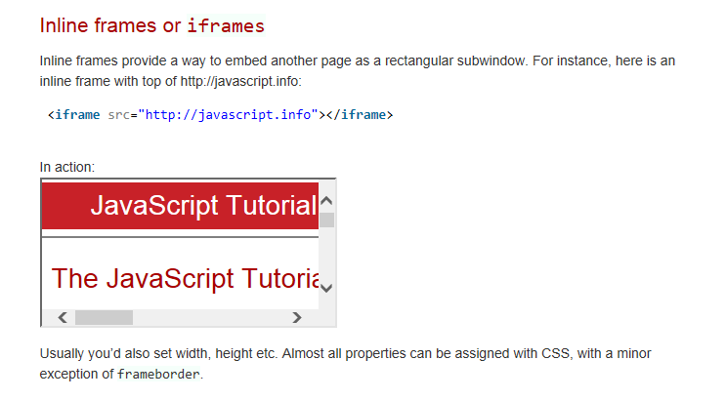
iframes

Slide 10
iframes - Inline Frames
Also called a floating frame
Embeds one web page within another
You can embed pages from your own website or another website such as YouTube.
Configure with the iframe element
Add a text in case the browser does not support iframes, the text should be between the opening and the closing iframe tag
<iframe src=“aboutus.html“>
<p> your browser does not support iframes </p>
</iframe>

Slide 11
iframes - Inline Frames
You can use iframe as a target frame for a link where the link will open in the iframe. The The target attribute of a link must refer to the name attribute of the iframe:
<iframe src="demo_iframe.htm" name="iframe_a"></iframe>
<p><a href="http://www.w3schools.com" target="iframe_a">Tutorial</a></p>
<p>your browser does not support iframes.</p>

Slide 12
<iframe> Attributes
Src
The address of the document embedded in the iframe
width
Specifies the width of an iframe (in pixels)
height
Specifies the height of an iframe (in pixels)
The seamless Attribute
Remove the iframe border to display the iframe page like it is a part of the containing document.
Example: < iframe seamless>
https://www.youtube.com/watch?v=E78JJa3IOok

Slide 13
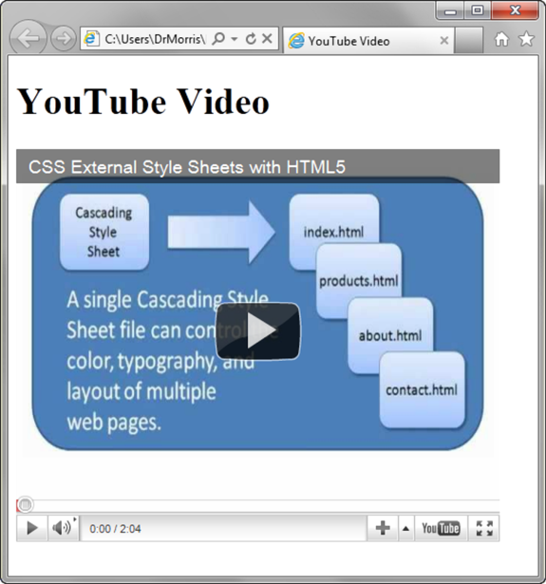
Embedding a YouTube Video
YouTube generates the code you need to embed the video. To do this you need to:
View the video page → click on share → embed
Then copy the code to your page
<iframe src="//www.youtube.com/embed/ZH1XOsv8Oyo" width="560" height="315” allowfullscreen>
</iframe>

Slide 14
Audio & Video

Slide 15
Common Audio File Types
.wav Wave File
.aiff Audio Interchange File Format
.mid Musical Instrument Digital Interface (MIDI)
.au Sun UNIX sound file
.mp3 MPEG-1 Audio Layer-3
.ogg Ogg Vorbis (open-source)
. m4a MPEG 4 Audio.

Slide 16
Common Video File Types
.mov Quicktime
.avi Microsoft Audio Video Interleaved
.wmv Windows Media File
.flv Flash Video File
.mpg MPEG (Motion Picture Experts Group)
.m4v .mp4 (MPEG-4)
.ogv Ogg Theora (open-source)
.webm VP8 codec (open video format, free)

Slide 17
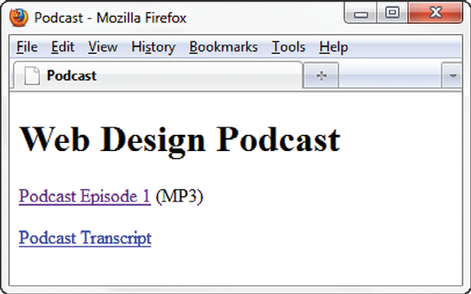
Configure Audio & Video
Most basic method to provide audio or video files:
Hyperlink
<a href=“wdfpodcast.mp3" title=“Web Design Podcast”>Web Design Podcast</a>

Slide 18
Audio & Video Tutorial
https://www.youtube.com/watch?v=4I1WgJz_lmA

Slide 19
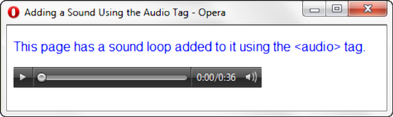
HTML5 Audio & Source Elements
<audio controls="controls">
<source src="soundloop.mp3" type="audio/mpeg">
<source src="soundloop.ogg" type="audio/ogg">
<a href="soundloop.mp3">Download the Audio File</a> (MP3)
</audio>

Slide 20
Audio element attributes
src: the file name
type: the type of the audio file such as audio/mpeg
• controls: Select if you want to display audio controls such as Play, Pause, and Mute in the HTML page.
• autoplay: Select if you want the audio to start playing as soon as it loads on the web page.
loop: indicates weather the audio should be played over & over.
title: a brief text description.

Slide 21
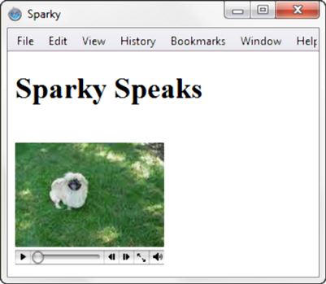
HTML5 Video & Source Elements
<video controls="controls" poster="sparky.jpg"
width="160" height="150">
<source src="sparky.m4v" type="video/mp4">
<source src="sparky.ogv" type="video/ogg">
<a href="sparky.mov">Sparky the Dog</a> (.mov)
</video>

Slide 22
Video element attributes
src: the file name
type: the type of the video file such as video/mp4
• controls: Select if you want to display audio controls such as Play, Pause, and Mute in the HTML page.
• autoplay: Select if you want the audio to start playing as soon as it loads on the web page.
loop: indicates weather the audio should be played over & over.
title: a brief text description.
height: video height in pixels.
width: video width in pixels.
poster: the image to be displayed if the browser cannot play the video.

