Slide 1
Graphics
The img element

Slide 2
You Will Learn
  Apply the image element to add graphics to web pages
  Optimize an image for web page display
  Configure images as backgrounds on web pages
  Configure images as hyperlinks
  Configure visual effects with CSS3 including multiple background images, rounded corners, box shadow, text shadow, opacity, and gradients
  Configure RGBA color with CSS3
  Use HTML5 elements to caption a figure
  Use the HTML5 meter and progress elements
  Find free and fee-based graphics sources
  Follow recommended web design guidelines for graphics on web pages

Slide 3
Types of
Graphics
Graphic types commonly used on web pages:
  GIF
  JPG
  PNG

Slide 4
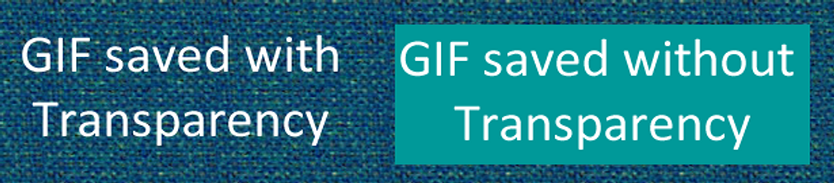
GIF
Background color configured to be transparent
Background color – no transparency
Graphics Interchange Format
Best used for line art and logos
Maximum of 256 colors
One color can be configured as transparent
Can be animated
Uses lossless compression
Can be interlaced

Slide 5
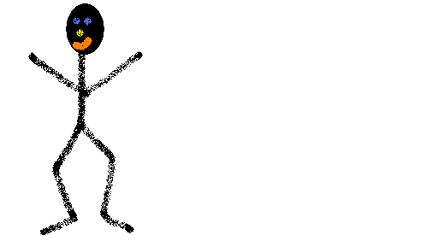
Animated GIF
Several images. Each is slightly different than the other.

Slide 6
Lossless Compression
Used when a GIF is saved. Nothing in the original image is lost. The compressed image when rendered will contain the same pixels as the original.

Slide 7

Interlacing
Browsers renders webpage documents in order (line by line). The top of the standard image begin to display after the browser has read 50% of the image.
But an Interlaced image progressively display and seems to fade in as it downloads.

Slide 8
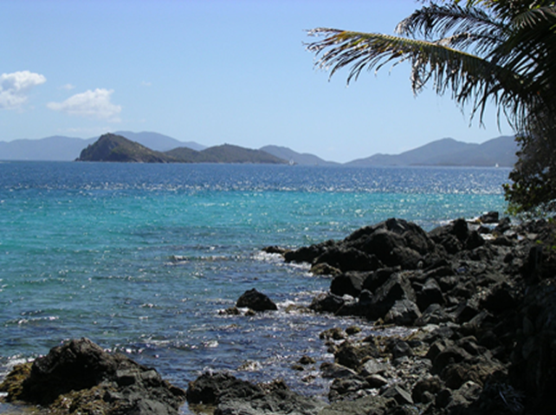
JPEG
Joint Photographic Experts Group
Best used for photographs
Up to 16.7 million colors
Use lossy compression
Cannot be animated
Cannot be made
transparent
Progressive JPEG – similar to interlaced display

Slide 9
Lossy Compression
Some pixels in the original image are lost or removed from the compressed file. It displays similar to but not exactly the same as the original image.
A comparison: http://www.youtube.com/watch?v=2Qo5prktYNQ

Slide 10
Optimization
Image optimization is the process of creating an image with the lowest file size that still renders a good quality image.
By using graphical applications such as:
  Adobe Photoshop
  Adobe Fireworks
  Gimp.org

Slide 11
Optimization
Higher quality → higher file size
Lower quality → lower file size
Pixelation should be avoided

Slide 12
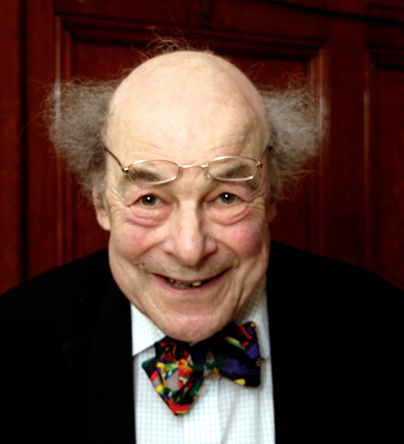
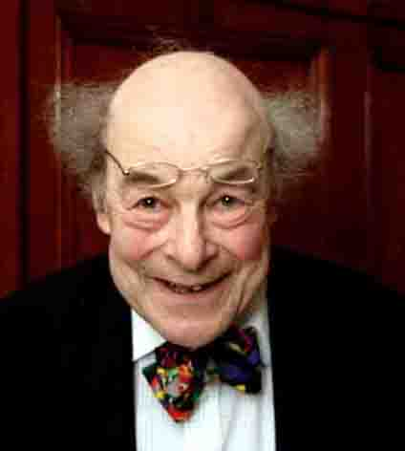
Optimization
Professor Heinz Wolff
225 KB
33 KB

Slide 13


Optimization

Slide 14
PNG
Combines the best of GIF & JPEG
Portable Network Graphic
Support millions of colors
Support multiple levels of transparency
(but browsers do not --
so limit to one transparent color for Web display)
Support interlacing
Use lossless compression
Browser support is growing

Slide 15
HTML Image Element
Configures graphics on a web page
src Attribute
  File name of the graphic
alt Attribute
  Configures alternate text content (description)
height Attribute
  Height of the graphic in pixels
width Attribute
  Width of the graphic in pixels
Note: The <img> align attribute is not supported in HTML5. Use CSS instead.
<img src=“cake.gif” alt=“birthday cake” height=“100” width=“100”>

Slide 16
Accessibility & Images
Required:
  Configure the alt attribute
    Alternate text content to convey the meaning/intent of the image
    NOT the file name of the image
    Use alt="“ for purely decorative images
Recommended:
  If your site navigation uses image links for the main navigation, provide simple text links at the bottom of the page.

Slide 17
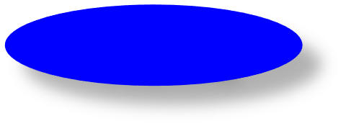
Image Links
Images can be used as hyperlinks just like plain text.
To create an image hyperlink use an anchor element to contain an image element
Browsers automatically add a border to image links.
Configure CSS to eliminate the border
img {border-style:none; }
<a href="index.html"><img src="home.gif"
height="19" width="85" alt="Home"></a>
Home

Slide 18
External Images, Sounds, and
Animation
Use the same syntax for links to external
animations and sounds. They only difference is
the file extension of the linked file. For example:
<A HREF=“AdamsRib.mov”>link anchor</A>
Specifies a link to a QuickTime movie.

