Slide 1
Web Development & Design Foundations with HTML5
Tables
Copyright © Terry Felke-Morris

Slide 2
Learning Outcomes
In this chapter, you will learn how to ...
  Create a table on a web page
  Apply attributes to format tables, table rows, and table cells
  Increase the accessibility of a table
  Style an HTML table with CSS

Slide 3
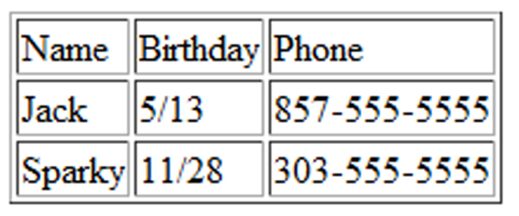
HTML Table
Tables are used on web pages
to organize tabular information
Composed of rows and columns – similar to a spreadsheet.
Each individual table cell is at the intersection of a specific row and column.
Configured with table, tr, and td elements.
The table is a block display element.
In the past tables used to format web pages layout but not anymore.

Slide 4
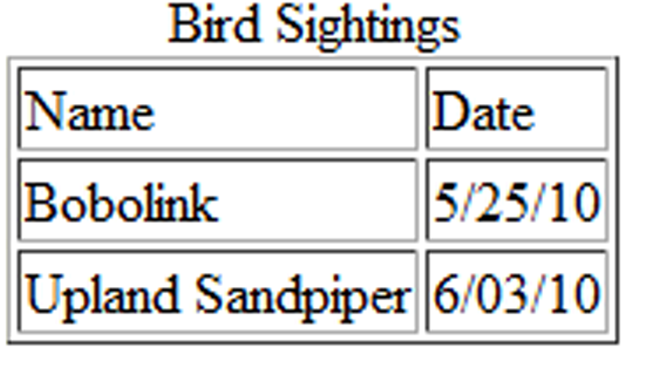
HTML Table Elements
<table>
Contains the table and end with </table>
<tr>
Contains a table row and end with </tr>
<td>
Contains a table data cell and end with </td>. The table cell can contain text, graphics and other HTML elements.

Slide 5

HTML
Table Example
We code the table row by row and then each row is coded cell by cell:
<table border="1”>
<tr>
<td>Name</td>
<td>Date</td>
</tr>
<tr>
<td>Bobolink</td>
<td>5/25/10</td>
</tr>
<tr>
<td>Upland Sandpiper</td>
<td>6/03/10</td>
</tr>
</table>
By default there is no border. We will add the border property in the HTML to display it in this practice only. Adding the border property to your html is obsolete in html5 but valid in XHTML. We will later use the border property in CSS.

Slide 6
Table Header Element
Similar to the table data element, but its purpose is to configure columns and rows headings.
The text will be displayed as Center and Bold.
Starts with <th> and ends with </th> instead of <td> tags.

Slide 7
The Caption Element
<caption>
Configures a description of the table and ends with </caption>
Used to describe the data table content.
By default the caption displayed above the table. (later we will configure the placement of the caption with CSS)
How to code? In the line immediately after the <table> tag

Slide 8
The Caption Element
<table border="1">
<caption> Bird Sightings </caption>
<tr>
<th>Name</th>
<th>Birthday</th>
</tr>
<tr>
<td>James</td>
<td>11/08</td>
</tr>
<tr>
<td>Karen</td>
<td>4/17</td>
</tr>
<tr>
<td>Sparky</td>
<td>11/28</td>
</tr>
</table>

Slide 9
Question
How did we code a caption for images?

Slide 10
Hands-on Practice 1
Create a table that describes two schools you have attended.
  Use the caption “school history”
  The table has three rows and three columns
  First row will have table header elements:
  School attended Years Degree Awarded
  Use border=“1” property

Slide 11
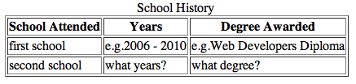
Your table should look like this

Slide 12
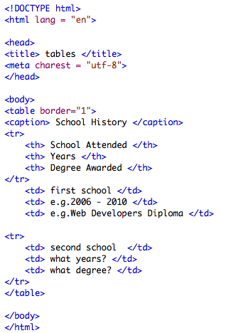
The code is:

Slide 13
HTML Common Table Attributes
align (obsolete)
bgcolor (obsolete)
border (obsolete)
cellpadding (obsolete)
cellspacing (obsolete)
summary (obsolete but may be reinstated)
width (obsolete)
Use CSS to configure table characteristics instead of HTML attributes

Slide 14
HTML Common Table Cell Attributes
align (obsolete)
bgcolor (obsolete)
colspan
rowspan
valign
height (deprecated)
width (deprecated)
Use CSS to configure most table cell characteristics instead of HTML attributes

Slide 15
We will get into more complex table configuration.. Ready?

Slide 16

HTML colspan Attribute
Number of columns that a cell will occupy
<table border="1">
<tr>
<td colspan=“2”>
Birthday List</td>
</tr>
<tr>
<td>James</td>
<td>11/08</td>
</tr>
<tr>
<td>Karen</td>
<td>4/17</td>
</tr>
</table>

Slide 17
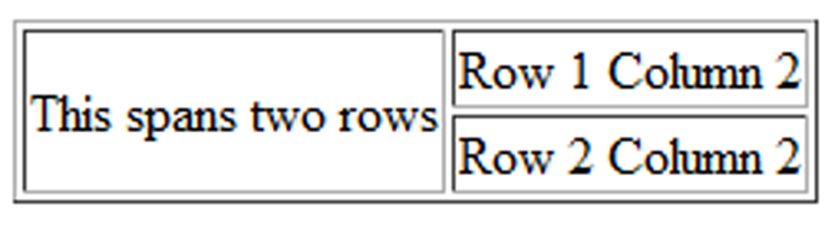
HTML rowspan Attribute
Number of rows that a cell will occupy
<table border="1">
<tr>
<td rowspan="2">This spans two rows</td>
<td>Row 1 Column 2</td>
</tr>
<tr>
<td>Row 2 Column 2</td>
</tr>
</table>
2 td
1 td

Slide 18
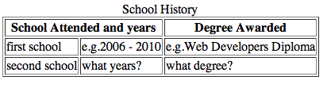
Hands-on Practice 2
Modify the table you created in Practice 1 to look like this:

Slide 19
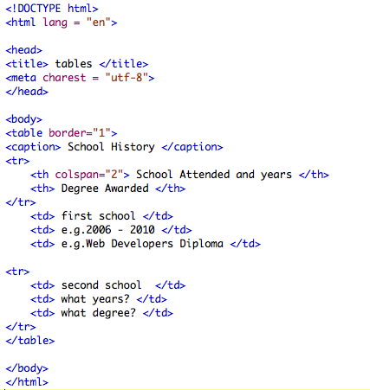
The code is:
… the rest of the code stays the same

Slide 20
Accessibility and Tables
Use table header elements (<th> tags) to indicate column or row headings.
Use the caption element to provide a text title or caption for the table.
Complex tables:
Associate table cell values with their corresponding headers
  <th> tag id attribute
  <td> tag headers attribute

Slide 21
<table border="1">
<caption>Bird Sightings</caption>
<tr>
<th id="name">Name</th>
<th id="date">Date</th>
</tr>
<tr>
<td headers="name">Bobolink</td>
<td headers="date">5/25/10</td>
</tr>
<tr>
<td headers="name">Upland Sandpiper</td>
<td headers="date">6/03/10</td>
</tr>
</table>

Slide 22
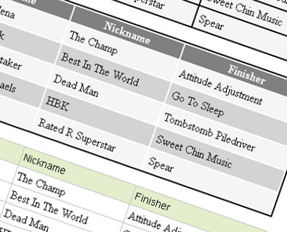
Lets Style our tables with CSS..

Slide 23
Using CSS to Style a Table
HTML Attribute | CSS Property
Align X | Align a table: table { width: 75%; margin: auto; } Align items within a table cell: text-align
Bgcolor X | background-color
Cellpadding X | padding
Cellspacing X | border-spacing or border-collapse
height | height
Valign X | vertical-align: the vertical placement of content values: sub, super, top, text-top, text-bottom, middle
width | width
border | border, border-style, or border-spacing
-- | background-image
-- | Caption-side specifies the placement of the caption. Values: top and bottom

Slide 24
Hands-on Practice 3
Add two additional rows to your table that contain any data then,
Code CSS style rules to your table. Use embedded CSS.
Add a style rule to center the table, have a border and a width of 600px. Don’t forget to delete the border property from the html (hint: margin: auto;)
Configure a border and padding for your td and th element selectors. (hint: td,th { } )
    Border 1 px, solid and have a color of #5c743d
    Padding of 5px
    Have the font of your data in Arial or any other sans serif.
3. Eliminate the space between the borders of the table cell, add this to your table selector (hint: border-spacing: 0;)
4. Configure a background color for every other row of your table, the background color is: #eaeaea (hint: use a class) --Often called zebra striping --
5. Place your caption to the bottom of the table (hint: caption-side)

Slide 25
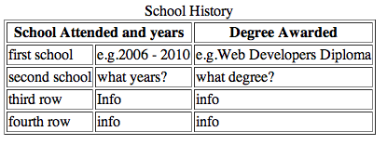
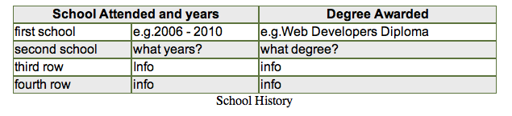
Before the CSS
After the CSS

Slide 26
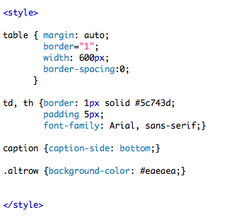
The CSS
Border: 1px not =

Slide 27
CSS Structural Pseudo-classes
Allows you to select and apply classes to elements based on their position in the structure of the document, e.g every other row of the table.
To apply a Pseudo class, write it after the selector. e.g. li:first-of-type {color: #ff0000;}

Slide 28
CSS Structural Pseudo-classes
Pseudo-class | Purpose
:first-of-type | Applies to the first element of the specified type
:first-child | Applies to the first child of an element (CSS2 selector)
:last-of-type | Applies to the last element of the specified type
:last-child | Applies to the last child of an element
:nth-of-type(n) | Applies to the “nth” element of the specified type Values: a number, odd, or even
Zebra Stripe a Table
tr:nth-of-type(even) { background-color: #eaeaea; }

Slide 29
Hands-on Practice 4
Rework the table from Practice 3 to use structural pseudo-classes.
In your HTML file , delete all class=“altrow” from your tr elements.
In your CSS: locate the .altrow class and replace it with the tr:nth-of-type (even). Run your file.
Now lets change the first row background color and text color by adding the style rule:
tr:first-of-type {background-color: #666;
color: white;}

Slide 30
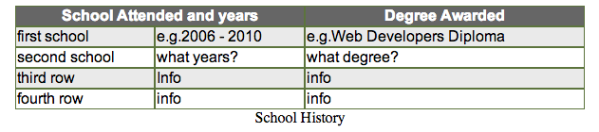
Hands-on Practice 4
Your table should look like:

Slide 31
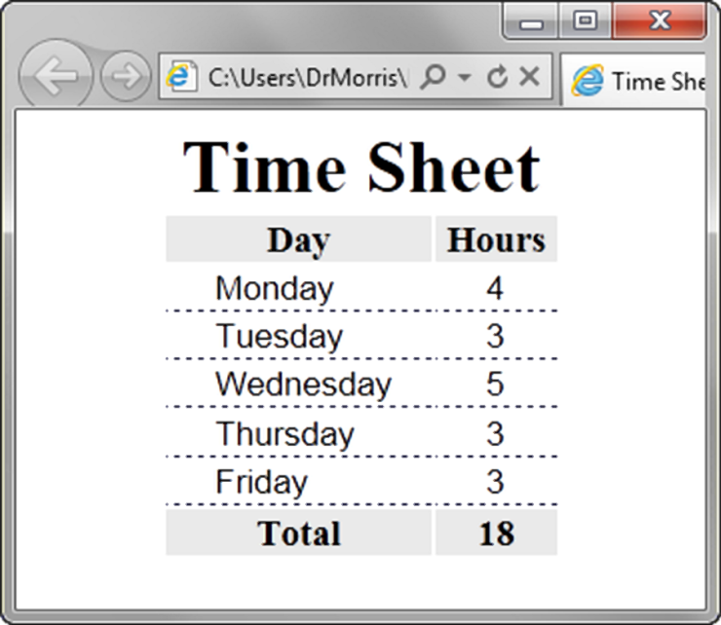
Table Row
Groups
<table> <caption>Time Sheet</caption>
<thead>
<tr>
<th id="day">Day</th>
<th id="hours">Hours</th>
</tr>
</thead>
<tbody>
<tr>
<td headers="day">Monday</td>
<td headers="hours">4</td>
</tr>
…
<tr>
<td headers="day">Friday</td>
<td headers="hours">3</td>
</tr>
</tbody>
<tfoot>
<tr>
<td headers="day">Total</td>
<td headers="hours">18</td>
</tr>
</tfoot> </table>
<thead>
table head rows
<tfoot>
table footer rows
<tbody >
table body rows. Required if you configure thead ir tfoot. Thead & tfoot section must be coded before tbody

Slide 32
HTML <td> headers Attribute
The headers attribute specifies one or more header cells a table cell is related to.
The headers attribute has no visual effect in ordinary web browsers, but can be used by screen readers.
In the previous code the
<td headers="day">Monday</td>
means that the data in this cell is related to the <th> that has the id “day”
http://www.w3schools.com/tags/att_td_headers.asp

Slide 33
Summary
This chapter introduced the HTML and CSS techniques used to create and configure tables on web pages.

