Slide 1
Web Development & Design Foundations with HTML5
Forms

Slide 2
Learning Outcomes
In this chapter, you will learn how to ...
  Describe common uses of forms on web pages
  Create forms on web pages using the form, input, textarea, and select elements
  Create forms that provide additional accessibility features using the accesskey and tabindex attributes
  Associate form controls and groups using the label, fieldset, and legend elements
  Create custom image buttons and use the button element
  Use CSS to style a form
  Configure new HTML5 form controls including the email, URL, datalist, range, spinner, calendar, and color controls
  Describe the features and common uses of server-side processing
  Invoke server-side processing to handle form data
  Find free server-side processing resources on the Web

Slide 3

Overview of Forms
Forms are used all over the Web to
  Accept information
  Provide interactivity
Types of forms:
  Search form, Order form, Newsletter sign-up form, Survey form, Add to Cart form, and so on…

Slide 4
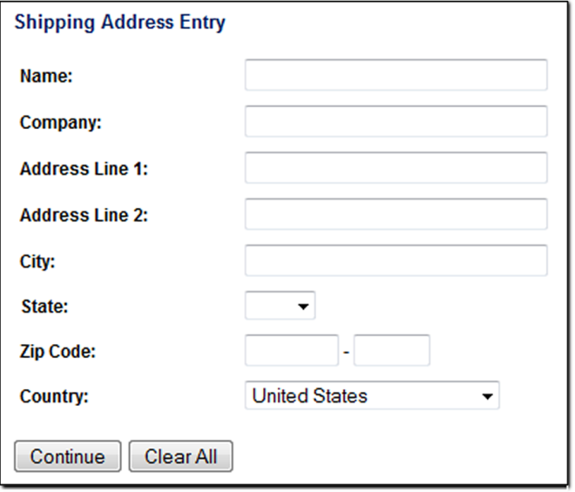
Overview of Forms (2)
Form
  An HTML element that
  contains and organizes
  form controls such as
  text boxes,
  check boxes,
  and buttons
  that can accept information from website visitors.

Slide 5
Two Components of Using Forms
1. The HTML form
  -- the web page user interface
and
2. The server-side processing
  Server-side processing works with the form data and sends e-mail, writes to a text file, updates a database, or performs some other type of processing on the server.

Slide 6
HTML Using Forms
<form>
  Contains the form elements on a web page
  Container tag ends with </form>
  Form elements cannot be nested inside each other
<input>
  Configures a variety of form elements including text boxes, radio buttons, check boxes, and buttons
  Stand alone tag
<textarea>
  Configures a scrolling text box
  Container tag ends with </textarea>
<select>
  Configures a select box (drop down list)
  Container tag ends with </select>
<option>
  Configures an option in the select box
  Container tag ends with </option>

Slide 7
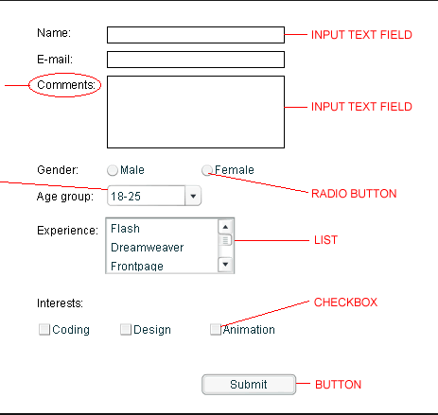
Form control elements

Slide 8
HTML form element
The form element attributes:
  action
    URL or file name/path
    Required
    Specifies the server-side program or script that will process your form data
  method
    get – default value,
    form data passed in URL
    post – more secure,
    form data passed in HTTP Entity Body
  name
    Identifies the form
  id
    Identifies the form
  Autocomplete
    Default value yes. Values: on & off.
    <form name=“order” method=“post” id=“order” action=“demo.php>
    …form controls go here…
    </form>

Slide 9
HTML form Controls
1. The input element: <input>
A stand alone tag used to configure several different types of form controls.
Use the type attribute to specify the type of the form controls

Slide 10
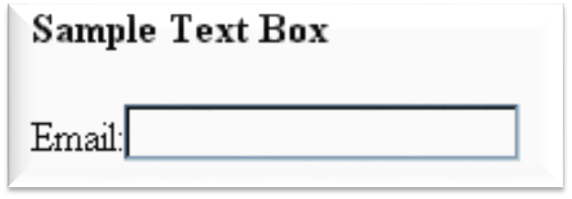
Input Text box
<input>
Accepts text information
Attributes:
  type=“text”
  name
  id
  Size: numeric value
  Maxlength: numeric value
  Value: text or numeric characters, assigns an initial value to the textbox
  readonly: display only and cannot be edited
  autocomplete
  autofocus
  Placeholder: text or numeric, brief info to assist the user
  required: value is “required”
  Accesskey: keyboard characters
  tabindex: numeric, tab key order

Slide 11
Why use both name & id?
The name attribute so it can be easily accessed by the client-side scripting language such as JavaScript or by server-side processing such as PHP.
The id is for CSS & scripting.
The values assigned to the name or id attribute on a particular element are the same.

Slide 12
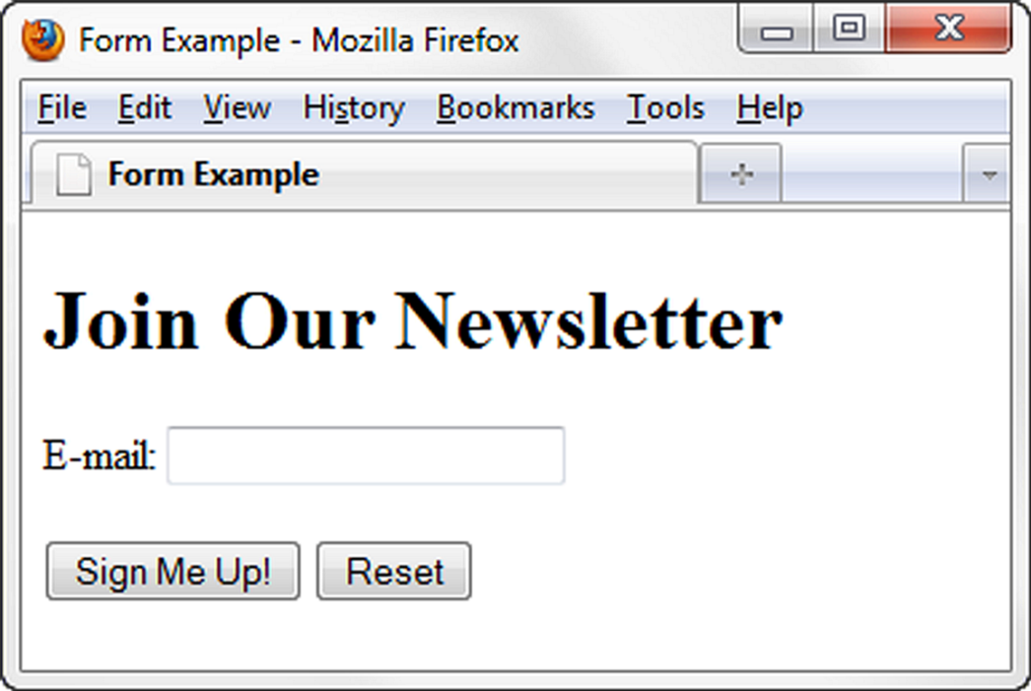
Sample Form HTML
<form>
E-mail: <input type="text" name ="email" id="email"><br>
<input type="submit">
<input type=“reset">
</form>

Slide 13
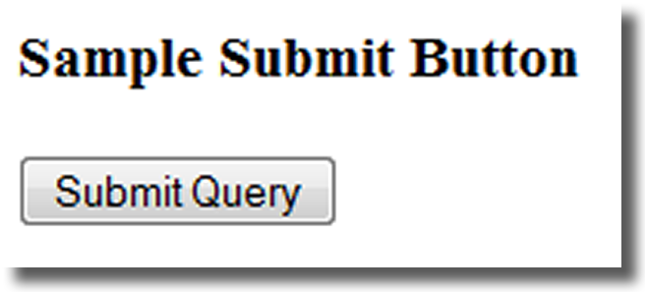
input Submit Button
<input>
Submits the form information
When clicked:
  Triggers the action method on the <form> tag
  Sends the form data (the name=value pair for each form element) to the web server.
Attributes:
  type=“submit”
  name
  id
  Value: configures the text displays on the button
  e.g <input type=“submit”>

Slide 14
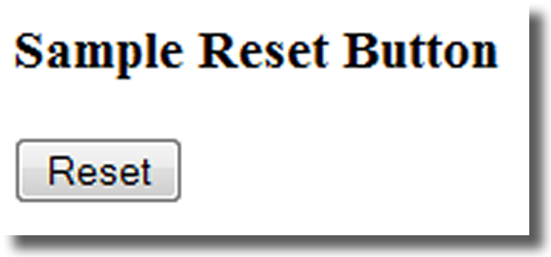
input Reset Button
<input>
Resets the form fields to their initial values
Attributes:
  type=“reset”
  name
  id
  Value: configures the text displays on the button
  e.g <input type=“reset”>

Slide 15
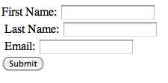
Hands-On Practice1
Create this form:

Slide 16
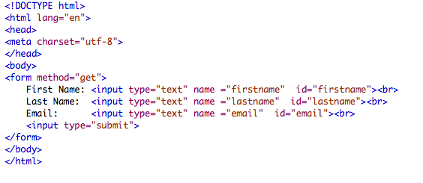
The code
______________________________________________________
Add the attribute value of to the submit button and render your page
<input type=“submit” value=“Sign Up”>

Slide 17
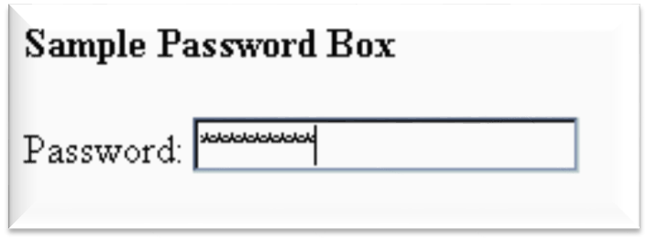
input Password box
<input>
Accepts text information that needs to be hidden as it is entered
Different browsers use different symbols (shown as asterisks or circles)
Attributes:
  type=“password”
  name
  id
  Size
  maxlength
  e.g Password: <input type=“password” name=“pword” id=“pword”>

Slide 18
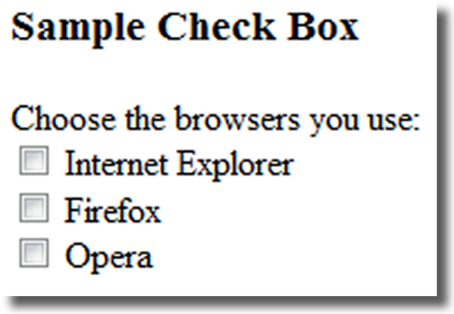
input Check box
<input>
Allows the user to select one or more of a group of predetermined items
Attributes:
  type=“checkbox”
  name
  Id
  checked: value of “checked”
  value: The value attribute defines this value which is send by a post request. All check boxes can have the same value
  Required
  readonly
  autofocus
  accesskey
  tabindex
  e.g <input type="checkbox" name=”IE” id=“IE” value=“yes">Internet Explorer<br>
  <input type="checkbox" name=”Firefox” id=“Firefox” value=“yes">Firefox<br>
  <input type="checkbox" name=”Opera” id=“opera” value=“yes">Opera<br>
1

Slide 19
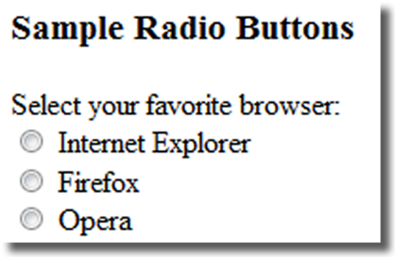
input Radio Button
<input>
Allows the user to select exactly one from a group of predetermined items
Each radio button in a group is given the same name and a unique value
Attributes:
  type=“radio”
  name
  Id
  checked: value of “checked”
  value: The value attribute defines this value which is send by a post request. Should be a unique value for each radio button in the group.
  Required
  readonly
  Autofocus
  accesskey
  tabindex
  e.g <input type=“radio” name=“Favbrowser” id=“favIE” value=“IE">Internet Explorer<br>
  <input type=“radio” name=“Favbrowser” id=“favfirefox” value=“Firefox">Firefox<br>
  <input type=“radio” name=“Favbrowser” id=“favOpera” value=“Opera">opera<br>

Slide 20
input Hidden form data
<input>
This form control is not displayed on the web page.
Hidden form fields
  Can be accessed by both client-side and server-side scripting
  Sometimes used to contain information needed as the visitor moves from page to page.
Use hidden fields to pass along information to the forms that is generated by the program, script, or web page.
Remember that hidden fields are not hidden from view. Your readers can see them if they view the source of your web page. So you should never use a hidden input field to store passwords or any other sensitive information.
Attributes:
  type=“hidden”
  name
  id
  value
  e.g <input type=“hidden” name=“sendto” id=“sendto” value=order@site.com>

Slide 21
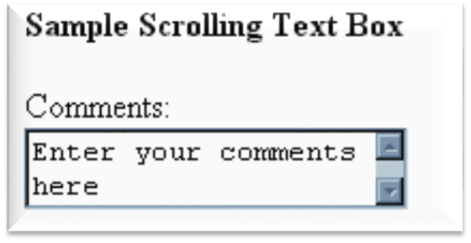
textarea Scrolling Text Box
<textarea> </textarea>
Configures a scrolling text box
Attributes:
  name
  id
  Cols: the width in characters (required)
  Rows: the height (required)
  Wrap: values: hard or soft, configures the line breaks.
  maxlength, disabled, readonly, placeholder, required, accesskey, tabindex
  e.g. <textarea name=“comments” cols=“40” rows=“2”> enter your comments here </textarea>

Slide 22
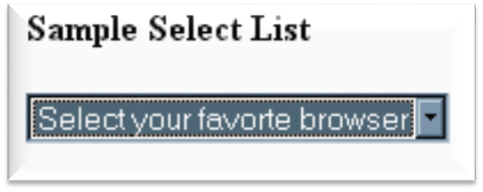
Select List
<select></select>
Configures a select list (along with option elements)
Also known as: Select Box, Drop-Down List, Drop-Down Box, and Option Box.
Allows the user to select one or more items from a list of predetermined choices.
Attributes:
  name
  id
  Size: no. of choices the browser will display
  Multiple: value: multiple, to accept more than one choice

Slide 23
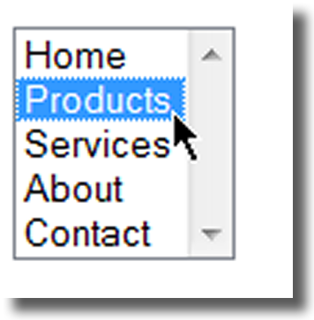
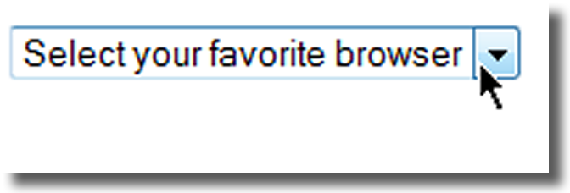
Options in a Select List
<option></option>
Configures the options in a Select List
Attributes:
  Value: assigns a value to the option
  Selected: the initial option selected

Slide 24
Options in a Select List
<select size=“1” name=“favbrowser” id=“favbrowser”>
<option> select your favorite browser </option>
<option value=“internet Explorer”> Internet Explorer</option>
<option value=“Firefox”> Firefox</option>
<option value=“Opera”> Opera</option>
</select>

Slide 25
Options in a Select List
<select size=“5” name=“jumpmenu” id=“jumpmenu”>
<option value=“index.html”> Home</option>
<option value=“product.html”> Products</option>
<option value=“services.html”> Services</option>
<option value=“about.html”> About</option>
<option value=“contact.html”> Contact</option>
</select>

Slide 26
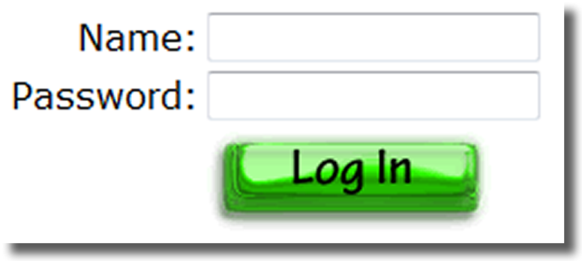
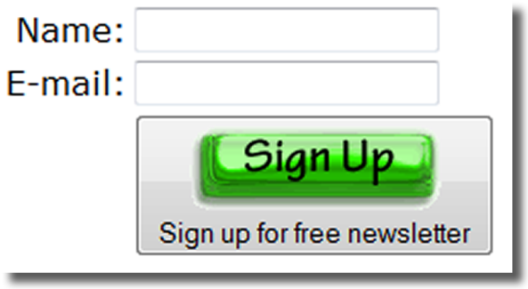
Image button & Button element
Changing the plain submit button to have more visually interesting.

Slide 27
Input Image Button
<input>
Submits the form
When clicked:
  Triggers the action method on the form tag
  Sends the form data (the name=value pair for each form element) to the web server.
Attributes:
  type=“image”
  name
  id
  src
  e.g. <input type=“image” src=“login.gif” alt=“login button”>

Slide 28
BUTTON ELEMENT
<button></button>
A container tag
When clicked, its function depends on the value of the type attribute.
Can contain a combination of text, images, and media
Often is not used
Attributes:
  type=“submit”, type=“reset”, type=“button”
  name
  id
  alt
  value
  e.g.
  <button type=“submit”>
  <img src=“signup”.gif width=“80” height=“28” alt=“Sign up for free newsletter”>
  </button>

Slide 29
Accessibility & Forms
Label Element
Fieldset Element
Legend Element
Tabindex Attribute
Accesskey Attribute

Slide 30
Label element
<label></label>
Associates a text label with a form control
Helpful to people who are using assistive technology
Two Different Formats:
<label>Email: <input type="text" name=“email" id ="email"></label>
  Or
  <label for="email">Email: </label>
  <input type="text" name="CustEmail" id= "email">

Slide 31
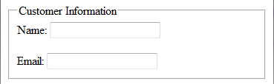
Fieldset and Legend Elements
The Fieldset Element
  Container tag
  Groups elements of similar
  purpose together
  More visually pleasing form
The Legend Element
  Container tag
  Creates a text label within the fieldset
  <fieldset>
  <legend>Customer Information</legend>
  <label>Name:
  <input type="text" name="Name" id="Name“></label>
  <br><br>
  <label>Email:
  <input type="text" name="Email" id="Email"></label>
  </fieldset>

Slide 32
tabindex attribute
Helpful for visitors who have difficulty using the mouse.
Attribute that can be used on form controls and anchor tags
Modifies the default tab order (the default is to move to the next form control)
Assign a numeric value
<input type="text" name="CustEmail" id="CustEmail" tabindex="1">

Slide 33
accesskey attribute
Attribute that can be used on form controls and anchor tags
Create a “hot-key” combination to place the focus on the component
Assign a value of a keyboard letter
On Windows use the CTRL and the “hot-key” to move the cursor
<input type="text" name="CustEmail" id="CustEmail" accesskey="E">

Slide 34
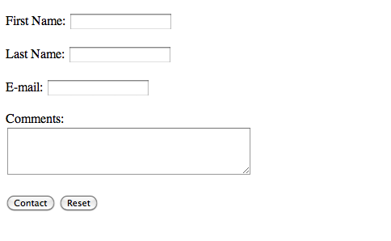
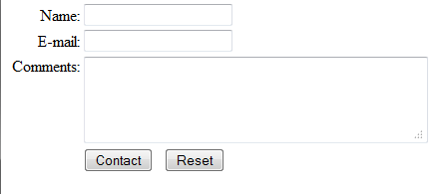
Styling a Form

Slide 35
Format a Form
With a Table
<form method="get">
<table border="0">
<tr>
<td>Name:</td>
<td><input type="text" name="fmail" id="fmail"></td>
</tr>
<tr>
<td>E-mail:</td>
<td><input type="text" name="email" id="email"></td>
</tr>
<tr>
<td>Comments:</td>
<td><textarea name="comments" id="comments" rows="4" cols="40"></textarea></td>
</tr>
<tr>
<td>&nbsp;</td>
<td><input type="submit" value="Contact">
&nbsp; <input type="reset"></td>
</tr>
</table>
</form>
td:first-of-type {text-align: right; vertical-align: top}

Slide 36
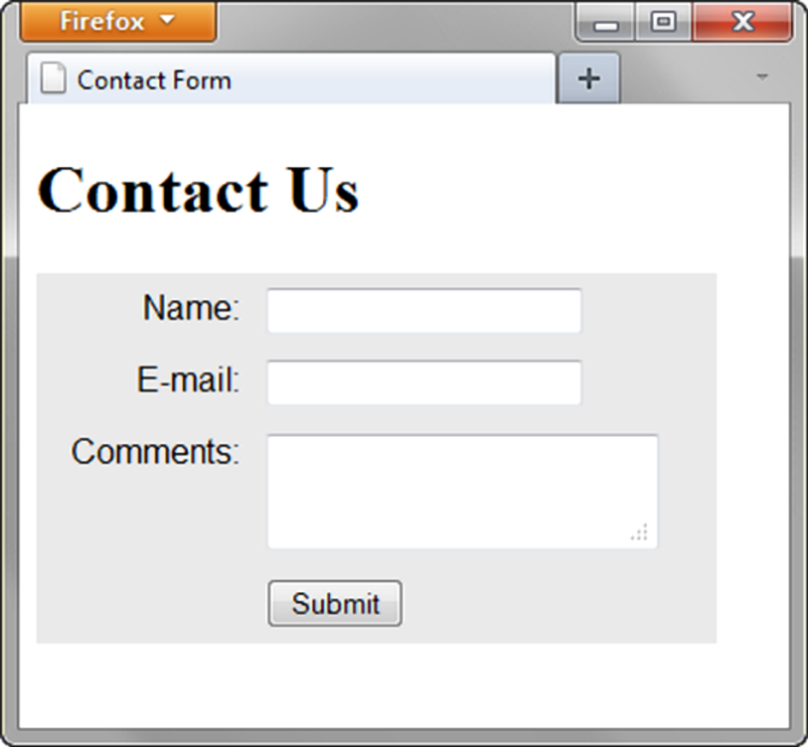
Using CSS to Style a Form
Transitional Approach
  Use a table to format the form but configure styles instead of HTML table attributes.
table { background-color: #eaeaea;
border-style: none;
width: 20em;
font-family: Arial, sans-serif; }
th {font-weight: normal
text-align: right;
vertical-align: top; }
td { padding: 5px;}

Slide 37
Using CSS to Style a Form
“Pure" CSS Approach
  Another way to style a form using only CSS
  not using a table to format the form.
  Use CSS float and display: block

Slide 38
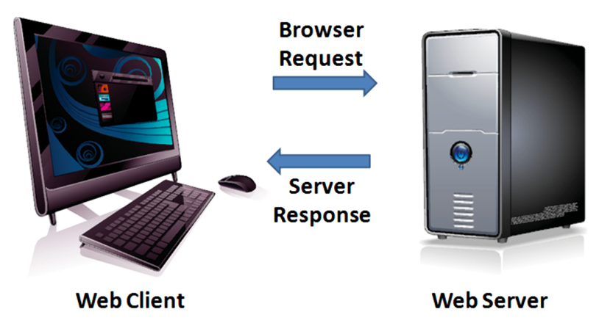
Server-Side
Processing
Your web browser requests web pages and their related files from a web server.
The web server locates the files and sends them to your web browser.
The web browser then renders the returned files and displays the requested web pages for you to use.

Slide 39
Server-Side Scripting
One of many technologies in which a server-side script is embedded within a Web page document saved with a file extension such as:
  .php (PHP)
  .asp (Active Server Pages)
  .cfm (Adobe ColdFusion)
  .jsp (Sun JavaServer Pages)
  .aspx (ASP.Net).
Uses direct execution — the script is run either by the web server itself or by an extension module to the web server.

Slide 40
Common Uses of
Server-Side Scripting
Search a database
Place an order at an online store
Send a web page to a friend
Subscribe to a newsletter

Slide 41
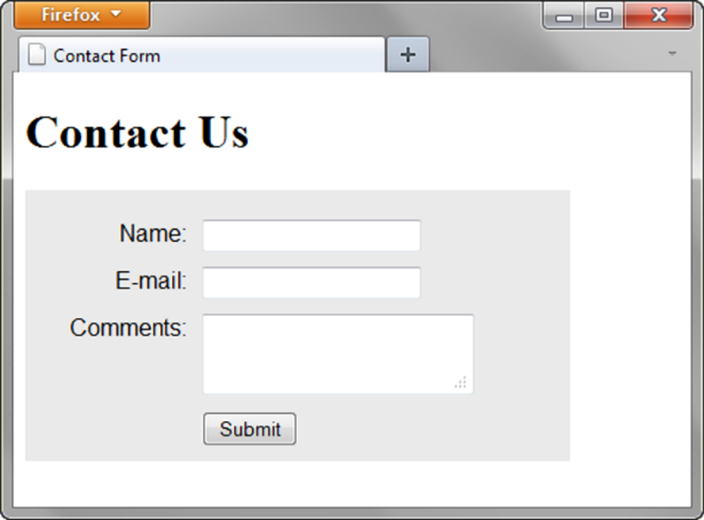
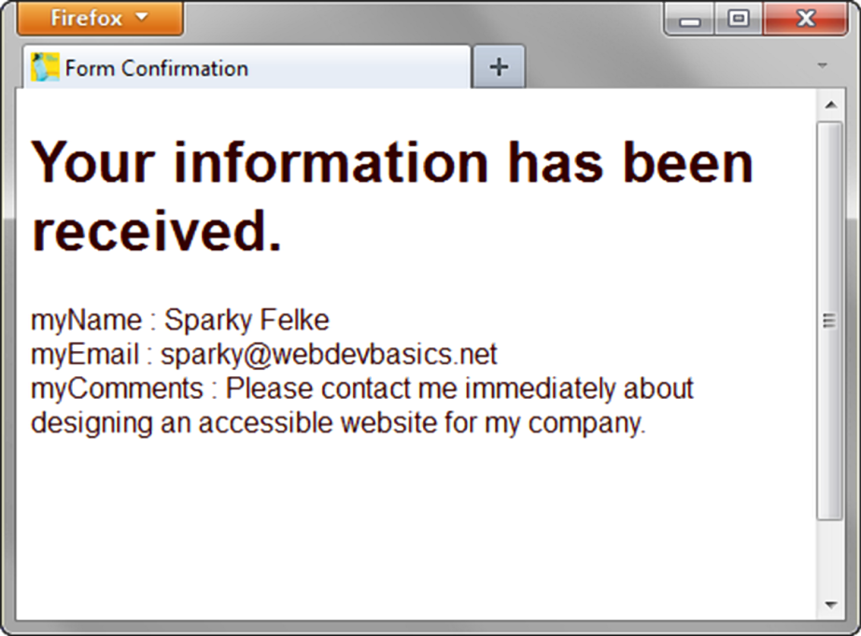
Sending information to a Server-side Script
<form method="post" action="http://webdevbasics.net/scripts/demo.php ">

Slide 42
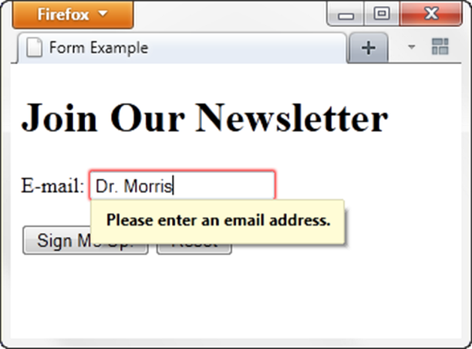
HTML5: Email Text Box
<input>
Similar to textbox but accepts text information in e-mail address format
Common Attributes:
  type=“email”
  name
  id
  size
  maxlength
  value
  placeholder
  required

Slide 43
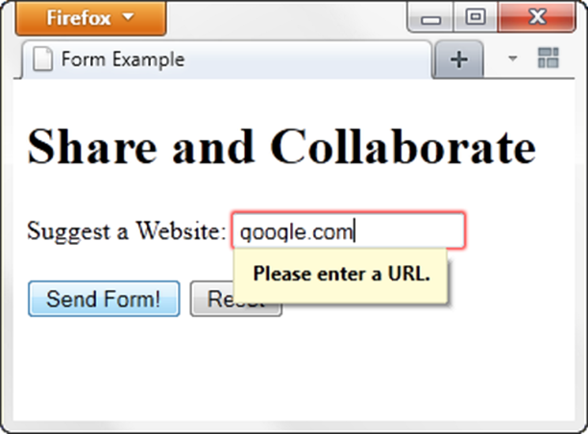
HTML5: URL Text Box
<input>
Accepts text information in URL format
Common Attributes:
  type=“url”
  name
  id
  size
  maxlength
  value
  placeholder
  required

Slide 44
HTML5: Telephone Number Text Box
<input>
Accepts text information in telephone number format
Common Attributes:
  type=“tel”
  name
  id
  size
  maxlength
  value
  placeholder
  required

Slide 45
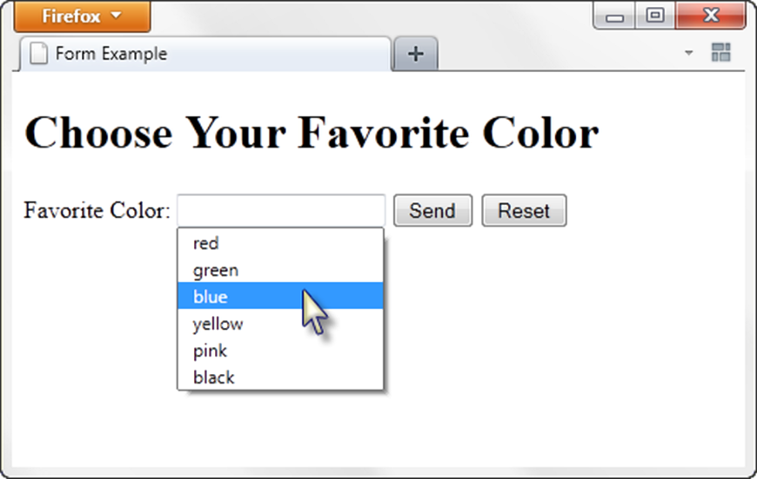
HTML5: Datalist Control
Selection of choices are offered along with a text box for entry.
<label for="color">Favorite Color:</label>
<input type="text" name="color" id="color" list="colors" >
<datalist id="colors">
<option value="red">
<option value="green">
<option value="blue">
<option value="yellow">
<option value="pink">
<option value="black">
</datalist>

Slide 46
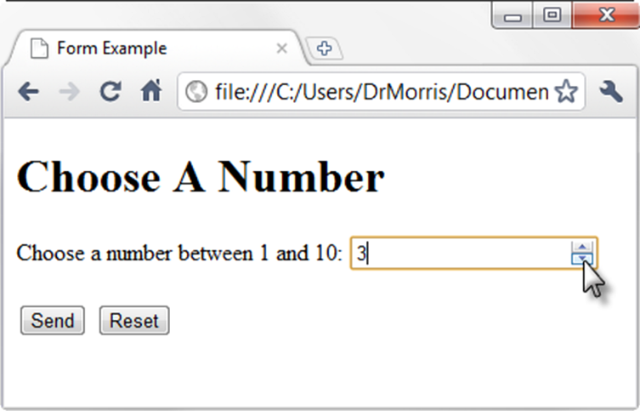
HTML5: Spinner Control
<label for="myChoice">Choose a number between 1 and 10:</label>
<input type="number" name="myChoice" id="myChoice"
min="1" max="10">

Slide 47
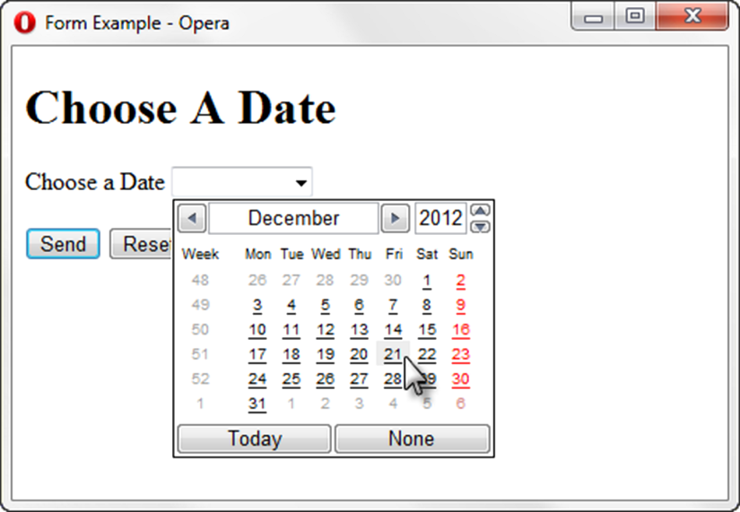
HTML5: Calendar Control
<label for="myDate">Choose a Date</label>
<input type="date" name="myDate" id="myDate">

Slide 48
Q & A

