Slide 1
Website trends
2015-2016

Slide 2
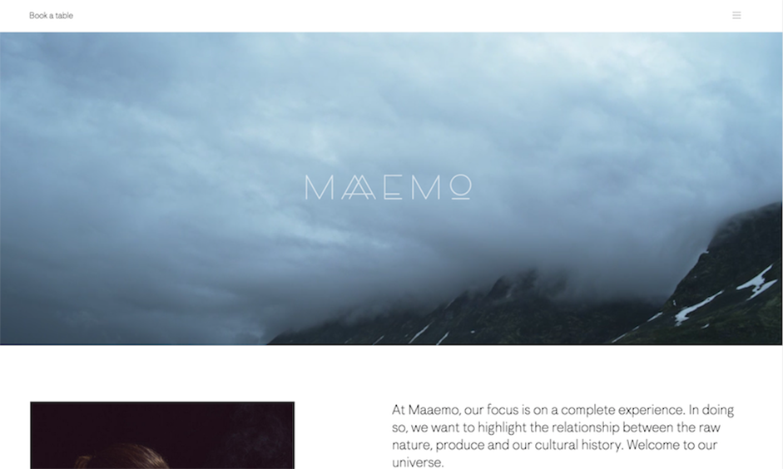
Hero images
A hero image is a large banner image, prominently placed on a web page, generally in the front and center

Slide 3
Hero Video Headers (Think Movie-Style Sites)
Websites design is going to the movies. Higher speed Internet connections and better video plugin integration is making it easier for more websites to include an immersive movie-style experience. Video clips are growing from small snippets to almost full-length preview clips. The images are sharp, crisp and in high definition.
http://follow-your-intuition.com/

Slide 4
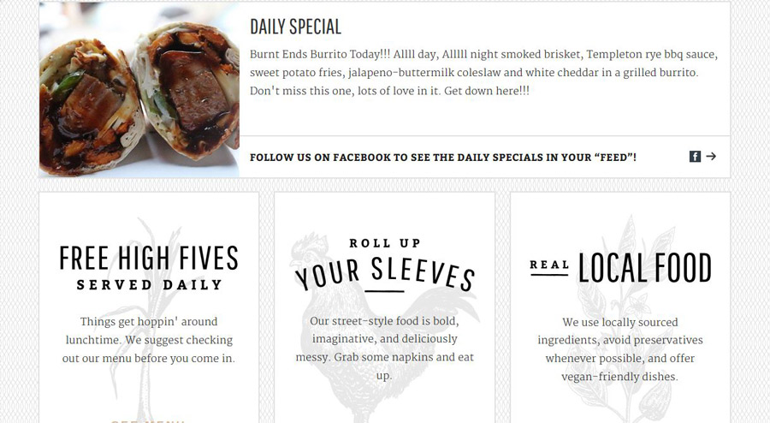
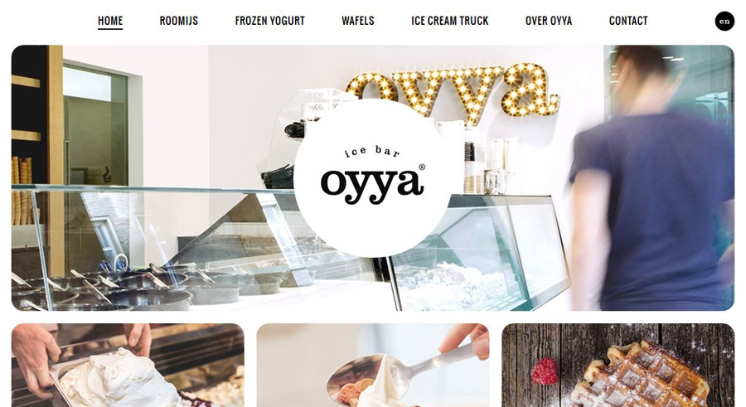
Card-Style interfaces
keep information organized in a user-friendly container and are engaging for users.
https://dribbble.com/shots/1435404-Property-List/attachments/211304

Slide 5
Long scroll
Placing all your important elements above the fold.
Above the fold: Originally used to refer to the upper half of a newspaper page, the term came to mean "the part of the page visible without scrolling.
http://www.dangersoffracking.com/

Slide 6
Rich Animations
Large scale animations. These are used as a primary interaction tool have more impact on users and include effects like parallax scrolling and pop-up notifications.
http://www.neotokio.it/
http://www.lovedays.org/
Small scale animations. These include spinners, hover tools and loading bars, and don’t require any user input.
http://www.petenottage.co.uk/

Slide 7
Rich Animations
Loading animations: Keep them simple and avoid adding sound. They should however match your site’s personality and color palette.

Slide 8
Rich Animations
Hover animations: Hover effects give a more intuitive feel to a site as users mouse over content for instant visual feedback.

Slide 9
Flat Design
Flat design has been around for a while and is compatible with other trends such as minimalism, responsive web design and Material Design.
http://www.buildinamsterdam.com/
http://interactions.webflow.com/

Slide 10
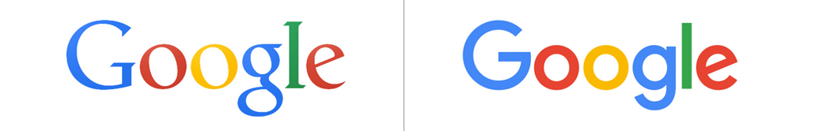
Flat Design
Flat design to continue to be a dominate design aesthetic throughout 2016.
Take for example Google’s logo. The company changed its logo to make it more flat (losing the bevels) and changed the font. It found that a cleaner sans-serif font for its logo helped cut the size of the logo file used on sites by more than half. Google also found that it was easier to read on smaller devices.

Slide 11
Flat Design
It is design stripped down to the basics. It removes any stylistic choices that give it the illusion of three-dimensionality, like drop shadows, gradients, and textures. It’s focused purely on the interplay of icons, typography, and color

Slide 12
Material Design
Material Design makes use of depth and shadow, which allows for more depth than pure flat design.
https://www.google.com/design/spec/material-design/introduction.html

Slide 13
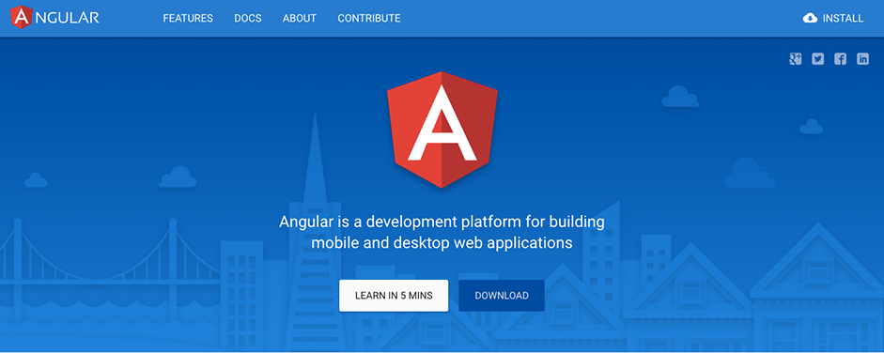
Material Design

Slide 14
Material design

Slide 15
Flat Design vs. Material Design: How Are They Different?
Material design really isn’t that big a departure from flat design: both use the same clean and minimal aesthetic. You can basically think of material interfaces as flat interfaces cut apart. And while material design’s animations have been widely praised, when you boil it down, they just serve to make things more user-friendly. In fact, there’s nothing that says that you can’t combine the aesthetics of the two, using material to give some extra pop to a flat site that remains otherwise unchanged.

Slide 16
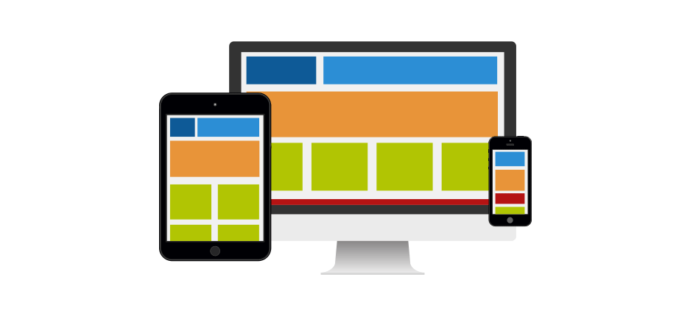
Responsive Design
Responsive web design has become incredibly popular in recent years thanks to the rise of mobile internet usage.
More details about responsive design in the “responsive design” slides

Slide 17
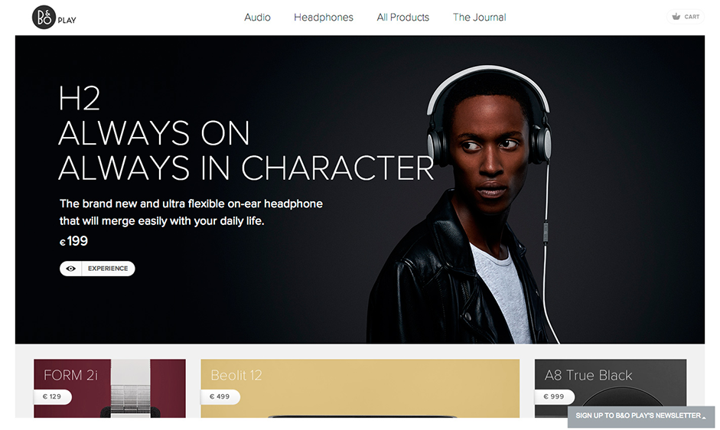
Simple typography
Simple typefaces help to ensure that text remains legible and readable in flat design.
Big, bold typefaces will continue to rule because they work well with other trendy elements

