Slide 1
Web Development & Design Foundations with HTML5
JavaScript – Part 2

Slide 2
Learning Outcomes
  Using operators
  Using the if control structure

Slide 3
Arithmetic Operators
When working with variables it is always useful to do some calculations. Operators are the symbols used to work with variables.
Operator | Description | Example | Value of Quantity
= | assign | quantity = 10 | 10
+ | addition | quantity = 10 + 6 | 16
- | subtraction | quantity = 10 - 6 | 4
* | multiplication | quantity = 10 * 2 | 20
/ | division | quantity = 10 / 2 | 5

Slide 4
Arithmetic Operators
Operator | What it does
x % y | Modulus of x and y (remainder of the division)
-x | Reverse the sign on x
x + y (Numeric) | Adds x and y together
x + y (String) | Concatenates text x and text y together “black” + “cat” produces “blackcat”

Slide 5
Assignments
When you put a value into a variable, you are assigning that value to the variable, and you use an assignment operator to do the job.
X=Y Sets X to the value of Y
X+=Y Same as X = X + Y
X-=Y Same as X = X – Y
X*=Y Same as X = X * Y
X/=Y Same as X = X / Y
X%=Y Same as X = X % Y

Slide 6
Arithmetic Operators
Result = Result + 1;
Shorthand:
Result +=1;
Result ++;
++ Result;

Slide 7
Operator precedence
Some variables are treated more important than others:
Multiplication and division: more important
Addition and subtraction: less important
Example: Result = 5 + 5 * 10; Result = (5 + 5) * 10;
55 = 5 + 50 100 = 10 * 10

Slide 8
Comparison Operators
Operator | Description | Example | Sample values of quantity that would result in true
= = | Double equals sign (equivalent) “is exactly equal to” | quantity = = 10 | 10
> | Greater than | quantity > 10 | 11, 12 (but not 10)
> = | Greater than or equal to | quantity > = 10 | 10, 11, 12
< | Less than | quantity < 10 | 8, 9 (but not 10)
< = | Less than or equal to | quantity < = 10 | 8, 9, 10
! = | Not equal to | quantity ! = 10 | 8, 9, 11 (but not 10)

Slide 9
Logical Operators
! (not)
&& (and)
|| (or)

Slide 10
Decision Making
if (condition) {
… commands to execute if condition is true
}
else {
… commands to execute if condition is false
}

Slide 11
Decision making: example
if(Day==“Friday”){
document.write(“Have a nice weekend!”);
}
else{
document.write(“Good Morning!”);
}

Slide 12
Decision making: example2
If(Day==“Friday” || Day==“Saturday”)
{ document.write(“Have a nice weekend!”);
}
else
{ document.write(“Good Morning!”);
}

Slide 13
Nested if then .. else statements
var country = “france”;
if (country==“spain”)
{
document.write(“buenos dias”);
}
else
  { if (country==“italy”)
  {document.write(“buon giorno”);}
  else
  {if (country==“france”)
  {document.write(“bonjour”);}
  }
  }

Slide 14
Hands-on practice 2
The user will be prompted for a quantity and must enter a quantity greater than 0.
If the user enters a value that is 0 or a negative number, an error message should be displayed.
If the user has inserted a positive value, write “thank you” to the screen.
Use prompt method & write the message to the document.

Slide 15
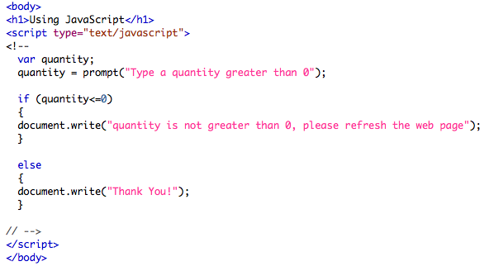
The code:

Slide 16
quiz1
What would be the output of:
<script type="text/javascript">
<!--
var txt1=”This is too";
var txt2=" easy";
var txt3=txt1+txt2;
document.write(txt3);
//-->
How to insert a space into your expressions?
txt1+” “+txt2

Slide 17
quiz2
What would be the output of:
<script type="text/javascript">
<!--
var txt1=10;
var txt2=20;
var txt3=txt1+txt2;
document.write(txt3);
//-->

Slide 18
quiz3
What would be the output of:
<script type="text/javascript">
<!--
var txt1=“10”;
var txt2=“20”;
var txt3=txt1+txt2;
document.write(txt3);
//-->

Slide 19
JS resources
http://www.w3schools.com/js/
http://www.Lynda.com
http://www.youtube.com/watch?v=_cLvpJY2deo

