Slide 1
JavaScript5
Event Handling

Slide 2
onmouseover
One of the most commonly used event handler
It is a simple image swap technique
When the mouse pointer goes over the element
Syntax:
<img src="map.gif" alt=“swapping a pic” onmouseover="this.src=’pic2.gif';”>
The only thing is that the picture stays on pic2 and never goes back to pic1 unless we add a 2nd event handler (next slide)
The code changes the content of its own element using “this”

Slide 3
onmouseout
When the mouse pointer moves out of an element.
Syntax:
<img src="map.gif" alt=“swapping a pic” onmouseover="this.src=’pic2.gif';”
onmouseout="this.src=’map.gif';”>

Slide 4
Tip
The onmouseout & onmouseover are often used together

Slide 5
What would you do?
If you want to have these images including the img swapping as links?
You will only add the a href (check older slides)
E.g.
<a href=“about.html”> <img src="map.gif" alt=“swapping a pic” onmouseover="this.src=’pic2.gif';”
onmouseout="this.src=’map.gif';”>
</a>

Slide 6
Practice
Download the folder “practice”
Add img1 below the navigation, you image should work as a link to google website.
center your image, apply image swapping technique in javascript (onmuseover & onmouseout)
You will swap img1 with img2 when the mouse goes over the image

Slide 7
What more can JavaScript do?
Change HTML Content
Change CSS
Validate form Input

Slide 8
Change HTML Content
One of many HTML methods is getElementById().
This example uses the method to "find" an HTML element (with id="demo"), and changes the element content (innerHTML) to "Hello JavaScript”
Syntax: document.getElementById("id")

Slide 9
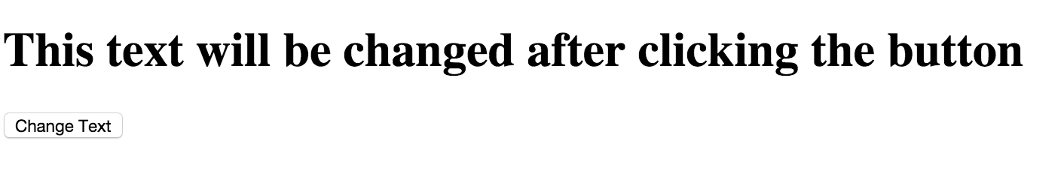
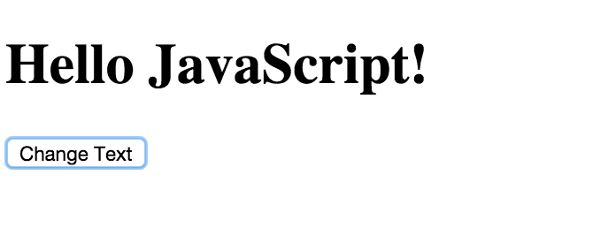
Example

Slide 10
Example Answer
<body>
<h1 id="demo">This text will be changed after clicking the button
</h1>
<input type="button" value= "Change Text"
onclick="document.getElementById('demo').innerHTML = 'Hello JavaScript!'">
</body>

Slide 11
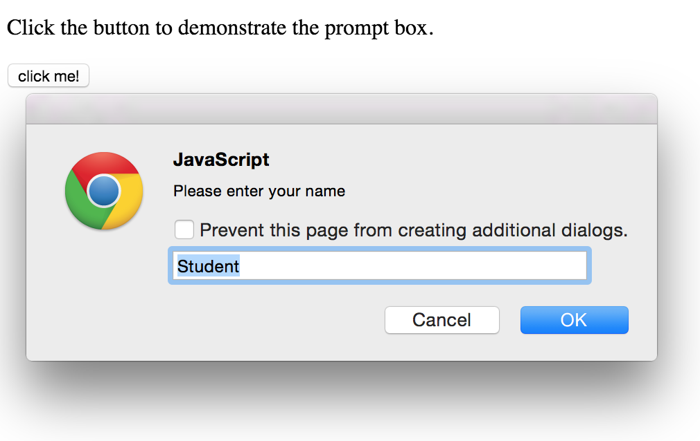
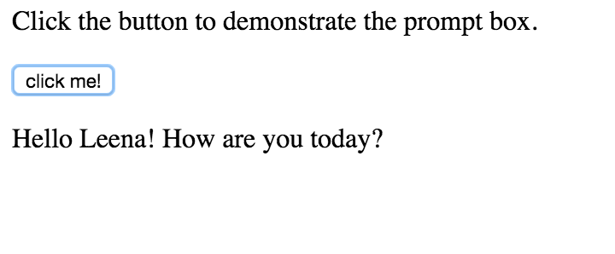
Practice
Default Value in a prompt Method

Slide 12
Practice Answer
<head>
<script>
function testName() {
var person = prompt("Please enter your name", "Student");
if (person != null) {
document.getElementById("demo").innerHTML = "Hello " + person + "! How are you today?";
} }
</script>
</head>
<body>
<p>Click the button to demonstrate the prompt box.</p>
<input type="button" value="click me!" onclick= "testName()">
<p id="demo"></p>
</body>

Slide 13
A fun Example at W3schools
http://www.w3schools.com/js/tryit.asp?filename=tryjs_intro_lightbulb

Slide 14
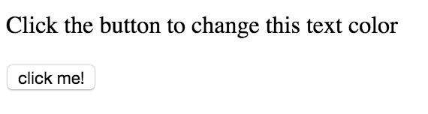
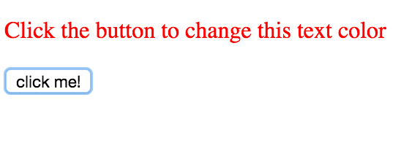
Change HTML Styles (CSS)

Slide 15
Practice Answer
<head>
<script>
function ChangeColor() {
var x = document.getElementById("demo");
x.style.color = "red";
}
</script>
</head>
<body>
<p id="demo">Click the button to change this text color</p>
<input type="button" value="click me!" onclick= "ChangeColor()">
</body>

Slide 16
To change the font size
x.style.fontSize = "25px";

Slide 17
Validate Form Input
The isNaN() function
determines whether a value is an illegal number (Not-a-Number).
This function returns true if the value is NaN, and false if not.

Slide 18
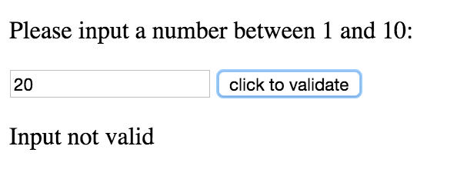
Example

Slide 19
The Code
<body>
<p>Please input a number between 1 and 10:</p>
<input id="numb" type="number">
<input type="button" value="click to validate" onclick="myFunction()">
<p id="demo"></p>
<script>
function myFunction() {
var x, text;
// Get the value of the input with id="numb"
x = document.getElementById("numb").value;
if (isNaN(x) || x < 1 || x > 10) {
text = "Input not valid";
} else {
text = "Input OK";}
document.getElementById("demo").innerHTML = text;
}
</script>
</body>

Slide 20
Thank you

