Slide 1
Publishing your website

Slide 2
Objectives
What is FTP?
How to publish a website using ftp
FTP command line
FTP client software's
FTP command line Features

Slide 3
FTP: File Transfer Protocol
The File Transfer Protocol (FTP) is a standard network protocol used to transfer computer files from one host to another host over a TCP-based network, such as the Internet.

Slide 4
FTP: File Transfer Protocol
Web developers commonly use FTP to publish their websites
The hosting company will provide you the FTP access details.

Slide 5
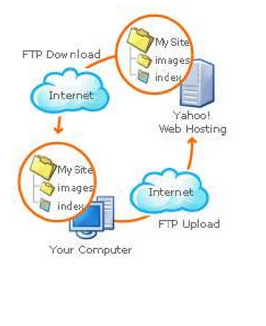
FTP: File Transfer Protocol

Slide 6
How to?
Using FTP client
FTP client is a software that allows you to move your files to a server in order to publish your website.
There are many ftp client programs that you can download from the internet Or you run it from the command-line (ftp command) which is installed in many operating systems.

Slide 7
The FTP Command line
Microsoft built in to all current versions of Windows.
With little effort, you can use the Windows FTP client to manage all your FTP needs.

Slide 8
Lets test it!

Slide 9
Use the PSU FTP server
Follow these steps to access the ftp server:
The ftp server only works on campus
Hostname: 10.0.6.41
Username: Your Student ID
Password: Your student Password

Slide 10
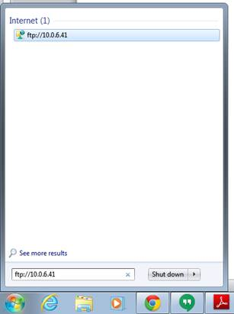
The steps:
From start menu type ftp://10.0.6.41

Slide 11
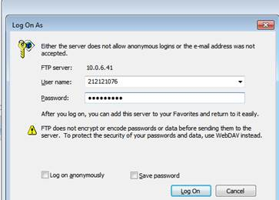
2- Enter student username and password

Slide 12
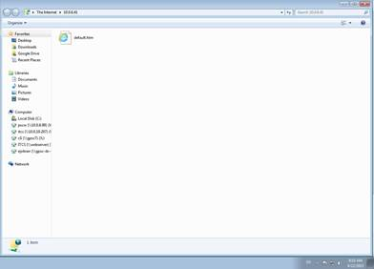
3- Server will open and you can add your files using drag and drop or copy & paste

Slide 13
To display your website in a browser
1- From web browser type the url
http://10.0.6.41/IS211/filename
e.g. if my website directory folder is: AsmaProject and my homepage is index.html I will write:
http://10.0.6.41/IS211/AsmaProject/index.html

Slide 14
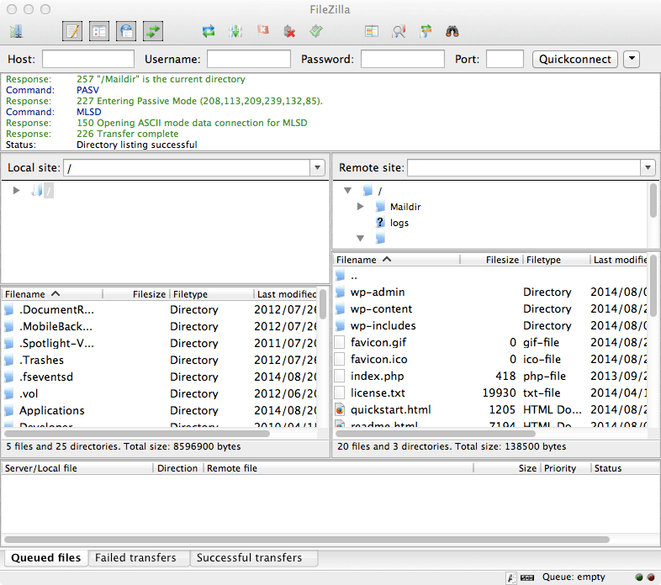
Top FTP clients 2014
1. FileZilla (for Windows, Macs and Linux)
One of the most popular open-source FTP clients of all time
Cross platforms.
GUI-based FTP tools
Great for beginners.
Open Source
Download it from: https://filezilla-project.org
http://winningwp.com/best-free-and-premium-ftp-clients-for-macs-and-windows/

Slide 15
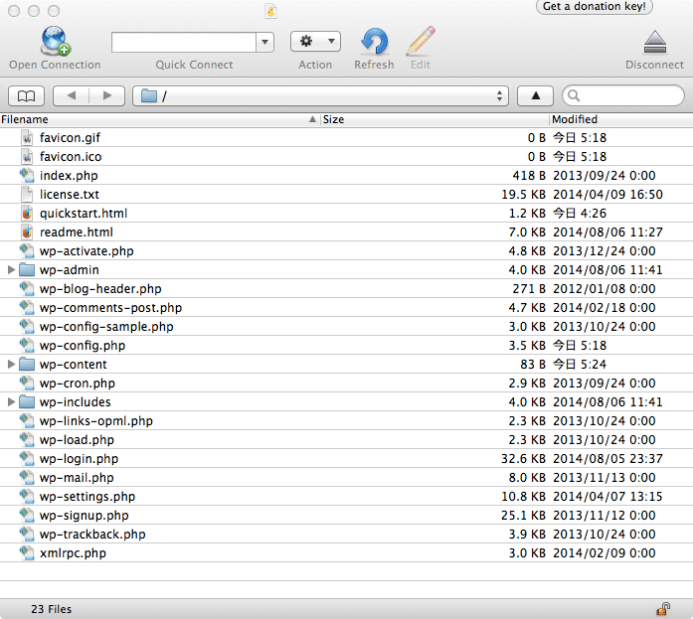
Top FTP clients 2014
2. Cyberduck (for Windows and Macs)
User-friendly
Cross platforms.
GUI-based FTP tools
Allows you to edit files.
Open Source
Download it from:
https://cyberduck.io
http://winningwp.com/best-free-and-premium-ftp-clients-for-macs-and-windows/

Slide 16
Upload & download
Uploading: transferring files from a client computer to a server computer.
Downloading: transferring file from a server computer to a client computer.

Slide 17
FTP Features
Transferring files
Renaming files
Deleting files
Creating directory folders

Slide 18
FTP is the simplest & most secure way to exchange files over the internet.

Slide 19
Congratulations
You just published your website to the PSU server!

Slide 20
Hosting your website with a hosting company
Always better to check top hosting for the year
http://www.top10bestwebsitehosting.com/

Slide 21
How to?
Go the website of the hosting providers you have chosen, register and they will send you via email all details you need of how to access the ftp to transfer your files.
In that email there will be a username and a password to access FTP.

