Slide 1
Customer360 Data Warehouse
Built in SQL Server: from messy data to business answers
Presented by Amogelang

Slide 2
Project goal & approach
Build a Customer360 warehouse: one view of every customer
Modelled the data in Excel first: grouped related columns by colour
Planned the architecture in draw.io before writing any code
Built everything with SQL only

Slide 3
Two-database architecture
stg_Customer360
Staging: one flat table, customer_activity
dwh_Customer360
Warehouse: split into dimension tables
→
Data is only split into separate tables when the warehouse is built.

Slide 4
Challenge: the CSV would not load
Too many problems in the CSV to import as a flat file in SSMS
Strategy: insert the values manually with INSERT … VALUES (test1.sql)
Why it mattered: staging loaded cleanly and became a trusted starting point
Result: staging load ran successfully

Slide 5
Star schema design
dim_customer
dim_customer_contact
dim_fact
dim_location
dim_interaction
dim_event
dim_account
dim_transaction
dim_dates

Slide 6
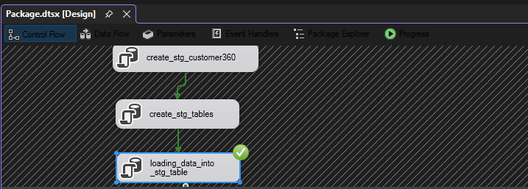
SSIS pipeline — Phase 1: staging
This phase prepares the raw Customer360 data for the warehouse.
1. create_stg_customer360 — creates the staging database.
2. create_stg_tables — creates the staging table structure.
3. loading_data_into_stg_table — loads the source data into staging. The green check indicates success.

Slide 7
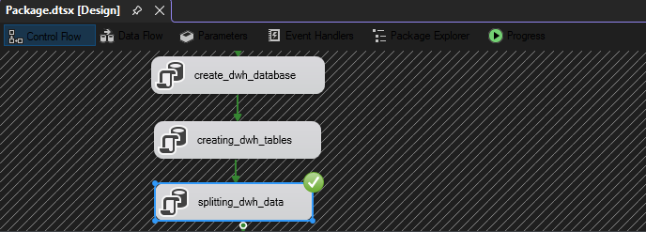
SSIS pipeline — Phase 2: data warehouse
This phase creates the warehouse structure and separates the staged data into the designed tables.
1. create_dwh_database — creates the data warehouse database.
2. creating_dwh_tables — creates the warehouse tables.
3. splitting_dwh_data — distributes staged data into warehouse tables. The green check indicates success.

Slide 8
Answering 20 business questions
Themes: customer base, products, transactions, CRM/engagement, segmentation, plus 2 stretch questions
All answers run as SQL against the dimensional model, not raw tables
Each ambiguous term (e.g. "active", "high value") has a stated definition
One single script: DWH build plus all 20 answers

