Slide 1

A MINOR PROJECT ON PLATFORM FOR ALGORITHMIC CRYPTOGRAPHIC EVALUATION
AMOGH BHATTARAI [PUR078BCT005]
ARPANA SHARMA GHIMIRE [PUR078BCT016]
BIBISHA BASNET [PUR078BCT022]
JENISHA SHRESTHA [PUR078BCT039]

Slide 2
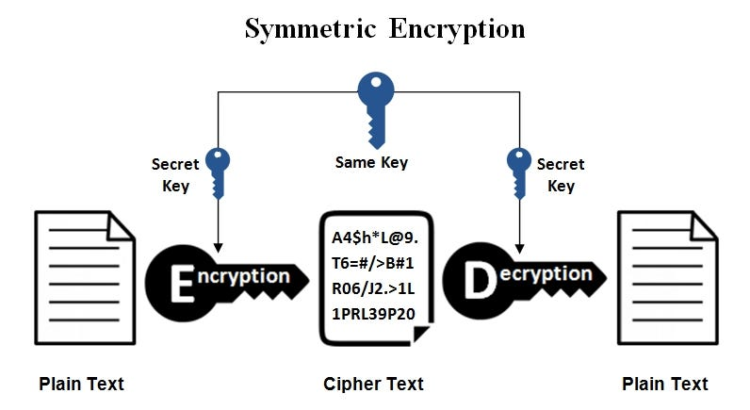
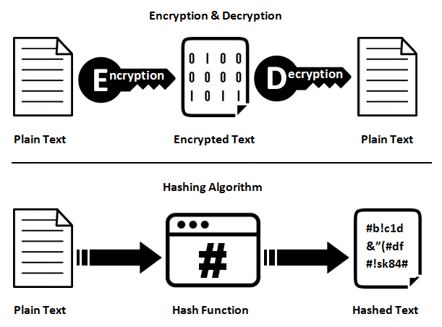
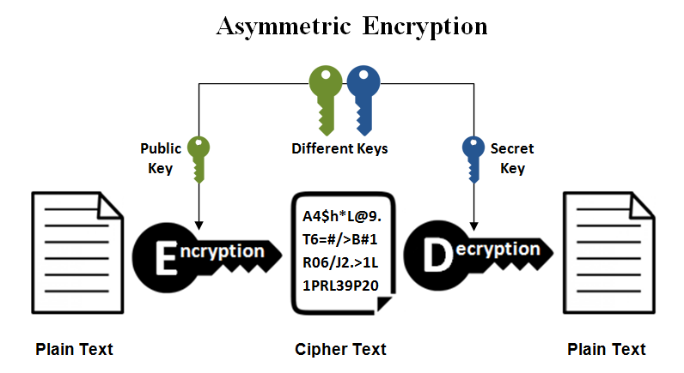
INTRODUCTION
In an age when data security is critical, cryptographic algorithms play an important role in protecting information. Our project provides a platform for benchmarking these cryptographic algorithms, including standardized metrics for performance, resource utilization, etc across different media.

Slide 3
A QUICK OVERVIEW
The algorithms used are:
AES-CBC(128 Bit key) 2. AES-CBC(256 Bit key)
3. AES-GCM(128 Bit key) 4. AES-GCM(256 Bit key)
5. CHA-CHA 20 6. CHA-CHA 20 POLY and
7.Crystals-Kyber.

Slide 4
PROBLEM STATEMENT
Choosing the right cryptographic algorithm is challenging due to varying needs like speed, resource usage, and security level.
A standardized way to evaluate cryptographic algorithms across different medias is missing.
Difficulty arises for developers and network engineers to make informed decisions about cryptographic implementations.

Slide 5
OBJECTIVES 1. To develop a platform for benchmarking cryptographic algorithms across diverse media types including text, audio, images, and more, ensuring standardized evaluation and comparison. 2. To develop a pipeline for all sort of media inputs that can be fed into existing algorithms.

Slide 6
LITERATURE REVIEW
Z. A. Shaikh et al. (2024): A review on cryptographic information security for Industry 5.0, focusing on privacy, real-time access control, and solutions like re-encryption for IIoT.
H. Kwon et al. (2023): A performance evaluation of 16 KpqC algorithms using a unified benchmarking approach for fair comparisons in Post Quantum Cryptography.
Chalkias et al. (2024): A benchmarking framework for cryptographic algorithms in fastcrypto, identifying performance issues and optimization opportunities in encryption and blockchain.

Slide 7
OBJECTIVES 1. To develop a platform for benchmarking cryptographic algorithms across diverse media types including text, audio, images, and more, ensuring standardized evaluation and comparison. 2. To develop a pipeline for all sort of media inputs that can be fed into existing algorithms.

Slide 8
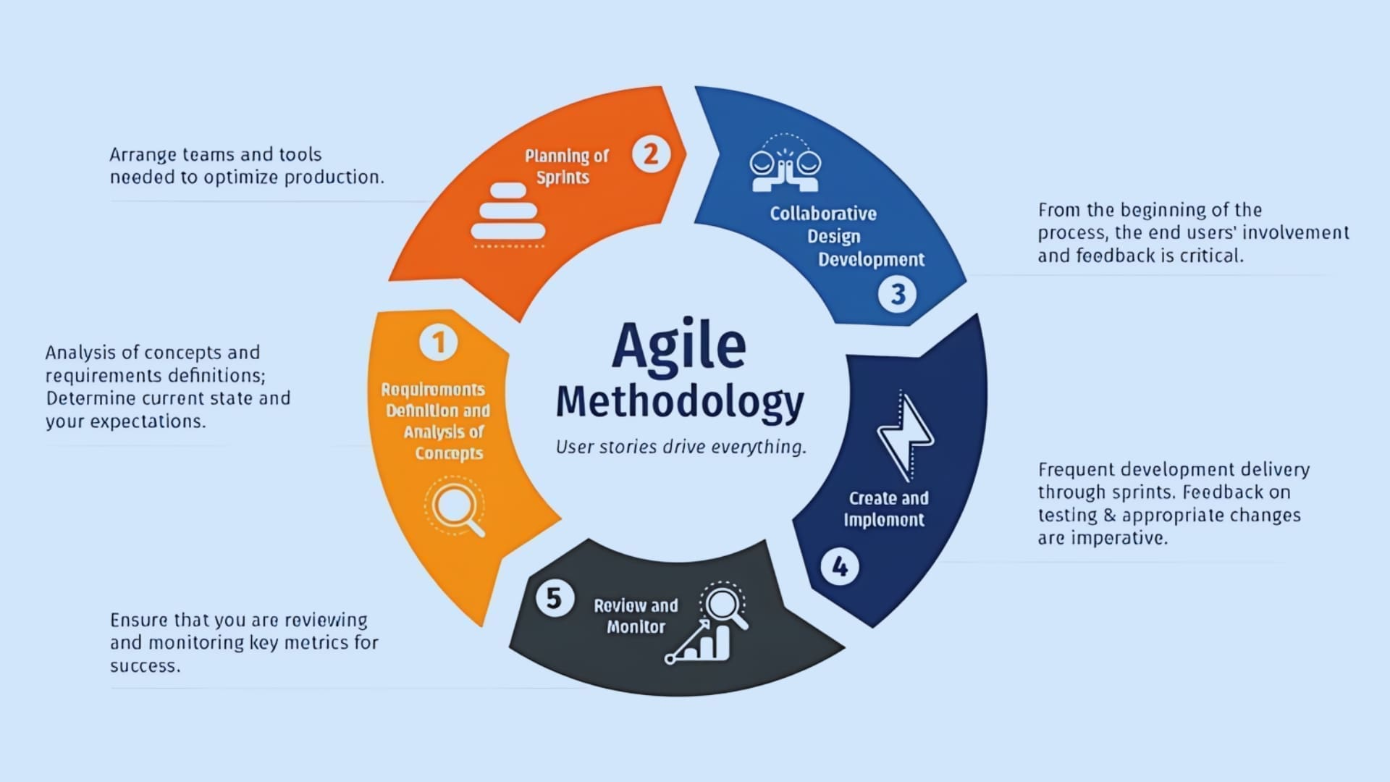
SOFTWARE DEVELOPMENT METHODOLOGY

Slide 9
REQUIREMENT ANALYSIS Functional Requirements: 1. Cryptographic Algorithm Support 2. Benchmarking metrics 3. Comparison Feature 4. Real-Time Reporting

Slide 10
REQUIREMENT ANALYSIS Non Functional Requirements: 1. Performance 2. Reliability 3. User Friendly

Slide 11
TECHNOLOGIES USED
Python
Python libraries
Cryptography
Matplotlib
HTML
CSS
JavaScript
Overleaf and Google Slides
Github
Render

Slide 12
SYSTEM DESIGN
SPEED PROCESSOR AVALANCHE EFFECT CORRELATION-COEFFICIENT TIME THROUGHPUT
PDF IMAGES AUDIOS VIDEOS TEXTS
AES
CHA-CHA 20
POST QUANTUM

Slide 13
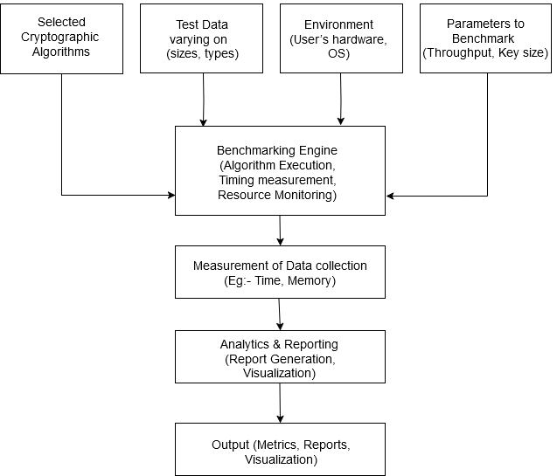
BLOCK DIAGRAM

Slide 14
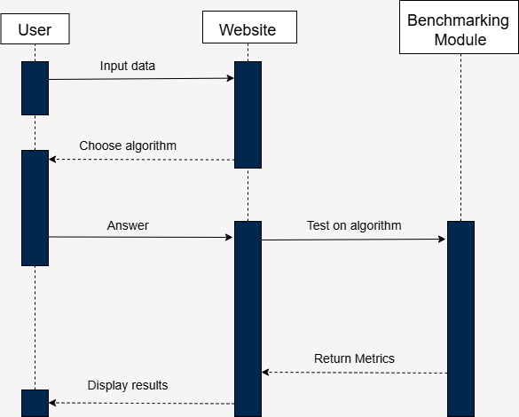
SEQUENCE DIAGRAM

Slide 15
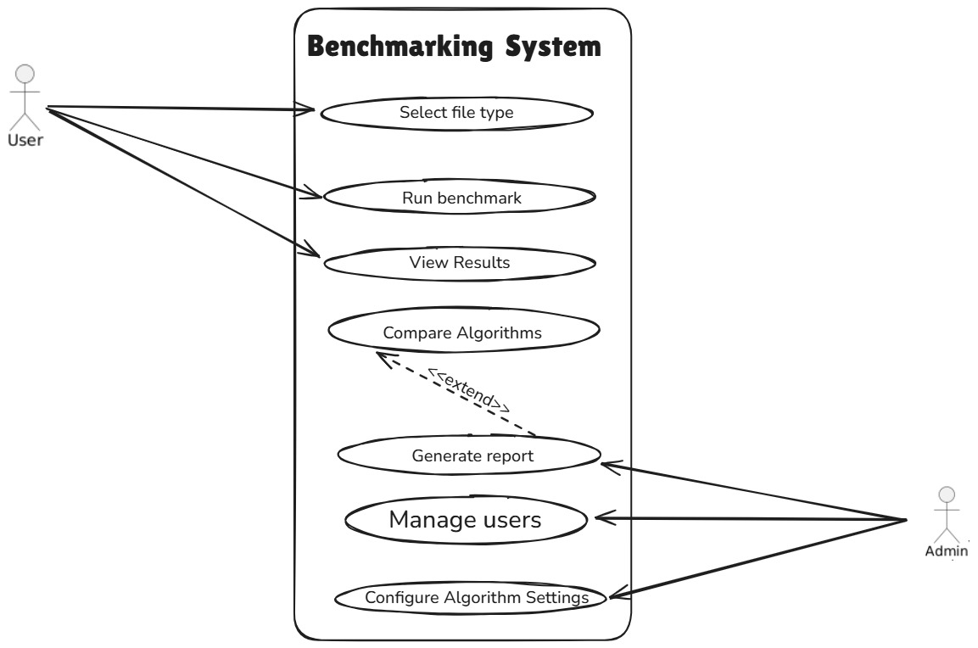
USE-CASE DIAGRAM:

Slide 16
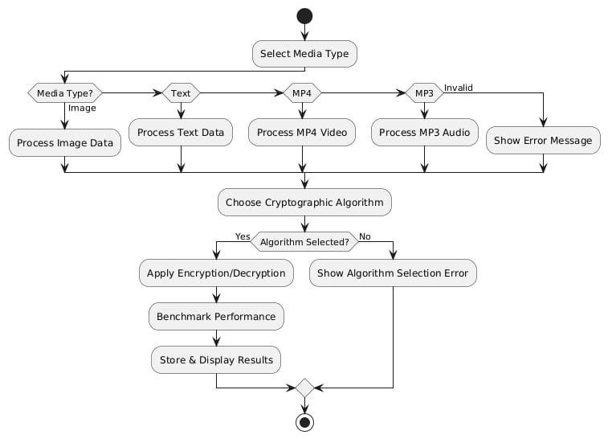
ACTIVITY DIAGRAM:

Slide 17
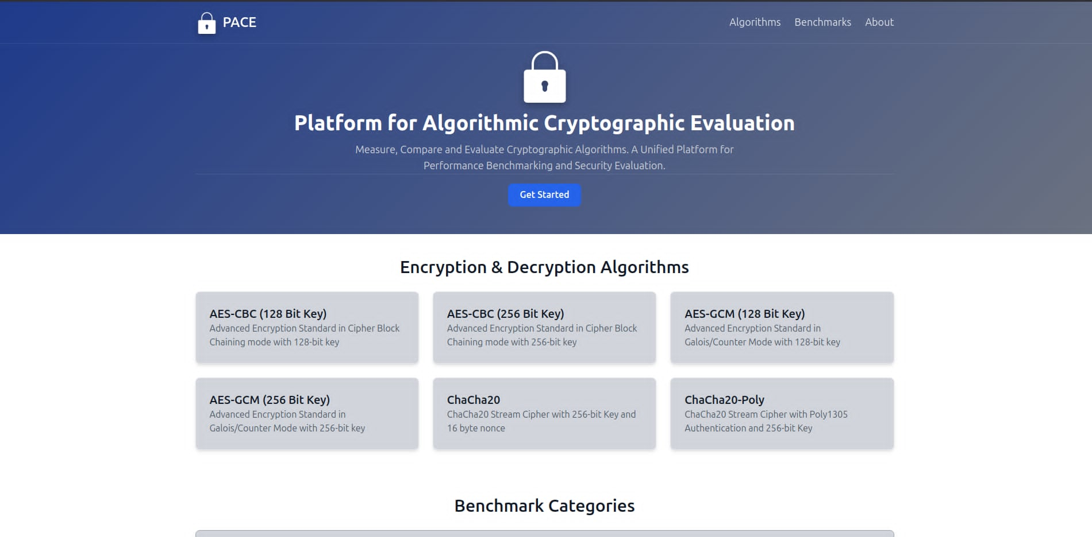
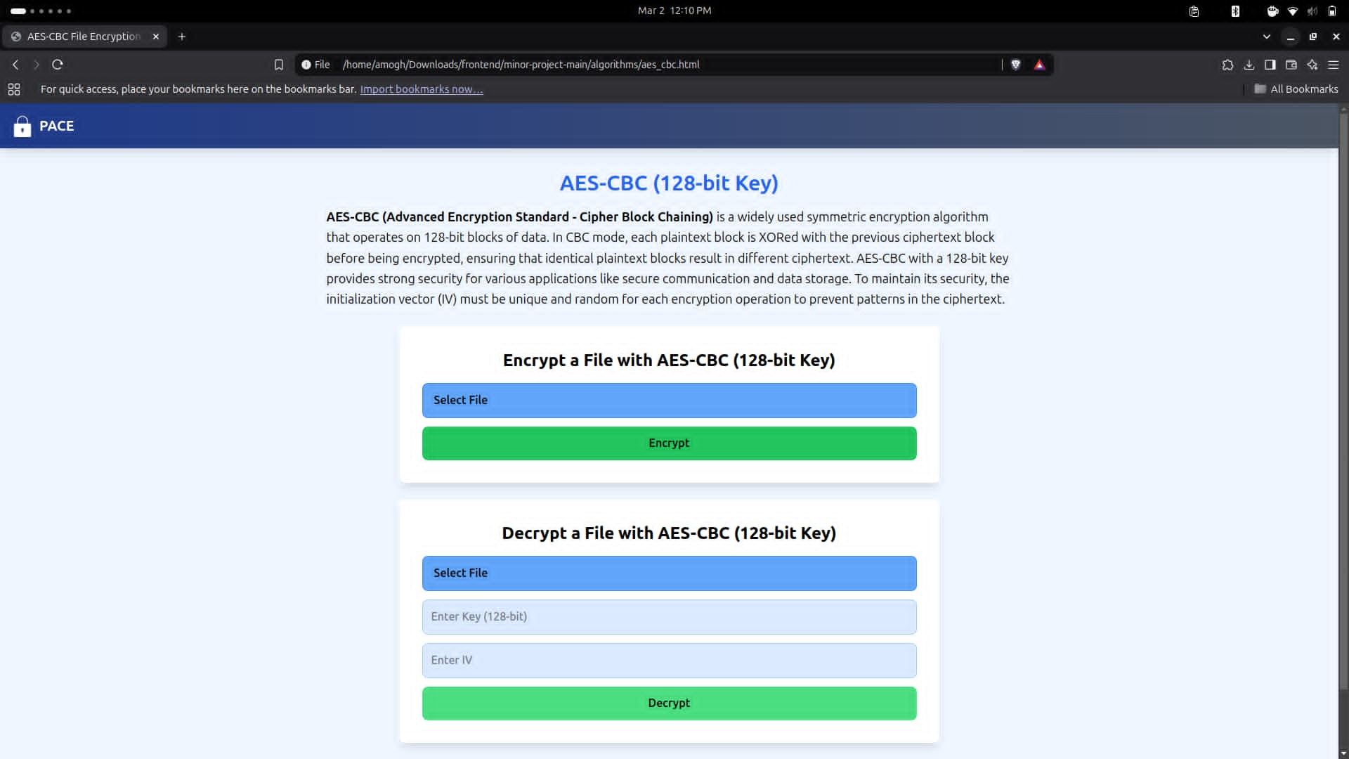
RESULTS:

Slide 18
REFERENCES [1] Z. A. Shaikh, F. Hajjej, Y. D. Uslu, S. Yuksel, H. Dinc¸er, R. Alroobaea, A. M.Baqasah, and U. Chinta, “A new trend in cryptographic information security forindustry 5.0: A systematic review,” IEEE Access, 2024. [2] H. Kwon, M. Sim, G. Song, M. Lee, and H. Seo, “Evaluating kpqc algorithm sub-missions: Balanced and clean benchmarking approach,” in International Confer-ence on Information Security Applications. Springer, 2023, pp. 338–348. [3] K. K. Chalkias, J. Lindstrøm, D. Maram, B. Riva, A. Roy, A. Sonnino, and J. Wang,“Fastcrypto: Pioneering cryptography via continuous benchmarking,” in Compan-ion of the 15th ACM/SPEC International Conference on Performance Engineering,2024, pp. 227–234.

Slide 19
THANK YOU.

