Slide 1
70.1%
UE24CS352A — MACHINE LEARNING MINI-PROJECT
Classification of Legal Text
best test acc
Replicating & extending a Stanford CS229 NLP project — teaching a classifier to read U.S. Supreme Court opinions and guess their legal category.
Based on: Krithika Iyer, "Classification of Legal Text" (CS229, 2020)

Slide 2
EXECUTIVE SUMMARY
Five phases, one steadily improving model
70.1%
5
13
7,971
Best test accuracy
(SBERT + SVM)
Phases of work
Legal categories
(issue_area)
Supreme Court opinions
used
We replicated the original paper's two methods (LDA, Doc2Vec), then went beyond it: compared 4 classifier types, deep-tuned the winner, and swapped in a modern pretrained embedding model.
✓
Replicated the paper's Doc2Vec+LR baseline: 59.1% accuracy
✓
Tuning the paper's own setup got it to 62.2%, then swapping in SVM got to 68.8%
✓
A modern pretrained model (SBERT) beat everything, with zero training: 70.1%
1 / 14

Slide 3
THE PROBLEM
Can a model guess a court ruling's legal category?
Legal opinions use long, non-standard sentence structures that break typical NLP tooling. We classify U.S. Supreme Court opinions into their human-curated legal category — at two levels of detail.
15
Broad categories (issue_area) — e.g. Criminal Procedure, Civil Rights, First Amendment
260+
Fine-grained issue codes (issue) — much harder, far less data per category
2 / 14

Slide 4
DATASET
Real Supreme Court opinions — no substitute needed
Same source the original paper used: the Supreme Court Database via the textacy package. Still downloadable today.
8,419
7,971
70/15/15
opinions, 1946-2016
after filtering rare classes
train / dev / test split
Opinions run long (median ~34,000 characters) — each truncated to its first 4,000 characters so training stays fast, keeping the part where judges usually state the issue and holding.
3 / 14

Slide 5
APPROACH
Three ways to turn text into numbers
Σ
LDA
Counts which words cluster together across all rulings (gensim, TF-IDF). No training beyond that — pure statistics.
2021-era paper default.
Doc2Vec
A small neural net learns a 50-number “fingerprint” per ruling, trained from scratch on our ~5,600 documents only.
The paper's other method.
⌘
SBERT
A modern transformer, pretrained on 1B+ sentence pairs before it ever sees our data. No training needed — just encode.
Our Phase 5 addition.
✨
A fourth method (BERT fine-tuning) was in the original paper, but it ran out of memory there — no baseline to replicate.
4 / 14

Slide 6
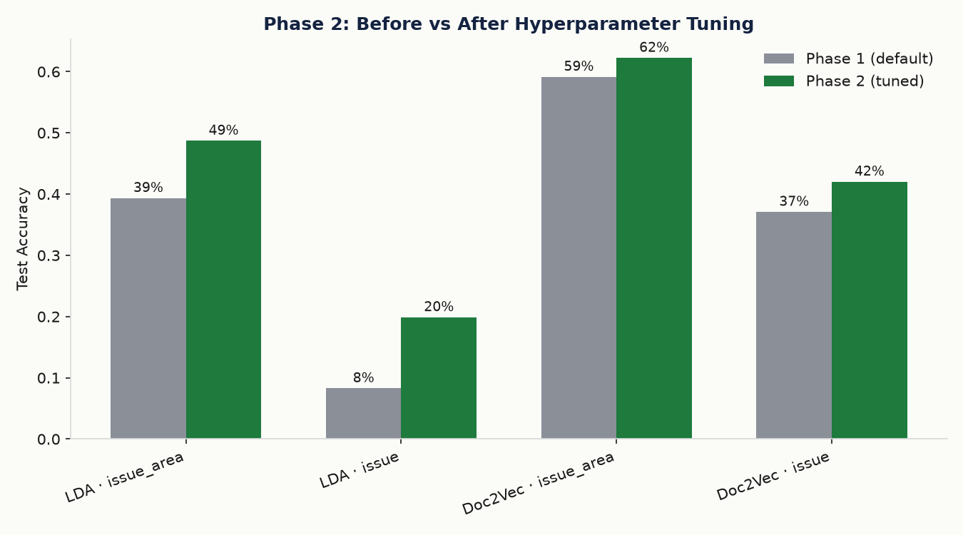
PHASE 1 + 2 — REPLICATION & FEATURE TUNING
Replicating the paper, then tuning its own settings
The paper's Doc2Vec+LR, trained with its default settings, then with LDA's topic count and Doc2Vec's vector size tuned on dev only.
59.1%
62.2%
Phase 1
paper defaults
Phase 2
tuned feature size
LDA needed more topics (50→100) to separate 15+ categories. Doc2Vec preferred a smaller fingerprint (100→50) — with ~5,600 training rulings, bigger vectors just overfit.
5 / 14

Slide 7
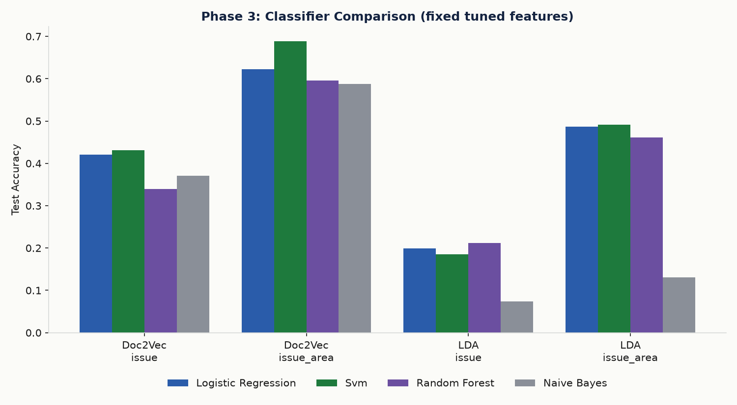
PHASE 3 — BEYOND THE PAPER
Same features, different classifier on top
The paper only tries Logistic Regression. We also tried SVM, Random Forest, and Gaussian Naive Bayes — same Doc2Vec fingerprints, issue_area task.
68.8%
0.499
Winner: SVM (RBF)
Macro-F1
SVM wins — its RBF kernel draws a curved decision boundary through the embedding space that straight-line Logistic Regression can't match.
6 / 14

Slide 8
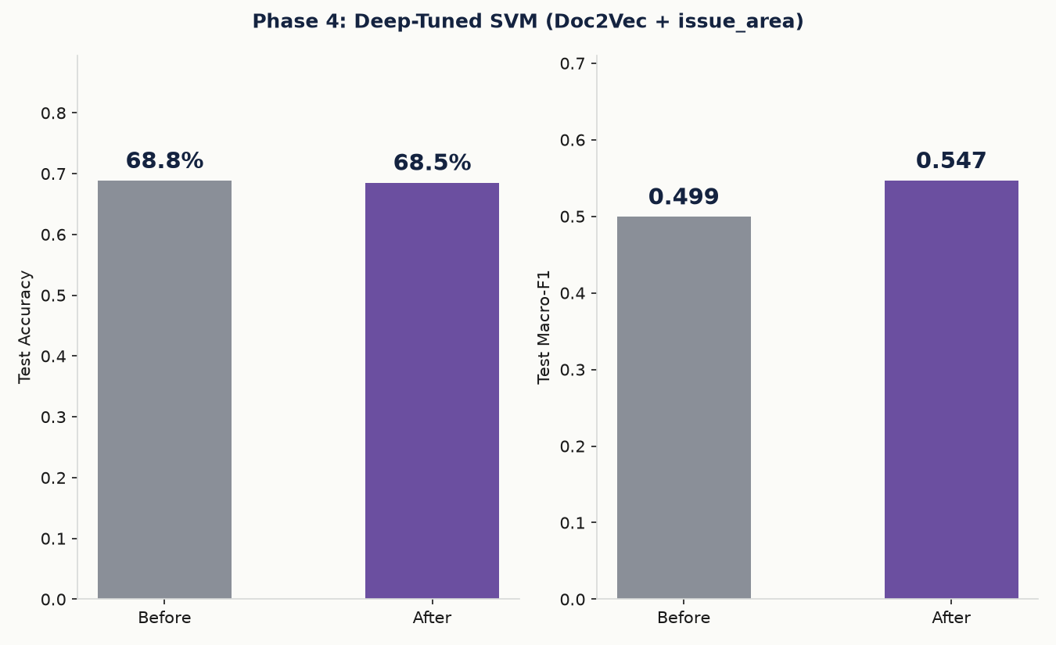
PHASE 4 — DEEP-TUNED SVM
A wider search finds a different kind of win
Phase 3's SVM was still untuned. We grid-searched 40 kernel/C/gamma combinations on dev accuracy — the metric that actually matters for the deployed model.
Winning config: kernel=poly, degree=3. Accuracy held flat (68.8%→68.5%, within noise for an ~850-example test set) while macro-F1 jumped (0.499→0.547).
7 / 14

Slide 9
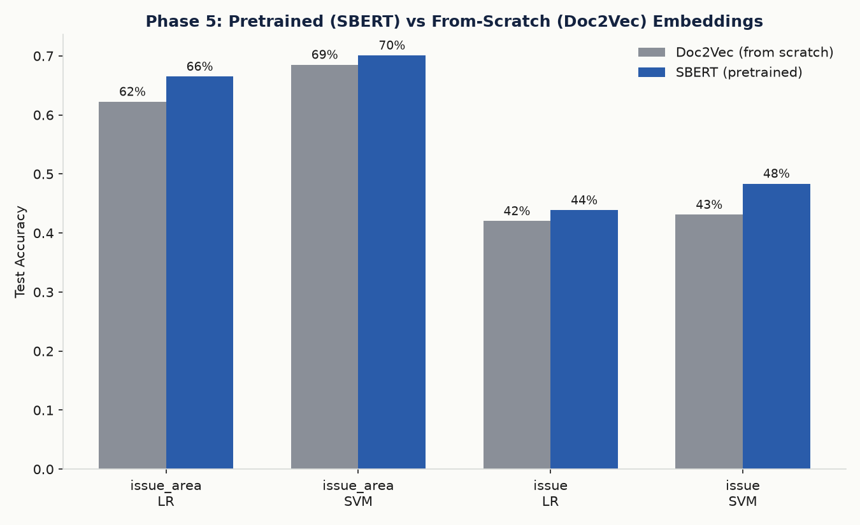
PHASE 5 — PRETRAINED EMBEDDINGS
A pretrained model beats everything, with zero training
Doc2Vec learns from scratch on just our ~5,600 documents. SBERT is pretrained on 1B+ sentence pairs before it ever sees a court opinion — we only use it to encode, never train.
SBERT + SVM: 70.1% accuracy — our new overall best, beating Phase 4's deep-tuned Doc2Vec SVM (68.5%).
8 / 14

Slide 10
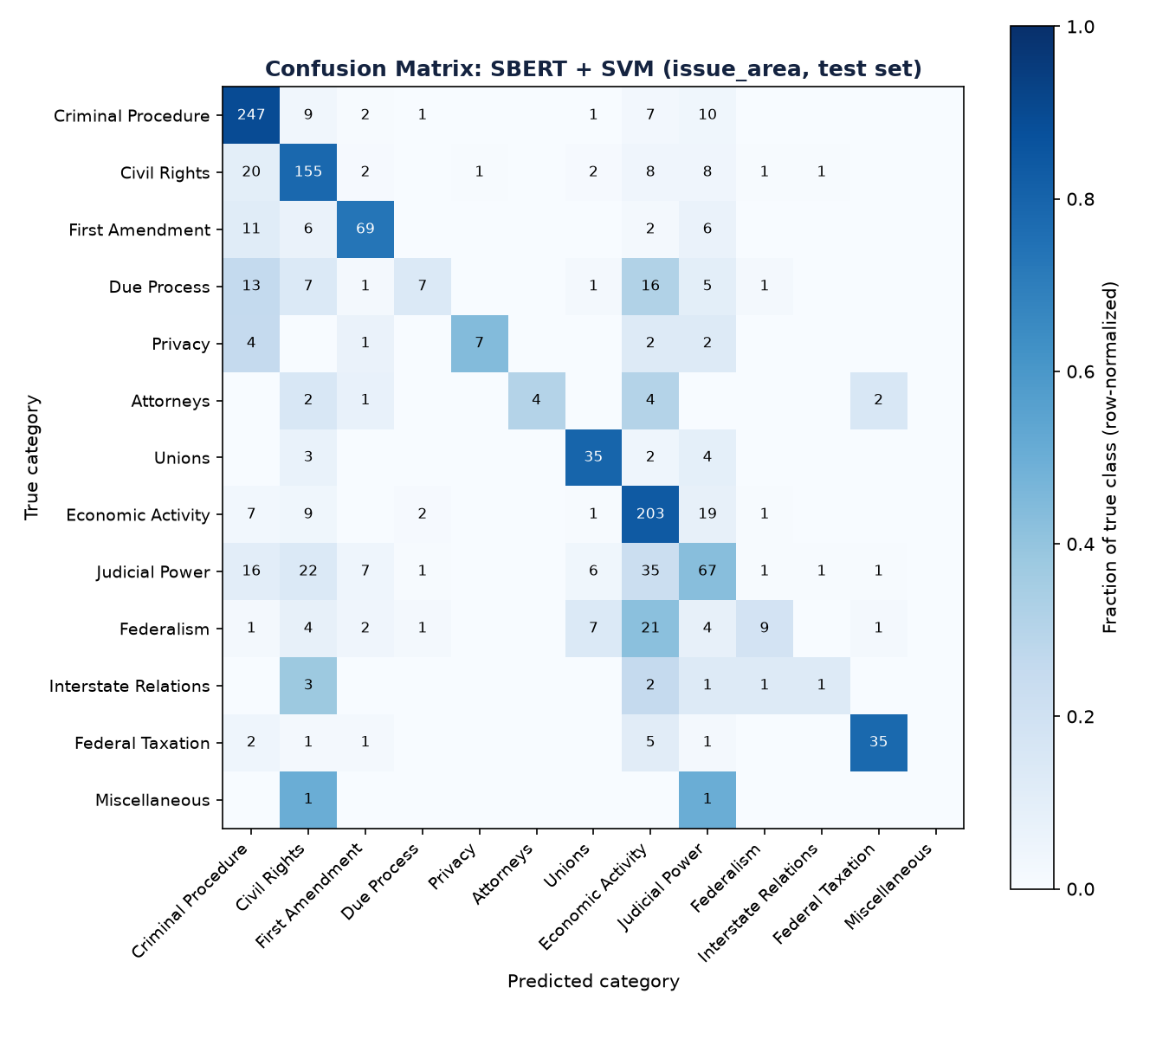
A CLOSER LOOK
Where the best model actually gets confused
Rows = true category, columns = predicted — Economic Activity pulls in misclassifications from Judicial Power and Federalism.
9 / 14

Slide 11
ERROR ANALYSIS
What does a mistake actually look like?
A confident mistake
True category: Attorneys
Predicted: Federal Taxation (97%)
Excerpt: “...an assignment made by a subcontractor to his performance-bond surety of all sums to become due for performance of the subcontract, as security for any indebtedness...”
The case is about an attorney's fee dispute, but its surface language is dominated by bond/surety/payment terms — the model latched onto financial vocabulary over the deeper legal issue.
A clear correct call
True category: Unions
Predicted: Unions (50%)
Excerpt: “...the Secretary of Labor sued under §402(b) of the Labor-Management Reporting and Disclosure Act to invalidate a union election...”
Explicit, unambiguous labor-law vocabulary (Secretary of Labor, union election, Labor-Management Act) gives the model a clean, confident signal to work with.
The pattern: the model reads surface vocabulary, not legal reasoning — it does well when a case's language matches its category, and struggles when the real legal issue is buried under financial or procedural detail.
10 / 14

Slide 12
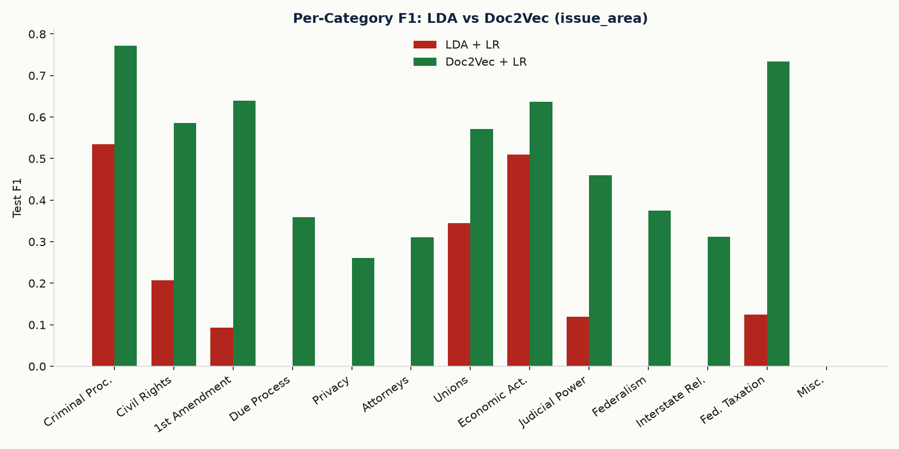
A CLOSER LOOK
LDA guesses the majority class. Doc2Vec doesn't.
LDA — collapses on rare categories (near-0 F1 on Privacy, Attorneys)
Doc2Vec — far more balanced across all 13 categories
11 / 14

Slide 13
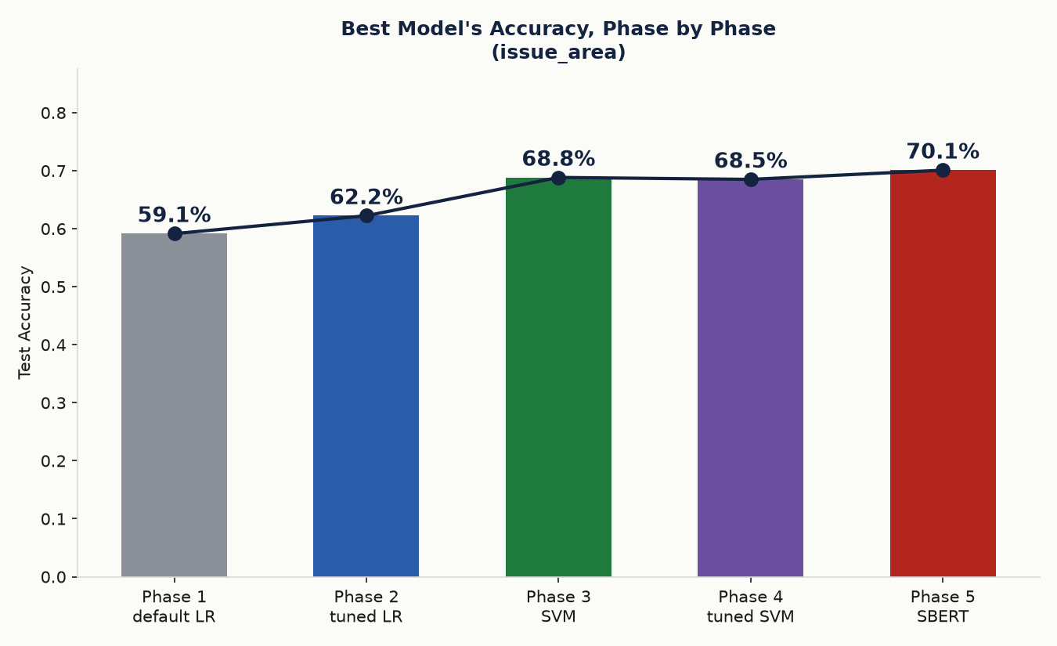
PUTTING IT TOGETHER
Each phase pushed the best model further
From 59.1% (paper's default) to 70.1% (SBERT) — without ever touching the dataset itself.
12 / 14

Slide 14
LIMITATIONS & FUTURE WORK
What we'd do with more time
✓
4,000-character truncation loses most of each opinion (median length: ~34,000 characters)
✓
Fine-grained 'issue' task (260+ classes) is still weak everywhere we tried — ~40-48% accuracy at best
✓
Single train/dev/test split — no cross-validation, so small accuracy differences carry real uncertainty
✓
BERT fine-tuning (vs. SBERT's frozen embeddings) could push further, if memory/compute allow
✓
A Legal-BERT variant, pretrained on legal text specifically, is a natural next embedding to try
13 / 14

Slide 15
CONCLUSIONS
✓
Pretrained embeddings (SBERT) beat from-scratch ones (Doc2Vec) at every comparison point
✓
Classifier choice matters almost as much as features — SVM beat every other classifier tried
✓
Tuning helped every phase — though Phase 4 traded flat accuracy for a macro-F1 win
✓
Coarse categories beat fine-grained ones everywhere — a data problem, not a model problem
✓
Overall: 59.1% → 70.1% across 5 phases, without touching the dataset
✓
Our numbers land in the same range and order as the original paper's
github.com/amogh-herle/ML-MINI-PROJECT
14 / 14

