Slide 1
HTML5
Basics

Slide 2
What is HTML?

Slide 3
What is HTML?
Hyper Text Markup Language
NOT a Programming Language like JAVA,C
Markup language for creating webpages/documents
Building blocks of the web

Slide 4
What we need to Start
Web Browser
Google Chrome(Best)
Mozilla Firefox
VS Code
Sublime Text
Safari
Edge
IE(Worst)
Atom.io
Notepad++
Text Editor

Slide 5
Creating an HTML file
Does NOT need a server
Files must end with the .html extension
Runs in a web browser (Chrome, Firefox, etc)
index.html is the root/homepage of a website
http://www.something.com
Loads the index.html file
http://www.something.com/about.html
Loads the about.html file

Slide 6
Example
Create a index.html
Print demo text

Slide 7
Tag Syntax
<tagname>content</tagname>
<h1>About Us</h1>
<p>This is a paragraph</p>
<br/> (self-closing)
<br>(Fine in HTML5)
Element names surrounded by angle brackets
Normally come in pairs(start and end tag)
End tag is usually the same but with a forward slash
Some tags close themselves

Slide 8
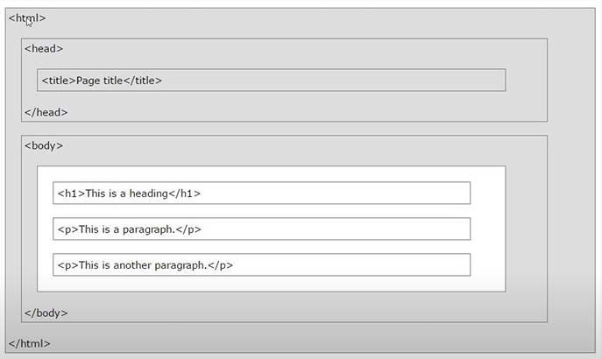
HTML Page Structure
<head> tag – Nothing to do with the output that is in the browser.
Contains:
Links to CSS, JavaScript files
Metadata like page description, keywords(for SEO)

Slide 9
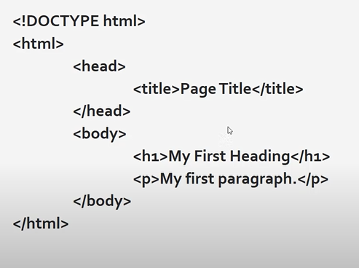
HTML Page Structure – Simple webpage
DOCTYPE-
Explains what type of document the page is
HTML4,HTML5,XHTML
<!DOCTYPE html> -
not a tag, just a declaration that tells the browser what type of document it is i.e HTML5
Page should begin with this declaration

Slide 10
Example
Create index.html
Create page structure

Slide 11
Inline vs Block Level Elements
Inline
Block
Do not start on a new line
Take only necessary width
<span>,<img>,<a>
Start on a new line
Take full width available
<div>,<h1>-<h6>,<p>,<form>

Slide 12
Example
Create index.html
Create page structure
Use
h1,p,strong,em
Anchor tag

Slide 13
Tag attributes
All tags have attributes
Provide information about an element
Placed within the start tag
Key/value pairs (id=“someid”)
<tagname attributename=“attribute value”>
Content</tagname>
<h1 title=“My Company”>About Us</h1>

Slide 14
Example
Create index.html
Create page structure
Use: h1,p,strong,em
Anchor tag
Create List
Create Table
Create Forms
Create Button
Add a image
Quotations

Slide 15
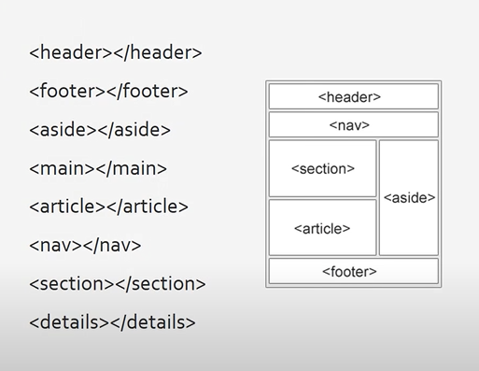
HTML5 Semantic Tags
A semantic element clearly describes its meaning to both the browser and the developer

Slide 16
Example
Create a blog
Add Posts
Add styling
Add meta tags

