Slide 1
Javascript
MERN Training

Slide 2
Contents
What is Javascript?
Why learn Javascript?
What does it mean?
What does Javascript do?

Slide 3
What is Javascript?

Slide 4
What is Javascript?
Scripting Language
Implementation of ECMAStandard – only defines syntax/characteristics of the language
Easy to use and learn
Runtime, not compiled
Primarily client side, but also server side
Interacts with HTML and DOM
Browser control
Form validation, formatting
Adds client side application support

Slide 5
Common Misconceptions
Javascript != Java
Java is complex: requires declarations, compiling and servers
Javascript is unrelated to Java, except that: both use C syntax
Javascript uses many Java names and naming conventions
Javascript looks like Java, but is easier for less technical users to program

Slide 6
Related languages
ECMAScript
Standardized version of Javascript
Jscript
Microsoft version of Javascript
VBScript
Only works with Microsoft products
DHTML
Combination of CSS and Javascript

Slide 7
Why learn Javascript?

Slide 8
Why learn Javascript?
Programming language of the browser
Build interactive user interfaces with frameworks like React
Used in building very fast server side and full stack applications
Used in mobile development (React Native, NativeScript)
Used in Desktop Application Development (Electron JS)

Slide 9
What can we do with Javascript?

Slide 10
What can we do with Javascript?
To create interactive user interface in a web page (menu, pop-up alert, windows, etc)
Manipulating web content dynamically
Change the content and style of element
Replace images on a page without page reload
Hide/Show contents
Generate HTML contents on the fly
Form validation
AJAX

Slide 11
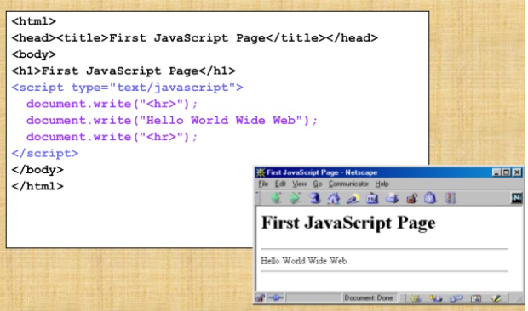
A simple script

Slide 12
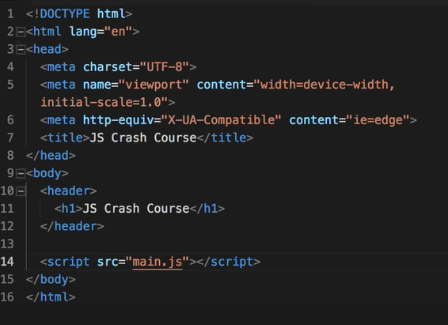
Example
console.log(); - console is global object
console.error();
console.warn();

Slide 13
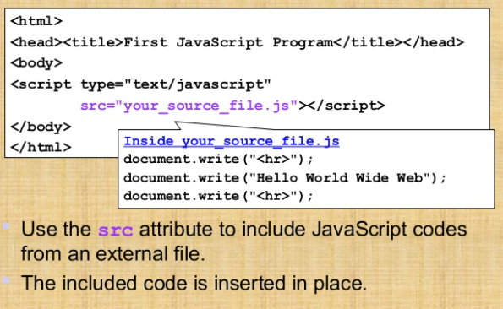
Embedding Javascript
The script inside an HTML document is interpreted in the order they appear in the document
Scripts in a function is interpreted when the function is called
So where you place the <script> tag matters

Slide 14
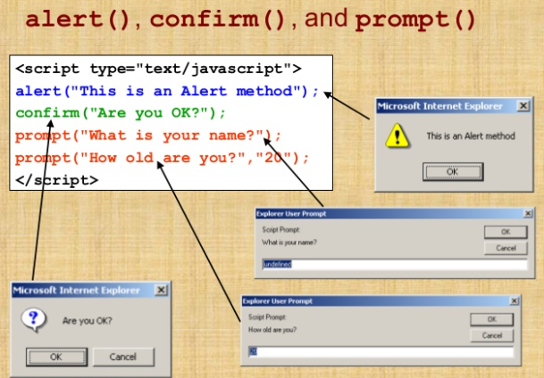
Basic Javascript functions
alert(“Text to display”);
Display message in a dialog box
The dialog box will block the browser
var answer = confirm(“Are you sure?”);
Display a message in a dialog box with 2 buttons:”OK”and “Cancel”
Reurns true/false
prompt(“What is your ID number?);
prompt(“What is your name?”, “No name”);
Display a message and allow user to enter a value
Second argument is default value to be displayed in the input text field
Returns OK/Cancel

Slide 15
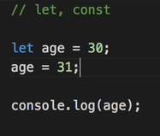
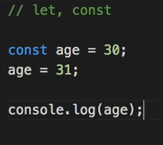

Variables
var – used earlier a lot, not now
– globally scoped
– can cause problems
let – Added in ES2015 (ES6)
– can reassign values
const – Added in ES2015 (ES6)
– cannot reassign values
– use it when u don’t wanna reassign

Slide 16
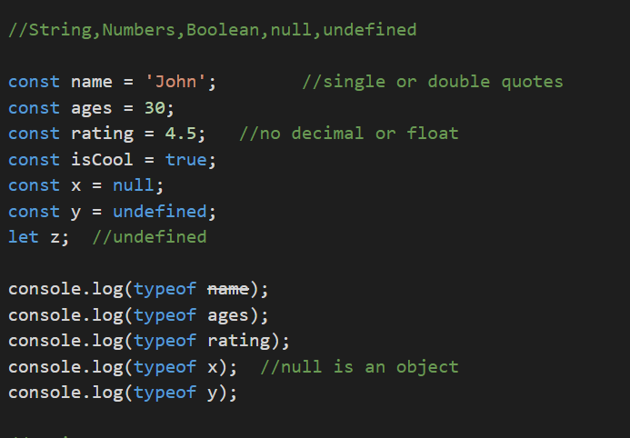
Data types
String
Numbers
Boolean
Null
undefined

Slide 17
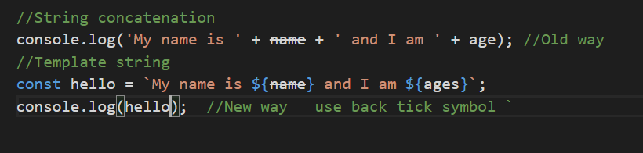
String concatenation
Old way – Using + sign
New way – Using Template String (in ES6)

Slide 18
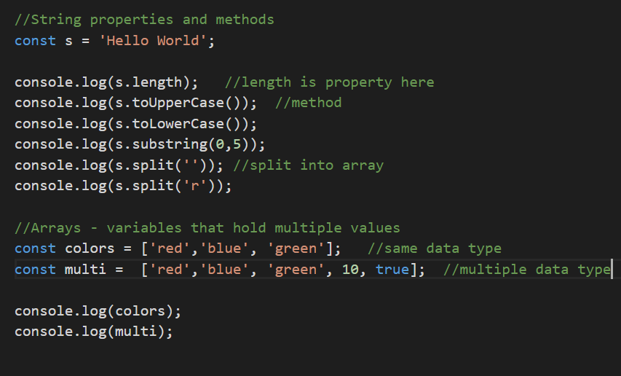
Examples
String properties and methods
Arrays

Slide 19
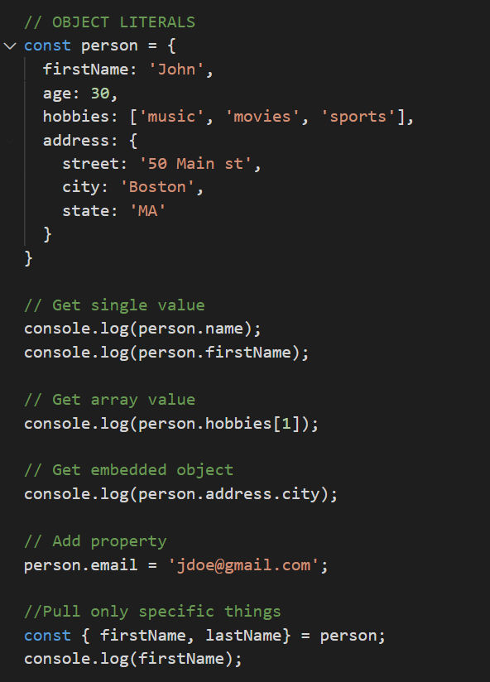
Object Literals
Key value pairs

Slide 20
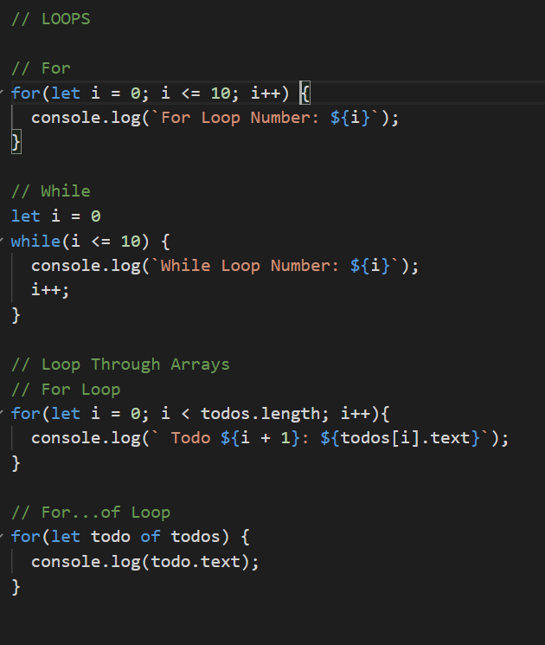
LOOPS
For
While
For…of

Slide 21
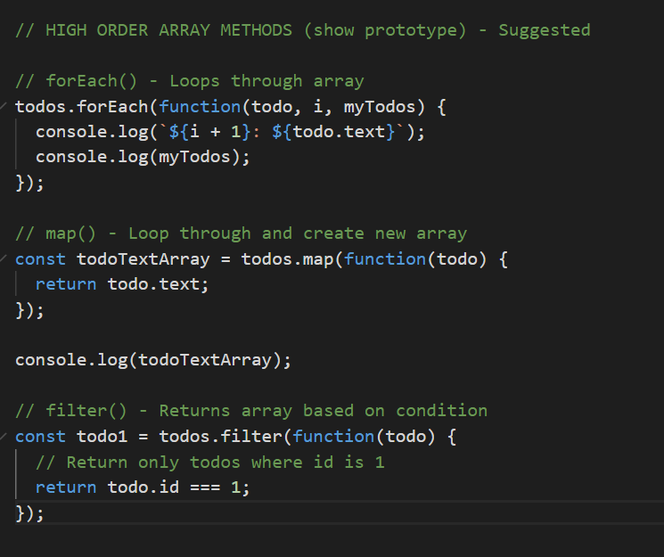
Higher Order Array Methods
Higher order functions are functions that operate on other functions, either by receiving them as arguments or by returning them. It is a function that accepts a function as a parameter or returns a function as the output.
forEach()
map()
filter()

Slide 22
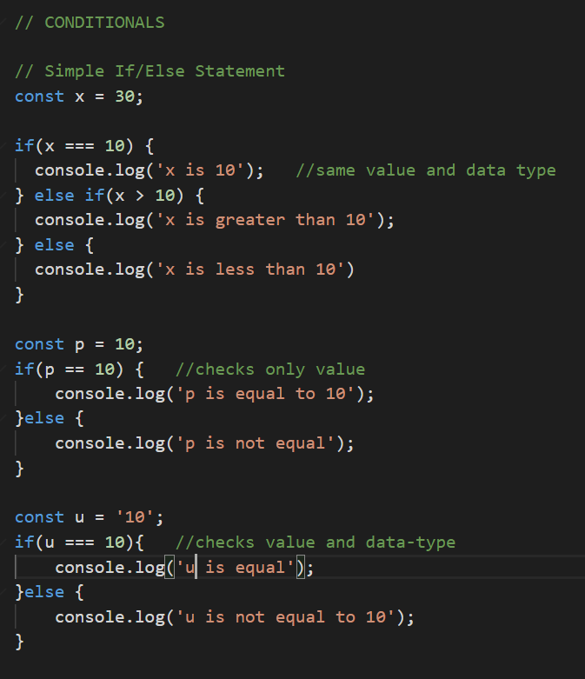
Conditionals
If/else
Ternary
Switch

Slide 23
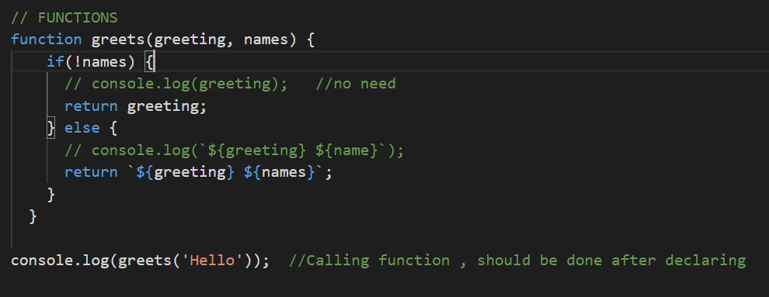
Functions
Function functioname () {
//body
}

Slide 24
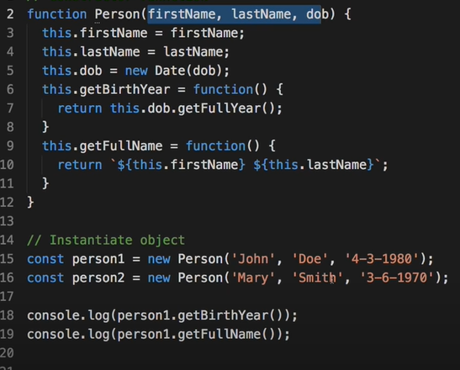
OOP - Object
Construct objects by-
Constructor function
with prototypes
Using ES6 classes
Using prototypes- better way

Slide 25
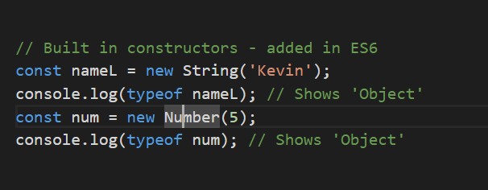
Built in constructors
String
Number

Slide 26
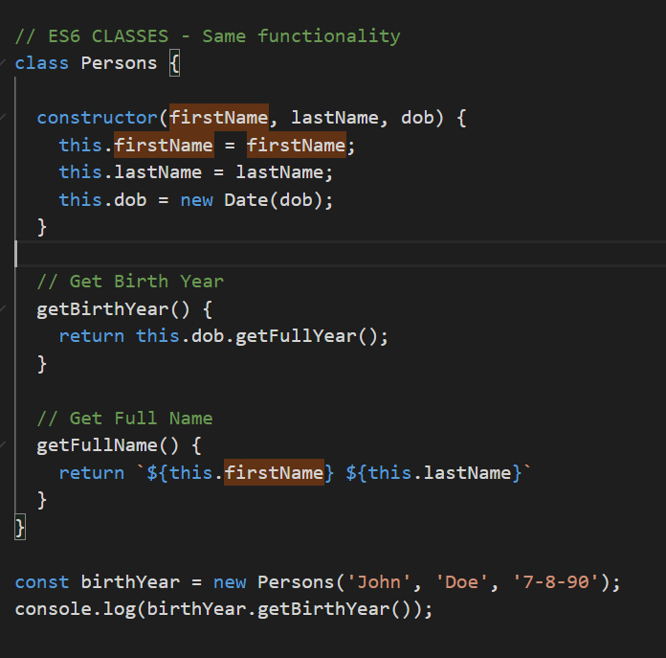
Constructor class – added in ES6
Same meaning
Better way of writing
Optional

Slide 27
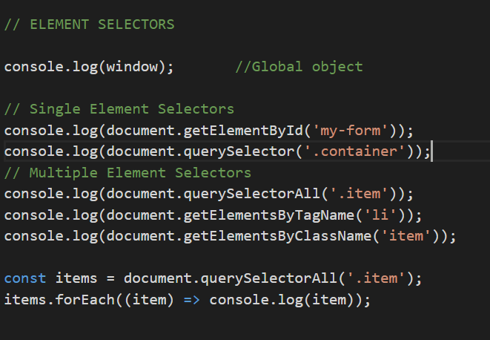
Manipulating the DOM
ELEMENT SELECTORS
Single element selectors
Multiple element selectors
window object
window.alert(“”);
document object
document.getElementById();

Slide 28
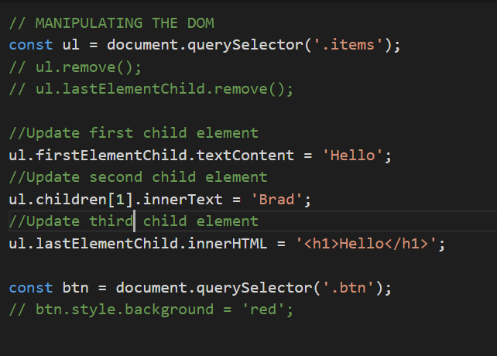
Manipulating the DOM
querySelector
firstElementChild
children[].innerText
innerHTML

Slide 29
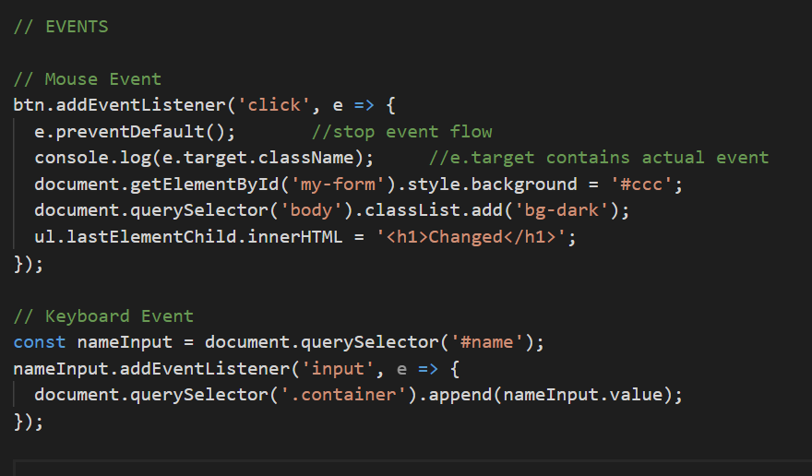
Events
Mouse event
Keyboard Event

Slide 30
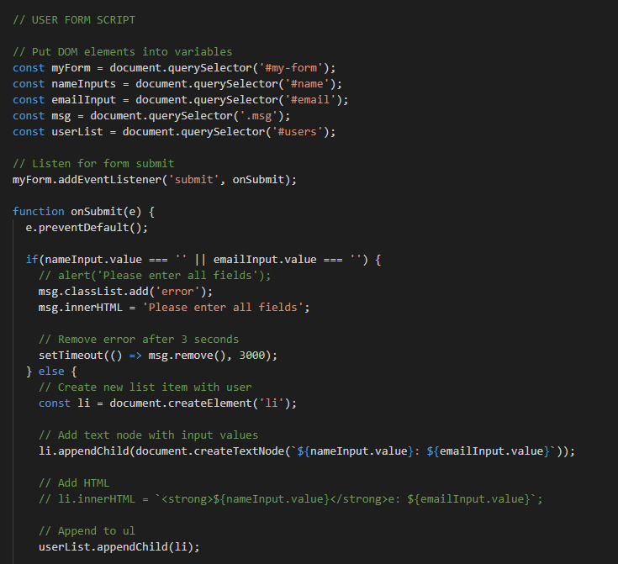
DOM Manipulation

