Slide 1

Mini Project-1 (22EC49)
First Phase Presentation
February 2025, 4th Semester
Dayananda Sagar College of Engineering, Bangalore, Karnataka
Department of Electronics & Communication Engineering
Mini Project Batch No : 42
Design and Analysis of Operational Transconductance Amplifier
 | 1DS23EC025 |  | A |  | AMOGH S PUROHITH
 | 1DS23EC159 |  | C |  | PRATHAM S NAYAK
 | 1DS23EC167 |  | C |  | RAGHUNANDAN B R
 | 1DS22EC007 |  | A |  | ABHINEETH THAIRE
Mini Project Co-Ordinator:
Dr. BASAVARAJ S S
Mini Project Guide:
Dr. KIRAN A GUPTA

Slide 2
Introduction and Objective
Introduction
Operational Transconductance Amplifier is a voltage-controlled current source that converts input voltage into output current and hence provide current gain.
OTA is an essential components in analog and mixed-signal circuits, providing a tunable transconductance for signal processing applications.
Objective
Design and analysis of Operational Transconductance Amplifier using Open Source EDA tools.
Implement Open Source OTA IP core that can be used for building complex circuits.

Slide 3
Literature Survey
Sl No. | Paper Title | Author | Year | Key-findings
1 | Design of High Performance Operational Transconductance Amplifier | Vasudeva.G and Mandar Jatkar | 2023 | Proposed folded cascode OTA design , it achieved unity gained bandwidth of 8.895MHz and power consumption of 1.902mW.This OTA consumes less power and has a very low settling time.
2 | Design of High Gain and Bandwidth Operational Transconductance Amplifier (OTA) | Shikha Soni, Vandana Niranjan and Ashwani Kumar | 2021 | OTA having high gain and high bandwidth for high speed analog communication techniques and precision filtering is designed
3 | Low Power CMOS OTA Design for Biomedical Applications | M V Sai Meena, Somashekhar Malipatil, D Santhosh Kumar | 2020 | Designed a two-stage OTA with voltage scaling from 2.5V to 1.2V, reducing power consumption from 0.512mW to 0.15mW.
4 | Design of Balanced OTA | Twinkle Patel, Kishen Raikar, Sharan Hiremath, Prof. Sneha Meti | 2015 | OTA design for modular circuit of Digital-Audio Sigma-Delta modulator.

Slide 4
Methodology
Specifications
Gain, Gain Bandwidth Product, ICMR, Power dissipation, Slew rate, Output swing, Phase margin, NMOS and PMOS parameters, Supply Voltage
Design and Topology
Design calculations and fully differential topology
Schematic and Layout
Designing the schematic in Xschem integrated with SKY130 PDK
Simulation and Analysis
Simulations (DC, AC, Transient) and analysis to evaluate the performance and functionality of the design
Optimization
Optimizing the design to enhance performance, efficiency, and reliability

Slide 5
Specifications
Gain = 80dB/dec
Gain-Bandwidth Product = 5MHz
CL = 1nF
Slew rate = 10v/us
Vout range = 0.2-1.6V
Phase Margin = 60 degree
ICMR = 0.2-1.4V
Nmos parameters- Vth = 0.5V, UnC.ox = 180uA/v^2, 1/Va = 0.08V^1
Pmos parameters- Vth=-0.4V, Up.Cox =60uA/V^2 , 1/Va = 0.06V^-1

Slide 6
Block diagram
OTA
I_{BIAS}
gm
I_{IN-}
V_{IN-}
I_{o}
V_{o}
V_{IN+}
I_{IN+}
GND

Slide 7
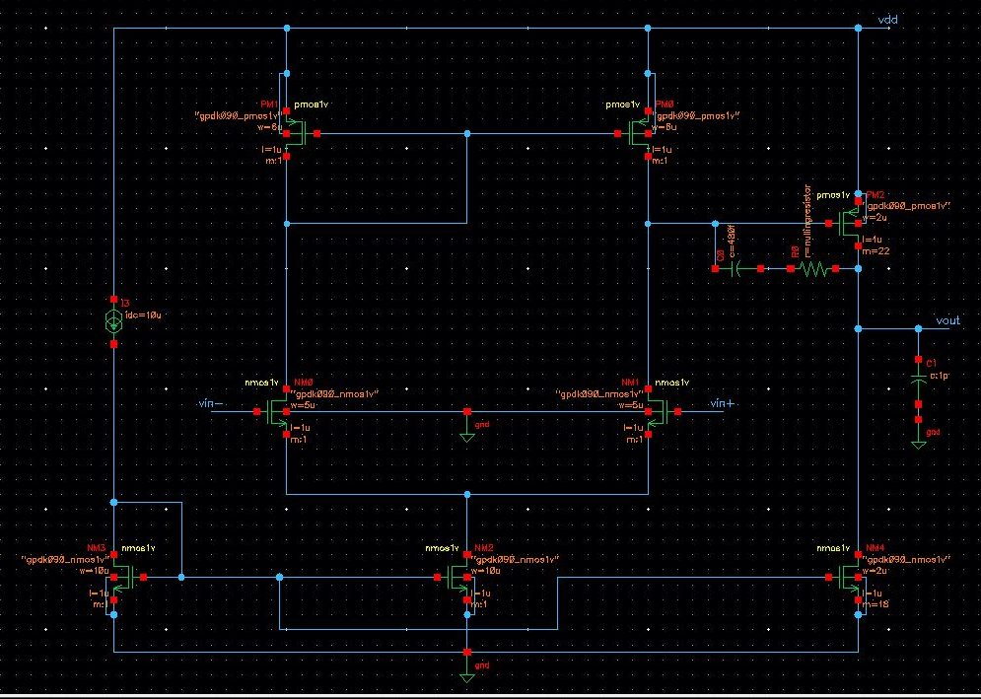
Block diagram
Iref and tail current
Based on slew rate requirement we get the reference current value
We get Iref = 10uA
We have used current mirror inorder to copy the current We obtain tail current from current mirror using Iref value
Both the pmos current load is in saturation with w/l = 6:1

Slide 8

Block diagram
Differential Current Input
With given icmr value of 0.8 to 1.6
Gain bandwidth product
$$\text{GBP}=\frac{g_{m1,} g_{m2}}{C_{L}}$$
By substituting values we have w/l = 5/1

Slide 9
Block diagram
Current Mirror
Common source gain amplifier
The size of these NMOS is based on the value of ICMR = -0.8
w/l = 10/1 & 2/1
The pmos common source amplifier adds 40dB, the additional gain is required to meet the specification of 80dB
Miller compensation consisting of miller capacitor and nulling resistor are added to stabilize the phase margin

Slide 10
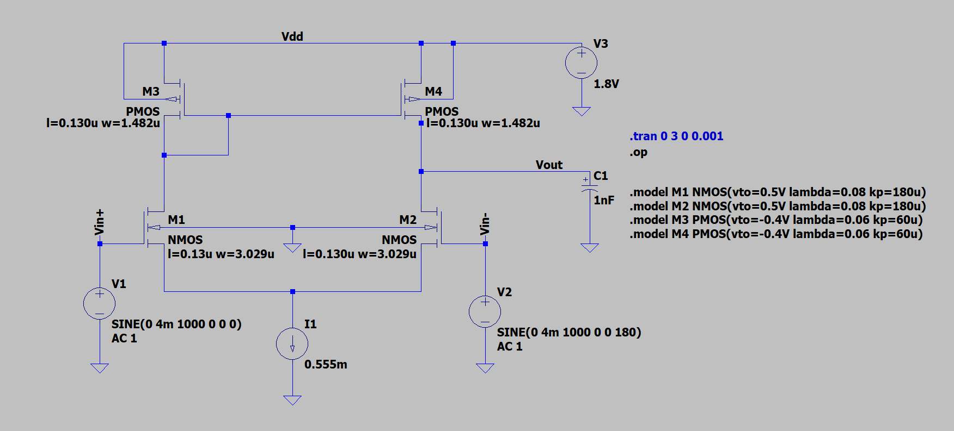
Schematic

Slide 11
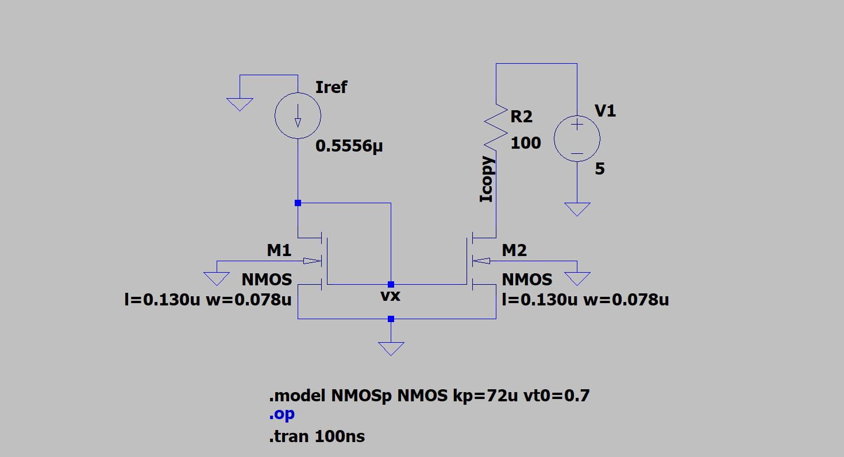
Schematic

Slide 12
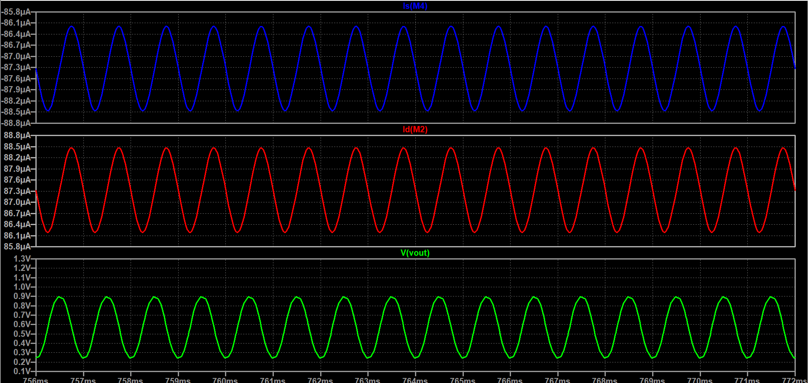
Simulation

Slide 13
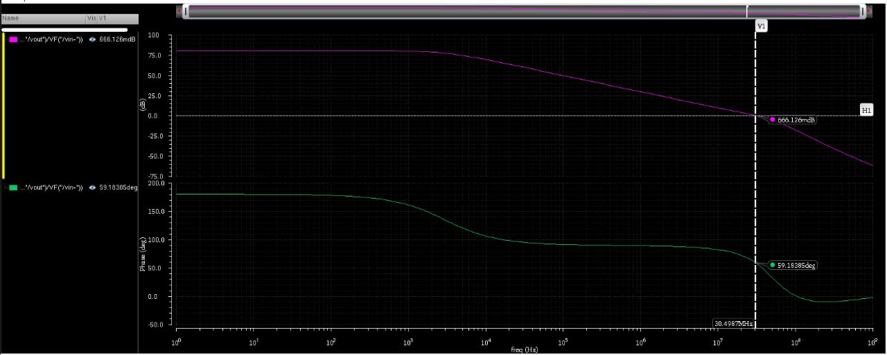
Simulation

Slide 14
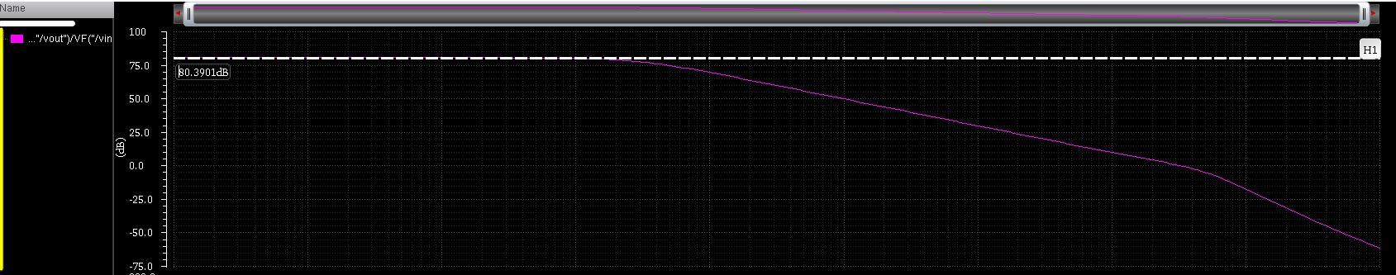
Simulation

Slide 15
Expected Outcome and Flow
Software tools used
LT-Spice,XSchem, sky130 PDK, NGSpice, MAGIC VLSI
Expected Outcome
To design and implement an open source IP core that can be used as a building block for future circuits.
Flow of Mini Project Work
Feb - 2025 | Specification of OTA
Mar - 2025 | Design Calculation and Schematic of OTA
April - 2025 | Simulation and Analysis of OTA
May - 2025 | Optimization of OTA

Slide 16
References
1. | X. Ramus, 'Demystifying the Operational Transconductance Amplifier,' Texas Instruments, Application Report SBOA117A, May 2009, Revised Apr. 2013.
2. | W. L. F. Wulff, 'CNR OTA for SKY130 Process,' GitHub Repository, 2024.
3. | S. Schippers, 'Xschem: A Schematic Capture Program for VLSI Design,' 2024.
4. | H. Vogt, M. Tavakoli, and N. Klamt, 'Ngspice: The Open Source Spice Circuit Simulator,' 2024.
5. | R. T. Edwards, 'Open PDKs: Process Development Kit for Skywater 130nm and Others,' 2024.
6. | J. Ousterhout, 'Magic VLSI Layout Tool,' 2024.

