Slide 1
Economic Growth vs Sustainable Development- GRAPHS
by AMOGH GUPTA and AJUN NIGAM

Slide 2
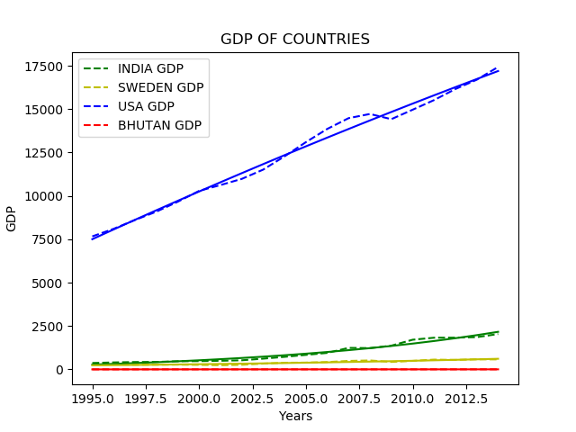

Slide 3
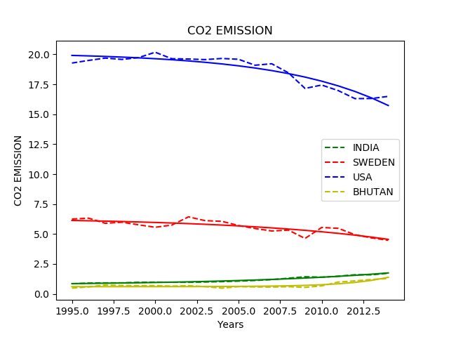

Slide 4
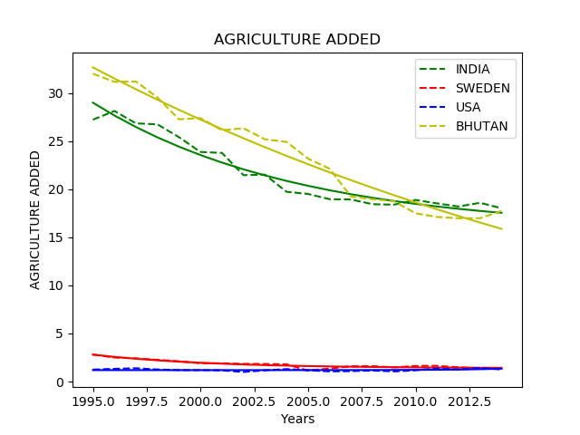

Slide 5
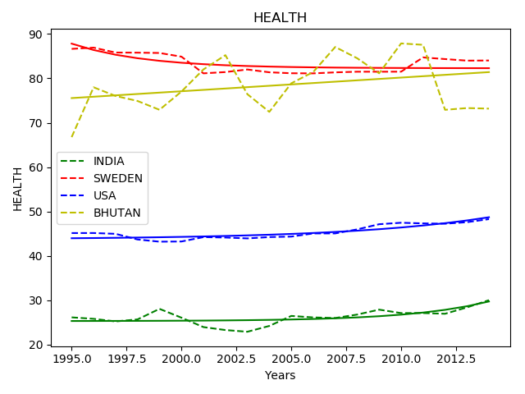

Slide 6
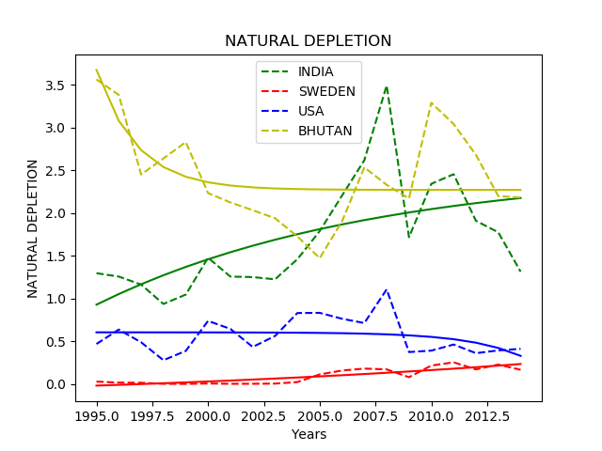

Slide 7
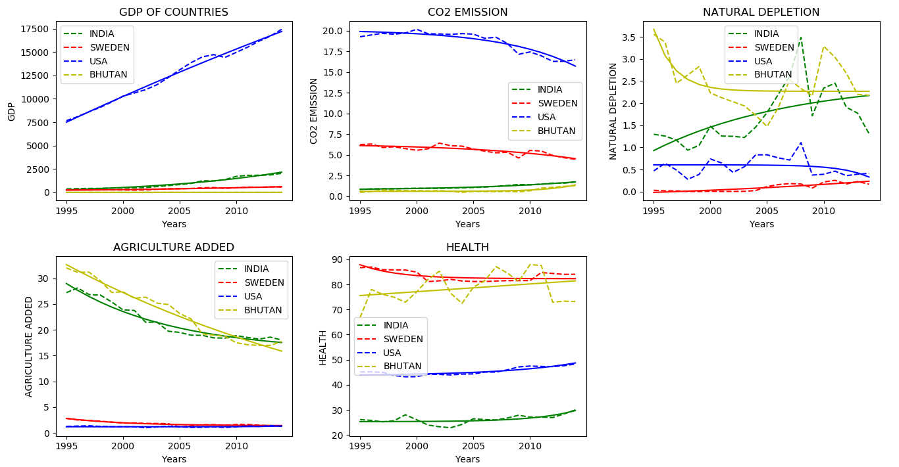

Slide 8
