Slide 1

Audio Source Separation
Team Members
Amogh Targe (IEC2020018)
Mohit Kumar Meena (IEC2020004)
Under the guidance of:
Dr. Shanti Chandra

Slide 2
Table of Content
Introduction
Literature Survey
Evaluation Metrics
Proposed Methodology
Code
Future Work
Conclusion
Results

Slide 3
Introduction
What is Audio Source Separation ?
Audio source separation is the process of isolating individual sound sources from a mixture of sounds. In speech signal processing, this technique has revolutionized the field by enabling enhanced speech recognition, noise reduction, and speaker diarization applications. Researchers have developed groundbreaking techniques and algorithms to separate speech signals from complex audio mixtures, leading to significant advancements in the field.
Also known as Cocktail Party Problem.

Slide 4
Traditional ways of Audio Source Separation
Traditional approaches to audio source separation relied on techniques such as
blind source separation,
non-negative matrix factorization, and
independent component analysis.
While these methods have been effective to some extent, they often faced limitations in terms of their ability to handle complex audio mixtures or distinguish between overlapping sources. As technology advances, researchers are exploring new algorithms and machine learning techniques to further improve the accuracy and efficiency of audio source separation, paving the way for enhanced speech signal processing capabilities.

Slide 5
Applications
The advancements in audio source separation using deep learning techniques include
noise reduction,
automatic speech recognition,
speaker diarization,
music transcription,
audio forensics, and hearing aids.
This significantly improved the accuracy and efficiency of these applications, allowing for better speech understanding and communication in various real-world scenarios.

Slide 6
Paper No | Paper Title and Author Name | Year | Method Used
1. | D. Wang and J. Chen, "Supervised Speech Separation Based on Deep Learning: An Overview," in IEEE/ACM Transactions on Audio, Speech, and Language Processing, vol. 26, no. 10, pp. 1702-1726, Oct. 2018, doi: 10.1109/TASLP.2018.2842159. | 2018 | DNN in supervised learning and many de-noising techniques and R-NN and Wave-U-Net was used. It covers the key components of supervised separation, including learning models, training targets, and acoustic features, and reviews various techniques for isolating speech from background interference, while addressing issues like generalization and defining the target source. This paper concluded: a solution to the cocktail party is a separation system that elevates speech intelligibility of hearing-impaired listeners to the level of normal-hearing listeners in all listening situations.
2. | R. J. Cant, C. S. Langensiepen and W. Metcalf, "Mask Optimisation for Neural Network Monaural Source Separation," 2017 UKSim-AMSS 19th International Conference on Computer Modelling & Simulation (UKSim), Cambridge, UK, 2017, pp. 116-121, doi: 10.1109/UKSim.2017.21. | 2017 | The study aims to improve the efficiency of sound source separation in audio files by evaluating the impact of reducing the ideal binary mask through time and frequency bin averaging. By comparing the original separate musical channels mask with ideal binary and soft masks and experimenting with different averaging levels, the research shows that substantial computational cost reduction (up to a 16-fold reduction in neural network weights) is possible while maintaining effective source separation results. It is possible to optimise the deep neural network as used, by reducing the size of the mask used to train it. The extent to which this reduction can be applied depends on the end user requirements, and whether instrumental or vocal separation is required. In the majority of cases however, a 50% reduction in time and frequencies provides an acceptable result.

Slide 7
Evaluation Metrics
To evaluate performance of audio source separation techniques metrics used:
Signal-to-Distortion Ratio (SDR),
Signal-to-Interference Ratio (SIR),
Signal-to-Artifact Ratio (SAR), and
Perceptual Evaluation of Speech Quality (PESQ).
These metrics measure the quality of the separated signals by comparing them to the original sources, assessing factors like distortion, interference, and artifact presence. Proper evaluation allows researchers to benchmark and improve their algorithms, enhancing the overall performance of audio source separation in speech signal processing.

Slide 8
Advancements in Deep Learning for SSP
As deep learning continues to revolutionize various fields, it also holds great potential for improving speech signal processing. Deep learning techniques, such as convolutional neural networks and recurrent neural networks, can now effectively separate audio sources, even in complex mixtures and overlapping scenarios. These advancements in deep learning have opened up new possibilities for more accurate and efficient speech signal processing, with applications ranging from noise reduction to automatic speech recognition.
The method known as Natural Language Processing is used.

Slide 9
Methodology
The STFT will be applied to convert the audio signal into the time-frequency domain signal where we can observe the signal more efficiently.
Now we do Magnitude (strength of freq) and Phase (phase shift of freq) separation and pick out top N loudest frequency components based on magnitude.
Apply binary masks which attenuates every other frequency magnitude to separate audio sources from STFT representation.
Original phase information and N separated audio sources in STFT representation in converted into separate time domain audio signal with ISTFT.
https://stackoverflow.com/questions/43109708/how-to-plot-spectrogram-using-stft-in-pythonpectrogram using STFT in python? - Stack Overflow

Slide 10
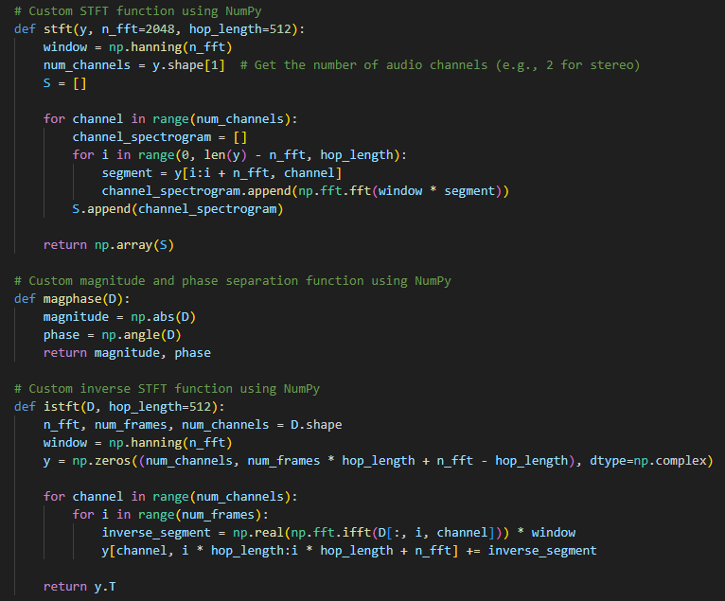
Code

Slide 11
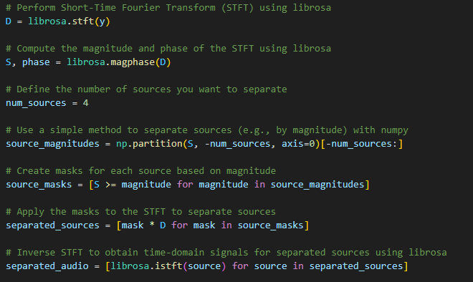
Code
We use default cosine window, i.e. Hann window
In STFT and ISTFT.

Slide 12
Deep Learning
While audio source separation techniques have shown significant advancements, there are still several challenges that researchers face. These challenges include the presence of overlapping sources, varying acoustic conditions, and the limitations of current algorithms in handling complex mixtures. Overcoming these challenges is crucial to achieving accurate and reliable separation results, which can greatly benefit applications such as speech recognition, speaker diarization, and audio transcription.

Slide 13
MUSDB18 Database
MUSDB18 comes encoded in STEMS which is a multitrack audio format that uses lossy compression.
The musdb package, internally, relies on FFMPEG(a suite of libraries and programs for handling video, audio, and other multimedia files and streams) to decode the multi-stream files. For convenience, we developed a python package called stempeg that allows to easily parse the stem files and decode them on-the-fly.
When you install musdb (which depends on stempeg), it is therefore necessary to also install the FFMPEG library.
Using WAV files (Optional) : If you want to use WAV files (e.g. for faster audio decoding), musdb also supports parsing and processing pre-decoded PCM/wav files. musdb comes with the ability to convert a STEMS dataset into WAV version. This script can be used from the command line by

Slide 14
Methodology
torchaudio very effective dataloaders, inverse STFT and resampler.
The flawless implementations of the classical BLSTM recurrent layers.
Many off-the-shelf optimization algorithms and training tricks, as well as the straightforward way you implement training loops which you can debug.
torch.hub is an extraordinary attempt at promoting reproducible research. Since it was pretty easy to setup, we added a hub support to our new Separator module.

Slide 15
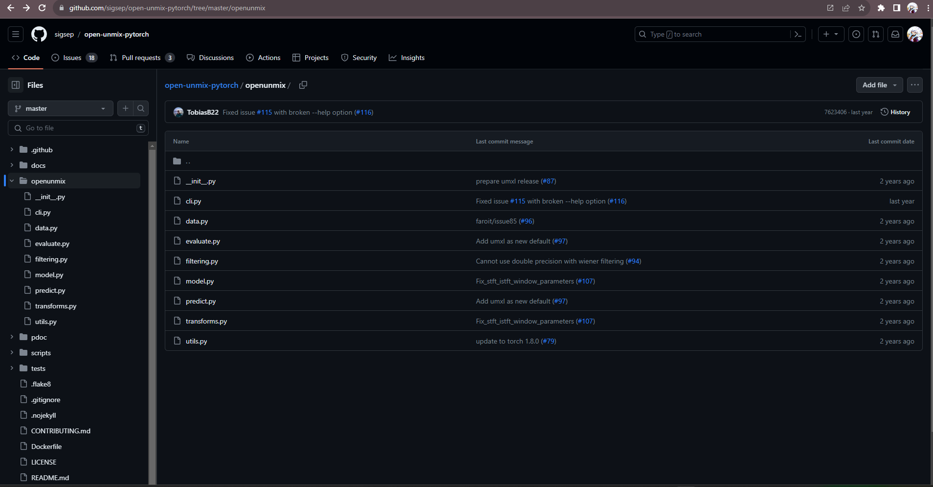
OPENUNMIX

Slide 16
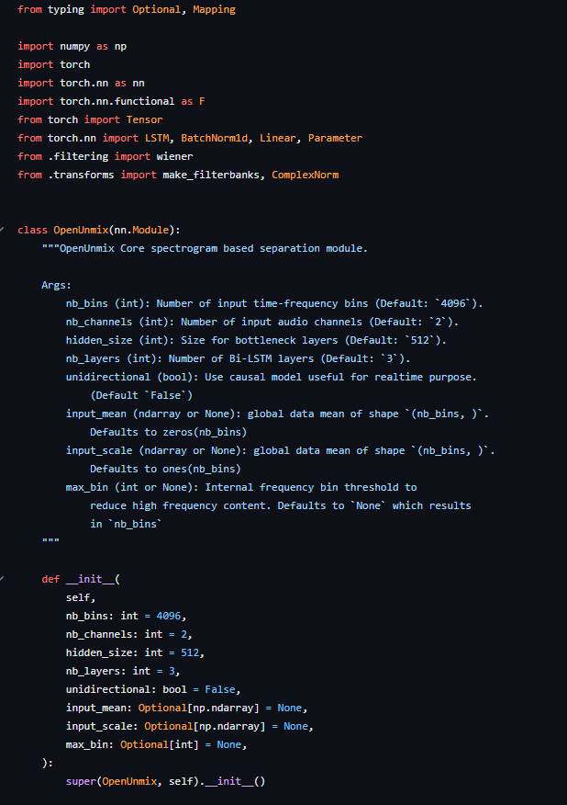
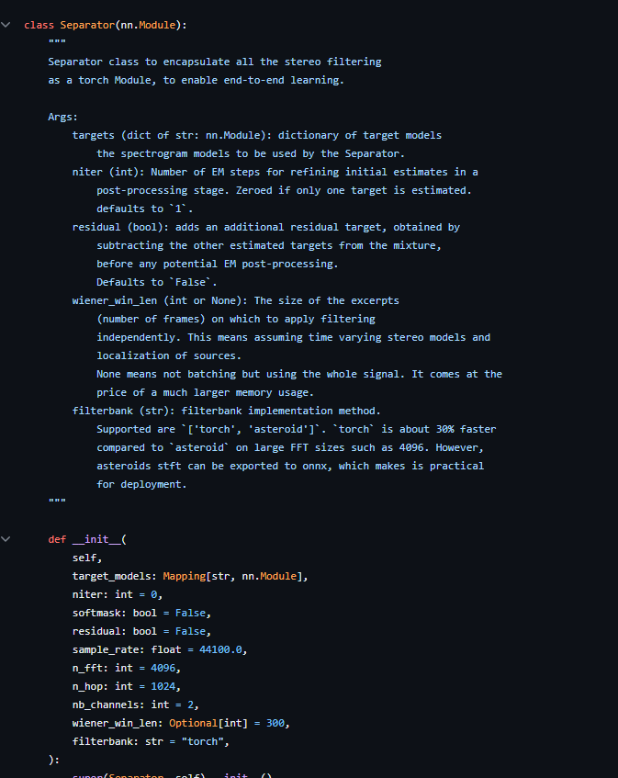

Slide 17
Challenges
While audio source separation techniques have shown significant advancements, there are still several challenges that researchers face. These challenges include the presence of overlapping sources, varying acoustic conditions, and the limitations of current algorithms in handling complex mixtures. Overcoming these challenges is crucial to achieving accurate and reliable separation results, which can greatly benefit applications such as speech recognition, speaker diarization, and audio transcription.

Slide 18
Future Work
Continuing the advancements in audio source separation, future research opportunities lie in exploring deep learning techniques, developing robust algorithms, and further understanding the perceptual aspects of audio separation. Additionally, investigating real-world applications, such as enhancing voice assistants, improving audio quality in telecommunication systems, and enabling better auditory scene analysis, can pave the way for innovative solutions in speech signal processing.

Slide 19
Conclusion
In conclusion, the advancements in audio source separation have opened up new possibilities in speech signal processing. The exploration of deep learning techniques, robust algorithms, and perceptual aspects, combined with real-world applications, has the potential to revolutionize and improve various areas, including voice assistants, telecommunication systems, and auditory scene analysis. The future of speech signal processing is exciting and promising.

Slide 20
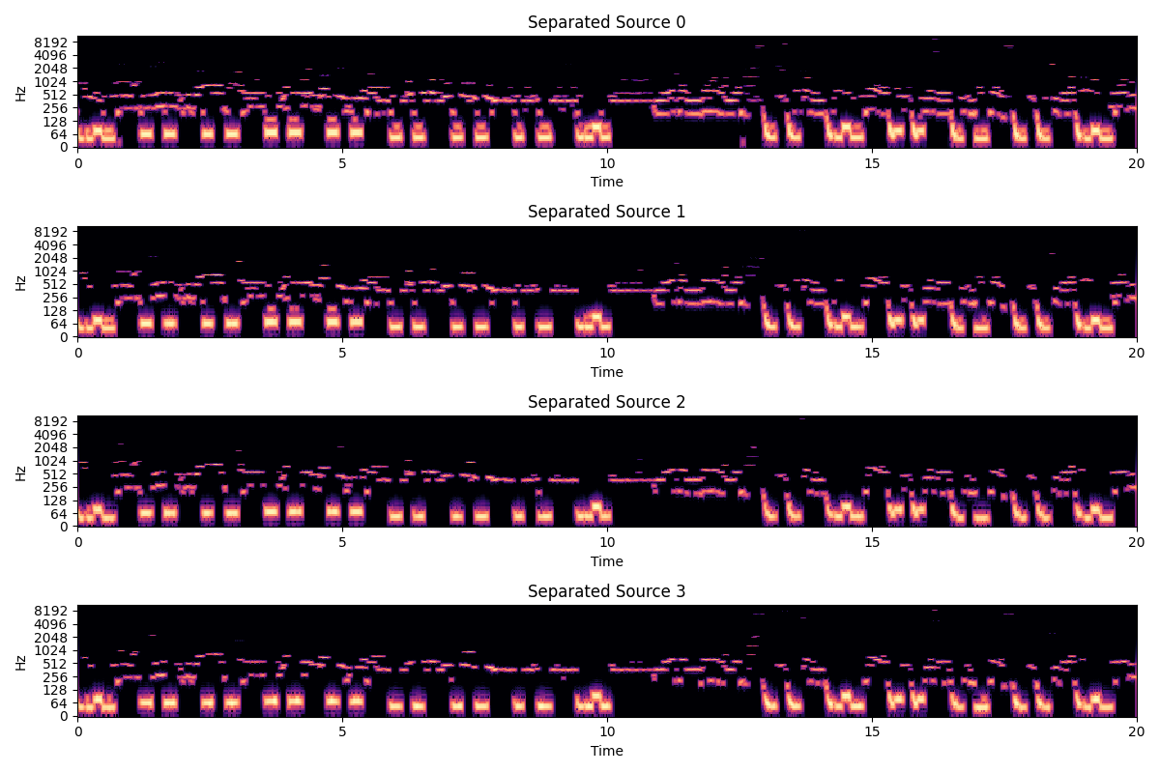
Previous Results

Slide 21
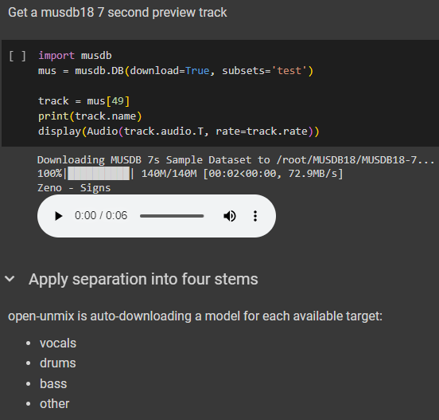
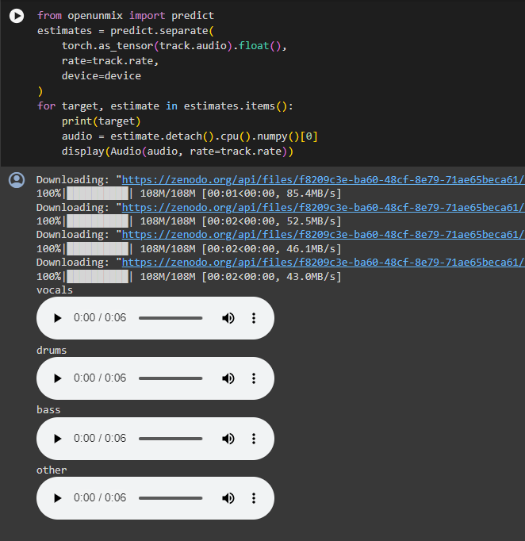

Results

Slide 22
References
[1] D. Wang and J. Chen, "Supervised Speech Separation Based on Deep Learning: An Overview," in IEEE/ACM Transactions on Audio, Speech, and Language Processing, vol. 26, no. 10, pp. 1702-1726, Oct. 2018, doi: 10.1109/TASLP.2018.2842159.
[2] R. J. Cant, C. S. Langensiepen and W. Metcalf, "Mask Optimisation for Neural Network Monaural Source Separation," 2017 UKSim-AMSS 19th International Conference on Computer Modelling & Simulation (UKSim), Cambridge, UK, 2017, pp. 116-121, doi: 10.1109/UKSim.2017.21.

Slide 23
Thank You!!

