Slide 1



Mahatma Education Society's
Pillai HOC College of Engineering & Technology
Department of Computer Engineering
(AUTONOMOUS)
THREATSHIELD DL
Web Attack Detection System
Group members :
1. Amogh P Kalyanshetti
2. Vikas S Bhosale
3. Aditya N Chorge
Under the guidance :
Prof. Shweta Patil
Under the guidance :
Prof. Dr . Vibhuti Awasthi
Group members :
1. Aditya N Chorghe
2. Vikas S Bhosale
3. Parag P Gonji
4. Amogh P Kalyanshetti

Slide 2
Presentation Outline
Introduction
Existing System
Problem Statement
Scope
System Architecture
Proposed Architecture
Methodology
Expected Outcome
Conclusion
References
Introduction
Existing system
Problem statement
Scope
System Architecture
Proposed Architecture
Methodology
Expected Outcome
Cost estimation
Gantt Chart
Conclusion
References

Slide 3
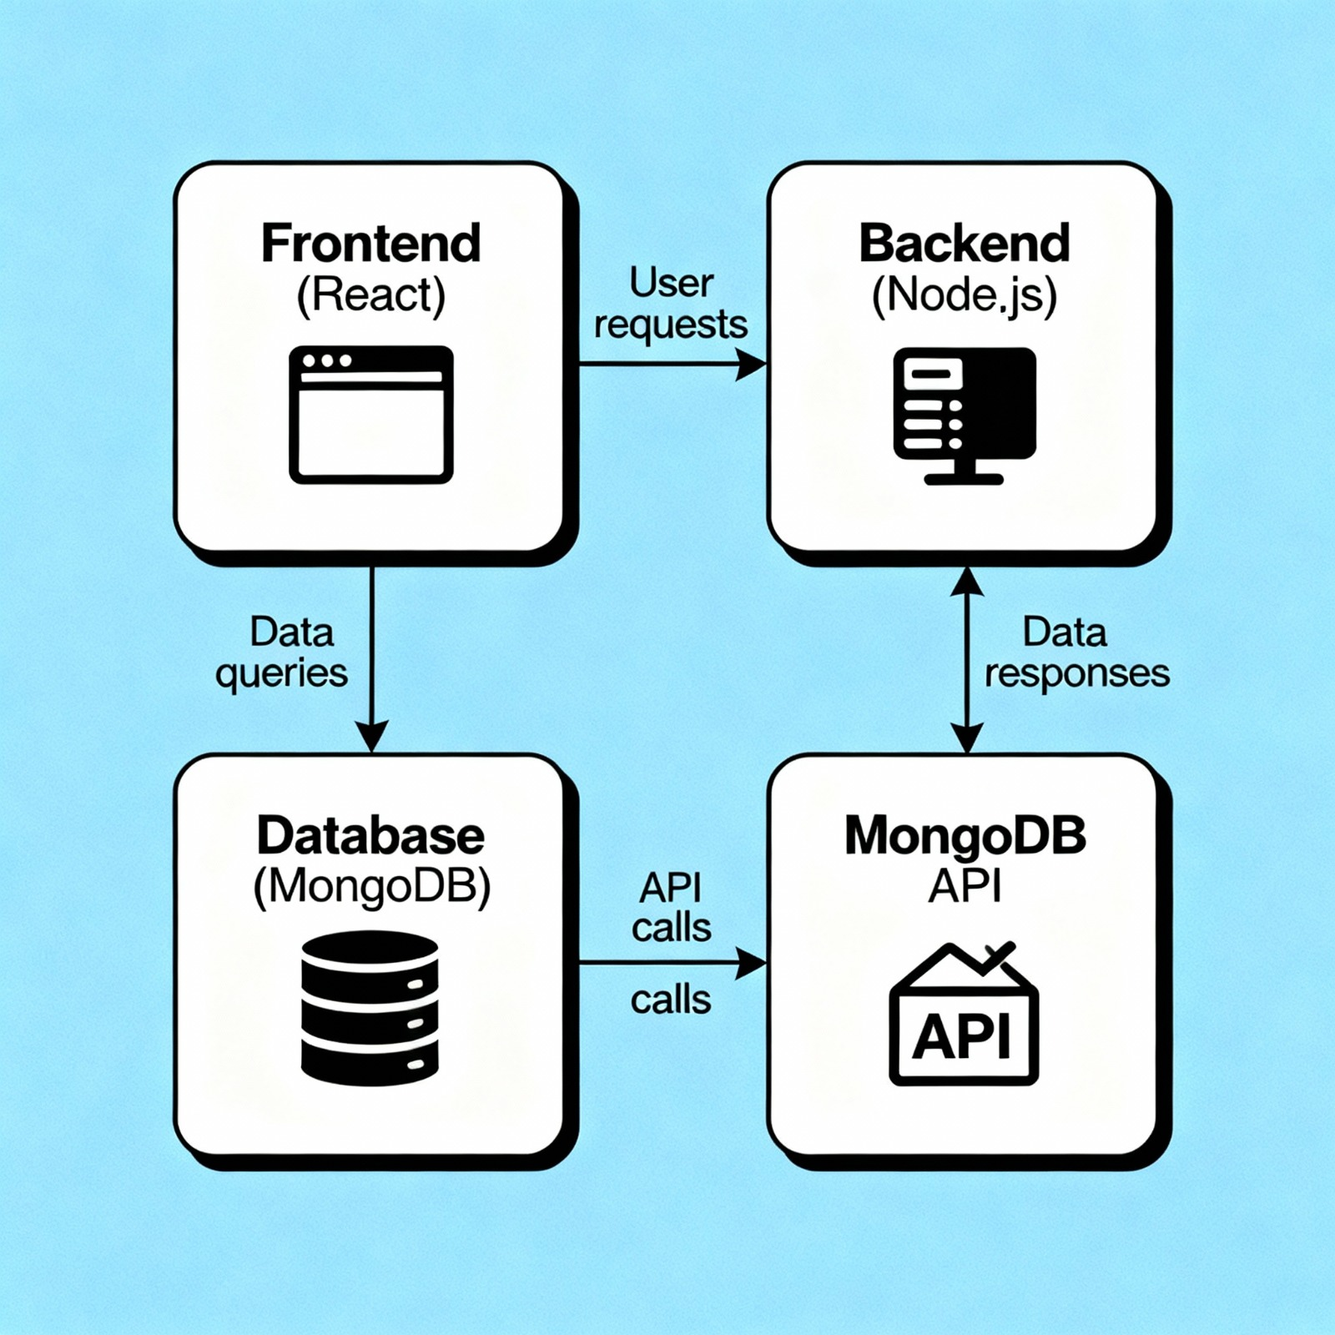
Introduction
Cyber attacks targeting web applications have increased significantly in recent years.
Malicious activities such as SQL Injection, Cross Site Scripting (XSS), and Path Traversal
are commonly used by attackers to exploit vulnerabilities in web systems. Traditional
security solutions mainly rely on rule‑based filtering which may fail to detect new or
modified attack patterns.
ThreatShield DL is a deep learning based web attack detection system designed to analyze
HTTP requests and identify suspicious behavior. The system uses machine learning models
along with rule‑based validation to detect malicious inputs and classify different attack types.
A job application website is essentially a digital marketplace that stands at the intersection of talent and opportunity. It functions as a powerful, two-sided network, providing a central platform where employers can efficiently post and manage job openings, and job seekers can actively search, discover, and apply for roles globally.
Far more than just a listing service, these platforms streamline the entire recruitment process. For candidates, they offer advanced search filters, personalized profiles, and simplified, often one-click, application methods. For companies, they are crucial business tools, leveraging systems like Applicant Tracking Systems (ATS) and recruiter dashboards to automate screening, filter resumes based on keywords, and dramatically reduce the time it takes to find and hire the best fit

Slide 4
Existing System
Traditional web security systems depend mainly on static rules and signature based detection.
These methods can detect known attacks but often fail to identify new or modified attack patterns.
Web servers typically rely on simple input validation techniques which may not detect complex
malicious payloads. As a result, attackers can bypass security mechanisms using advanced
techniques.
The existing systems also lack intelligent monitoring capabilities and real‑time attack
analysis which makes web applications vulnerable to modern cyber threats.
The current job recruitment process is largely fragmented and inefficient. Most companies rely on traditional methods such as email-based applications, manual resume screening, and in-person submissions, which makes the process slow and unorganized. Job seekers often struggle with finding authentic job postings, as many listings on social media or unverified websites lack credibility. The absence of centralized platforms leads to scattered information, forcing applicants to navigate multiple sources to find suitable opportunities.
Additionally, employers face significant challenges in managing hundreds of resumes manually, tracking candidate progress, and communicating updates effectively. There is often no automated filtering system, making it difficult to shortlist qualified candidates quickly. The lack of real-time status updates also results in poor transparency for applicants. Overall, the existing system is inefficient, time-consuming, and lacks the structured workflow needed for modern hiring.

Slide 5
Problem Statement
Web applications are frequently targeted by cyber attacks such as SQL Injection, XSS,
and Path Traversal which can compromise sensitive data and disrupt services.
Traditional security approaches struggle to detect evolving attack patterns and require
significant manual monitoring.
There is a need for an intelligent system capable of automatically analyzing HTTP requests,
detecting malicious patterns, and providing real‑time alerts to improve web security.
Finding a suitable job and managing the recruitment process is often time-consuming and inefficient for both job seekers and employers.
Job seekers struggle to access authentic job listings, apply easily, and track their application status. Employers face challenges in reaching the right candidates, managing multiple applications, and conducting an organized hiring process.
There is a need for a centralized, user-friendly online platform that connects employers and job seekers, simplifies the application process, and ensures efficient, transparent, and organized recruitment.

Slide 6
Scope
The ThreatShield DL system focuses on detecting malicious HTTP requests using
machine learning and cybersecurity techniques.
The system analyzes user inputs and identifies potential web attacks including
SQL Injection, Cross Site Scripting (XSS), and Path Traversal.
It also provides a web‑based dashboard where users can test HTTP requests
and view attack detection results along with confidence scores.
Job Posting and Workflow:
Applicant Tracking System (ATS):
The scope includes a dedicated portal for employers to create, publish, edit, and archive job listings with detailed descriptions, company branding, and specific qualification requirements.
A central and critical component. This system must allow recruiters to screen, rank, and manage incoming applicants automatically, typically through keyword matching and qualification scoring.
Communication & Collaboration Tools:
Performance and Scalability:
Features to facilitate internal team collaboration (sharing notes, ranking candidates) and external communication (sending automated or custom messages and scheduling interviews).
The system must be built to handle millions of search queries and simultaneous users without degradation in performance, especially during peak hiring cycles.
Target Audience and Niche:
Job Posting & Management
We could look at specializing the site. Should it be a broad platform like LinkedIn, or a niche site focusing only on, say, remote tech jobs or healthcare roles?
Employers can post new job openings, edit job details, view applications, and manage the recruitment process.

Slide 7
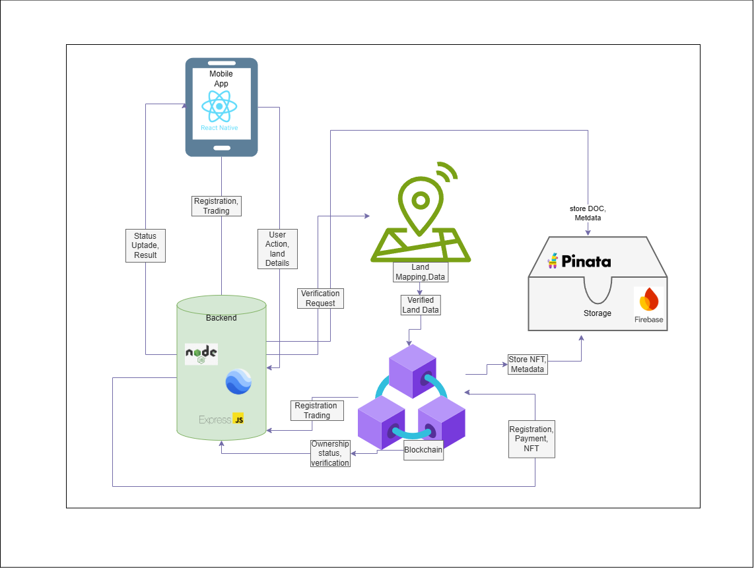
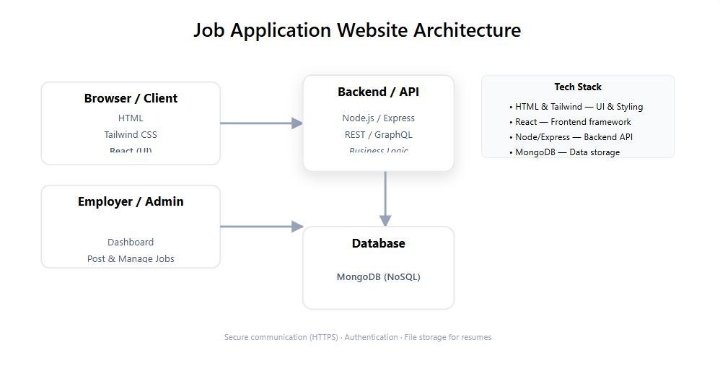
System Architecture
System Architecture
User Request
↓
ThreatShield Interface
↓
Preprocessing & Feature Extraction
↓
Deep Learning Model
↓
Attack Classification
↓
Security Response

Slide 8
Proposed Architecture
Technologies Used
Python
TensorFlow / Keras
Streamlit
Machine Learning
Cybersecurity Concepts
The deep learning model is trained on web attack datasets and integrated
into a Streamlit based dashboard for user interaction.
Frontend: HTML, Tailwind CSS, React
Backend: Node.js / Express
Database: MongoDB
Includes job posting, applications, tracking, and admin dashboards.

Slide 9
Methodology
Proposed Architecture
Users submit HTTP requests through the ThreatShield interface.
The system preprocesses the input and converts it into numerical features
for analysis by the deep learning model.
The model predicts whether the request is normal or malicious and
classifies the attack type. The result is displayed along with
a confidence score and recommended security response.

Slide 10
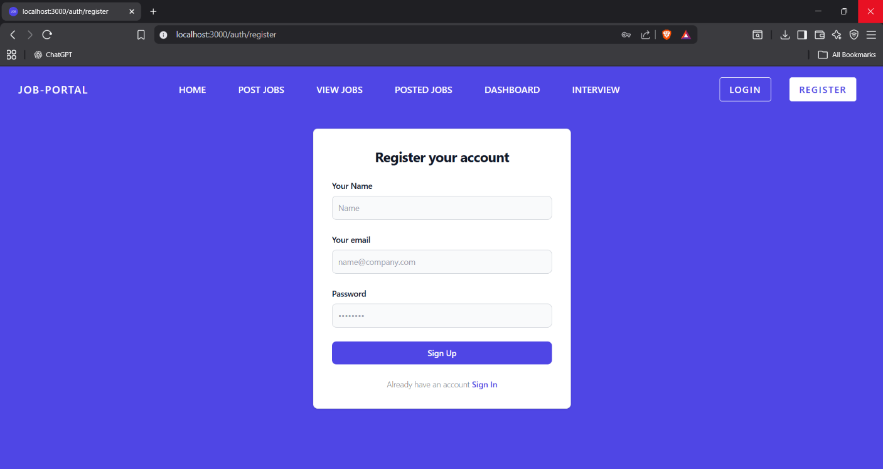
Outcomes

Slide 11
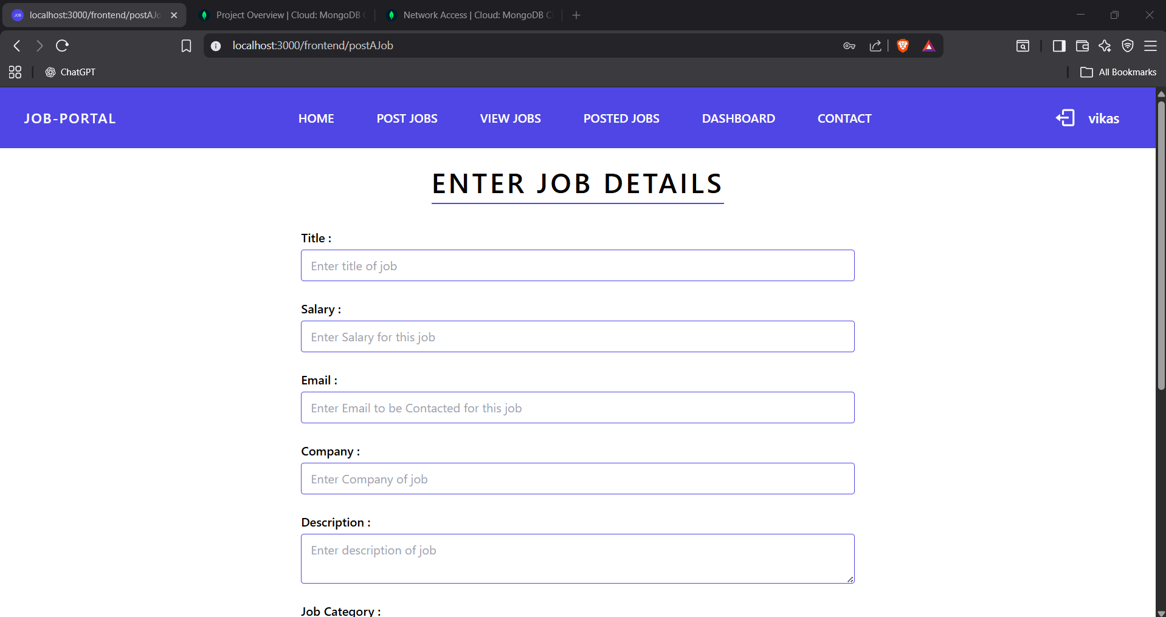
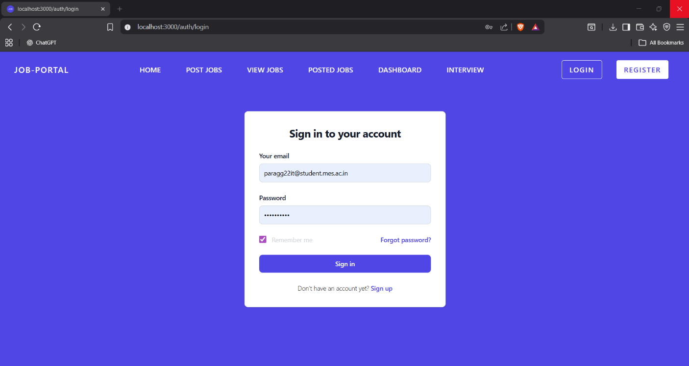
Posting Job

Slide 12
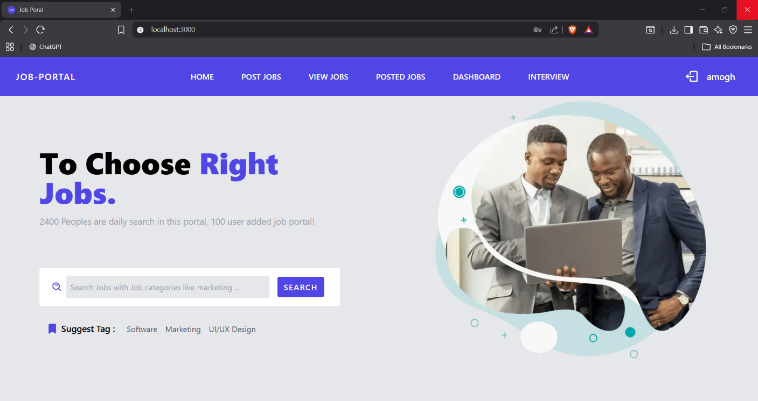
Display Job

Slide 13
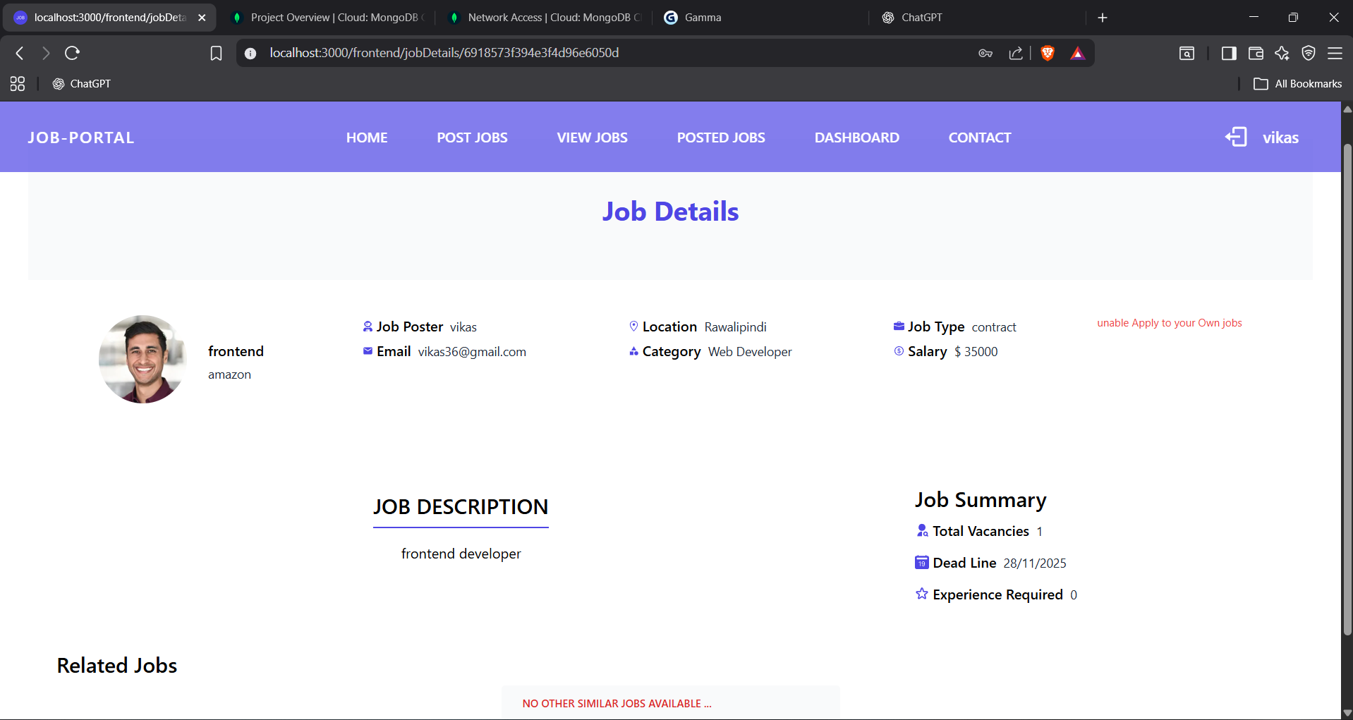
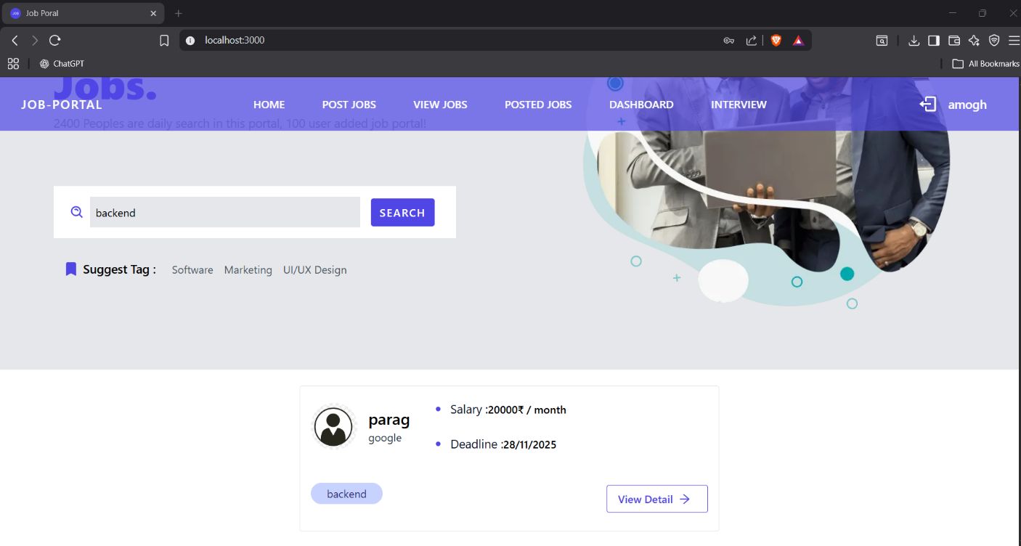
Job Details

Slide 14
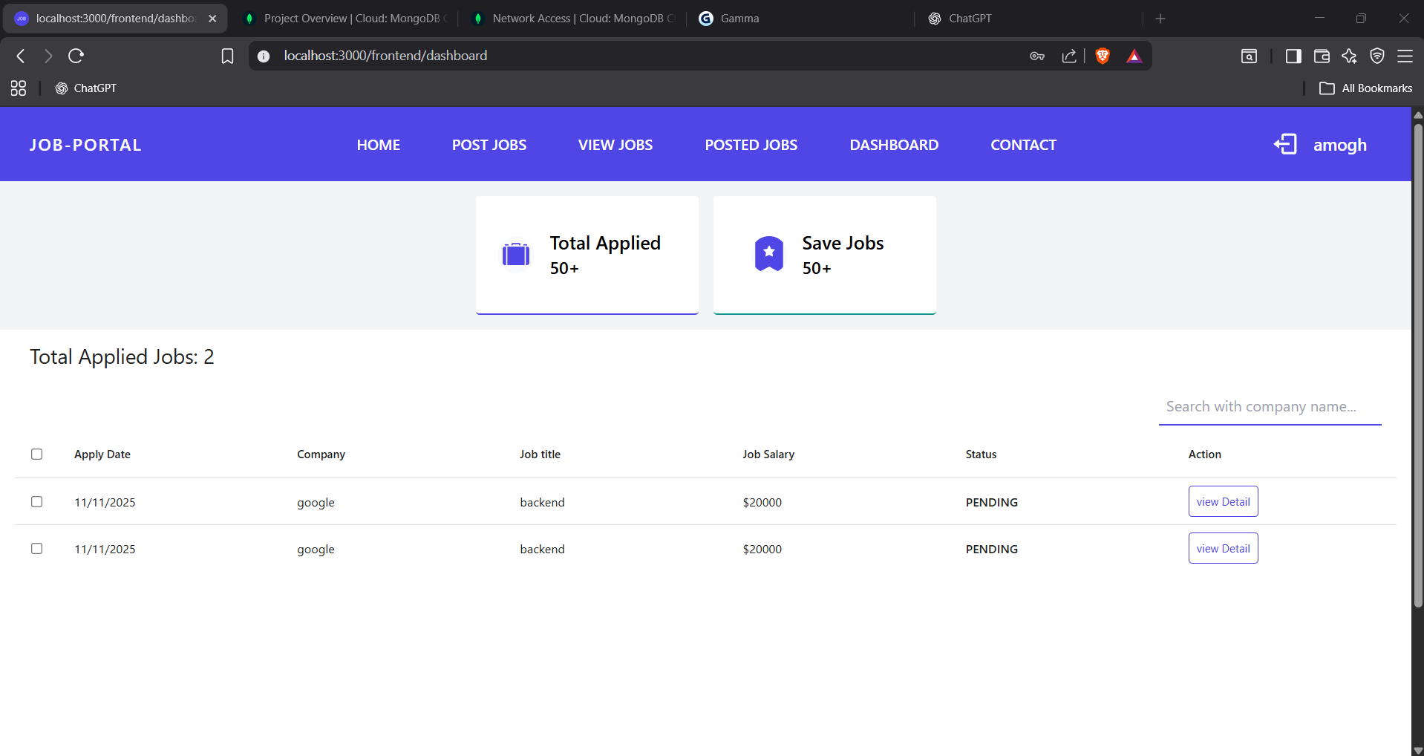
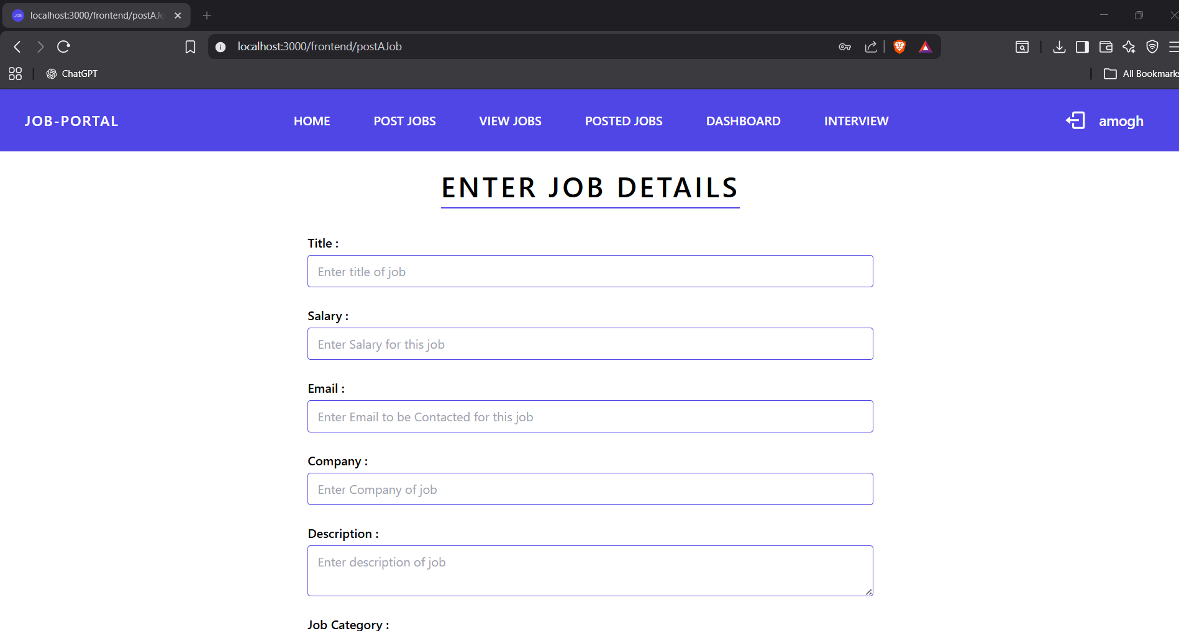
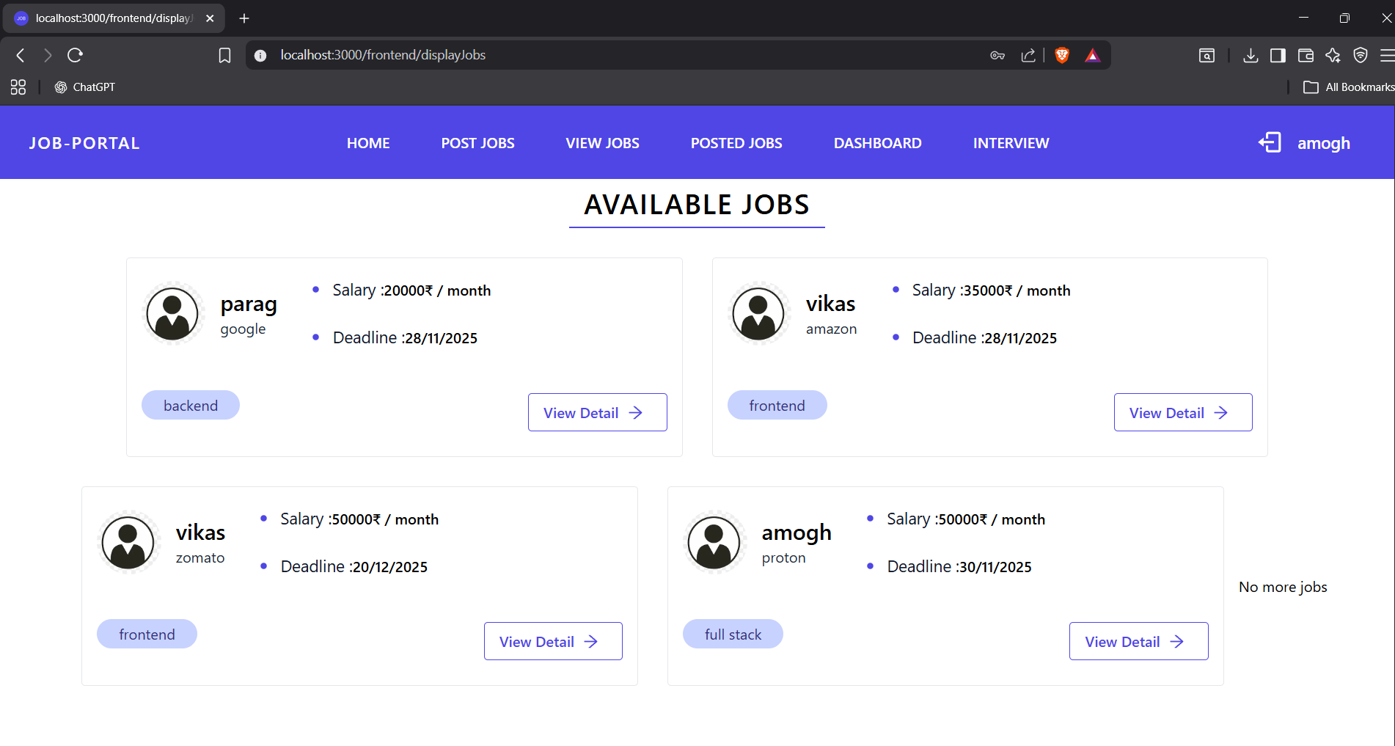
Dashboard

Slide 15
Apply Job

Slide 16
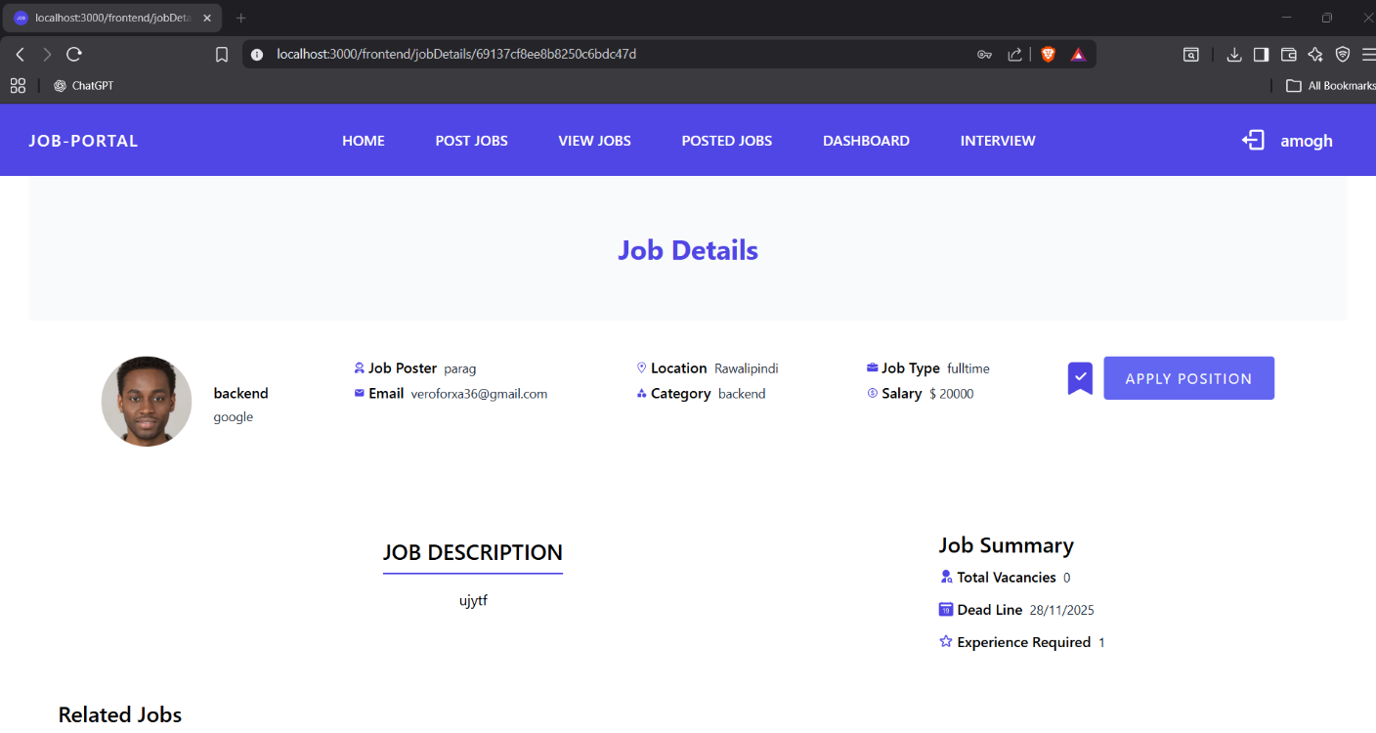

Slide 17
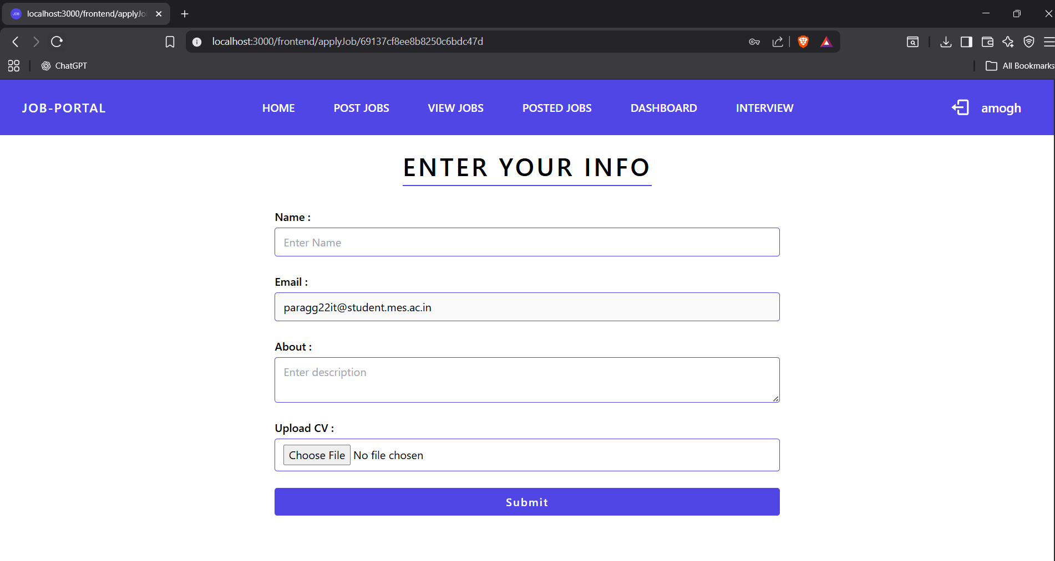

Slide 18
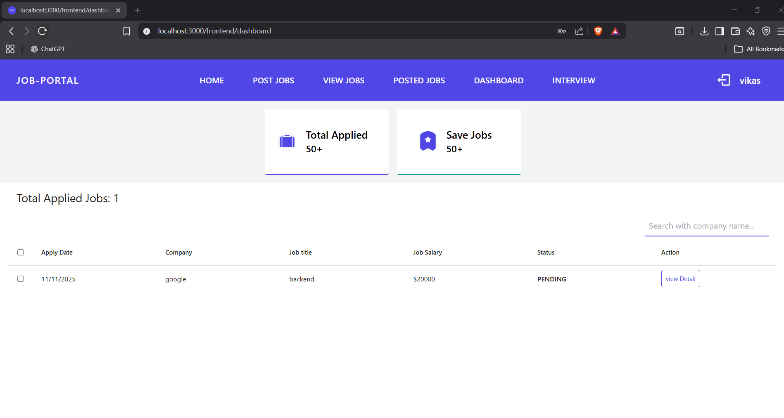

Slide 19
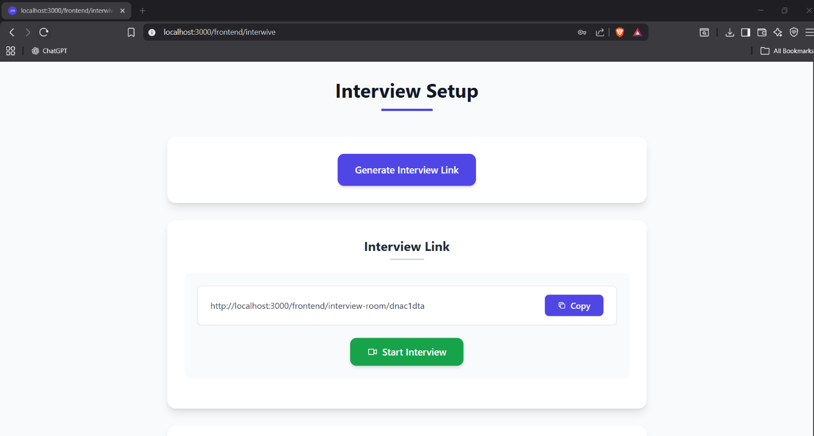

Slide 20
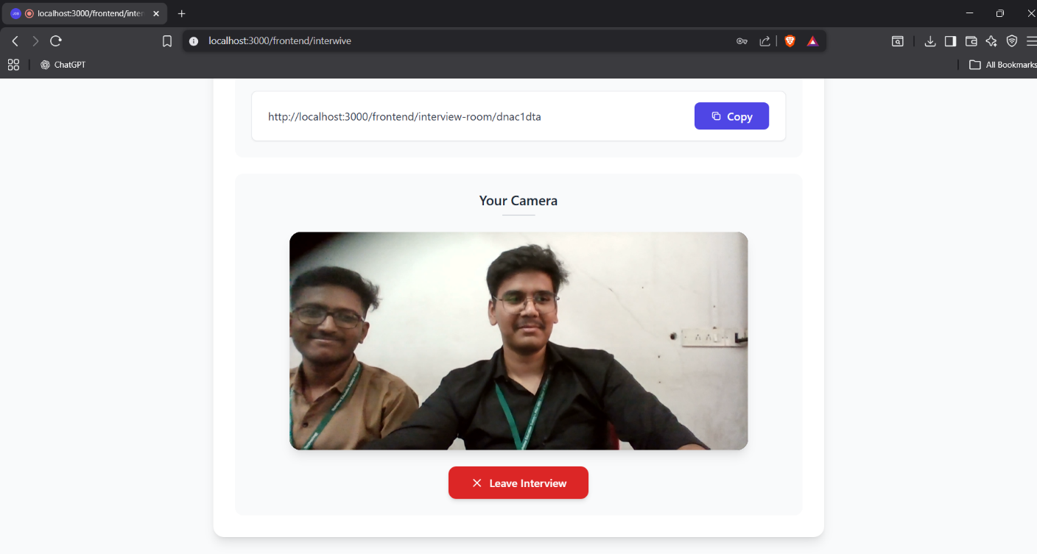

Slide 21
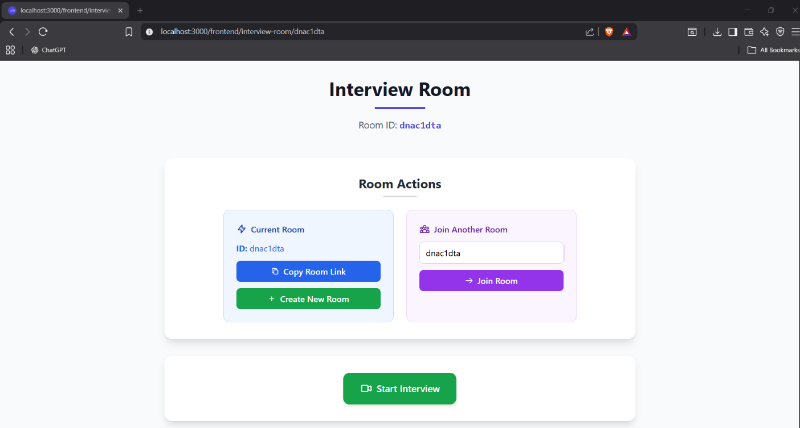

Slide 22
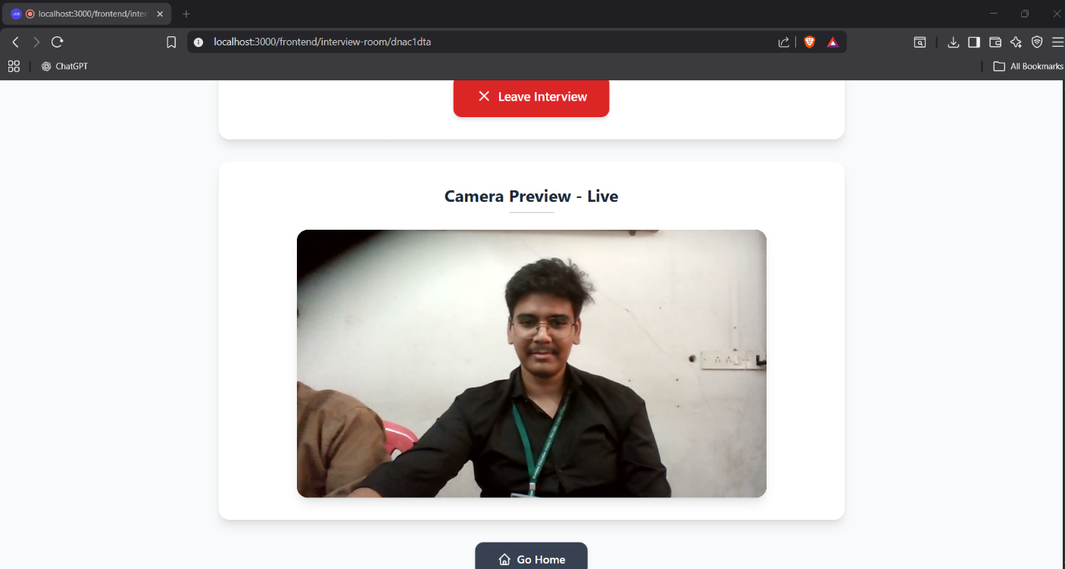

Slide 23
Conclusion
ThreatShield DL provides an intelligent solution for detecting
malicious web requests using deep learning techniques.
The system can identify multiple attack types such as SQL Injection,
XSS, and Path Traversal by analyzing HTTP request patterns.
This approach improves the ability to detect cyber threats and
supports administrators in monitoring suspicious activities
within web applications.
The Job Application Website provides a comprehensive digital solution to overcome the limitations of traditional recruitment systems. By offering features such as job posting, advanced search filters, resume upload, ATS-based screening, and real-time application tracking, the platform enhances transparency and reduces hiring time. Employers gain an organized, data-driven dashboard, while job seekers benefit from faster access to relevant opportunities. In conclusion, the system achieves its goal of creating a modern, scalable, and efficient recruitment ecosystem that improves user experience for both job seekers and employers.
The proposed Job Application Website successfully streamlines the end-to-end recruitment process by integrating job posting, applicant tracking, resume screening, and communication tools into a single platform. It improves efficiency for employers, enhances accessibility for applicants, and reduces delays in traditional hiring methods. Overall, the system offers a scalable, secure, and reliable solution for modern digital recruitment.
The Job Application Website provides an efficient and user-friendly platform that connects job seekers with employers. It simplifies job searching, application submission, and recruitment management, making the hiring process faster, transparent, and more organized.

Slide 24
References
https://leetcode.com/
https://www.hackerrank.com/
https://www.interviewbit.com/
https://www.geeksforgeeks.org/
https://aws.amazon.com/
https://judge0.com/
https://nextjs.org/docs
https://authjs.dev/
https://www.npmjs.com/package/@monaco-editor/react

