Slide 1
Project 1 Required Components
Read in labeled motion capture data
3D points
Part labels for each point
Tracking points through time to form trajectories, thus propagating part labels
Data association of trajectories up to time t-1 with points detected at time t
Do Kalman filter to update each trajectory with the point associated with it at time t
Write out the corrected points / labels
Quantitative evaluation

Slide 2
Project 1 Required Components
Read in labeled motion capture data
3D points
Part labels for each point
Tracking points through time to form trajectories, thus propagating part labels
Data association of trajectories up to time t-1 with points detected at time t
Do Kalman filter to update each trajectory with the point associated with it at time t
Write out the corrected points / labels
Quantitative evaluation

Slide 3
Recall: Filtering Framework
Recall our discussion of state space filtering
We want to recursively estimate the current state at every time that a measurement is received.
Two step approach:
prediction: propagate state pdf forward in time, taking process/model noise into account (translate, deform, and spread the pdf)
update: use Bayes theorem to modify prediction pdf based on current noisy measurement

Slide 4
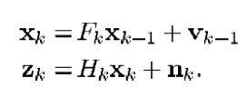
Recall: Kalman Filter
Kalman filtering is an example of Bayes filtering where:
Motion model and measurement model are linear
Noise is zero-mean Gaussian
Prior distribution on state vector is Gaussian
1) Motion model
2) Measurement model
p(v_{k}) = N(v_{k} | 0, Q_{k})
p(n_{k}) = N(n_{k} | 0, R_{k})

Slide 5
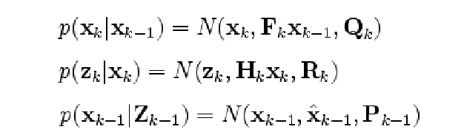
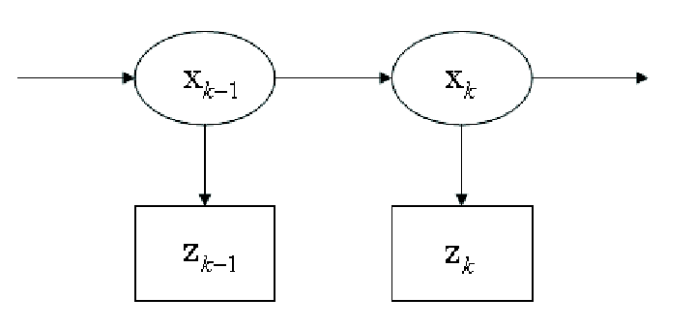
Kalman Filter
Under those conditions, all probability distributions remain Gaussian.

Slide 6
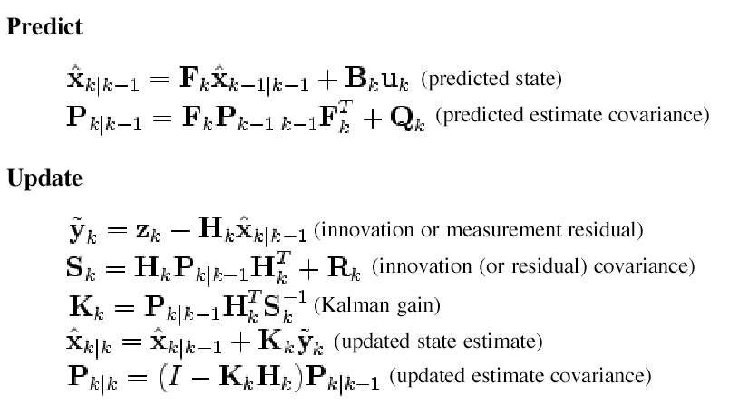
Kalman Filter

Slide 7
Problem
When tracking multiple objects, or when there are multiple detections, how do we know which detection to use when updating each state vector?
Two step approach:
prediction: propagate state pdf forward in time, taking process noise into account (translate, deform, and spread the pdf)
update: use Bayes theorem to modify prediction pdf based on current measurement
But which observation should we update with?

Slide 8
Data Association
Multi-frame matching (matching observations in a new frame to a set of tracked trajectories)
track 1
?
track 2
observations
How to determine which observations to add to which track?

Slide 9
Data Association
Intuition: predict next position along each track.
track 1
?
track 2
observations
How to determine which observations to add to which track?

Slide 10
Data Association
Intuition: predict next position along each track.
Intuition: match should be close to predicted position.
d₁
d₃
track 1
d₂
?
d₅
d₄
track 2
observations
How to determine which observations to add to which track?

Slide 11
Data Association
Intuition: predict next position along each track.
Intuition: match should be close to predicted position.
Intuition: some matches are highly unlikely.
d₁
d₃
track 1
d₂
?
track 2
observations
How to determine which observations to add to which track?

Slide 12
Gating
A method for pruning matches that are geometrically unlikely from the start. Allows us to decompose matching into smaller subproblems.
gating region 2
?
track 1
?
gating region 1
track 2
observations
How to determine which observations to add to which track?

Slide 13
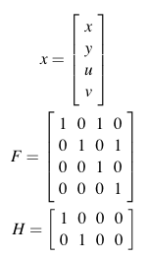

Gating for Kalman Filters
Note: this example uses 2D points. You will be using 3D points.
ellipsoidal gating region

Slide 14
Simpler Prediction/Gating
Could replace ellipsoidal error region with box or sphere:
r
r
constant position prediction
Note: the half-width or radius r should be computed somehow from the variances in D when KF covariance is decomposed as Cov => U D U^{T}
Alternatively, perhaps you could simplify the KF equations by assuming all covariance matrices are diagonal, with equal variances along the diagonal.

Slide 15
Filtering, Gating, Association
Add Gating and Data Association
prediction: propagate state pdf forward in time
Gating to determine possible matching observations
Data association to determine best match
4) update: use Bayes theorem to modify prediction pdf based on current noisy measurement

Slide 16
Global Nearest Neighbor (GNN)
Evaluate each observation in track gating region. Choose “best” one to incorporate into track.
o₂
o₁
track1
o₃
o₄
a_{1j} = score for matching observation j to track 1
Could be based on Euclidean or Mahalanobis distance to predicted location (e.g. exp{-d²}). Could be based on similarity of appearance (e.g. appearance template correlation score)

Slide 17
Global Nearest Neighbor (GNN)
Evaluate each observation in track gating region. Choose “best” one to incorporate into track.
ai1
o₂
3.0
2 5.0
3 6.0
4 9.0
o₁
track1
o₃
o₄
max
a_{i1} = score for matching observation i to track 1
Choose best match a_{m1} = max{a₁₁, a₂₁,a₃₁,a₄₁}

Slide 18
Global Nearest Neighbor (GNN)
Problem: if do independently for each track, could end up with contention for the same observations.
ai1
ai2
o₂
3.0
2 5.0
3 6.0 1.0
9.0 8.0
3.0
o₁
track1
o₃
o₄
o₅
both try to claim
observation o₄
track2

Slide 19
A Greedy (Best First) Strategy
Find the largest score.
Remove scores in same row and column from consideration (that is, enforcing the 1-1 matching constraints)
Repeat
1 2 3 4 5
0.95 0.76 0.62 0.41 0.06
0.23 0.46 0.79 0.94 0.35
0.61 0.02 0.92 0.92 0.81
0.49 0.82 0.74 0.41 0.01
0.89 0.44 0.18 0.89 0.14
1
2
3
4
5

Slide 20
Greedy (Best First) Strategy
Assign observations to trajectories in decreasing order of goodness, making sure to not reuse an observation twice.
ai1
ai2
o₂
3.0
2 5.0
3 6.0 1.0
9.0 8.0
3.0
o₁
track1
o₃
o₄
o₅
Note: solution may not be optimal! Later we will discuss other methods that find the optimal solution.
track2

Slide 21
Missing Observations
What to do if there is no good observation to use for updating a trajectory (that is, no observation in the gating region)?
track1

Slide 22
Missing Observations
Use predicted location as the updated location, but flag it as missing and increase the variance.
track1
This way you can keep predicting forward in time, and hopefully regain tracking using detections in future frames.

Slide 23
Project 1 Required Components
Read in labeled motion capture data
3D points
Part labels for each point
Tracking points through time to form trajectories, thus propagating part labels
Data association of trajectories up to time t-1 with points detected at time t
Do Kalman filter to update each trajectory with the point associated with it at time t
Write out the corrected points / labels
Quantitative evaluation

Slide 24
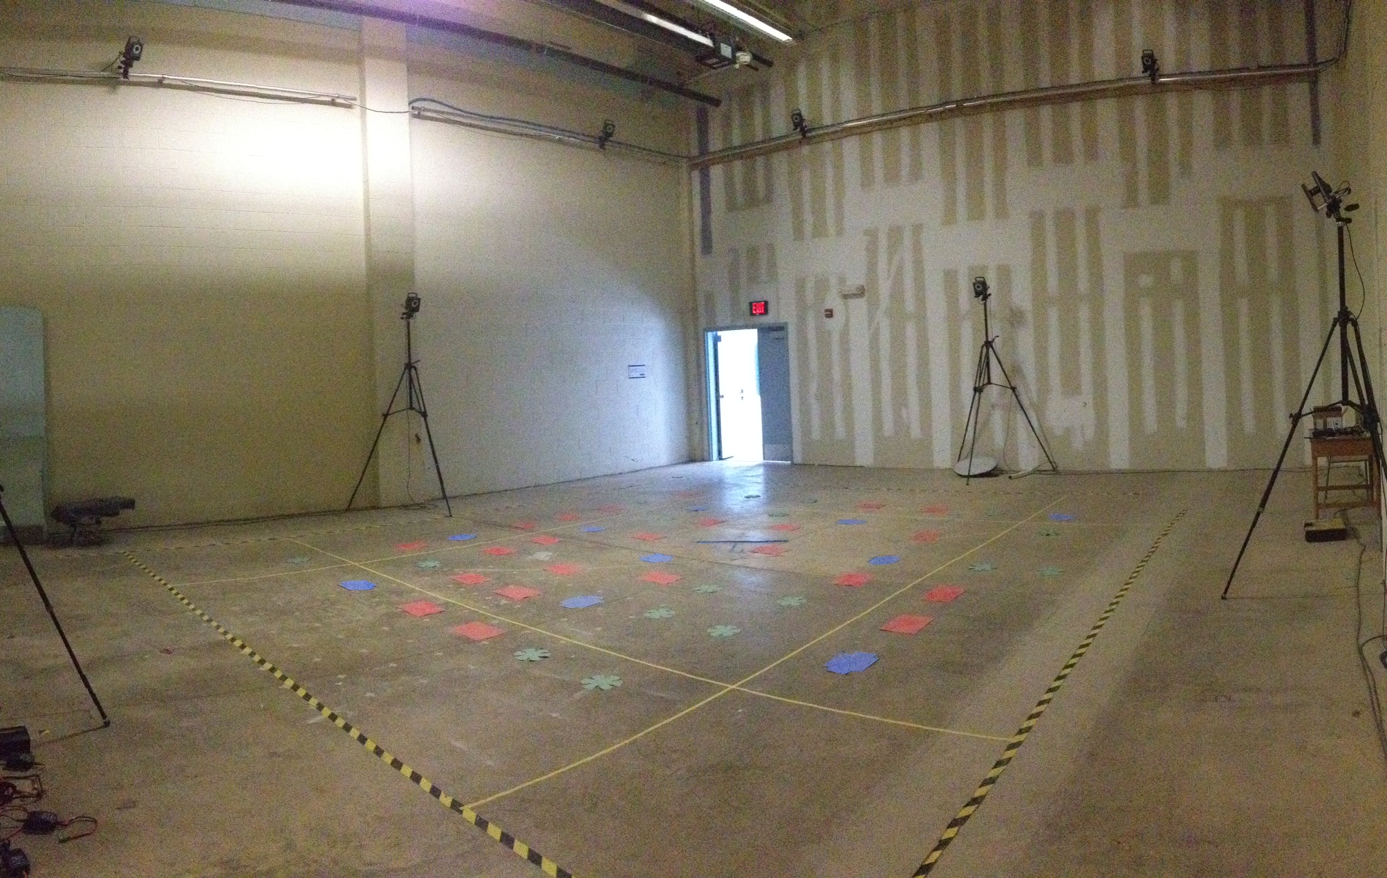
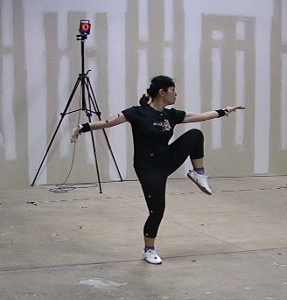
Motion Capture Overview

Slide 25
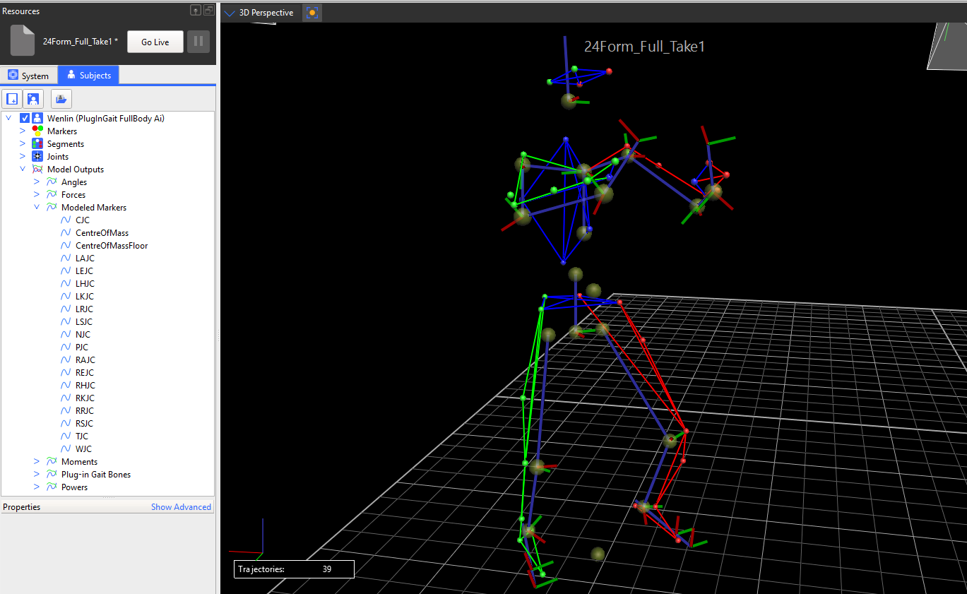
Motion Capture Overview

Slide 26
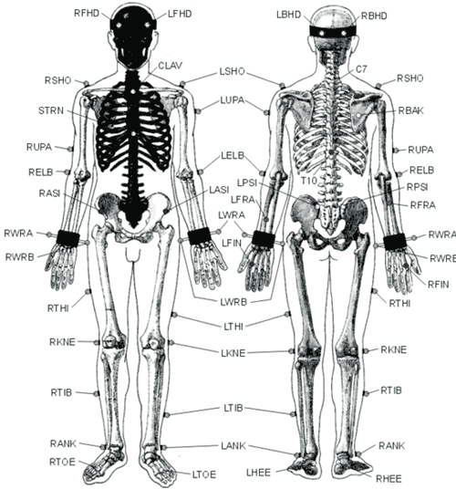
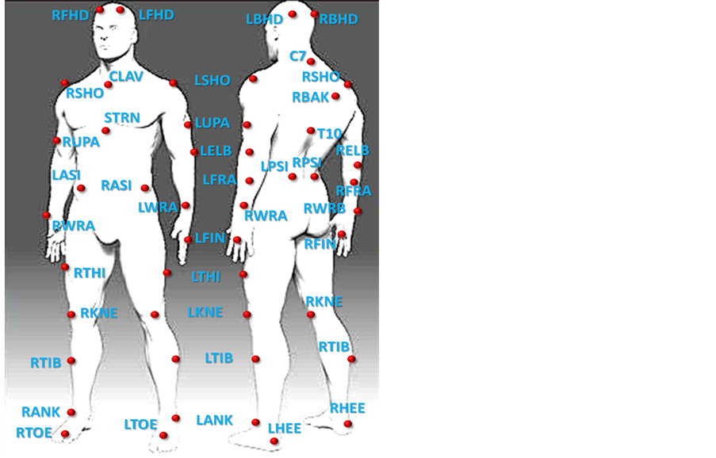
Marker Locations

Slide 27
Motivation
The markers are identical 17mm diameter IR sphere reflectors.
Because of this, when the VICON software finds the 3D positions of the markers there is no indication of which body part an individual marker corresponds to.
VICON has an automatic labeling tool that tries to label the markers in the sequence, but...

Slide 28
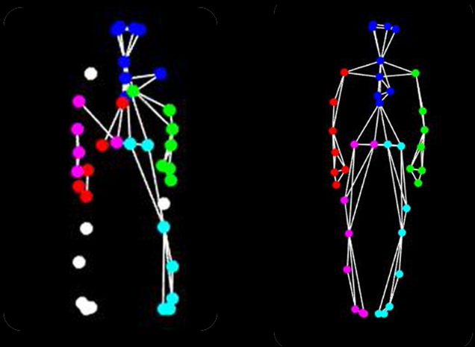
Motivation
The output of the VICON labeling tool has many errors including: unlabeled markers, mislabeled markers, extra markers, and missing markers.
VICON output
We want
this!

Slide 29
Overall Hope
After tracking, you will have 39 trajectories, each corresponding to one body marker.
The ground truth label of a marker in one frame thus determines the correct label for all points on the same trajectory.

Slide 30
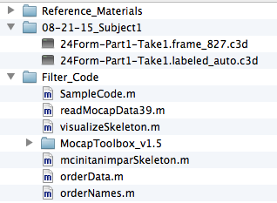
Getting Started
Background info + this ppt file
Data to use
One perfectly labeled frame
Sequence to be corrected
Start with this code...

Slide 31
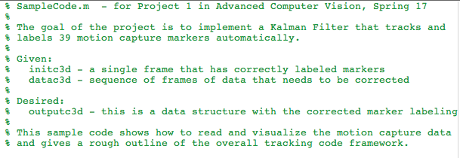
Getting Started
SampleCode.m is where you want to start

Slide 32
Extensions (do at least one in addition to the required components)
Implement particle filtering, and compare with KF for tracking
Implement JPDAF for “soft” data association
Implement an optimal approach for solving “hard” data association (hard vs soft, not vs easy). Some choices are:
Kuhn-Munkres (Hungarian) algorithm
Linear programming
Min-cost network flow
When I say “implement” I mean implement the whole algorithm, not just call a library routine that does it.

Slide 33
Extensions (Continued)
Use knowledge about neighboring markers to improve the data association / tracking
This is more open-ended... We don’t necessarily know what to do here.
One idea: some pairs of marker points are constrained to be a certain distance away from each other, because they are both on a body part that is rigid (e.g. forearm; head; lower leg).
Another idea: points on the same rigid body should move similarly. If one is missing, perhaps you can use the velocity of the visible one.

