Slide 1
LENDING CASE STUDY SUBMISSION
Group Members: Amogha J Namannavar, Surya Kiran Bende

Slide 2
Problem Statement
Company Profile
The company is the largest online loan marketplace, facilitating personal loans, business loans, and financing of medical procedures. Borrowers can easily access lower interest rate loans through a fast online interface.
Risk Factors
Like most other lending companies, lending loans to ‘risky’ applicants is the largest source of financial loss (called credit loss). The credit loss is the amount of money lost by the lender when the borrower refuses to pay or runs away with the money owed. In other words, borrowers who default cause the largest amount of loss to the lenders. In this case, the customers labelled as 'charged-off' are the 'defaulters’.
Business Objective
To identify risky loan applicants, then such loans can be reduced thereby cutting down the amount of credit loss. Identification of such applicants using EDA is the aim of this case study.
In other words, the company wants to understand the driving factors (or driver variables) behind loan default, i.e. the variables which are strong indicators of default. The company can utilize this knowledge for its portfolio and risk assessment

Slide 3
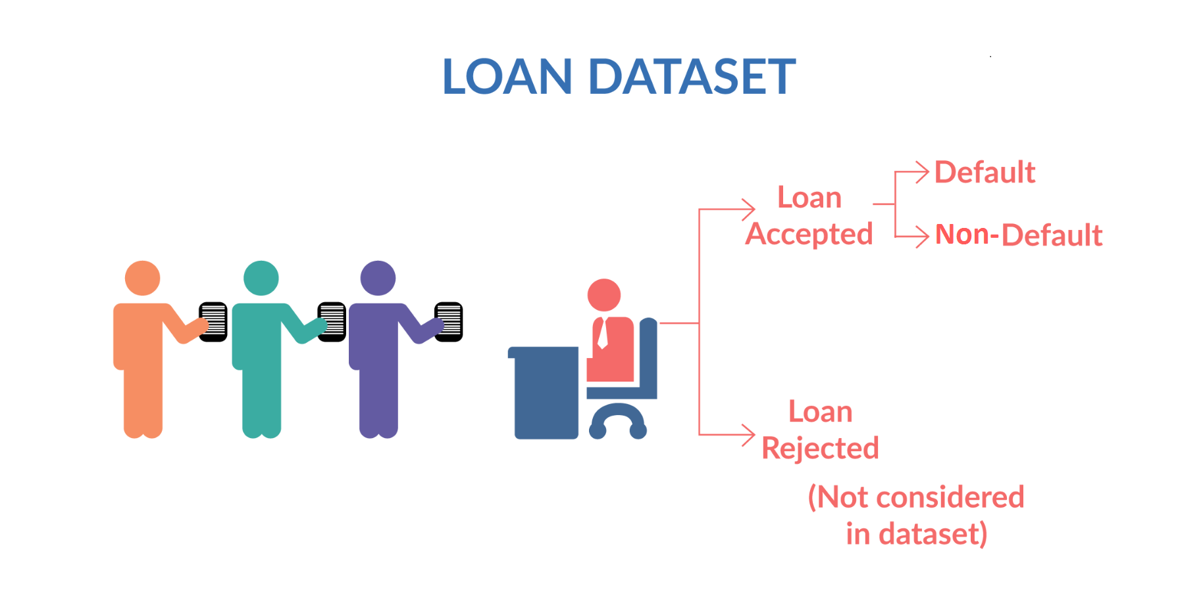
1) Loan accepted:
If the company approves the loan, there are 3 possible scenarios described below:
->Fully paid: Applicant has fully paid the loan (the principal and the interest rate)
->Current: Applicant is in the process of paying the instalments, i.e. the tenure of the loan is not yet completed. These candidates are not labelled as 'defaulted’. The Current type values are dropped as part of our analysis as it is not good predictor.
->Charged-off: Applicant has not paid the instalments in due time for a long period of time, i.e. he/she has defaulted on the loan
2) Loan rejected :
The company had rejected the loan (because the candidate does not meet their requirements etc.). Since the loan was rejected, there is no transactional history of those applicants with the company and so this data is not available with the company (and thus in this dataset)

Slide 4
Data Understanding
Types of Variables:
Customer Demographic
Loan related information
Customer Behaviour Variables (post loan approval)
Customer Demographics
Employment Length
Employment Title
Annual Income
Zip Code
Address state
Loan related information
Loan Amount
Funded Amount
Funded Amount Investment
Interest Rate
Loan Status
Loan Grade/Sub-Grade
Term
Purpose
Customer Behaviour Variables
Revolving Balance
Revolving Util
Delinq 2yrs
Earliest credit Line
Delinq Amount
Account Now Delinq
Num of Collections in 12 months
Payment plan

Slide 5
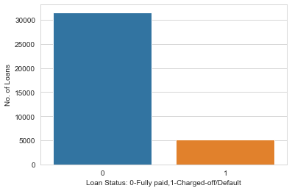
Data Analysis
Univariate Analysis – Target Variable
Insights from the graph:
More than 30000 loans are fully paid
Around 5000 loans are charged off/Default

Slide 6
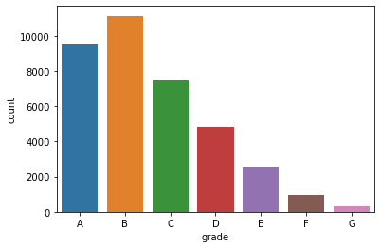
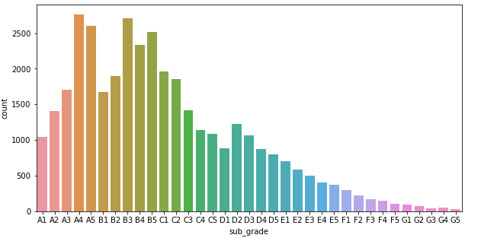
Univariate Analysis
Inferences for Grade and Sub-Grade
Most of the loans are belonging to grade A and B
Majority of the employees lie in A4 subgrade

Slide 7
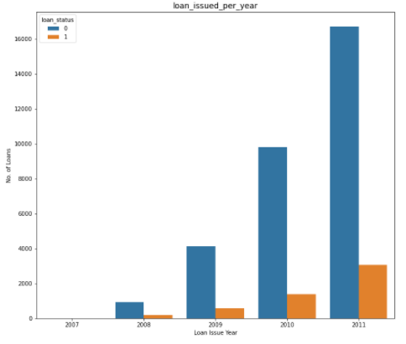
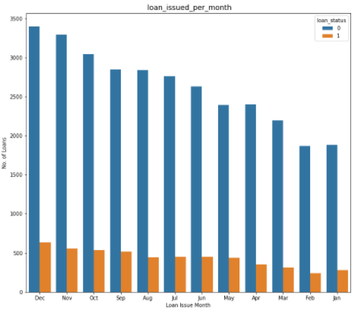
Year Wise and Month Wise Distribution of charged-off and fully paid loans
Insights from the above graph
No. of loans, fully paid and charged off are increasing every year. They are at maximum in the year 2011. This is a very positive trend for Lending Club as the requirement of loans are increasing by each year
The month-wise trend shows that most loans are fully paid as well as charged off as the year comes to an end, maximum in the month of December clearly stating the importance of year-end

Slide 8
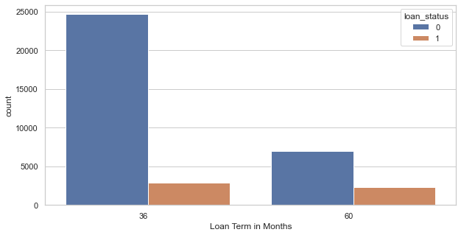
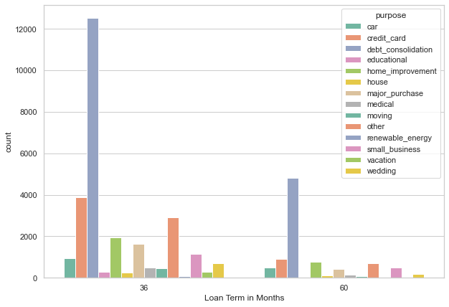
Bivariate Analysis Analyzing term with loan status and purpose
Inferences:
36 month term has maximum fully paid loans
36 and 60 months have debt consolidation as major loan purpose

Slide 9
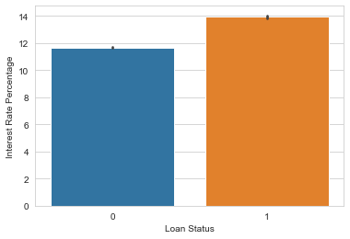
Analysis with Interest Rate
Inference
0-fully paid
1-Charged off/Defaulter
Loans having higher interest rate have more defaulters

Slide 10
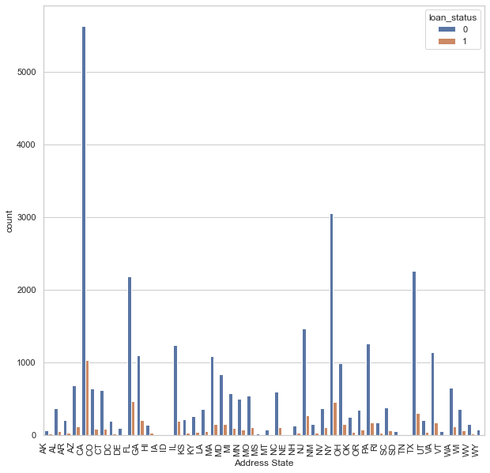
Bivariate Analysis (Address State)
Applicants from the state CA are having high probability to be default

Slide 11
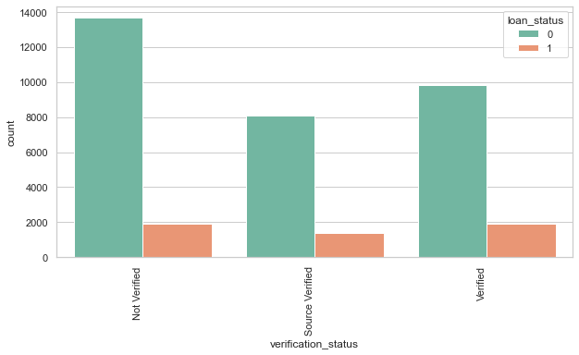
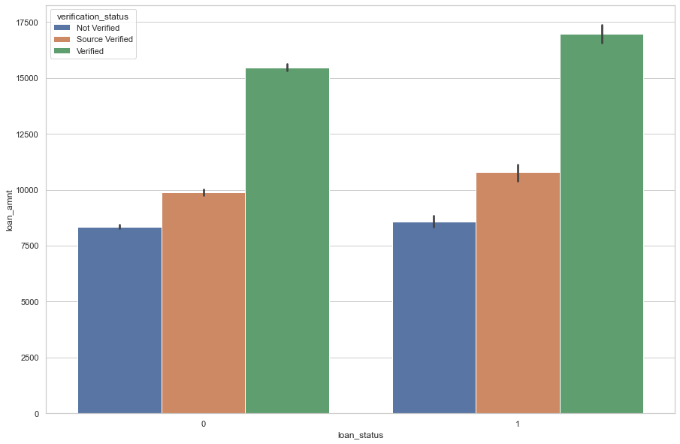
Analysis with Verification Status
Inference
Most of the data exists of applicants who are not verified

Slide 12
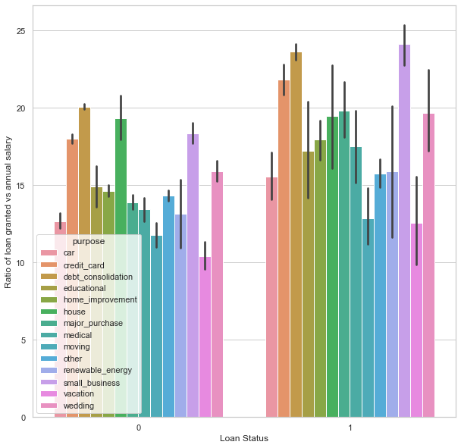
Analysis of loan status purpose and annual salary
Inference:
Applicants having higher income tends to charged off/default

Slide 13
Conclusion
1. Low grade loans have high tendency to default. Grading system is working as expected.
2. Loans having higher interest rate have more defaulters. Check the background of applicant thoroughly if interest rate is high.
3. Extra scrutiny must be done for the applicants belonging to CA state, as tendency to default is high.
4.When the purpose is debt consolidation check
applicant thoroughly as it has high tendency to
default.

